Slide 1
Comparing NYC Restaurants Inspection Results with Yelp Ratings & Reviews
Nishan Bose

Slide 2
Summary
Motivation
This project aims to explore the correlation between NYC Restaurants Health scores with Yelp Ratings and Reviews.
Is there an improvement in health score of a restaurant overtime depending on the reviews and/or ratings on Yelp?
Do reviews and ratings drive the upkeep/health decisions taken by owners of businesses?

Slide 3
Data Sources
NYC Inspection Results Data
Format: CSV
Access: Local File
Size: 200 mb, Number of Records: 500,000+
Variables: Category, Area, Name, Grade Date, Grade Score, Zipcode
Yelp API
Format: JSON
Access: API
Number of Requests: 19,000
Variables: ID, Name, Rating, Review Counts, Neighbourhood, Zipcode

Slide 4
Quick Facts
Restaurants are sources of diseases
18000+ Restaurants in Manhattan, Brooklyn and Queens
We do not know how Yelp ratings and Inspection scores are connected

Slide 5
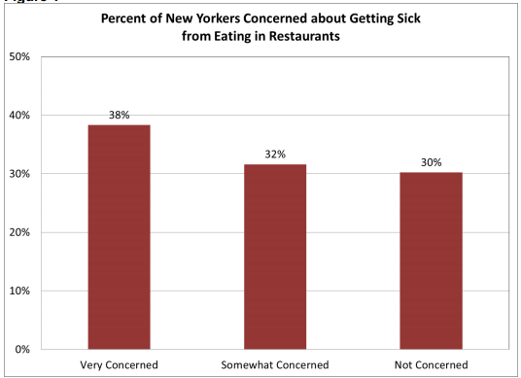

Slide 6
Findings
Restaurants with higher yelp ratings had considerably lower inspection scores (lower score is better) compared to the restaurants which had higher inspection scores (higher means health violation) and lower yelp ratings.
The trendline is evidence of the finding.

Slide 7
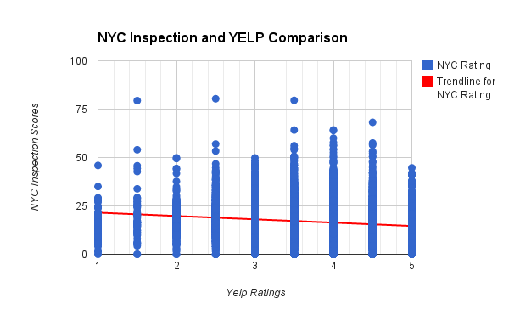

Slide 8
Thank You.

