Slide 1
NIYAMONE LABS
The diagnostic-lab
operating system,
built for India.
Walkthrough for - Sree Diagnostics, Bengaluru
Confidential - Prepared for client visit - May 2026

Slide 2
WHY WE ARE IN THIS ROOM
Run every branch of Sree Diagnostics
from one screen — and prove it on day one.
FASTER
CLEANER
SAFER
Report TAT cut by 40 %
Zero paperwork at billing
Every discount audit-trailed
Niyamone Labs x Sree Diagnostics - Confidential client walkthrough
2 / 31

Slide 3
THE PROBLEM
What every 5-branch lab in India tells us.
63 %
of report errors trace back to manual transcription between paper, Excel, and the LIMS.
3.4 hrs
lost per receptionist per day re-entering the same patient into 4 different systems.
Rs 4.2L
average annual leakage from un-tracked cash-counter discounts and refunds.
Niyamone Labs x Sree Diagnostics - Confidential client walkthrough
3 / 31

Slide 4
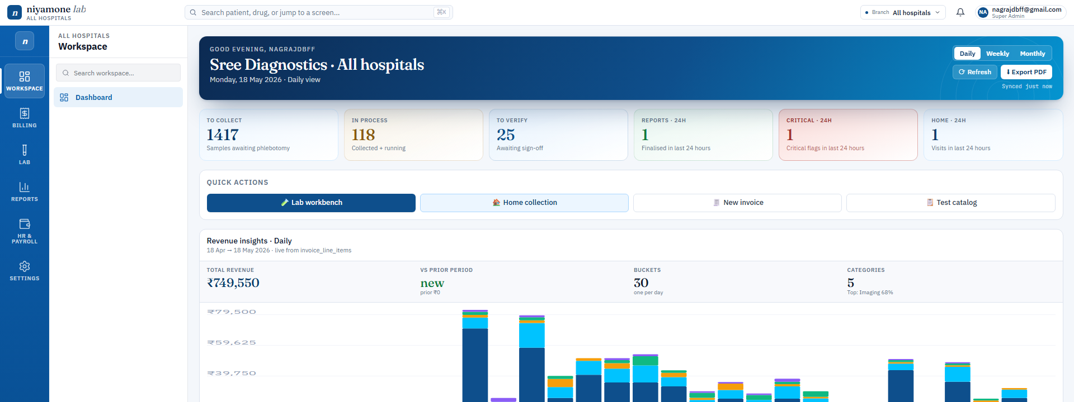
THE NIYAMONE PROMISE
One login. Every branch.
Every workflow. Live data.
Reception, lab, billing, pharmacy, IPD — same app, same login.
Branch switch in one click. No re-login. No data re-sync.
Your data lives in your Supabase tenant — full export, any time.
Indian-first: GST, TDS 194J, UHID, IFSC, PAN — built in, not bolted on.
Operational dashboard — one branch or all five, at a glance.
Niyamone Labs x Sree Diagnostics - Confidential client walkthrough
4 / 31

Slide 5
OUTCOMES YOU CAN MEASURE IN 90 DAYS
We do not ship features. We ship outcomes.
Metric
Today
Day 90 with Niyamone
Report turnaround time
4.2 hrs avg
less than 2.5 hrs avg
Manual reconciliation
Daily, 2 staff
Zero
Untracked discount
~ Rs 35K / mo
Rs 0 (every discount approved)
Branch reconciliation
End-of-week
Real-time
Patient WhatsApp
Manual upload
1-click, signed PDF
Niyamone Labs x Sree Diagnostics - Confidential client walkthrough
5 / 31

Slide 6
THE MATH
Payback in under 5 months. Then it is pure margin.
STATUS QUO / YEAR
NIYAMONE / YEAR
YEAR-1 SAVING
Rs 8.6 L
Rs 3.2 L
Rs 5.4 L
2 reconcilers + paper reports + leaked discounts + 3 disjoint tools.
All-in licence, support, 2 training cycles, unlimited branches.
Plus reclaimed staff hours redeployed to revenue work.
Figures based on a 5-branch lab benchmark. Actual numbers co-modelled in week 1.
Niyamone Labs x Sree Diagnostics - Confidential client walkthrough
6 / 31

Slide 7
01
SECTION
The walkthrough.
Seventeen screens. The entire lab in one application.
Niyamone Labs x Sree Diagnostics - Confidential client walkthrough
7 / 31

Slide 8
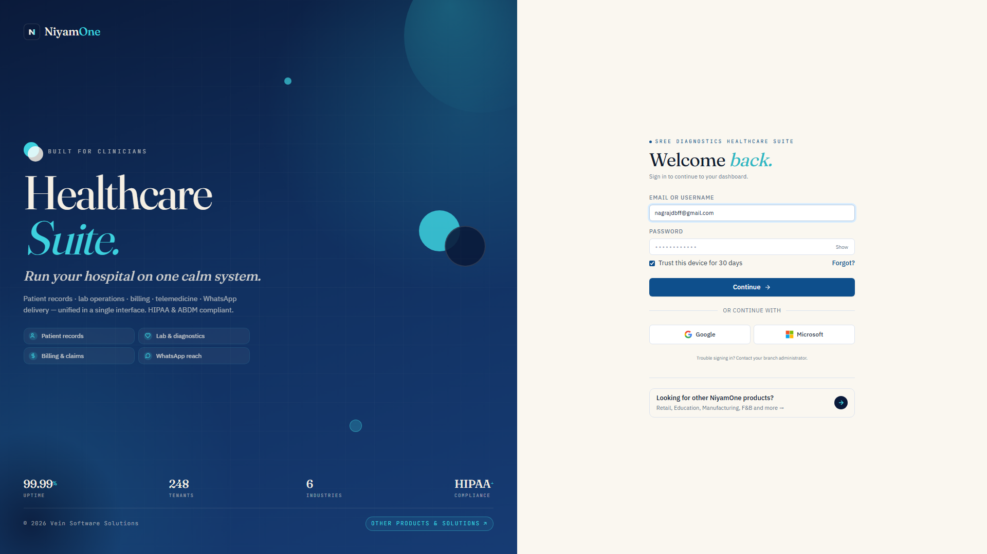
ACT III - 01 / 13 - LOGIN
Role-based login — same app, scoped to each user.
JWT carries staff_id + branch_id + role; nothing is trusted from the URL.
Super-admin sees all branches; branch-admin sees one; reception sees their own queue.
Inactive staff are blocked at the auth layer, not at the screen.
WHAT IT SAVES YOU
Reception logs in once, lands on her branch — never sees the other four.
Zero accidental cross-branch edits. Every action is name-stamped.
Niyamone Labs x Sree Diagnostics - Confidential client walkthrough
8 / 31

Slide 9
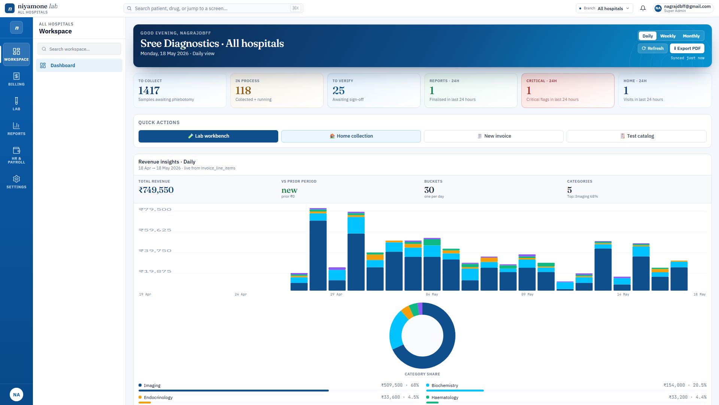
ACT III - 02 / 13 - DASHBOARD
One screen — every KPI, every branch.
Revenue, TAT, pending verifications, category share — live.
Branch slicer at the top reshapes every tile in <200 ms.
Export to PDF matches the on-screen design — pixel-for-pixel.
WHAT IT SAVES YOU
Owner sees the day at 8 AM; does not need to call anyone.
End-of-day reconciliation goes from 45 min to instant.
Niyamone Labs x Sree Diagnostics - Confidential client walkthrough
9 / 31

Slide 10
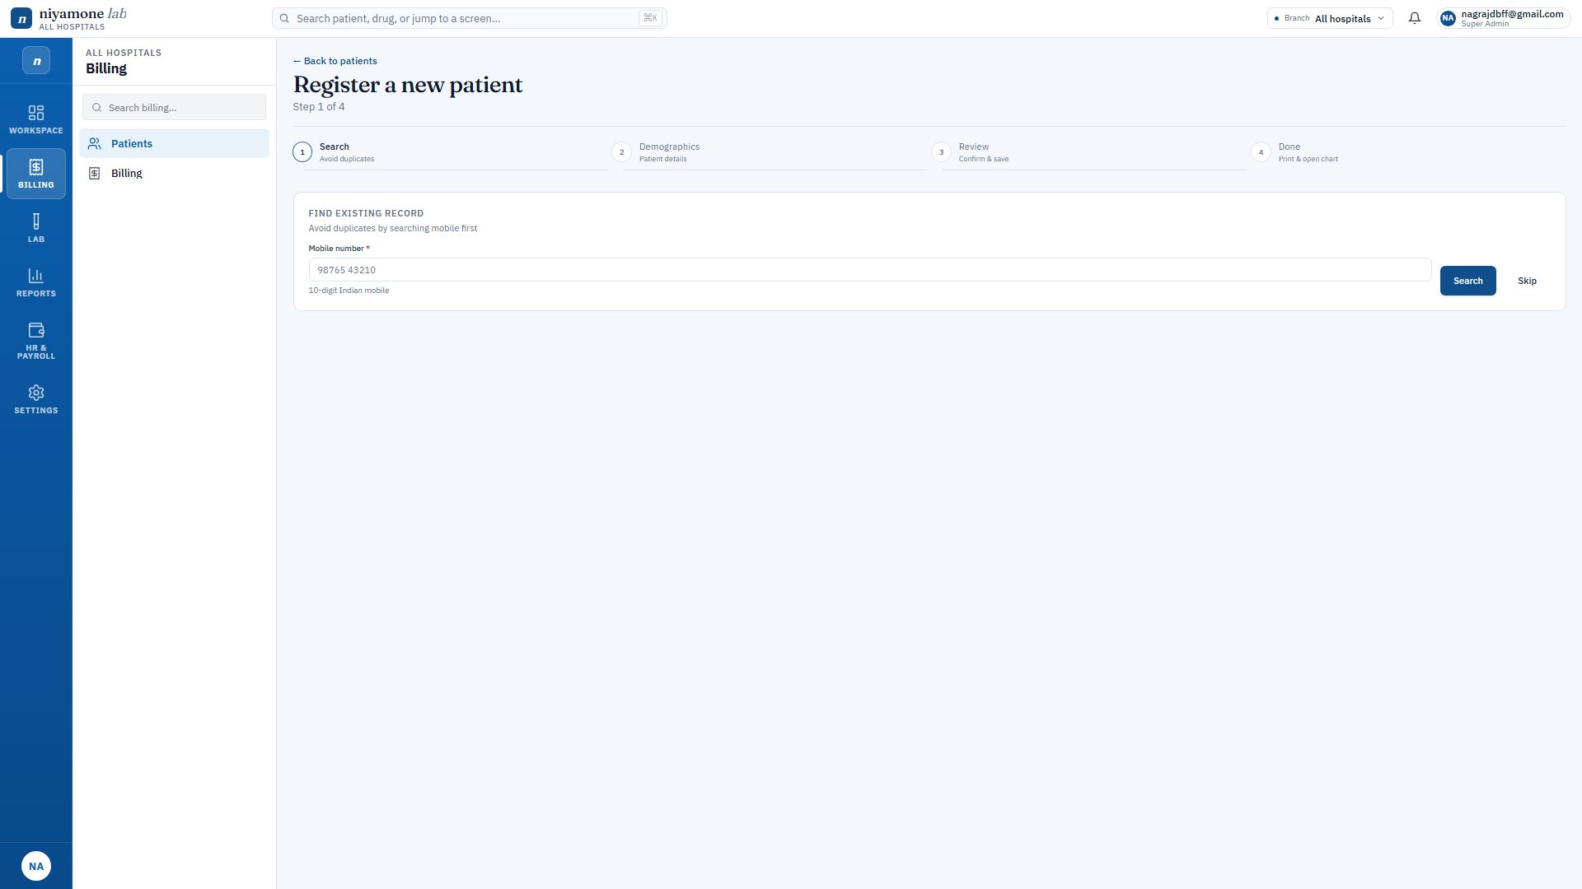
ACT III - 03 / 13 - PATIENTS
Register a patient in under 20 seconds.
Duplicate guard on mobile + name + DOB combo — no UHID drift.
Address book reused across home collection and report delivery.
Gender defaults to Male so reception can tab through and hit Save.
WHAT IT SAVES YOU
New patient, UHID, mobile, address — one screen, one save.
A 4-minute paper form becomes a 20-second tap-through.
Niyamone Labs x Sree Diagnostics - Confidential client walkthrough
10 / 31

Slide 11
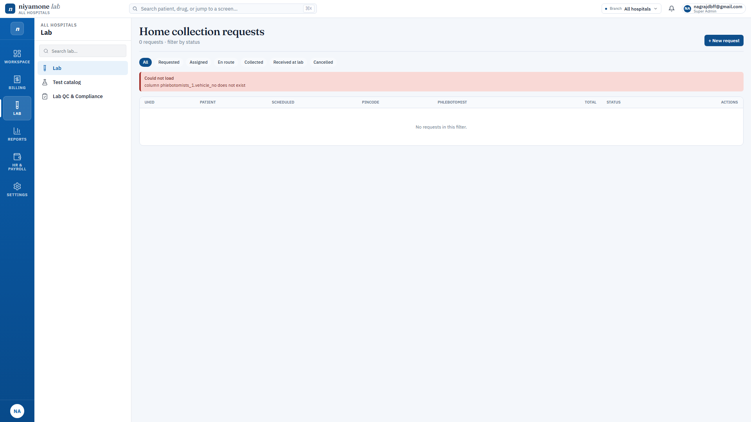
ACT III - 04 / 13 - APPOINTMENTS
Home collection that does not lose Rs 250.
Pickup surcharge auto-added to the invoice — editable + discountable.
Address captured once, reused on report + WhatsApp share.
Scheduled-at time shows on the invoice visit-details block.
WHAT IT SAVES YOU
Surcharge is a line item, not a sticky note on the cash register.
Eliminates the most common cause of cash leakage in home collection.
Niyamone Labs x Sree Diagnostics - Confidential client walkthrough
11 / 31

Slide 12
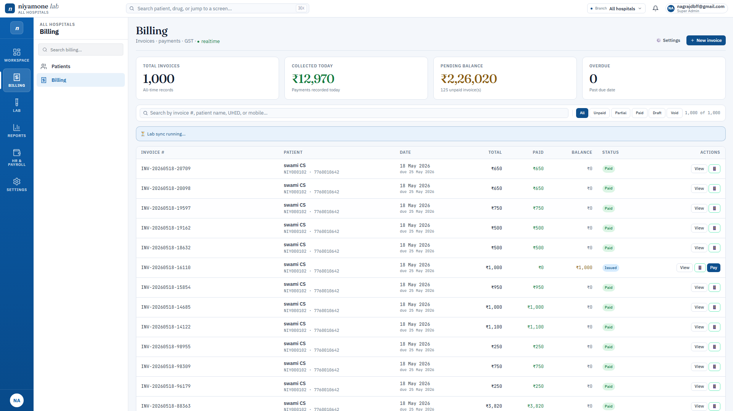
ACT III - 05 / 13 - BILLING
Invoice that knows where every line came from.
Lab, pharmacy, doctor, IPD, manual — each line tagged with provenance.
GST + discount tiers + payment + balance — all on one screen.
WhatsApp share with public link + auto-print on the patient phone.
WHAT IT SAVES YOU
Every paisa traces back to a clinical action. No mystery charges.
Audit-ready billing the first day you go live.
Niyamone Labs x Sree Diagnostics - Confidential client walkthrough
12 / 31

Slide 13
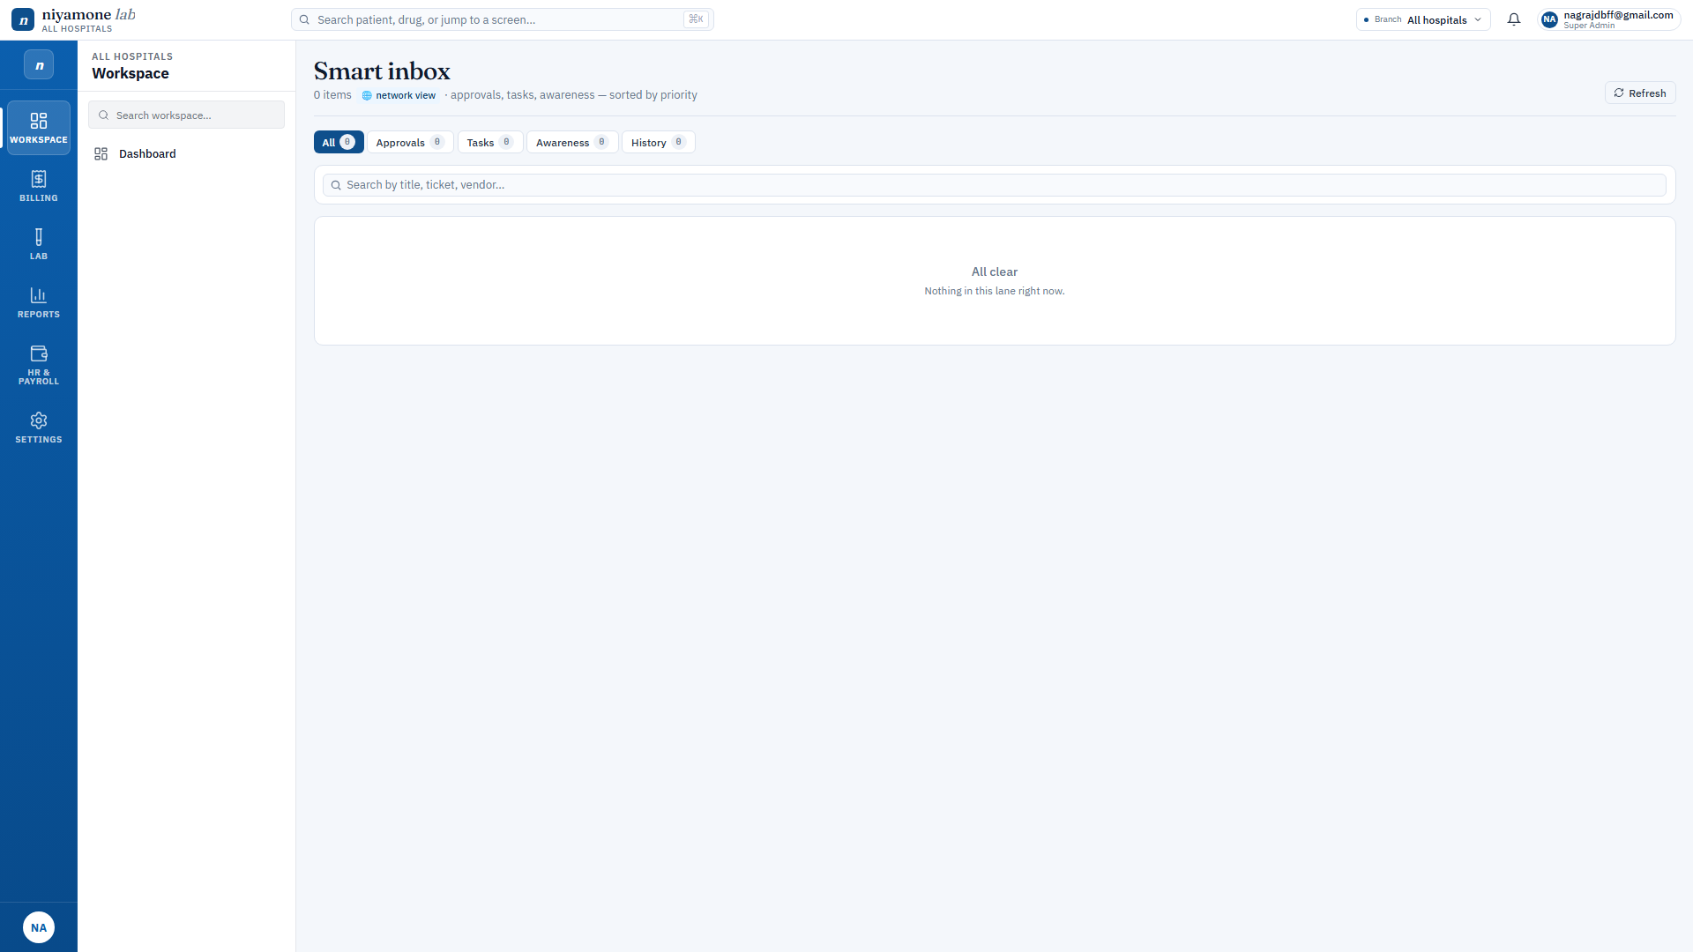
ACT III - 06 / 13 - SMART INBOX
No discount goes through unapproved.
Tiered: auto / branch-admin / super-admin — based on the percentage.
Submitted requests appear in the approver Smart Inbox in real time.
Approval, rejection, and apply-error are all audit-trailed.
WHAT IT SAVES YOU
Discount approval becomes a 30-second chat, not a phone call.
Plugs the single biggest revenue leak at the cash counter.
Niyamone Labs x Sree Diagnostics - Confidential client walkthrough
13 / 31

Slide 14
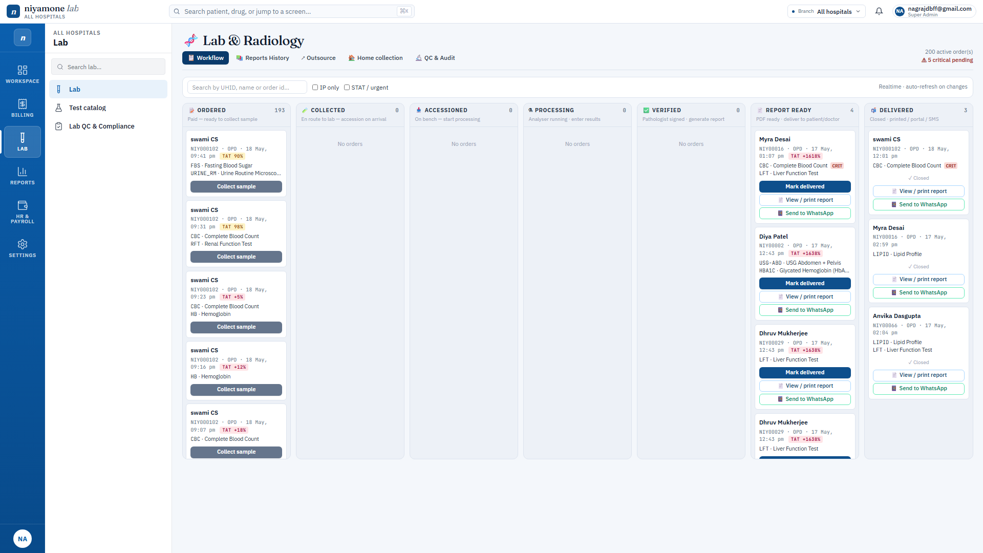
ACT III - 07 / 13 - LAB WORKFLOW
Accession to sample to result to verify to report.
One queue per stage. Items cannot skip stages.
Critical alerts surface immediately to the doctor on duty.
Verifier sign-off captured via uploaded digital signature.
WHAT IT SAVES YOU
Lab tech, pathologist, doctor — same workflow, three perspectives.
TAT visibility turns from a guess into a real-time number.
Niyamone Labs x Sree Diagnostics - Confidential client walkthrough
14 / 31

Slide 15
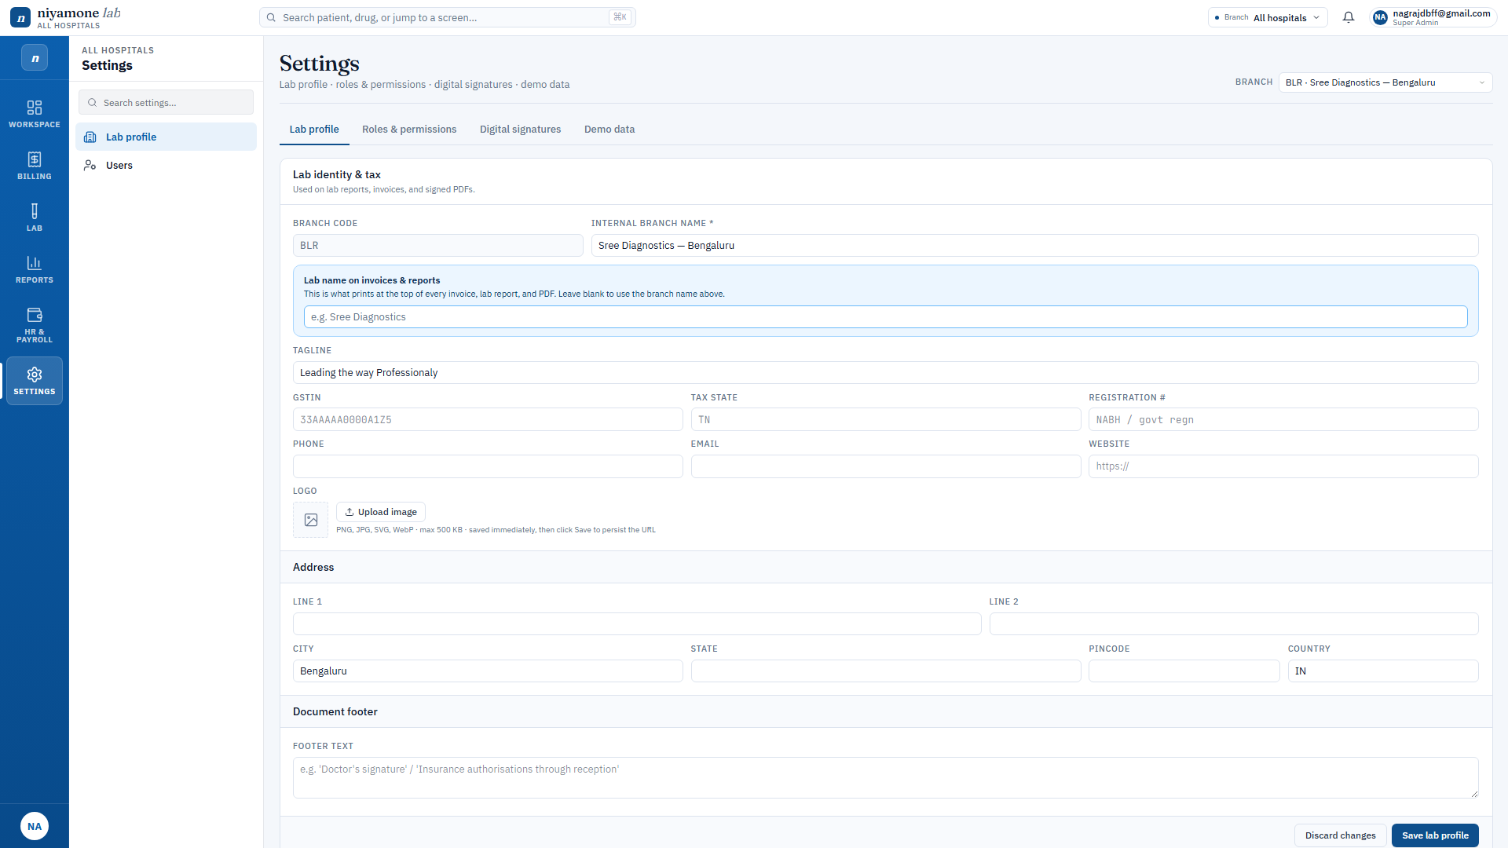
ACT III - 08 / 13 - LAB REPORT PDF
The Sree Diagnostics letterhead — pixel-perfect.
Header, footer, accreditations, seals, watermark — all configurable.
QR code on the footer points to a verifiable public URL.
Filename is PatientName_DD-MMM-YYYY_UHID — searchable in WhatsApp.
WHAT IT SAVES YOU
The exact PDF you sent us — generated in two clicks.
Brand consistency across every report, every branch, every device.
Niyamone Labs x Sree Diagnostics - Confidential client walkthrough
15 / 31

Slide 16
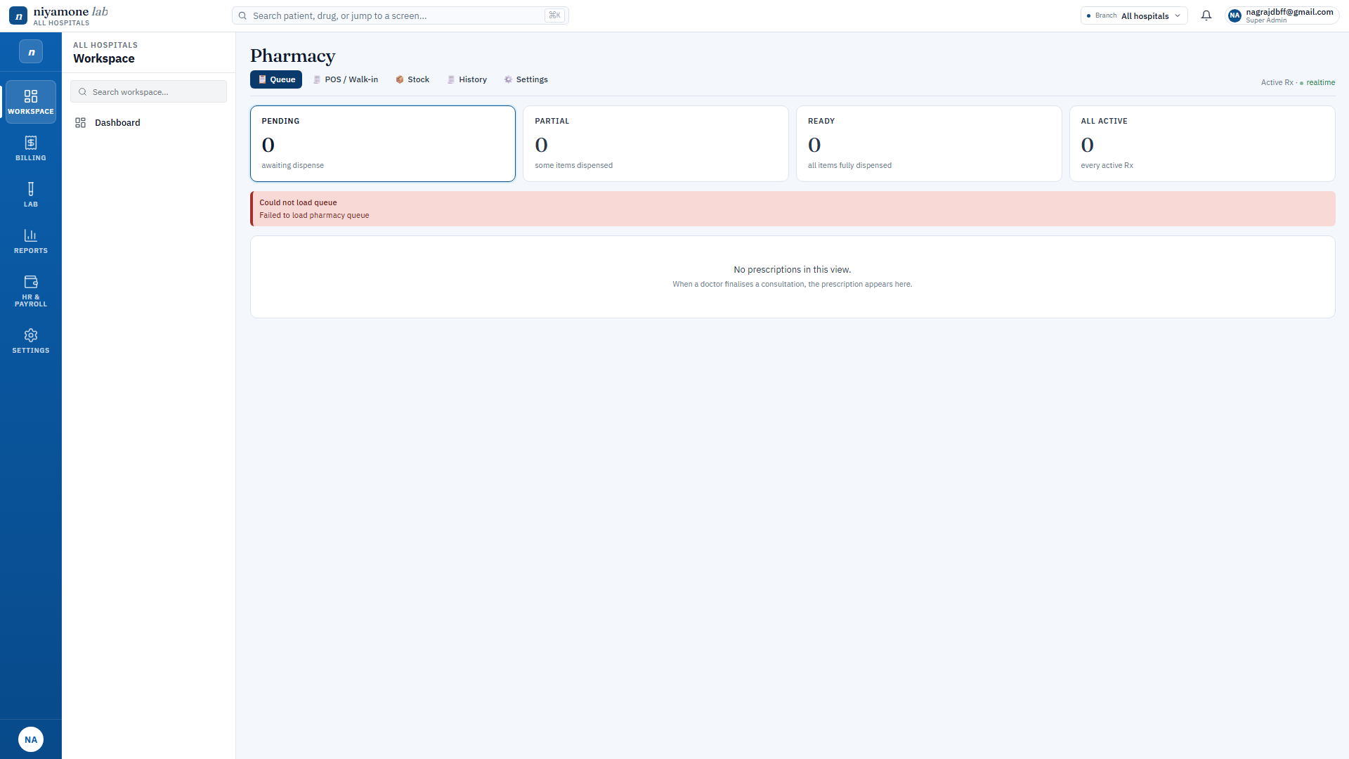
ACT III - 09 / 13 - PHARMACY
Dispense, indent, GRN — all in flow.
Stock-aware dispensing — will not sell what is not on the shelf.
Expiry guard at dispense time — flagged in red.
Sales auto-flow to the invoice with HSN + GST.
WHAT IT SAVES YOU
Pharmacy is no longer a parallel universe; it is part of the bill.
Stops the daily pharmacy-vs-billing tally meeting.
Niyamone Labs x Sree Diagnostics - Confidential client walkthrough
16 / 31

Slide 17
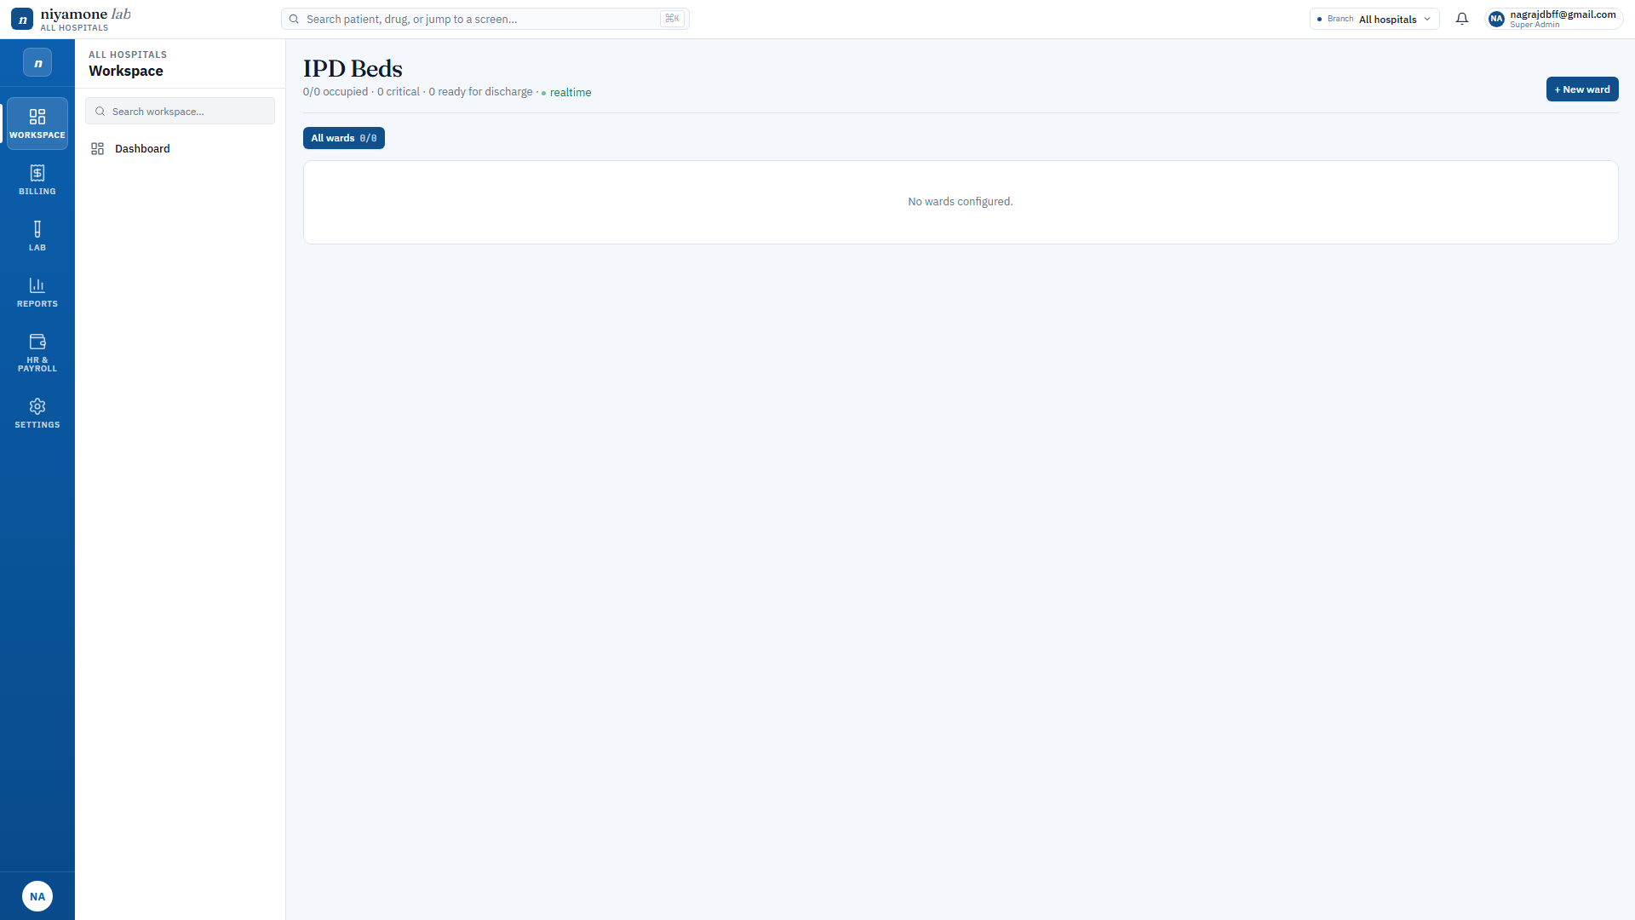
ACT III - 10 / 17 - IPD / WARDS
Bed map, doctor visits, consolidated bill.
Bed assignments time-tracked for accurate per-day billing.
Doctor visits roll up into the same invoice the lab uses.
Discharge produces one PDF: bill + summary + reports.
WHAT IT SAVES YOU
One discharge — one PDF — one signature.
Discharge bottleneck disappears.
Niyamone Labs x Sree Diagnostics - Confidential client walkthrough
17 / 31

Slide 18
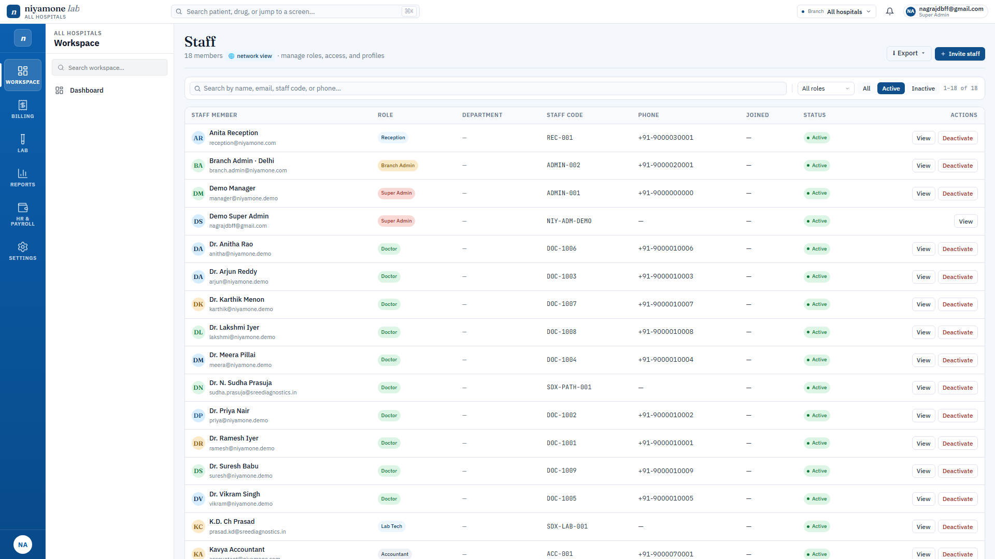
ACT III - 11 / 17 - HR · STAFF
One staff directory for every branch.
Onboard, role-assign, branch-scope, and de-activate from one screen.
PAN, UAN, IFSC, signature, photo — all stored against the staff record.
Role permissions cascade automatically — no manual ACL editing.
WHAT IT SAVES YOU
HR adds a new technician; she can log in and accession by lunch.
Onboarding goes from a 2-day form-shuffle to 15 minutes.
Niyamone Labs x Sree Diagnostics - Confidential client walkthrough
18 / 31

Slide 19
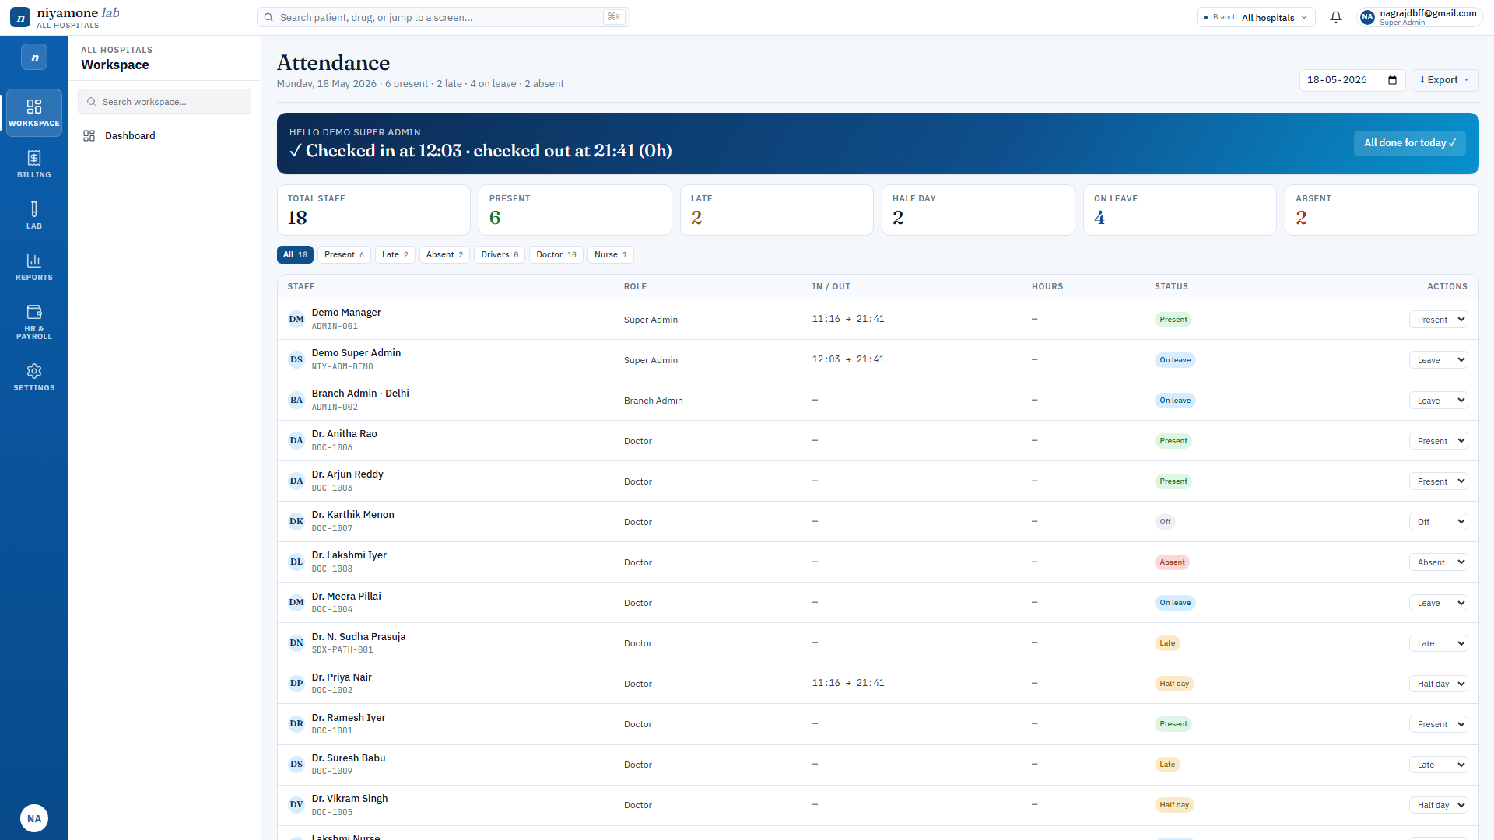
ACT III - 12 / 17 - HR · ATTENDANCE
Daily attendance — no biometric vendor required.
Self check-in/out from the same app each staff uses to work.
Late-mark and short-shift rules driven by the shift master.
Daily / weekly / monthly views feed straight into payroll.
WHAT IT SAVES YOU
Reception checks in at 8:58 AM; row appears live on the manager view.
Manual muster register is gone. Payroll reads attendance directly.
Niyamone Labs x Sree Diagnostics - Confidential client walkthrough
19 / 31

Slide 20
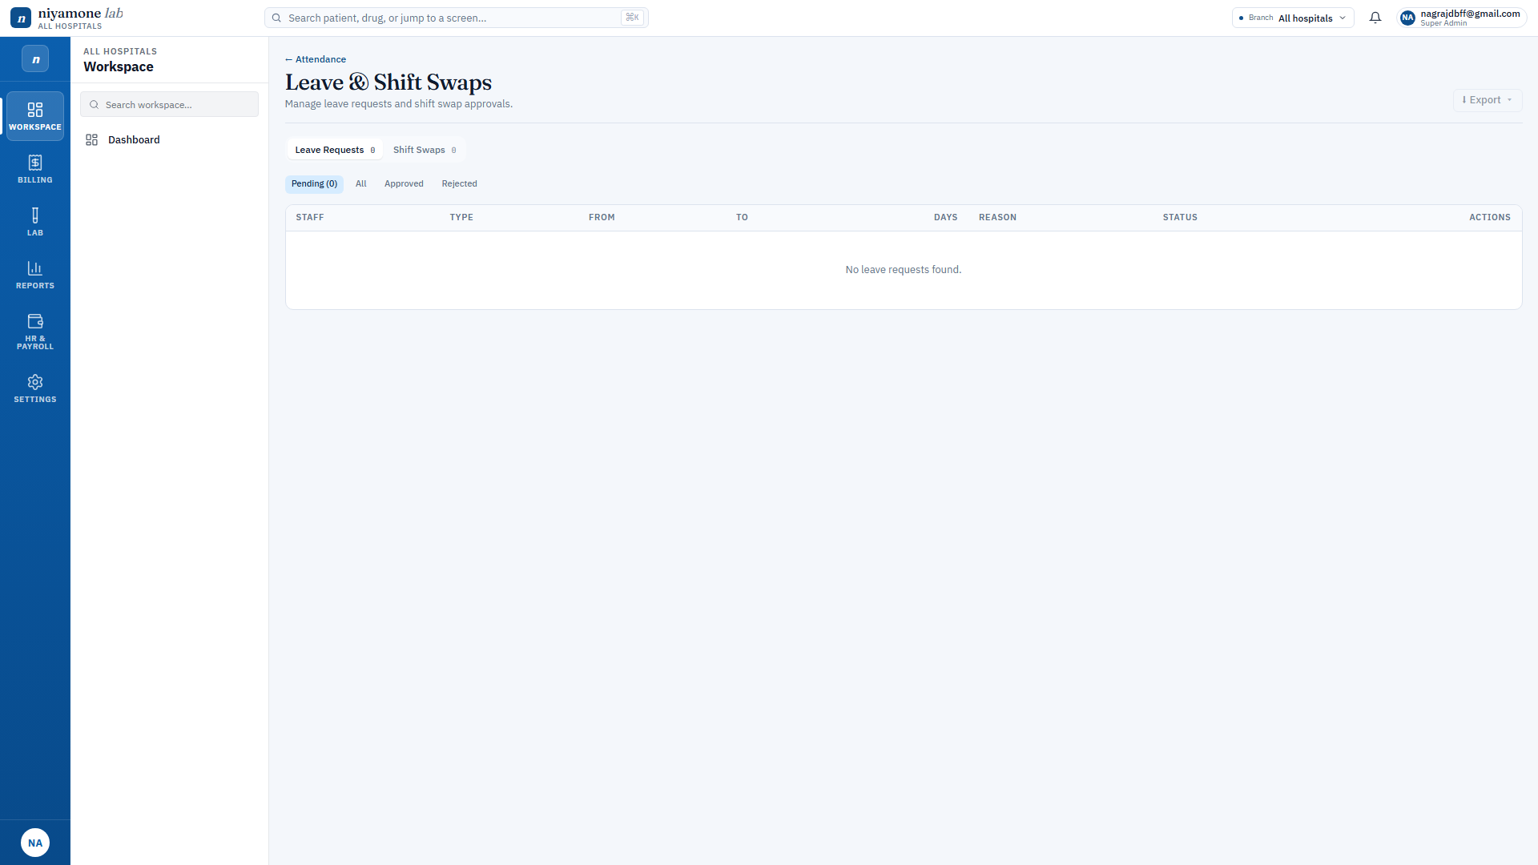
ACT III - 13 / 17 - HR · LEAVE & SHIFTS
Leaves and shift rosters in one place.
CL / SL / PL balances tracked per employee, per year.
Leave requests route to the right approver via Smart Inbox.
Shift master defines templates; rosters generated for any week.
WHAT IT SAVES YOU
Apply leave, approve in one click — balance updates instantly.
Leave reconciliation at year-end ceases to be a spreadsheet event.
Niyamone Labs x Sree Diagnostics - Confidential client walkthrough
20 / 31

Slide 21
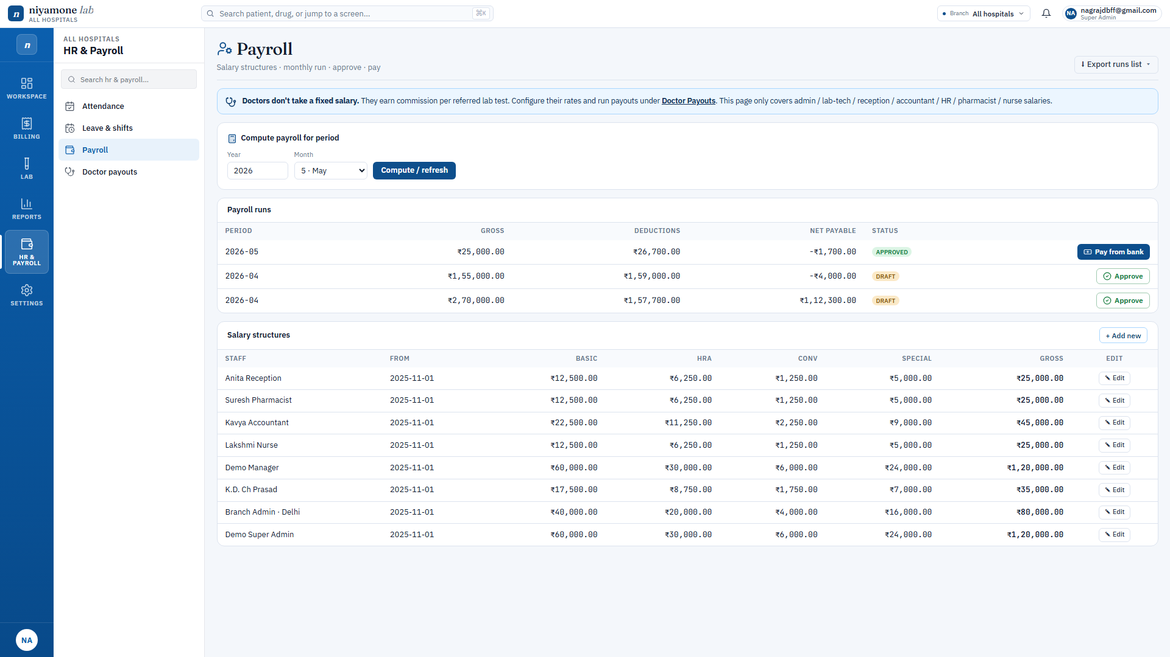
ACT III - 14 / 17 - PAYROLL · STAFF SALARY
Monthly salary run — attendance to bank, in minutes.
Pulls attendance + leaves + shift overtime automatically.
CTC components, PF, ESI, PT, TDS — all Indian-statutory aware.
Generates Form-16 ready payslips with branch letterhead.
WHAT IT SAVES YOU
Month-end payroll for 30 staff, one button, audit-ready.
Replaces the external payroll vendor and their per-staff fee.
Niyamone Labs x Sree Diagnostics - Confidential client walkthrough
21 / 31

Slide 22
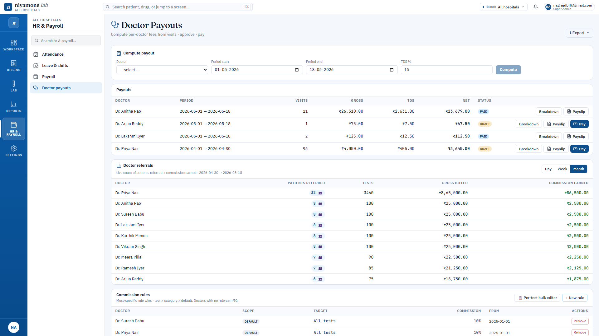
ACT III - 15 / 17 - PAYROLL · DOCTOR PAYOUTS
Doctor payouts the Indian way — TDS 194J built in.
Earnings + deductions side-by-side; TDS Section 194J auto-calculated.
Amount-in-words in Lakhs / Crores — auditor-friendly.
Lab header, branch address, GST — same letterhead as the report.
WHAT IT SAVES YOU
Payslip for a consultant takes 6 seconds, not 6 minutes.
Month-end consultant payouts cease to be a spreadsheet rodeo.
Niyamone Labs x Sree Diagnostics - Confidential client walkthrough
22 / 31

Slide 23
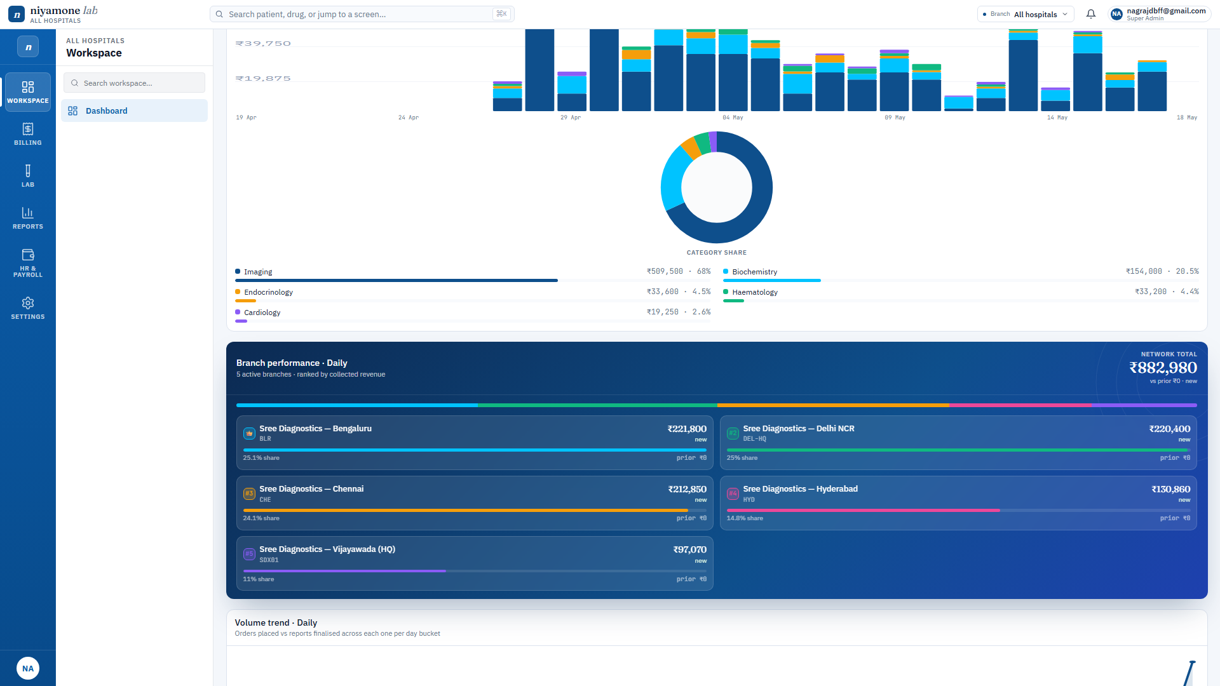
ACT III - 16 / 17 - REPORTS
On-screen and on-paper — identical.
Category share, revenue trend, branch drill — all interactive.
PDF export uses the same DOM, not a separate template.
Date range, branch, category — three controls, no SQL.
WHAT IT SAVES YOU
What you see is what you print — full stop.
No more "why does the PDF look different from the screen?"
Niyamone Labs x Sree Diagnostics - Confidential client walkthrough
23 / 31

Slide 24

ACT III - 17 / 17 - SETTINGS
Your brand, your seals, your instructions.
Logo, accreditations, watermark, footer seals — all uploadable.
Instructions per test / per branch / global — cascades intelligently.
Per-staff digital signature stored once, used everywhere.
WHAT IT SAVES YOU
The branding does not need a developer; reception can change it.
Re-branding moments (new NABL cert, new address) take 5 minutes.
Niyamone Labs x Sree Diagnostics - Confidential client walkthrough
24 / 31

Slide 25
02
SECTION
Built for trust.
Architecture, security, and the multi-branch reality.
Niyamone Labs x Sree Diagnostics - Confidential client walkthrough
25 / 31

Slide 26
ARCHITECTURE
Your data lives in your tenant.
Angular 21 frontend, Supabase backend, RLS per table.
All writes go through SECURITY DEFINER RPCs — no rogue UPDATEs possible.
Database snapshots are yours, exportable on demand, in standard Postgres dump.
No vendor lock-in: walk away with a .sql file.
Drop screenshot: 14-architecture.png
tools/sales-deck/screenshots/14-architecture.png
Schema diagram — every table owned by the client Supabase project.
Niyamone Labs x Sree Diagnostics - Confidential client walkthrough
26 / 31

Slide 27
SECURITY & COMPLIANCE
Row-level security, not screen-level pretending.
Postgres RLS gates every read and write by branch + role.
JWT custom claims (app_metadata) carry the role — tamper-proof.
Audit trail on every exception (discounts, voids, refunds).
Storage buckets for PDFs are private with signed URLs.
Drop screenshot: 15-security.png
tools/sales-deck/screenshots/15-security.png
RLS policies block cross-branch reads at the database, not the UI.
Niyamone Labs x Sree Diagnostics - Confidential client walkthrough
27 / 31

Slide 28
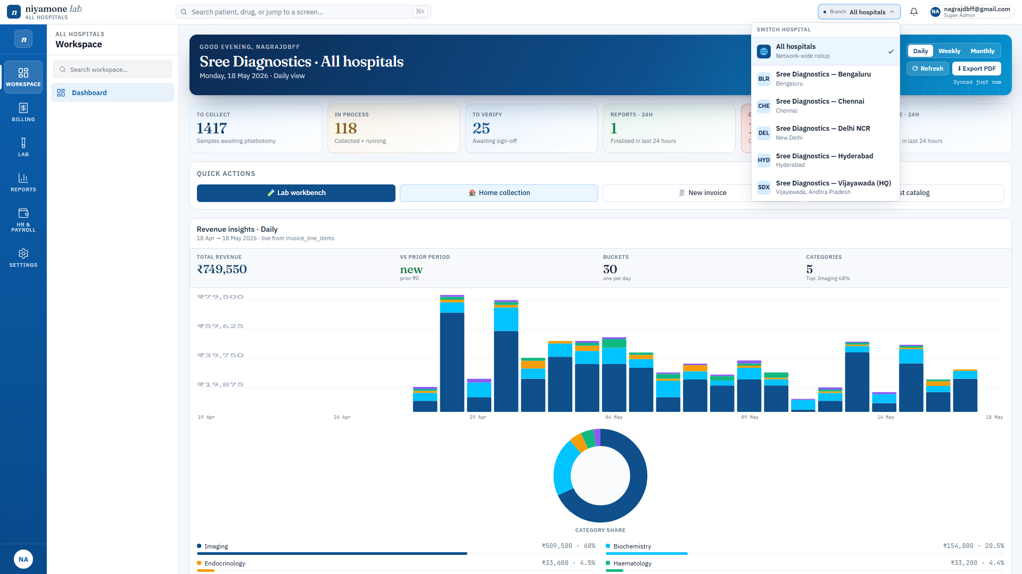
MULTI-BRANCH
Switch branches in one click — no relogin.
BranchStore is reactive; every screen reshapes on switch.
Realtime channels keep dashboards live across all branches.
Reports and exports stamp the active branch in the footer.
Top-bar branch switcher — propagates to every page instantly.
Niyamone Labs x Sree Diagnostics - Confidential client walkthrough
28 / 31

Slide 29
HOW WE ROLL THIS OUT
Three phases. Fixed milestones. You sign off each one.
PHASE 1
PHASE 2
PHASE 3
Weeks 1–3
Weeks 4–6
Weeks 7–9
Tenant set-up, master data, lab + billing live at branch HQ.
Rest of the branches onboarded, pharmacy + home collection on.
Doctor payouts, smart-inbox approvals, dashboards, training.
EXIT CRITERIA
EXIT CRITERIA
EXIT CRITERIA
Go-live: first invoice + first signed report from Niyamone.
Go-live: all branches live, WhatsApp delivery on.
Go-live: monthly close run end-to-end inside Niyamone.
Niyamone Labs x Sree Diagnostics - Confidential client walkthrough
29 / 31

Slide 30
TODAY WE AGREE
Three signatures. Nine weeks to live.
1. Scope locked
2. Commercials
3. Kick-off date
Phases, branches, integrations.
Licence + implementation + support.
Week 1 starts Monday.
Sign-off by: ___________________
Sign-off by: ___________________
Date: ___________________
Venkki M. K. - Niyamone Labs - venkki.mk@niyamone.com

