Slide 1


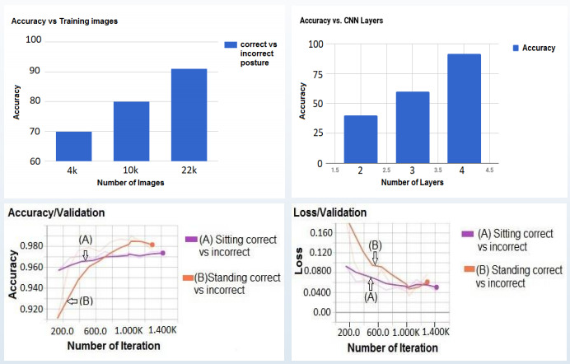
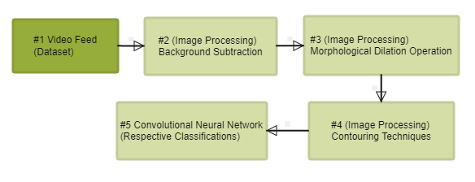
Proceedings of the World Congress on Engineering and Computer Science 2017 Vol I WCECS 2017, October 25-27, 2017, San Francisco, USA
Application of Convolutional Neural Network to Classify Sitting and Standing Postures
Nishank Singhal*, Srishti*, and V. Kalaichelvi**
*Department of Computer Science, BITS Pilani, Dubai Campus, U.A.E.
**Department of Electrical and Electronics Engineering, BITS Pilani, Dubai Campus, U.A.E
Abstract
Results
The paper aims at identifying whether a sitting or standing posture of a person is correct or incorrect using image processing and deep learning approach. The approach includes: (i) to check whether a person is present or not in the image read (ii) if present, then detect whether the person is sitting or standing (iii) in case of sitting, identify whether the posture is correct or incorrect (iv) in case of standing, identify whether the posture is correct or incorrect. In accomplishing the task, an overall accuracy of 91.3% is achieved. The method has been evaluated by testing with a real time video feed thereby demonstrating the efficiency of the model and the wonderful power of Convolutional Neural Network (CNN)
Introduction
The goal of this paper is to estimate a 2D human upper body posture by involving the identifications of the key points of the neck joints . It is important to clarify here what the term posture means as different professionals define it differently. According to Yasmeen, Shahrukh, and Farooqui, posture is the position in which one holds their body against gravity while sitting or standing. With change in times, where spine and neck related problems were mainly associated with adults a decade ago, today are also associated with school-aged and university aged students. One of the causes is having poor posture often about which students are not aware. Even young computer professionals due to their sedentary lifestyle fall victim to the pain which may be trivial in the early stages of their life, but may grow as they grow older because of their bad posture.
Conclusion
The above results suggest what a promising tool CNNs can be, especially to solve visual recognition tasks. With such competitive simulation time and easy implementation, CNNs have an added advantage of their holistic construct which offers local connectivity and parameter sharing which makes them all the more a preferred choice for such Computer Vision tasks. The present work shows how postures can be classified by modelling the problem with a CNN. The work’s application of CNN on posture classification achieves results to the extent of 91.3% accuracy on real time environment situations with a simplified approach.
Problem Statement
The two major tasks of the problem involve: estimation of craniovertebral angle and posture classification. Image processing techniques help in identifying the points of interest for finding out craniovertebral angle . This is followed by employing CNN as a training technique
Implementation
References
Michal Latalski, Jerzy Bylina, Marek Fatyga and Tadeusz Trzpis, “Risk Factors of Postural Defects in Children at School Ages,” Annals of Agricultural and Environmental Medicine (AAEM), Vol. 20, No. 3, pp. 583-587, 2013.
Esther Liyanage, Indrajith Liyanage and Masih Khan, “Efficacy of Isometric Neck exercises and Stretching with Ergonomics Over Ergonomics Alone in Computer Professionals,” International Journal of Scientific and Research Publications (IJSRP), Vol. 4, No. 9, Sep. 2014.
Wang C, Tian F, Zhou Y, He W and Cai Z, “The Incidence Of Cervical Spondylosis Decreases with Aging in the Elderly, and Increases with Aging in the Young and Adult Population: A Hospital Based Clinical Analysis,” Clinical Interventions in Aging, Vol. 11, No. 11, pp. 47-53, 2016
Max Jaderberg, Karen Simonyan, Andrew Zisserman and Koray Kavukcuoglu, “Spatial Transformer Networks,” 28th International Conference on Neural Information Processing Systems (NIPS’15), pp. 2017-2025, 2015
Jianxin Wu, Introduction to Convolutional Neural Networks, LAMDA Group National Key Lab for Novel Software Technology Nanjing University, China, 2017
Swapnil V Tathe and Sandipan P Narote, “Face Recognition in Videos using Gabor Filter,” IOSR Journal of Computer Engineering (IOSRJCE), pp. 75-81, 2017
Notes:
1

