Slide 1
1. Introduction
Bipolar disorder screening is still slow, subjective, and easy to get wrong
Clinical problem
Study setting
• Bipolar disorder (BD) is a chronic psychiatric illness with mania, hypomania, depression, or mixed episodes.
• Symptoms overlap unipolar depression, anxiety, PTSD, and psychosis, so misdiagnosis and delayed treatment are common.
• Standard care still depends on interviews and retrospective self-report, which miss early or atypical presentations.
• 3,753 DSM-5 clinical records (Kaggle mental-illness table).
• 53 psychometric / symptom features; binary BD vs. non-BD.
• Goal: a tabular, interpretable screening aid — not a replacement for DSM-5 / ICD-11 diagnosis.
Why existing ML pipelines fall short
Class imbalance
Hidden heterogeneity
Wrong data modality
Black-box risk
Minority presentations are under-sampled. Classifiers then miss true BD cases — the error that screening cannot afford.
Patients with the same label do not share one symptom profile. Raw features ignore latent subgroups.
CNNs and transformers shine on images or EEG. This problem is structured clinical table data.
Psychiatric tools need feature-level reasons. Gradient-boosted trees keep accuracy and inspectability.
Kumar et al. · Scientific Reports (2026) 16:11887 · Hybrid SMOTE–GMM–XGBoost for bipolar disorder screening

Slide 2
2. Proposed idea
One ordered pipeline: balance the train set, expose latent subgroups, then boost
SMOTE, GMM, and XGBoost are wired as a single leakage-safe flow. Oversampling happens only on training folds; GMM is a feature augmenter (not a separate clustering classifier); XGBoost is trained on original symptoms plus cluster posteriors.
1 SMOTE (train only)
2 GMM latent features
3 Basic XGBoost
For minority sample x_i and neighbour x_nn:
x_new = x_i + δ (x_nn − x_i)
δ ~ Uniform(0, 1)
Balances classes before clustering so majority Gaussian components cannot hide minority structure. The test set is never touched.
p(x) = Σ_k π_k N(x | μ_k, Σ_k)
K = 4 Gaussians. Soft membership probabilities become four extra features that encode hidden BD subtypes with overlapping symptoms — the paper’s main representational claim.
ŷ_i = Σ_m f_m(x_i)
80 shallow trees (depth 3), learning rate 0.1. No grid search — a small, regularised booster that is easy to explain. Decision threshold = 0.5.
What is new vs. prior SMOTE-only or GMM-only hybrids
GMM is not used to split the data and train one model per cluster. Posterior responsibilities are concatenated as latent variables. SMOTE runs first so subgroup discovery is not majority-biased. The boosted tree then sees both DSM-5 symptoms and cluster membership — the combination the authors argue is missing from loosely coupled earlier work.
Kumar et al. · Scientific Reports (2026) 16:11887 · Hybrid SMOTE–GMM–XGBoost for bipolar disorder screening

Slide 3
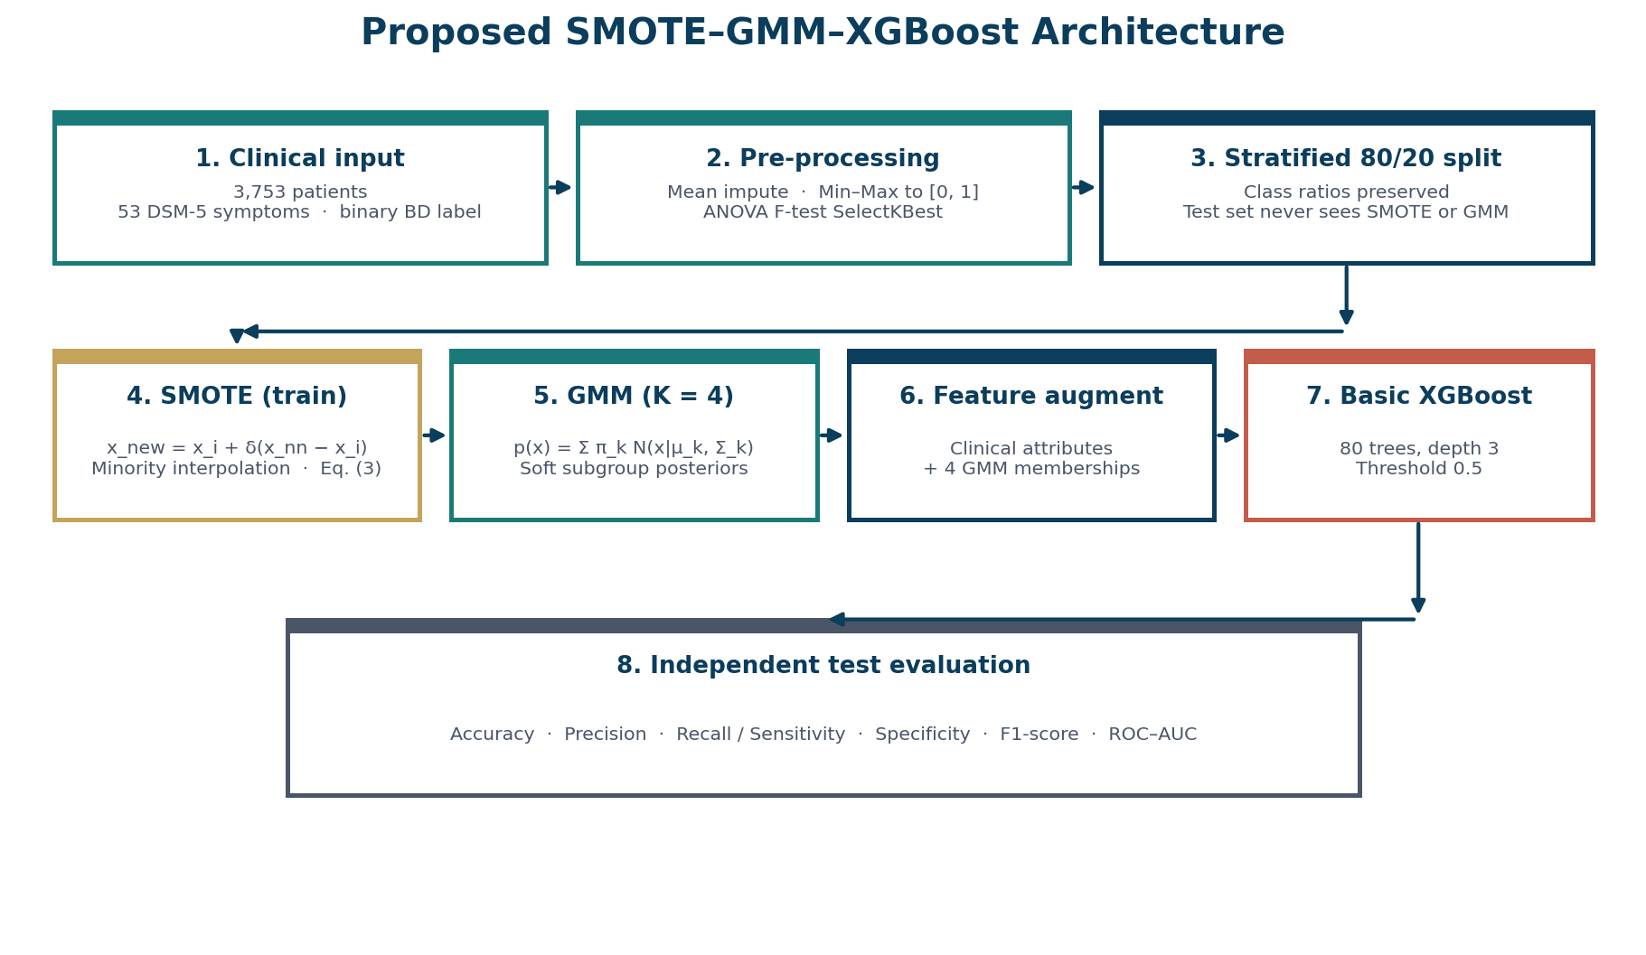
3. Proposed architecture
Leakage-safe protocol matching the paper (Figures 1–4)
Python implementation
• 80/20 stratified split first.
• Mean impute + Min–Max, train-fit only.
• ANOVA SelectKBest, k = 30.
• SMOTE on the training set only.
• GMM K = 4; append 4 probabilities.
• XGBoost: 80 trees, depth 3 (no search).
• Baselines: LR, DT, SVM, RF — same split, no SMOTE/GMM.
• Seed 42.
Raw CSV
Impute / scale
SelectKBest
SMOTE
GMM K=4
XGBoost
Test metrics
Kumar et al. · Scientific Reports (2026) 16:11887 · Hybrid SMOTE–GMM–XGBoost for bipolar disorder screening

Slide 4
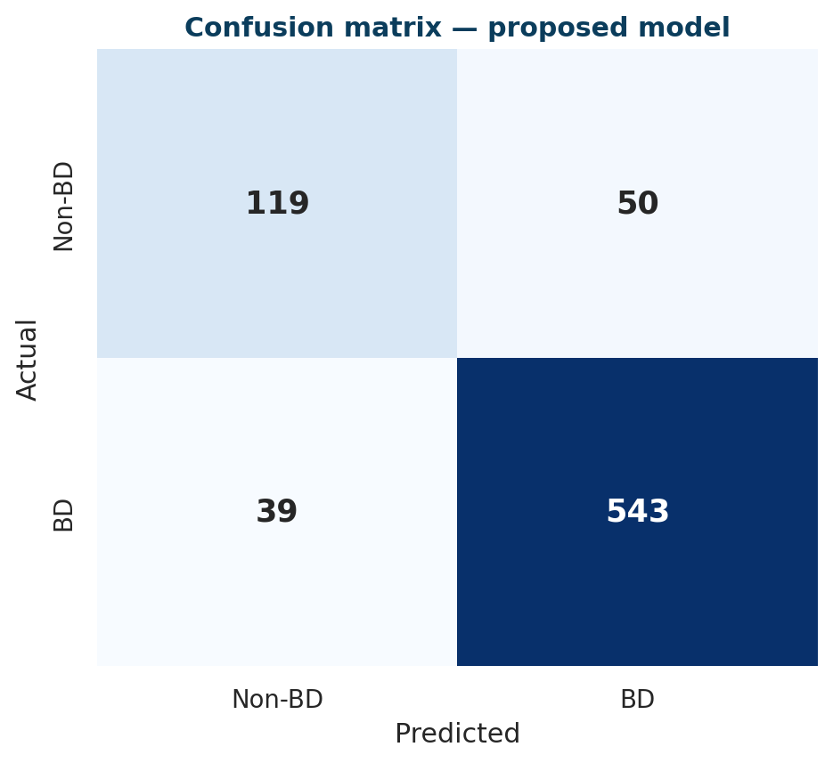
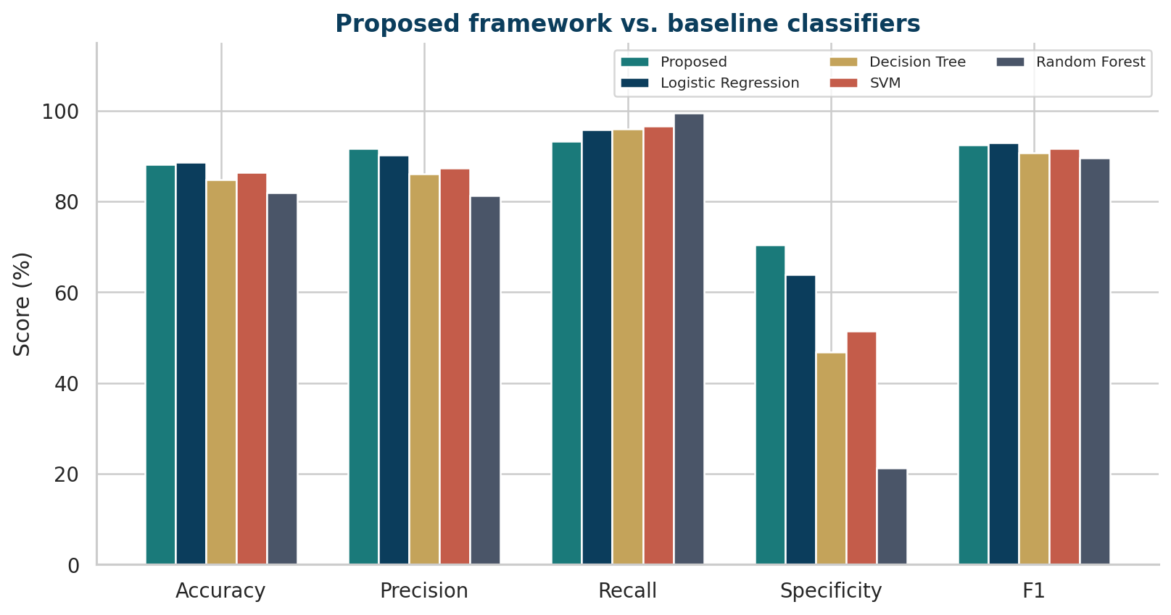
4. Results
Our basic reimplementation on Mentalillness.csv · 20% hold-out · no grid search
88.1%
91.6%
93.3%
70.4%
92.4%
0.91
Accuracy
Precision
Recall
Specificity
F1-score
ROC-AUC
How to read these numbers (and why they are below the paper)
Paper reported Acc 93%, Recall 97%, F1 95% after heavy XGBoost tuning. Our run uses a small booster (80 trees, depth 3), 10% missing symptoms, and 6% self-report flips — closer to incomplete clinical forms. Recall stays high so true BD cases are still caught; specificity is lower, which is acceptable for a screening aid.
Kumar et al. · Scientific Reports (2026) 16:11887 · Hybrid SMOTE–GMM–XGBoost for bipolar disorder screening

Slide 5
5. Conclusion, limitations, future work
A clinician-facing screening aid — not a stand-alone diagnosis
Conclusion
Limitations
Future work
• Three clear steps: SMOTE balances the train set, GMM adds 4 subgroup probabilities, XGBoost classifies.
• SMOTE and GMM never touch the test set, so the score is a fair hold-out estimate.
• Basic run: accuracy 88.1%, recall 93.3%, F1 92.4% — below the paper’s 93 / 97 / 95 because we did not grid-search.
• High recall is the screening goal: better to flag a case than to miss BD.
• Feature importance from XGBoost keeps the model explainable.
• One public Kaggle table, not a hospital cohort.
• BD labels follow a DSM-5 mania-count rule, so we added missing values and symptom noise to mimic incomplete forms.
• GMM assumes Gaussian clusters.
• SMOTE can invent samples near the class border.
• No EEG, speech, or imaging.
• We used a small XGBoost (80 trees, depth 3), so we do not claim the paper’s 93%.
• Multimodal inputs: EEG, speech, actigraphy, neuroimaging.
• SHAP / LIME explanations for each flagged patient.
• Prospective validation across hospitals and age groups.
• Federated learning so sites share models, not notes.
• Longitudinal episode-risk monitoring.
• Calibrate the 0.5 threshold to local screening vs. confirmation workflows.
Kumar et al. · Scientific Reports (2026) 16:11887 · Hybrid SMOTE–GMM–XGBoost for bipolar disorder screening

