Slide 1
CONNECTED BY INTELLIGENCE
ANVEXA
Investor Pitch | Finance & Growth Plan
Nishant | Chief Financial Officer
Pune, Maharashtra, India | Founded 2023
Capital with purpose. Growth with accountability.
ANVEXA | CFO INVESTOR BRIEF

Slide 2
Executive summary
Three-year B2B technology business seeking growth capital
• Core offer: cloud migration/support, cybersecurity hardening, AI-enabled reporting and custom business software.
• Operating base: Pune; current commercial focus on Pune and Mumbai, Maharashtra.
• Illustrative FY2025–26: ₹3.00 crore revenue, ₹36 lakh net profit, 58% gross margin.
• Pitch scenario: 32 active recurring clients and 45+ projects delivered over three years.
• Funding request: ₹2.00 crore for productization, sales, talent, infrastructure, security and working capital.
ANVEXA | CFO INVESTOR BRIEF • Illustrative model

Slide 3
Fix the draft before presenting
Investors will challenge contradictions first
• Annual revenue ₹1.20Cr + ₹2.00Cr + ₹3.00Cr = ₹6.20Cr cumulative; this conflicts with the draft’s ₹2.85Cr claim.
• Year 1 net profit is stated as ₹6L, while another sentence calls Year 1 a loss. Choose one consistent version.
• Funding ask appears as both ₹2Cr and ₹1.5Cr. This deck uses ₹2Cr throughout.
• 32 recurring clients and ₹90L ARR need a revenue bridge: recurring contracts versus onboarding and project work.
• Treat all company financials/client counts as illustrative unless verified; never invent named clients or client outcomes.
ANVEXA | CFO INVESTOR BRIEF • Illustrative model

Slide 4
Market reach: local execution, national opportunity
Be clear about where Anvexa is today versus where it plans to go
• Current focus: Pune and Mumbai, Maharashtra; delivery capacity remains Maharashtra-led.
• Target sectors: retail/distribution, IT/software services, logistics/manufacturing, professional services.
• Next expansion candidates: Ahmedabad/Surat and Bengaluru, only after pipeline and delivery milestones are met.
• No overseas client revenue is assumed in this base case.
• External context: MSMEs contributed 30.1% of India GDP in FY2022–23 (PIB, July 2024); Gartner forecast Indian public-cloud spending at US$17.5B in 2026. These are broad market indicators, not Anvexa revenue.
ANVEXA | CFO INVESTOR BRIEF • Illustrative model

Slide 5
Products & revenue streams
One accountable partner across connected services
• Anvexa InsightX: billing, inventory, dispatch and reporting dashboard.
• Anvexa CloudSphere: migration, monitoring and managed support; 99.9% uptime is a target only if contract/SLA terms support it.
• Anvexa NexusAI: workflow automation and scheduled reports.
• Anvexa Sentinel: security assessment, hardening and monitoring; never claim breach-proof protection.
• Anvexa StudioX: custom web/mobile portals and integrations.
• Revenue: onboarding/migration fees + recurring subscriptions/support + scoped custom projects.
ANVEXA | CFO INVESTOR BRIEF • Illustrative model

Slide 6
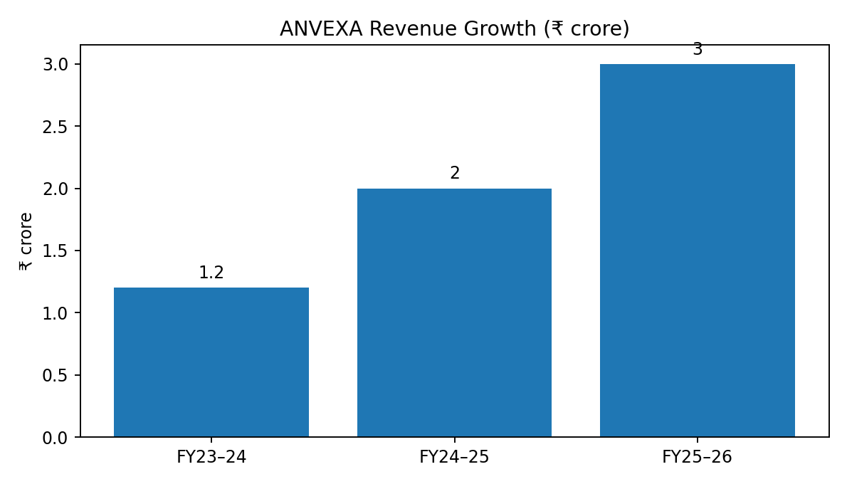
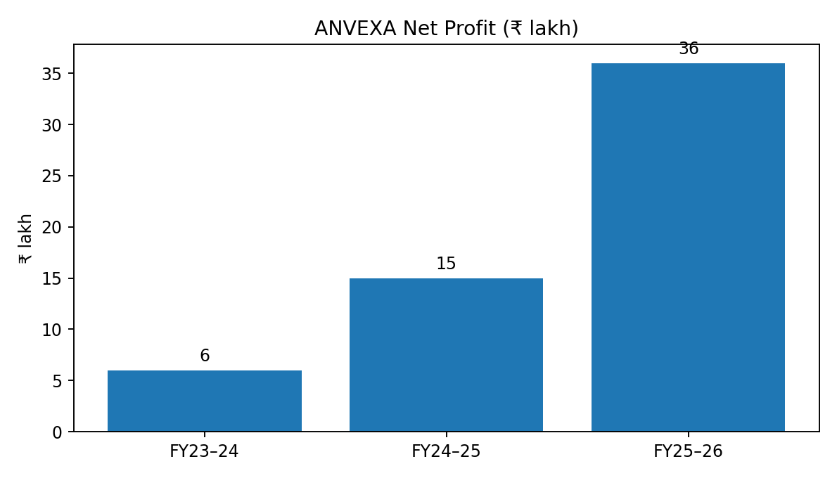
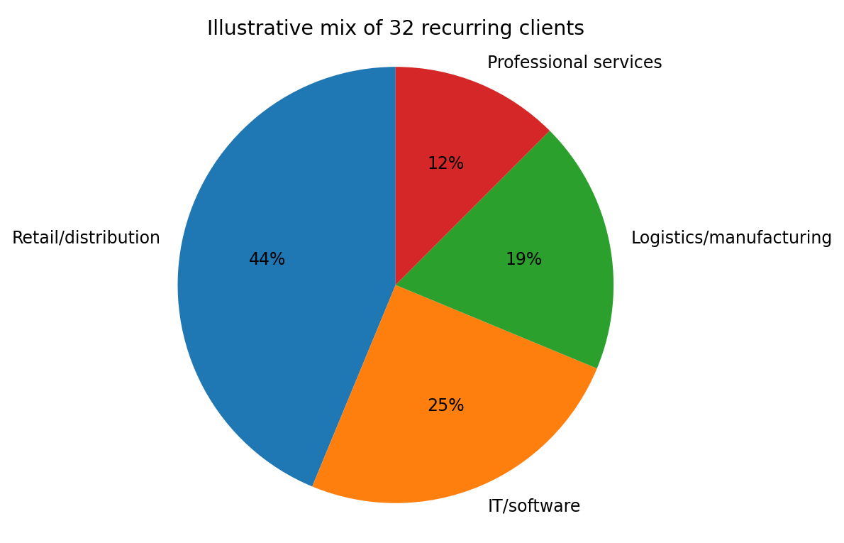
Client profile: quantify the base
Use aggregate profile unless client names and permissions are confirmed
• Pitch scenario: 32 active recurring clients at Year 3 end; 45+ completed projects cumulatively.
• Illustrative client mix: 14 retail/distribution, 8 IT/software, 6 logistics/manufacturing, 4 professional services.
• ₹90L ARR ÷ 32 clients = average ₹2.81L annual ARR/client (about ₹23,438/month); individual contracts vary.
• Appendix evidence: anonymized case study, problem → solution → outcome, timeline, contract type and renewal status.
• Do not name clients, show logos or quantify savings unless verified and approved.
Revenue: ₹1.20Cr → ₹2.00Cr → ₹3.00Cr | Net profit: ₹6L → ₹15L → ₹36L
ANVEXA | CFO INVESTOR BRIEF • Illustrative model

Slide 7
Three-year financial performance
Illustrative management case; reconcile against accounts before external use
ANVEXA | CFO INVESTOR BRIEF • Illustrative model

Slide 8
FY2025–26 P&L bridge
₹ lakh | internally reconciled illustrative numbers
• Revenue: ₹300L
• Direct delivery costs: ₹126L → Gross profit ₹174L (58% gross margin)
• Operating expenses: ₹114L → EBITDA ₹60L
• Depreciation + interest: ₹12L → Profit before tax ₹48L
• Estimated tax: ₹12L → Net profit after tax ₹36L (12% net margin)
• Tax is simplified for the classroom model, not an actual tax calculation.
ANVEXA | CFO INVESTOR BRIEF • Illustrative model

Slide 9
Cash discipline & working capital
Profit is not the same as cash
• Illustrative cash: ₹45L; receivables: ₹35L; existing loans: ₹20L. Verify these before presenting.
• Receivables-days rough proxy: ₹35L ÷ ₹300L × 365 ≈ 43 days; proper DSO uses credit sales and average receivables.
• Weekly ageing review; escalation at 30/45/60 days; milestone billing and clear payment terms.
• Maintain a 13-week rolling cash forecast and monthly budget-vs-actual review.
• Runway = unrestricted cash ÷ average monthly net cash burn; do not invent runway if cash flow is positive or commitments are unknown.
ANVEXA | CFO INVESTOR BRIEF • Illustrative model

Slide 10
Funding request & valuation
Proposed growth round; terms subject to negotiation
• Ask: ₹2.00 crore for 16.67% post-investment ownership.
• Post-money valuation = ₹2.00Cr ÷ 16.67% ≈ ₹12.00Cr.
• Pre-money valuation = ₹12.00Cr − ₹2.00Cr = ₹10.00Cr.
• Rationale to defend: revenue quality, 58% gross margin, ₹36L net profit, ₹90L ARR, retention and qualified pipeline.
• This is a proposed negotiating valuation, not an independent valuation or guaranteed investor return.
ANVEXA | CFO INVESTOR BRIEF • Illustrative model

Slide 11
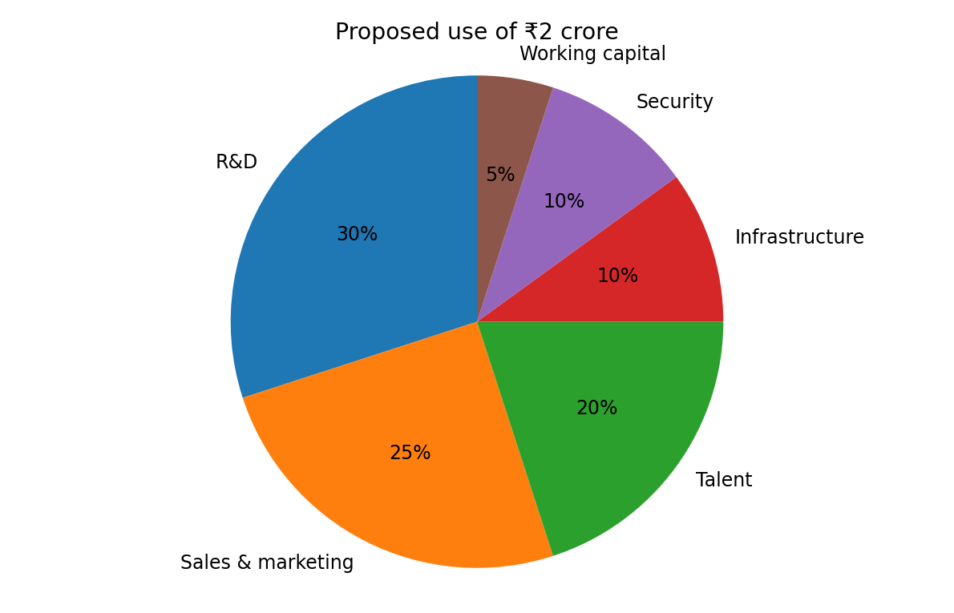
Use of funds: every rupee has a job
Proposed allocation of ₹2 crore
• Engineering & R&D: 30% = ₹60L — productize repeatable modules.
• Sales & marketing: 25% = ₹50L — targeted B2B pipeline and partner channel.
• Talent & hiring: 20% = ₹40L — hire against delivery/product milestones.
• Infrastructure & cloud: 10% = ₹20L — tooling, test environments and delivery capacity.
• Security & compliance: 10% = ₹20L — audits, controls and readiness.
• Working capital: 5% = ₹10L — buffer for collection timing.
ANVEXA | CFO INVESTOR BRIEF • Illustrative model

Slide 12
Milestones & risk controls
Capital released against measurable progress
• 0–3 months: confirm unit economics, select two product modules, launch monthly finance dashboard.
• 3–6 months: build qualified sales pipeline in Pune/Mumbai; publish three permissioned case studies.
• 6–12 months: package repeatable modules; track ARR, gross margin, collection days and renewals.
• 12–24 months: test Gujarat/Bengaluru partner channels only after pipeline and delivery gates are met.
• Risks: client concentration, delayed collections, scope creep, cybersecurity incidents, hiring ahead of demand and unproven quantum spend.
ANVEXA | CFO INVESTOR BRIEF • Illustrative model

Slide 13
Investor reporting & governance
A finance system investors can trust
• Monthly: P&L, cash-flow view, balance-sheet snapshot, budget variance, ARR, receivables ageing and sales pipeline.
• Quarterly: client concentration, churn/renewals, project margins, hiring progress, risk register and funding milestones.
• Controls: bank reconciliation, approval matrix, purchase orders, contract review and documented expense policy.
• Clearly label audited actuals, management accounts, forecasts and assumptions.
• Promise transparency and accountability—not guaranteed returns.
ANVEXA | CFO INVESTOR BRIEF • Illustrative model

Slide 14
ANVEXA
Capital with purpose.
Growth with accountability.
“Every rupee has a defined use, an owner, a milestone and a reported outcome.”
Nishant | Chief Financial Officer

