Slide 1

ROADMAP TO YOUR “PERFECT JOB”
Aishwarya Reddy Toom
Harshitha Suresh
Lakshmi Annapoorna Madireddy
Nishant Anand

Slide 2

OBJECTIVE
The main aim of this project is to help an individual who would want to understand the
key requirements to get into their desired job role in a top company.
* This is a term project and will not be used for any commercial publishing purpose.

Slide 3
ROADMAP
Overall Key takeaway
Latest Degree Level
Latest Degree Name
University Name
Top Skills
Total months of Experience
Employee profile
For every profile
Education
Experience
Skills
Location
Desired company and job role
LinkedIn
Employee Profiles
Glassdoor
Top Companies Details
* This is a term project and will not be used for any commercial publishing purpose.

Slide 4

GLASSDOOR
The output extracted gives information about top companies based on the ratings.
Interview difficulty level for the particular company.
Gives insight about the chances of getting an interview through different channels.
Makes the user understand on an average of how positive or negative the interview experience will be.
* This is a term project and will not be used for any commercial publishing purpose.

Slide 5

LINKEDIN PROFILE EXTRACTION
This would help the user to know :
Latest degree level
From this data, the user will be able to know what is the most popular and maximum degree level expected for getting recruited by the company for the desired job role.
Latest degree name
From this data, the user can understand which degree should be attained in order to get into the job role of that particular stream in that company.
University Name
From this data, the user can understand the pattern in the recruiting process of a company if they are considering graduates from a particular University more.
* This is a term project and will not be used for any commercial publishing purpose.

Slide 6
LINKEDIN PROFILE EXTRACTION
This would help the user to know :
Total duration of work experience
From this data, the user will be able to know the number of months of experience the company is looking for to hire for that particular job role.
Top Skills
This will help the user know the skillset the company is looking for an individual to have for that particular job role.
Previous Company employed with
From this data, the user can understand the pattern in the recruiting process of a company if they are considering employees from a particular company to hire from
* This is a term project and will not be used for any commercial publishing purpose.

Slide 7
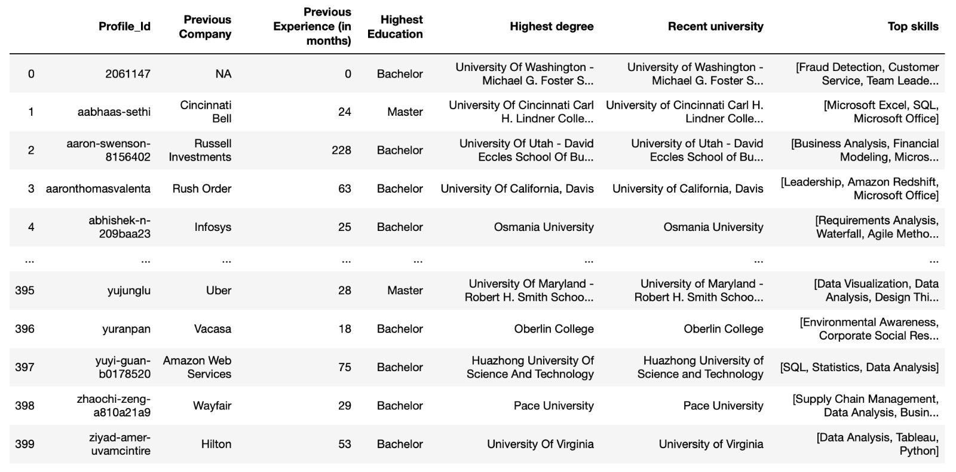
CONCLUSION
This particular dataset benefits the user in understanding the requirements to land in the desired job role in a top company of their choice.
* This is a term project and will not be used for any commercial publishing purpose.

Slide 8
LIMITATIONS
Getting API Key is difficult to run general queries unless the user is registered from a company. API handling would be more hassle free.
IP address should be white listed by the company for data to be scraped legally.
Maximum number of records that can be fetched is limited to 1000 profiles.
Companies like LinkedIn/Glassdoor update their features quite frequently which should be handled regularly.
This data set cannot be further used for any publishing purposes due to company’s terms of use.
* This is a term project and will not be used for any commercial publishing purpose.

Slide 9
THANK YOU

