Slide 1



IPL 2025 Performance Analytics
Business Question
In the high-stakes environment of IPL 2025, winning matches requires more than just talent—it requires data-driven decision making
Toss Impact: Does winning the toss impact the match?
Team Performance: Who leads the standings and why?
Player Impact: Which players influence results the most?
Venue Strategy: Which grounds favor which tactics?

Slide 2
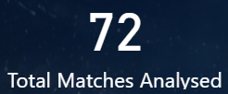
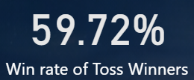
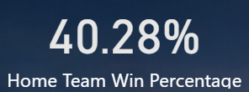
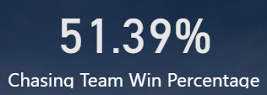
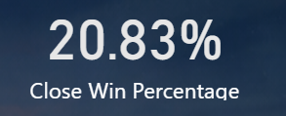
Dataset Overview and KPIs
The analysis is built on a comprehensive dataset of 74 matches from the 2025 season, providing a complete picture of the season’s results. It tracks basic match info like team names and dates, alongside tactical choices like who won the toss and whether they chose to bat or bowl first.
The data also records team scores, winning margins, and individual highlights like top scorers and best bowlers.
72 out of 74 matches were analysed as two matches were either abandoned or had no result
Indicates that winning the coin toss provides a measurable advantage, resulting in a match win nearly 60% of the time.
Reveals that playing at a home ground was not a major advantage this season
Shows a slight preference for batting second
Shows % of close wins where game was won either by less than 16 runs or by less than 3 wickets

Slide 3
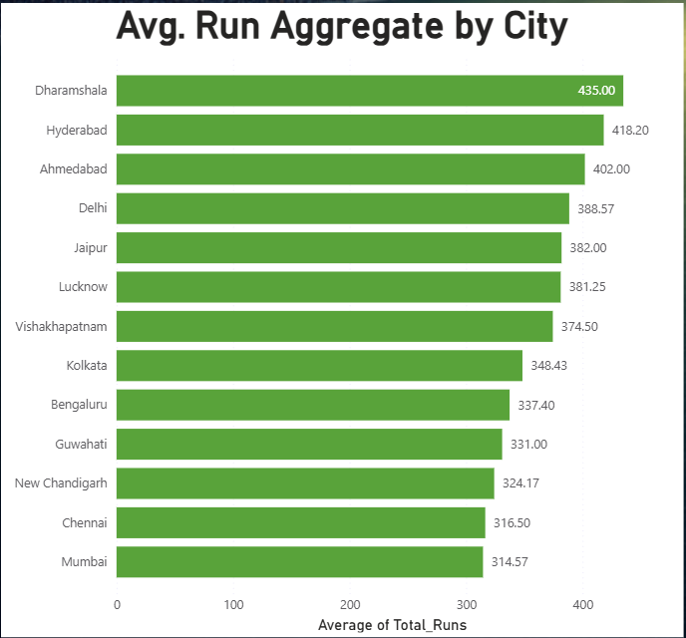
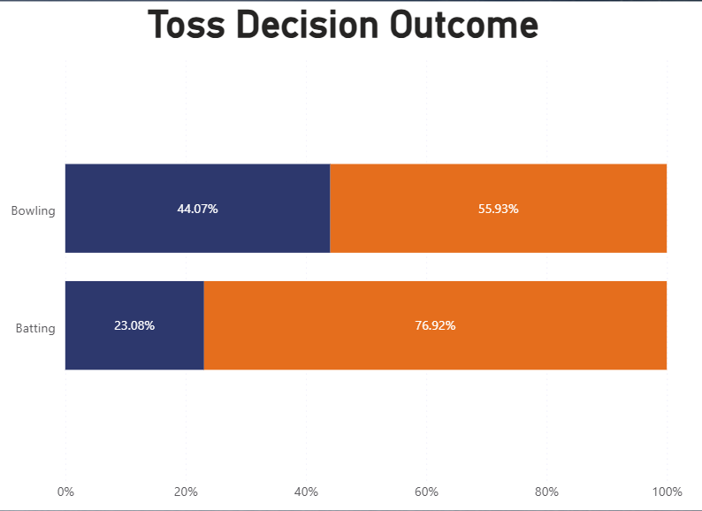

Key Insights
Batting first shows a 76.9% win rate but is a small 13-game outlier. The 60-game 'bowl first' sample (55% win rate) confirms chasing as the more consistent and reliable strategy league-wide.
Venue scoring varies significantly between different venue. High-aggregate grounds (400+) demand aggressive power-hitting to match high par scores, whereas lower-scoring grounds make spin-bowling and technical strike-rotation the decisive factors for victory.

Slide 4
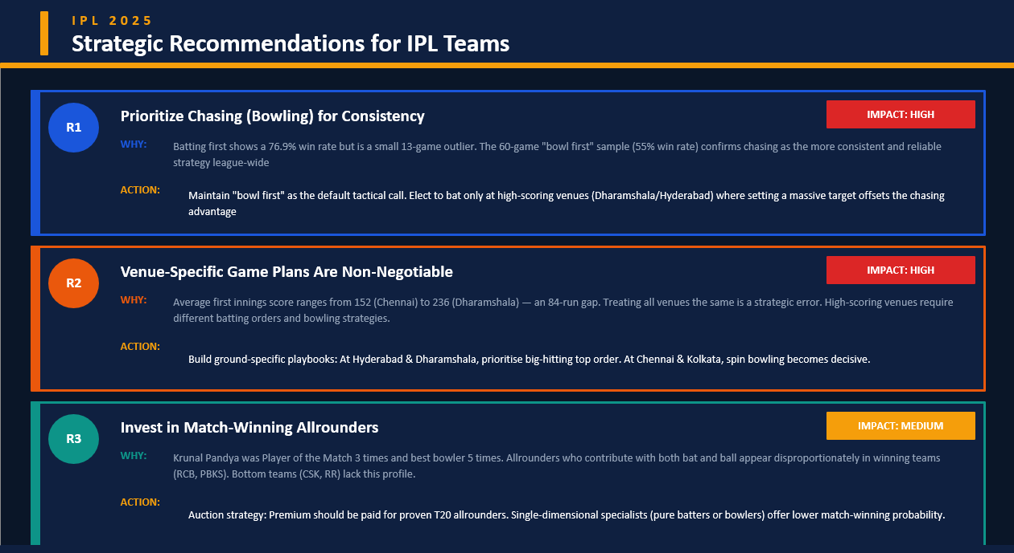

Slide 5
Assumptions and Limitations
ASSUMPTIONS MADE
DATA LIMITATIONS
All 74 matches are treated equally regardless of league stage (group vs playoffs)
No ball-by-ball data — phase-wise analysis (powerplay, death) not possible
Toss decision % calculated only on valid matches (excluding abandoned/no toss)
No player-level metrics (strike rates, economy rates, fielding stats)
Discount factors (weather, pitch condition, match importance) not captured
It is assumed that the scoring averages recorded at each venue reflect the inherent characteristics of the pitch and ground size rather than temporary weather events.

Slide 6
THANK YOU!

