Slide 1

IILM UNIVERSITY, GREATER NOIDA
INTERNSHIP PRESENTATION
AI & Machine Learning Internship
Applied Machine Learning through the Iris Species Classification and World Happiness Report EDA projects
STUDENT NAME
ENROLLMENT NUMBER
PROGRAM & SEMESTER
ORGANIZATION
Nishant Deshwal
25SCS1003004504
B.Tech (AI & ML) — 3rd Semester
Pluto Academy
Duration: 1 Month • Completed: June 2026 • Certificate ID: PA-OL-AIML-2026-0292

Slide 2





THE HOST ORGANIZATION
About Pluto Academy
Pluto Academy is a skills-training organization focused on empowering the next generation of tech professionals through hands-on, project-based learning in emerging technologies.
The AI & Machine Learning Internship program is delivered as a one-month, project-driven track where interns apply core ML concepts to real datasets — building a practical, portfolio-ready foundation in data science.
Govt. of India
UDYAM-RJ-06-0057331
Skill India
Quality Assured
Recognised Program
MSME Registered
Partner Organization
Certified Delivery
Founder, Pluto Academy: Tishant Agrawal | Verify at plutoacademy.in/verify-certificates/
AI & Machine Learning Internship | Nishant Deshwal
2

Slide 3




PROGRAM SNAPSHOT
Internship Overview
1 Month
2
3
100%
Duration
Applied ML Projects
Classification Models Built
Peak Model Accuracy
Learning Objectives
PROGRAM DOMAIN
Apply supervised ML algorithms to a real classification problem end-to-end
Artificial Intelligence &
Machine Learning
Perform exploratory data analysis (EDA) to uncover patterns in real-world data
Build a complete workflow: load, clean, visualize, model, and evaluate
Certificate ID
PA-OL-AIML-2026-0292
Completed
June 2026
Translate data insights into clear, presentable conclusions
UDYAM Reg.
UDYAM-RJ-06-0057331
AI & Machine Learning Internship | Nishant Deshwal
3

Slide 4





WHAT I WORKED WITH
Tools & Technology Stack
Python
Pandas & NumPy
Scikit-learn
Core programming language
Data wrangling & analysis
Model building & evaluation
Matplotlib & Seaborn
Google Colab
Jupyter Notebook
Data visualization
Cloud notebook environment
Interactive development
AI & Machine Learning Internship | Nishant Deshwal
4

Slide 5
PROJECT 01
Iris Flower Species Classification
A supervised machine learning project classifying flowers into three species using their sepal and petal measurements.
150
4
3
80/20
Total Samples
Numeric Features
Flower Species
Train / Test Split
Project Workflow
1
Loaded the Iris dataset from Scikit-learn into a Pandas DataFrame
4
Split the data into training (120) and testing (30) samples
2
Reviewed structure, data types, and confirmed there were zero missing values
5
Trained Logistic Regression, KNN, and Random Forest classifiers
3
Visualized feature relationships across species using a Seaborn pairplot
6
Evaluated and compared models with accuracy scores and a confusion matrix
AI & Machine Learning Internship | Nishant Deshwal
5

Slide 6
PROJECT 01 — RESULTS
Model Performance Comparison
100%
Accuracy achieved by all three
models on the held-out test set
The Random Forest confusion matrix showed zero misclassifications across all three species on the 30-sample test set — confirming the Iris dataset is highly separable using petal and sepal measurements.
AI & Machine Learning Internship | Nishant Deshwal
6

Slide 7
PROJECT 02
World Happiness Report — EDA
An exploratory data analysis identifying which socio-economic factors relate most strongly to happiness scores across 156 countries.
156
9
0
2019
Countries Analyzed
Data Columns
Missing Values
Report Year Studied
Project Workflow
1
Extracted and loaded the 2019 World Happiness Report CSV with Pandas
4
Plotted GDP per capita against happiness score to study the relationship
2
Checked for missing values and duplicates — dataset was already clean
5
Built a correlation heatmap across all contributing factors
3
Visualized the Top 10 and Bottom 10 happiest countries
6
Ranked factors by their correlation strength with the happiness score
AI & Machine Learning Internship | Nishant Deshwal
7

Slide 8
PROJECT 02 — KEY INSIGHTS
What Drives Happiness Scores?
TOP FINDINGS
GDP per capita is the strongest single predictor of a country's happiness score
Healthy life expectancy and social support follow closely behind
Finland, Denmark, and Norway top the 2019 happiness rankings
Generosity shows almost no correlation with happiness scores
AI & Machine Learning Internship | Nishant Deshwal
8

Slide 9


WHAT I GAINED
Skills & Learning Outcomes
Python for Data Science
Data Visualization
Machine Learning Modeling
Writing clean, reusable analysis code with Pandas & NumPy
Communicating patterns clearly using Matplotlib & Seaborn
Training and tuning classifiers with Scikit-learn
Model Evaluation
Exploratory Data Analysis
Professional Workflow
Using accuracy scores and confusion matrices to validate results
Framing the right questions before modeling begins
Structuring, documenting, and presenting a data project end-to-end
AI & Machine Learning Internship | Nishant Deshwal
9

Slide 10
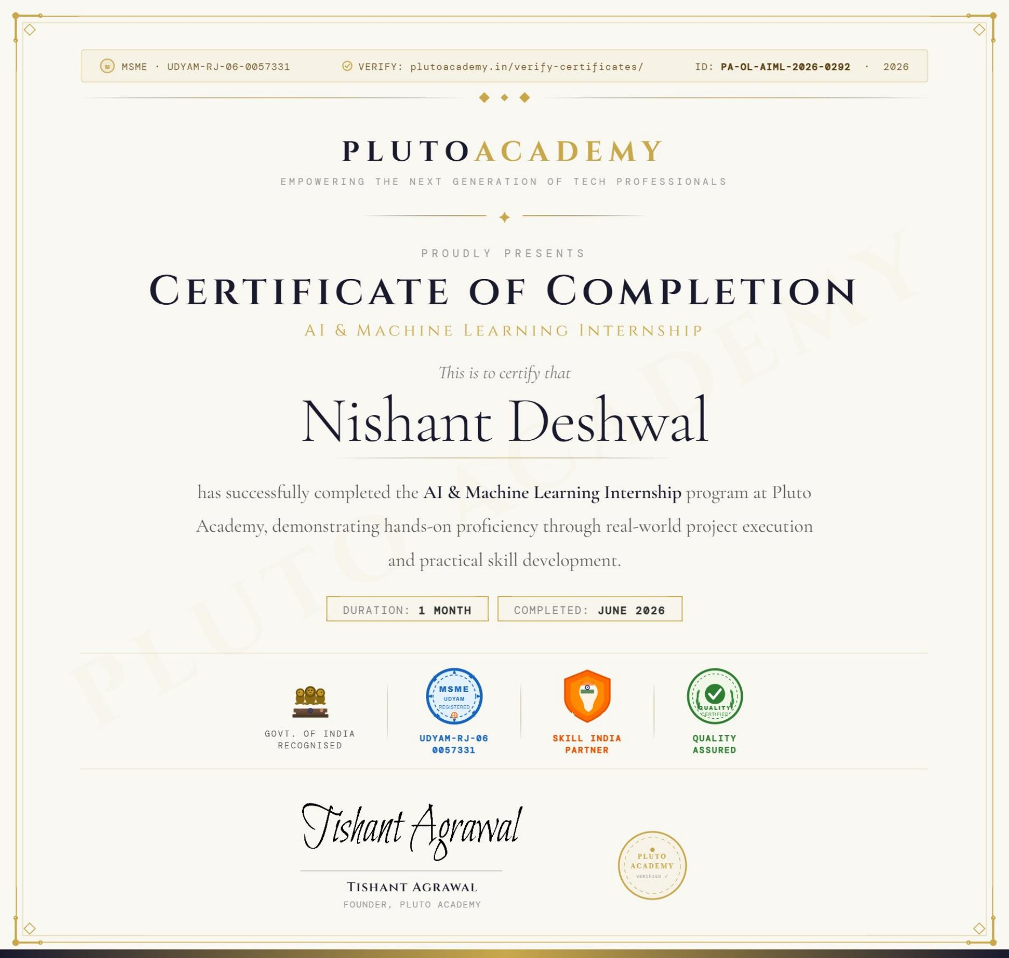
PROOF OF COMPLETION
Internship Certification
CERTIFICATE DETAILS
Issued By
Pluto Academy
Program
AI & Machine Learning Internship
Awarded To
Nishant Deshwal
Duration
1 Month
Completed
June 2026
Certificate ID
PA-OL-AIML-2026-0292
UDYAM No.
UDYAM-RJ-06-0057331
Signed by Tishant Agrawal, Founder — Pluto Academy
AI & Machine Learning Internship | Nishant Deshwal
10

Slide 11
CONCLUSION
Key Takeaways from the Internship
Completed two full applied-ML projects covering both classification and exploratory data analysis
Built and compared three classification models, achieving 100% test accuracy on the Iris dataset
Identified GDP, health, and social support as the strongest drivers of national happiness
Gained hands-on, portfolio-ready experience with the end-to-end data science workflow
This internship strengthened my practical grounding in AI & Machine Learning and lays a strong foundation for more advanced, real-world data science work ahead.
AI & Machine Learning Internship | Nishant Deshwal
11

Slide 12
Thank You
Questions & Discussion Welcome
Nishant Deshwal
B.Tech (AI & ML), 3rd Semester • IILM University, Greater Noida
nishantdeshwal2005@gmail.com • github.com/nishant-deshwal05 • linkedin.com/in/nishant-deshwal-279281359

