Slide 1
COVID-19 Global Data Explorer
Data Visualization Techniques (LA-2) | Public Health Analytical Project | Group 2
🌐 Live Interactive Dashboard: https://covid19-global-data-explorer-lqpxjhstcgzwc7gxhnshtd.streamlit.app/
💻 GitHub Repository: https://github.com/nishant-giri-j/covid19-global-data-explorer
Group 2 Members:
• Roll No. 02: Aashi Kohad — Dataset Discovery & Analytical Storytelling
• Roll No. 20: Himanshu Yadav — Analytical Questions & Visualization Selection
• Roll No. 37: Nishant Giri — Dashboard Development & Cloud Deployment
• Roll No. 55: Shreyash Karemore — Wrong Viz Challenge & AI Critic Evaluation

Slide 2
Five Analytical Questions & Visualizations
Q1. Wave Decoupling Dynamics ➔ [Dual-Axis Line Chart]
Cases (millions) vs deaths (thousands) differ by 1,000x. Secondary axis reveals decoupling during 2022 Omicron wave.
Q2. Demographic Age vs Deaths ➔ [Scatter Plot by Continent]
Shows positive correlation while spotlighting outliers like Japan (high age, low deaths) and Peru.
Q3. Continental Spread ➔ [Box Plot by Continent]
Demonstrates that inter-continental differences dominate over variation inside individual continents.
Q4. Seasonal Mortality Cycles ➔ [Year × Month Heatmap]
Recurring dark bands in Dec, Jan, and Feb expose respiratory winter surge cycles across consecutive years.
Q5. Global Vaccine Equity ➔ [Frequency Histogram]
Reveals a stark bimodal distribution (<30% vs >75%) that a single global average completely conceals.

Slide 3
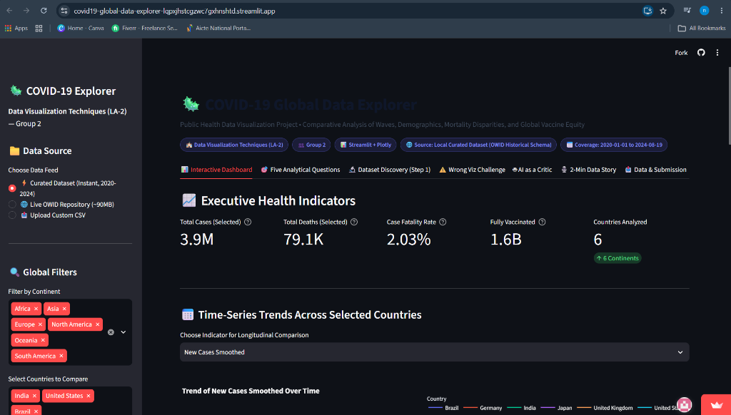
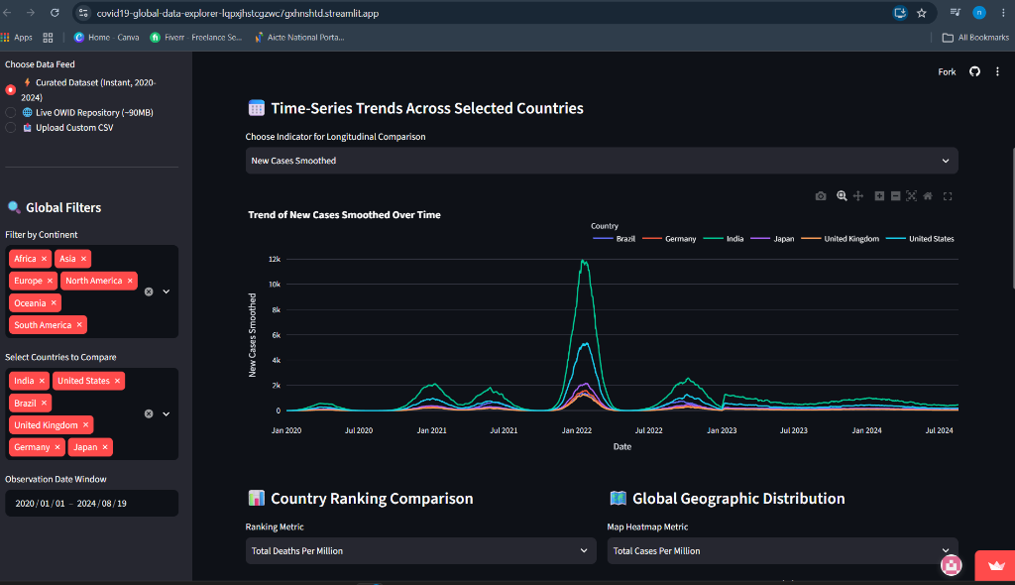
Live Dashboard Showcase & Visualizations
Interactive Features: Real-time KPI cards, country multiselect, date window slider, and dual-axis longitudinal trend comparisons.
Live App Link: https://covid19-global-data-explorer-lqpxjhstcgzwc7gxhnshtd.streamlit.app/

Slide 4
Five Major Findings & Three Actionable Recommendations
💡 Five Major Findings
1. Decoupling: Omicron wave produced 4x cases with proportionally far fewer deaths due to vaccines.
2. Age Sensitivity: Age correlates with deaths, but Japan was an outlier due to rapid masking.
3. Continental Disparities: Inter-continental variance exceeded internal continental variation.
4. Winter Seasonality: Recurring mortality surges in Dec–Feb across consecutive years.
5. Bimodal Vaccination: Countries split into twin clusters (<30% vs >75%), proving extreme inequity.
🎯 Three Actionable Recommendations
1. Regional mRNA Hubs: Fund decentralized vaccine manufacturing in Africa & Latin America.
2. Seasonal Preparedness: Schedule booster campaigns in autumn ahead of winter surges.
3. Standardized Surveillance: Mandate unified pandemic reporting standards under WHO.
⚠️ Wrong Visualization Challenge (Q5):
Correct Histogram exposes bimodal equity split. Misleading Pie Chart discretizes data into equal slices, concealing the valley of unimmunized nations.

Slide 5
2-Minute Data Story & AI as a Critic
🎙️ 2-Minute Data Story Framework:
1. What did we discover? Pandemic waves decoupled in 2022 (Omicron peak blunted by vaccines); age did not dictate death rates in Japan; and vaccine coverage formed a bimodal divide.
2. Why does it matter? Tabular spreadsheets hide these realities. Without dual-axis plots and histograms, vaccine effectiveness is unseen and global vaccine inequality is buried under misleading averages.
3. What action should be taken? Fund regional manufacturing hubs in low-income nations, schedule seasonal autumn booster surges, and mandate standardized real-time surveillance.
🤖 AI as a Critic Evaluation Summary (Q1):
• Dual Y-Axis [ACCEPTED]: Solves 1,000x scale gap between daily cases and deaths.
• Milestone Annotations [ACCEPTED]: Adds vital context (vaccine rollout, Omicron surge).
• Logarithmic Scale [REJECTED]: Distorts public health severity and absolute mortality perception.
• 7-Day Smoothed Label [ACCEPTED]: Ensures transparency regarding weekend reporting lags.

