Slide 1


Department of
Biomedical
Engineering
Driver Emotion Recognition Using a Hybrid Convolutional and LSTM Neural Network
NAME Vaishnavi W
ROLL NO AI20BTECH11025
NAME Nishant
ROLL NO BM22BTECH11013
Dr. Nagarajan Ganapathy
Research Supervisor
17.01.23
1

Slide 2
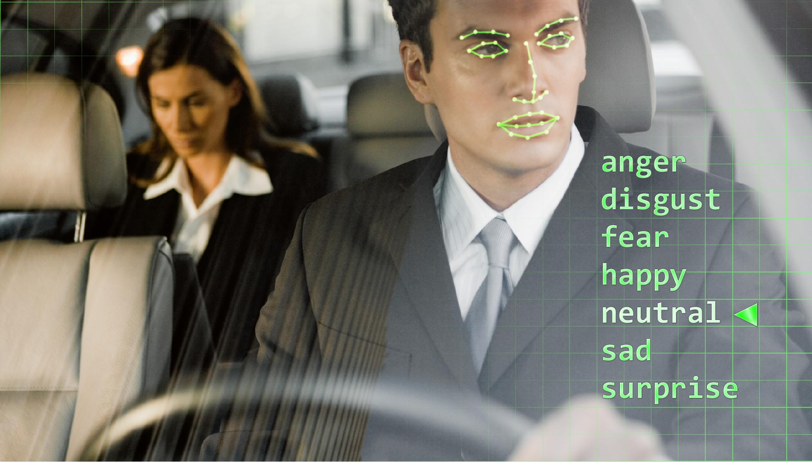
Introduction
Emerging Field: Combines AI with advanced sensing technologies to enhance safety and driver well-being.
Purpose: Real-time identification of drivers’ emotional states to predict and prevent risky behaviors.
Technological Advances:
  Utilizes physiological signals (ECG) and visual data (video).
  Simultaneous processing for improved detection accuracy.
Project Goal: Develop a hybrid CNN-LSTM model to precisely recognize emotions in varied driving conditions.
Impact: Potential enhancements in adaptive vehicle control systems, increasing overall driving safety.
🔗 Image Source

Slide 3
Literature review
Advanced Neural Network Models:
Probability and Learning-Based Approaches:
Guanglong Du et al., 2021 - This study introduced a convolutional bidirectional LSTM network that utilizes both facial geometry and ECG signals. This approach holds a lot of potential in accurately recognizing the emotions of drivers; an aggregate of these results confirms the validity of integrating both visual and physiological data.
D. Jiang et al., 2020 - Explored the advance classification algorithms, for emotion recognition, emphasizing the naturalness, and convenience of camera-based methods during interactive scenarios, such as driving, enhancing user experience and accuracy.
Enhanced Facial Emotion Recognition:
Continuous Emotion Recognition Techniques:
M. Hu et al., 2019 - Developed a method using local enhanced motion history images combined with CNN-CTSLSTM networks. The detected landmark-based method fine-tunes the facial emotion recognition method to sharpenness in detected facial landmarks by improving the local value difference image calculations for more accurate emotion detection.
S. Wu et al., 2019 - Investigated the fusion of facial expressions, head pose, and eye gaze for continuous emotion recognition in videos. Therefore, this work furthers the potential of both geometry-based and appearance-based methods to provide comprehensive data that significantly boosts emotion recognition systems.

Slide 4
Aim and Objective
Aim:
Developing an advanced driver emotion detection system, using a hybrid approach that combines CNNs and LSTMs, which aims at improving the safety features of the driver assistance systems through real-time emotion recognition.
Objectives:
Integrate Multimodal Data: Utilize video and ECG signals to efficiently detect driver emotions.
Enhance Accuracy: Applying CNNs and LSTMs for video and ECG data to improve emotion classification accuracy.
Evaluate Performance: Assess model effectiveness using accuracy, precision, recall, and F1-score; compare with single-modality models.
Facilitate Real-Time Implementation: Designing for real-time processing on edge devices for vehicle integration.

Slide 5
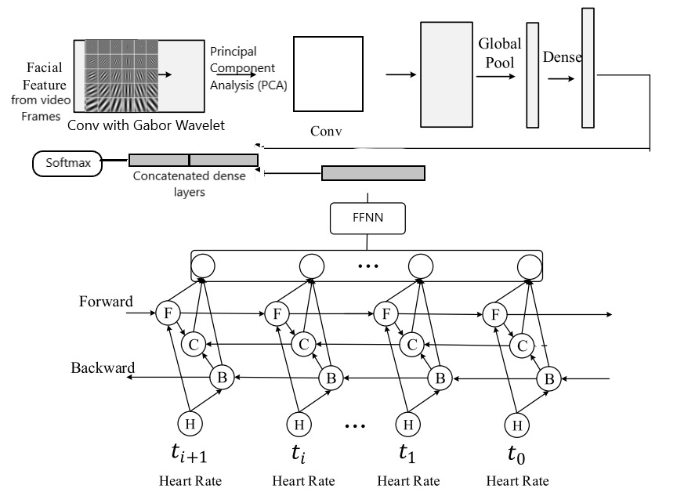
Proposed Architecture

Slide 6
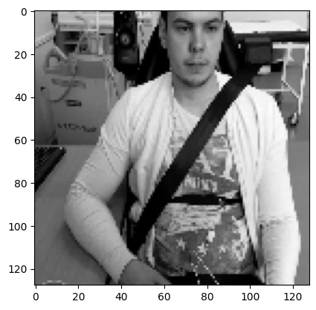
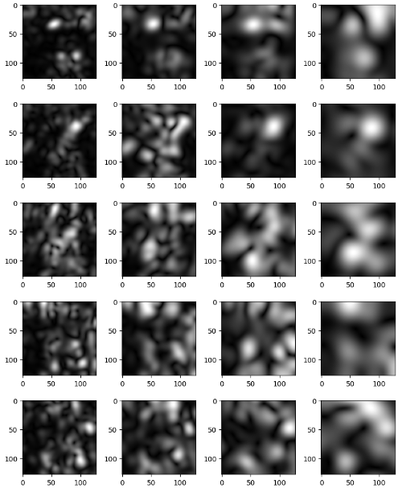
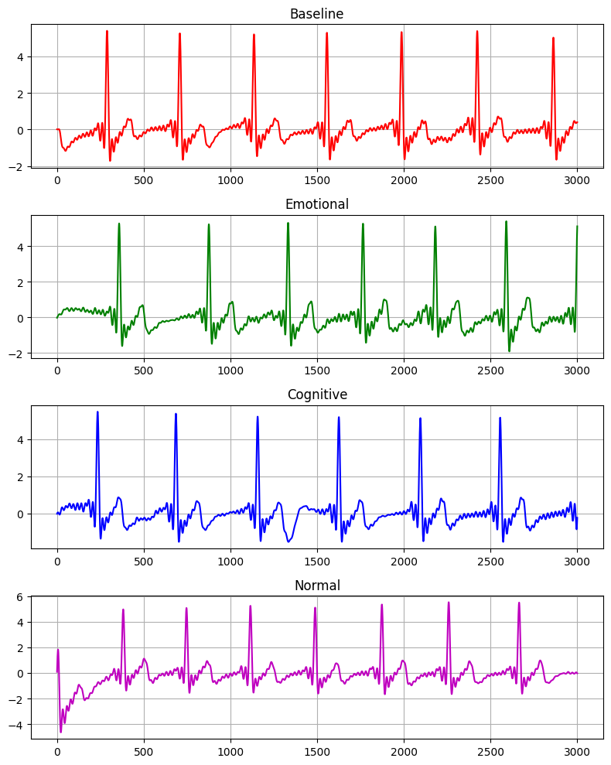
Methodology
Data Collection:
  Subjects: 10 male subjects under simulated driving conditions.
  Data Types: Video clips and ECG signals for four emotional states: Baseline, Cognitive, Emotional, Normal.
Data Preprocessing:
  Video: Frames converted to grayscale and resized to 240x240 pixels. ECG: Noise filtering and feature extraction using bandpass filters and biosppy library.
Feature Extraction:
  Video: Facial features via Gabor wavelets. ECG: Time and frequency domain features using Welch’s method.
Model Architecture:
  CNN for Video: Time Distributed CNNs process spatial features. BiLSTM for ECG: Captures temporal patterns from ECG data.
Integration and Classification:
  Fusion: Concatenate CNN and BiLSTM outputs. Classification: Dense layer with softmax for emotional state classification.
Model Training and Validation:
  Parameters: Adam optimizer, cross-entropy loss. Metrics: Accuracy, precision, recall, F1-scores; validated using confusion matrices.

Slide 7
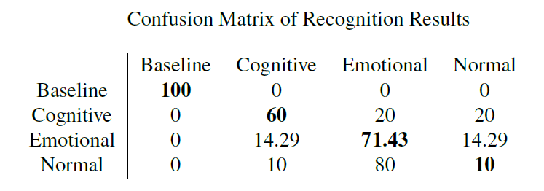
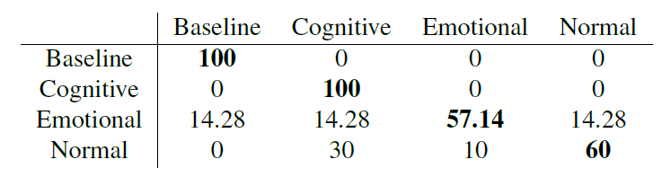
Results
ECG Based
Train Accuracy – 61%
Test Accuracy – 59%
Video Based
Train Accuracy – 97%
Test Accuracy – 78%

Slide 8
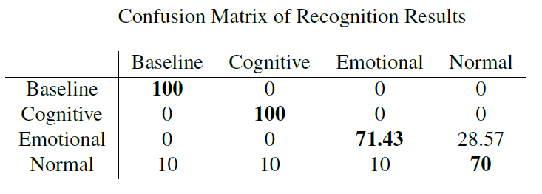
Results
Integration of ECG and Video
Train Accuracy – 98.4%
Test Accuracy – 84.3%

Slide 9
Conclusion
Our experiments show that relying solely on either video or ECG data for emotion detection yielded limited accuracy.
While the ECG-based model performed well for baseline and emotional states, it struggled with distinguishing between other emotions, possibly due to overlapping signal patterns.
Similarly, the video-based model faced difficulty detecting certain emotions due to subtle face expressions.
However, integrating video data with ECG signals through multimodal fusion led to enhanced performance. It underscores the effectiveness of combining modalities for more robust emotion detection.

Slide 10
References
Guanglong Du, Zhiyao Wang, Boyu Gao, Shahid Mumtaz, Khamael M. Abualnaja, Cuifeng Du, "A Convolution Bidirectional Long Short-Term Memory Neural Network for Driver Emotion Recognition," IEEE Transactions on Intelligent Transportation Systems, vol. 22, no. 7, pp. 4570-4578, July 2021 .
Min Hu, Haowen Wang, Xiaohua Wang, Juan Yang, Ronggui Wang, "Video facial emotion recognition based on local enhanced motion history image and CNN-CTSLSTM networks," Journal of Visual Communication and Image Representation, vol. 59, pp. 176–185, 2019 .
Suowei Wu, Zhengyin Du, Weixin Li, Di Huang, Yunhong Wang, "Continuous Emotion Recognition in Videos by Fusing Facial Expression, Head Pose and Eye Gaze," ICMI '19, October 14–18, 2019, Suzhou, China, ACM ISBN 978-1-4503-6860-5/19/10 .
Dazhi Jiang, Kaichao Wu, Dicheng Chen, Geng Tu, Teng Zhou, Akhil Garg, Liang Gao, "A probability and integrated learning based classification algorithm for high-level human emotion recognition problems," Measurement, vol. 150, 2020, Article 107049

