Slide 1



National Conference on Cognitive Computing
(NCCC-2024)
Conference Date: 15-16 Apr,2024
Car Damage Detection using Computer Vision
Presented by Geeta Hade , Apurva Kshirsagar, Nishant Khandhar, Atharva Kasar Under the guidance of Prof. Priti Warungse
Department of Computer Engineering
SINHGAD TECHNICAL EDUCATION SOCIETY’S
NBN SINHGAD TECHNICAL INSTITUTES CAMPUS
AMBEGAON (BK), PUNE - 411041

Slide 2
National Conference on Cognitive Computing
(NCCC-2024)
Conference Date: 15-16 Apr,2024
Presentation Outline
1. Introduction
2. Problem Statement and Objectives
3. Summary of Literature Survey
4. Methodology proposed
5. Results and Discussions
6. Conclusion
7. References

Slide 3
National Conference on Cognitive Computing
(NCCC-2024)
Conference Date: 15 -16 Apr,2024
Introduction
A vehicle-damage detection technique based on transfer learning and Convolutional Neural Network (CNN) are utilized to quickly handle accident compensation problems. The algorithms identify the damaged section of a car, determine its position, and then estimate the severity of the damage. Very satisfactory results have been produced using transfer learning to take advantage of available models that have been trained on a more generic object identification challenge.

Slide 4
National Conference on Cognitive Computing
(NCCC-2024)
Conference Date: 15-16 Apr,2024
Problem Statement:
Developing a computer vision system to automatically detect and classify car damage from images efficiently and accurately. This system aims to replace manual inspection methods, providing objective assessments for insurance claims processing, vehicle resale, and safety.
Objectives:
Computer vision technology can play a significant role in solving the problem of vehicle damage.
Using machine learning algorithms, computer vision systems can quickly and accurately identify vehicle damage, including dents, scratches, and other types of damage.
To minimize the time required for claim processing and maximize speed and accuracy.
To classify the damage on the basis of severity.
The reduce the number of fraud claims.
To decompose the problem of estimating the cost of car damage in a way that allows it to be applied to real-world datasets.

Slide 5
National Conference on Cognitive Computing
(NCCC-2024)
Conference Date: 15 -16 Apr ,2024
Summary of Literature Survey:
Sr.No | Title | Authors | Methodology
1 | Automatic Vehicle Damage Detection Classification framework using Fast and Mask Deep learning | Dasari Anantha Reddy, Saroj Shambharkar, Kandi Jyothsna, V Manoj Kumar, Chandrashekhar N Bhoyar, Rachna K. Somkunwar | The proposed framework is capable of predicting the type of vehicle damage i.e. either its minor damage or major damage. The proposed system is based on the machine learning algorithm as it evolving technology in artificially intelligent systems.
2 | Car Damage Identification and Categorization Using Various Transfer Learning Models | Sruthy C M, Sandra Kunjumon, Nandakumar R | Assessing Car Damage with Convolution Neural Networks and also utilizes the keywords ”bumper dent”, ”door dent”, ”glass shatter” etc.

Slide 6
National Conference on Cognitive Computing
(NCCC-2024)
Conference Date: 15 -16 Apr ,2024
Summary of Literature Survey:
Sr. No | Title | Authors | Methodology
3 | Car Damage Detection and Assessment Using CNN | Dasari Anantha Reddy, Saroj Shambharkar, Kandi Jyothsna, V Manoj Kumar, Chandrashekhar N Bhoyar, Rachna K. Somkunwar | The proposed framework is capable of predicting the type of vehicle damage i.e. either its minor damage or major damage. The proposed system is based on the machine learning algorithm as it evolving technology in artificially intelligent systems.
4 | Automated Detection of Multi-class Vehicle Exterior Damages using Deep Learning. | Maleika Heenaye-Mamode Khan, Mohammad Zafir Hussein Sk Heerah, Zuhairah Basgeeth | Proposed system allows the user to upload a vehicle image through the developed mobile application. We have adapted a pre-trained deep learning model to recognize and classify multiple types of vehicle damages.

Slide 7
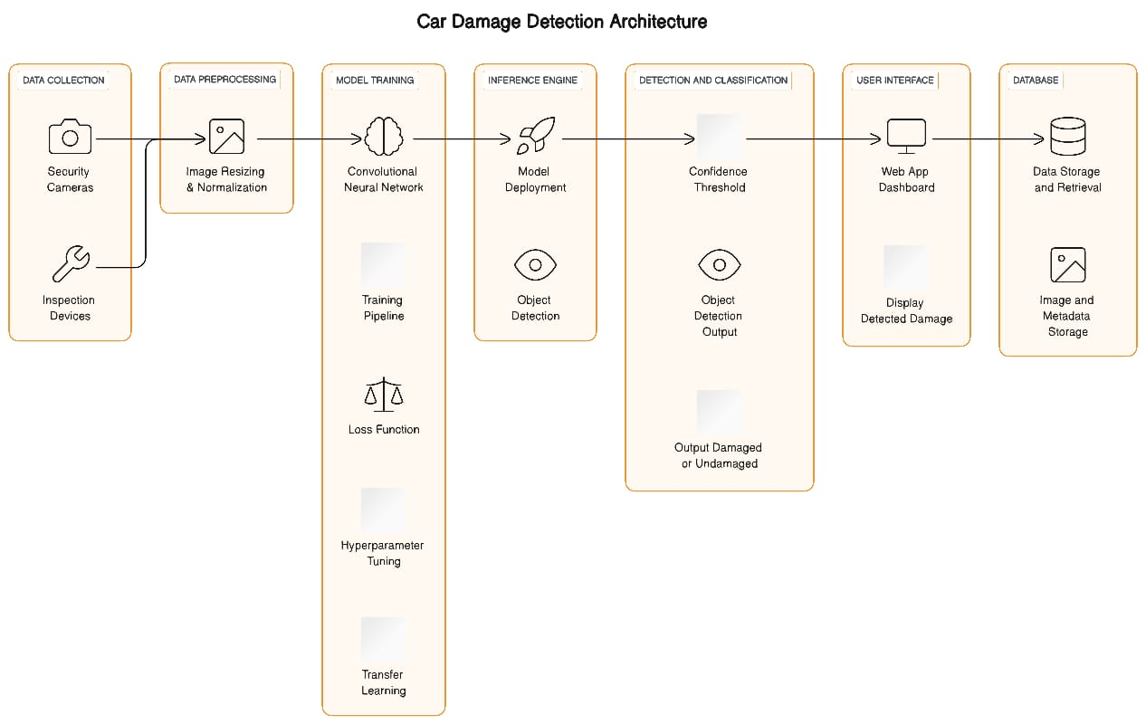
National Conference on Cognitive Computing
(NCCC-2024)
Conference Date: 15 -16 Apr,2024
System Architecture :
Figure 1: System Architecture

Slide 8
Methodology:
We begin by importing the required libraries.
Next, we preprocess our data, which includes resizing our images, one-hot encoding our labels, etc.
Model Selection: selection of computer vision model (e.g., Convolutional Neural Network, CNN) suitable for image classification or object detection tasks.
Model Training: Train the selected model using the training dataset. Fine-tune the model if needed.
Validation: Evaluation of the model's performance on the validation dataset. Adjusting hyperparameters as necessary.
Testing: Assessing the model's accuracy, precision, recall, and F1 score on the test dataset to ensure it generalizes well
User Interface: Creating a user-friendly interface for users to input images and receive damage detection results

Slide 9
National Conference on Cognitive Computing
(NCCC-2024)
Conference Date: 15 -16 Apr,2024
Algorithms:
Convolutional Neural Network (CNN)
Logistic Regression
VGG16
Layers Used:
Input Layer
Convolutional Layer
Pooling Layers
Fully Connected Layers
Output Layer

Slide 10
National Conference on Cognitive Computing
(NCCC-2024)
Conference Date: 15 -16 Apr,2024
Mathematical equations:
Overall Project Accuracy Calculation To calculate the overall accuracy of the project, we can use a weighted average approach based on the accuracies of Module 2, Module 3, and Module 4.
Weights (Assuming Equal Importance):
Module 2: Weight = 1/3 (33.33%)
Module 3: Weight = 1/3 (33.33%)
Module 4: Weight = 1/3 (33.33%)
Overall Accuracy Calculation:
=(0.33×Accuracy of Module 2)+(0.33×Accuracy of Module 3)+(0.33×Accuracy of Module 4)
Overall_Accuracy=(0.33×91%)+(0.33×65%)+(0.33×70%) Accuracy=(0.33×91)+(0.33×65)+(0.33×70)
Overall Accuracy=30.03+21.45+23.1
Overall Accuracy≈74.58%

Slide 11
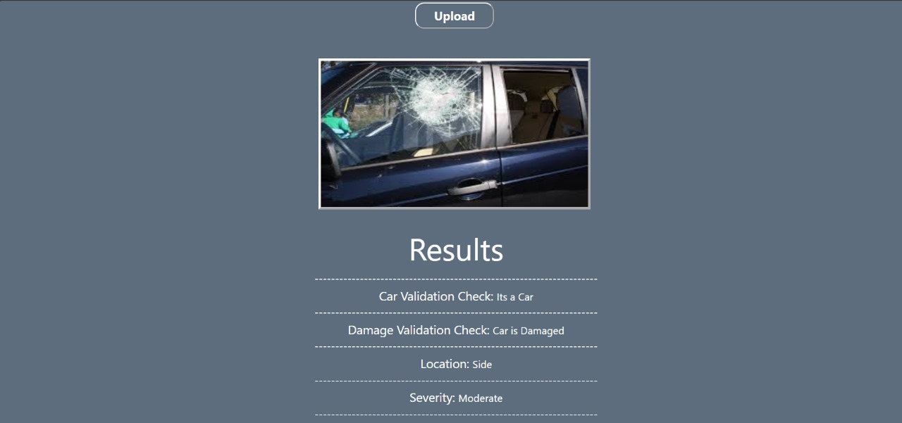
National Conference on Cognitive Computing
(NCCC-2024)
Conference Date: 15 -16 Apr,2024
Snapshot of Output:

Slide 12
National Conference on Cognitive Computing
(NCCC-2024)
Conference Date: 15 -16 Apr,2024
Result and Discussion
Module 2 (Damaged or Not)
Accuracy: 91%
Results: The model achieved an accuracy of 91% in distinguishing between damaged and undamaged cars.
Module 3 (Location)-
Accuracy: 65%
Results: The model achieved an accuracy of 65% in identifying the location of cars.
Module 4 (Severity)
Accuracy: 70%
Results: Achieved an accuracy of 70% in correctly categorizing car damage severity.
Overall Accuracy is 74.58%

Slide 13
National Conference on Cognitive Computing
(NCCC-2024)
Conference Date: 15 -16 Apr,2024
Conclusion
The Car Damage Detection project represents a significant advancement in leveraging computer vision and machine learning techniques for automating the process of car damage assessment. By combining powerful models like VGG16 and logistic regression classifiers, the system effectively identifies, evaluates, and categorizes car damage with high accuracy and reliability. Through rigorous checks and validations, the system ensures the integrity and precision of its assessments, providing users with a trustworthy tool for quickly and accurately determining the extent of damage to their vehicles. This not only saves time but also reduces the potential for human error inherent in manual inspection processes. Overall, the Car Damage Detection project represents a valuable contribution to the field of computer vision and sets the stage for future innovations in automated image-based assessments.

Slide 14
National Conference on Cognitive Computing
(NCCC-2024)
Conference Date: 15 -16 Apr,2024
References
[1] M. Chen, F. Bai and Z. Gerile, "Special Object Detection Based On Mask Rcnn," 2021 17th International Conference on Computational Intelligence and Security (CIS), 2021, pp. 128-132, doi: 10.1109/CIS54983.2021.00035.
[2] M. Ye et al., "A Lightweight Model of VGG-16 for Remote Sensing Image Classification," in IEEE Journal of Selected Topics in Applied Earth Observations and Remote Sensing, vol. 14, pp. 6916-6922, 2021, doi: 10.1109/JSTARS.2021.3090085.
[3] H. Bandi, S. Joshi, S. Bhagat and A. Deshpande, "Assessing Car Damage with Convolutional Neural Networks," 2021 International Conference on Communication information and Computing Technology (ICCICT), 2021, pp. 1-5, doi: 10.1109/ICCICT50803.2021.9510069.
[4] P. M. Kyu and K. Woraratpanya, “Car Damage Detection and Classification,” in Proceedings of the 11th International Conference on Advances in Information Technology, Bangkok Thailand, Jul. 2020, pp. 1–6, doi: 10.1145/3406601.3406651.
[5] H. Patel, “hemilpatel971/Damage-car-detection,” GitHub, Aug. 13, 2019. https://github.com/hemilpatel971/Damage-car-detection (accessed Feb. 10, 2021).

Slide 15
National Conference on Cognitive Computing
(NCCC-2024)
Conference Date: 15 -16 Apr,2024
Thank You !!

