Slide 1


Short Term Power Procurement for RE Rich Indian DISCOMS with Multi-Market Uncertainties
Bala Ganesh K, Rohit Vijay, Parul Mathuria, Rohit Bhakar
Presented By,
Bala Ganesh K
Centre for Energy and Environment
Malaviya National Institute of Technology Jaipur, Rajasthan, India
Paper Id: 145
4th International Conference on Energy, Power and Environment (ICEPE 2022)
29 Apr – 01 May, 2022
Notes:
Click to insert your subtitle

Slide 2

CONTENTS
Conclusion & Significance
Analysis - Methodology
RE Integration & Market Mechanisms
References
Indian Power Sector and DISCOMs Overview
Results and Discussion
Power Procurement – Indian Scenario

Slide 3
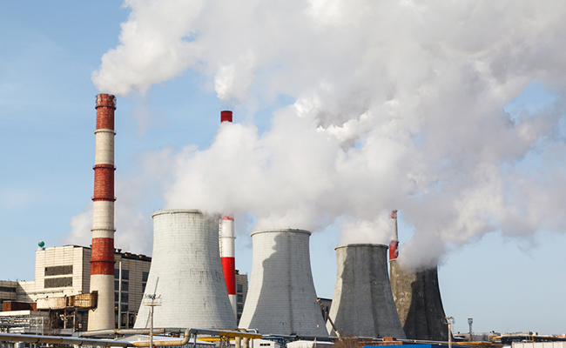
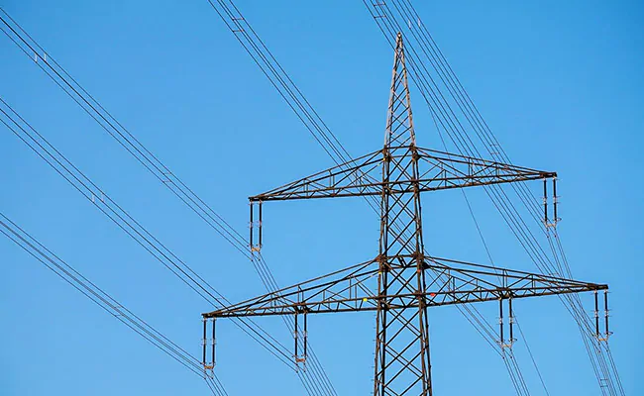
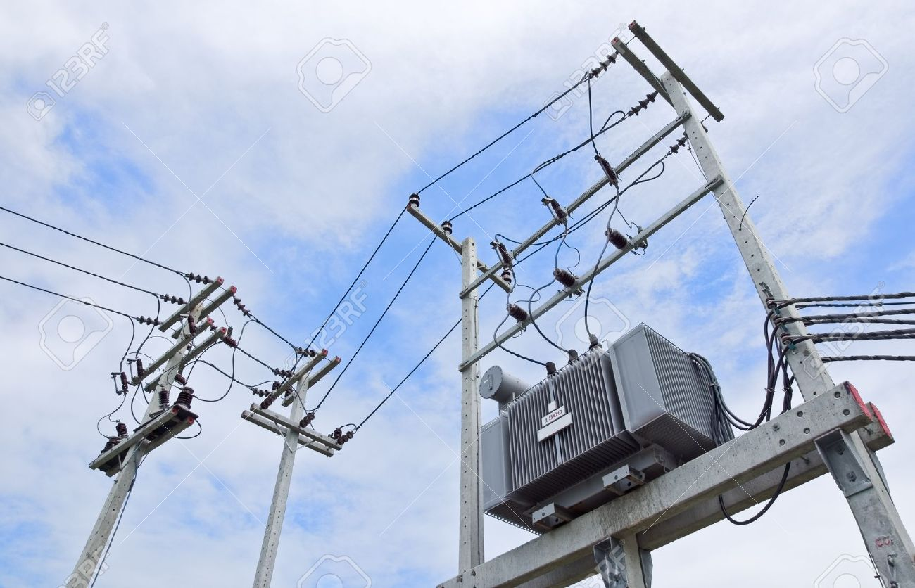
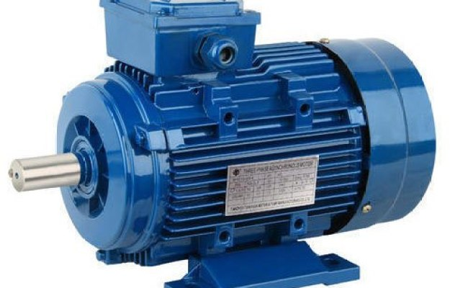




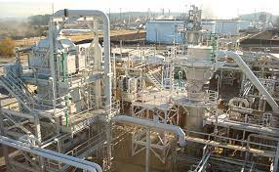

INDIAN POWER SECTOR AND DISCOMs OVERVIEW
GOVERNMENT & REGULATORS
GENERATING COMPANIES
TRANSMISSION COMPANIES
DISTRIBUTION COMPANIES
CONSUMER/LOAD
Central
State
Private (CPP/IPP)
Direct sale
PPAs with Discoms
Market sale
DAM
Open Access for large consumers
TAM
RTM
Transmission capacity & allocation priority
Transmission charges & waive off for RES
Green corridors for RES generation evacuation
Own Generation
Purchase and Sale
From Discoms
Open Access
Short Term Markets
Roof Top Solar PV
Reliability & Quality
24*7 Power for all
RPO
Cost effective power
Generation cost
Landed Cost (Evacuation)
ARR for DISCOMs
Consumer bill
Financial Constraints and Factors for DISCOMs
High Subsidies without financial back up from State Govt.
Non Liquidation of Regulatory Assets
High Aggregate Technical and Commercial Loss
Customers opting Open Access & Behind The Meter generation
Levelized Cost Of Electricity
Aggregate Revenue Requirement (ARR)
Per unit cost of electricity
^{[1], [2], [3], [4]}

Slide 4
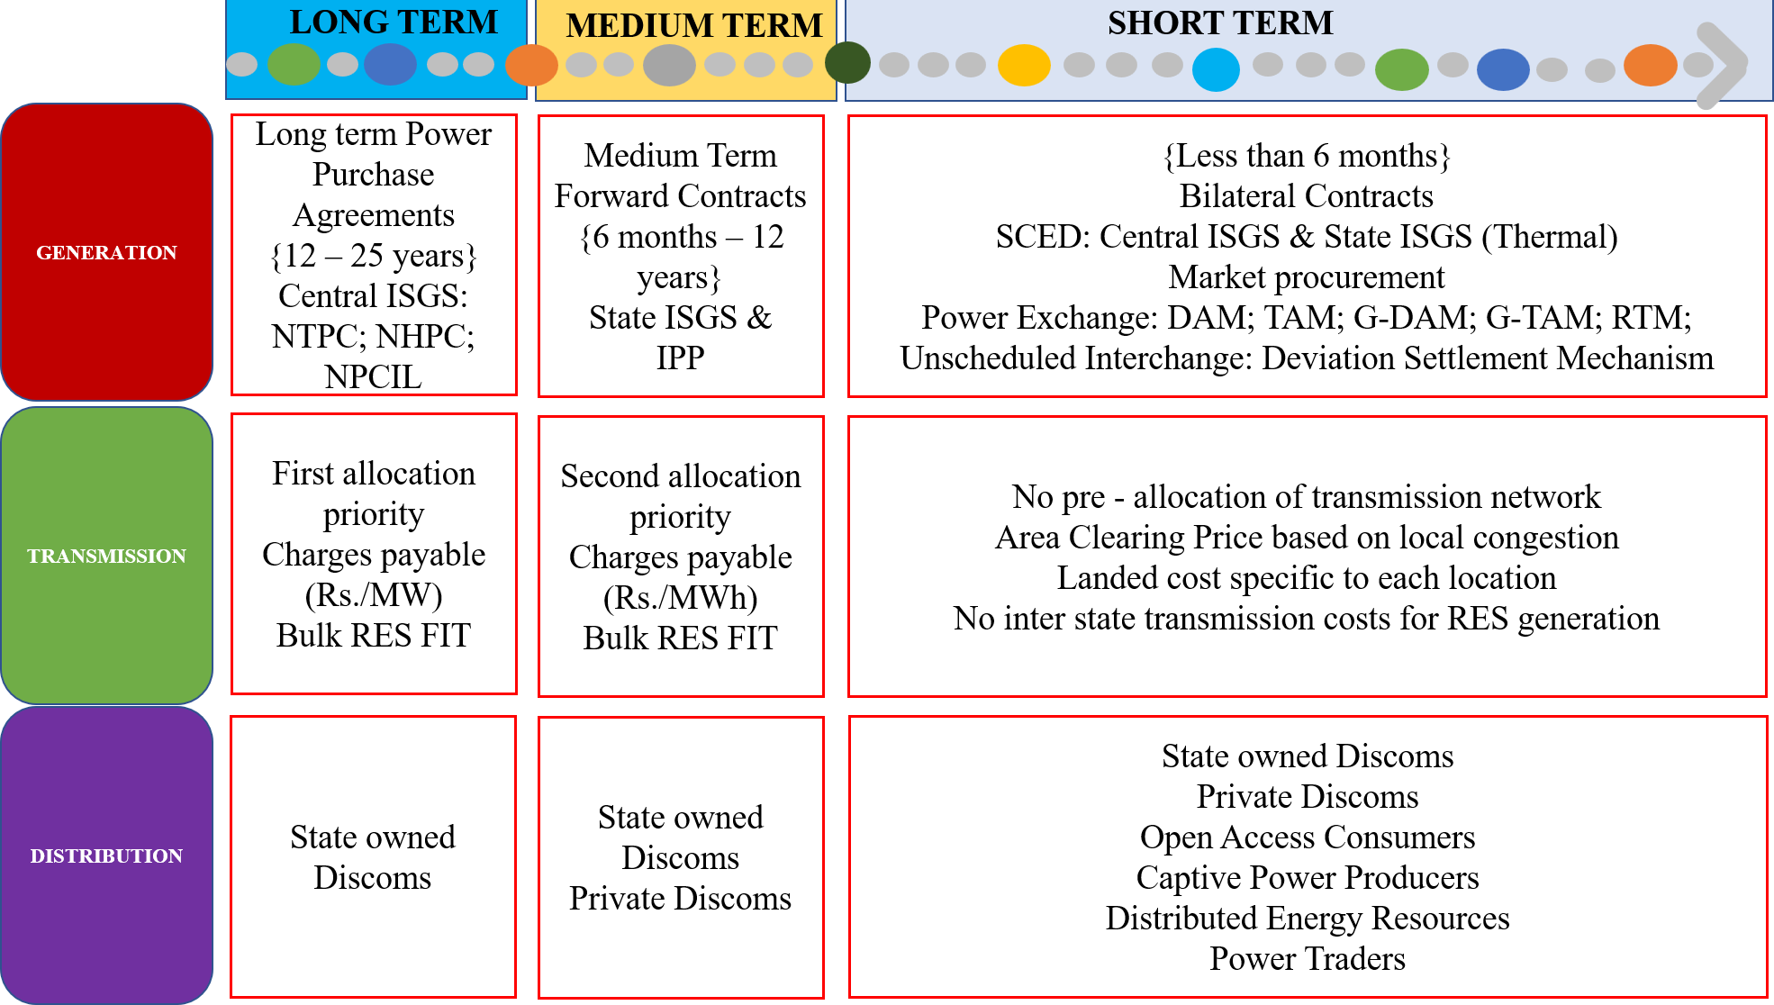
POWER PROCUREMENT – INDIAN SCENARIO
POWER PROCUREMENT EVOLUTION [2], [4], [5]
[6], [7], [8], [10], [14], [18]
ISGS (Central Thermal, Central Nuclear & Other Thermal)
Renewable (Wind, Biomass, Bagasse & Solar) & Traders
Market Procurement (Bilateral Contracts, DAM, RTM)
State (Thermal, Hydro & Gas) & Long Term PPAs
Behind the Meter Generation (PROSUMERS)

Slide 5
RENEWABLE ENERGY INTEGRATION & MARKET MECHANISMS
WIND ENERGY
SOLAR ENERGY
HYDRO ENERGY
POWER EXCHANGES
[5], [10], [11], [12]
DAM
TAM
RTM
RECM
G-DAM
G-TAM
Load & load duration profile
Long & medium term contracts
Energy Market contracts
Share of RES (FIT & RPO)
Own generation (conventional plants)
Intra and Inter State Transmission networks
Optimum Generation Mix
Transmission capacity addition
Consumer Financial benefits
Gap between ACS-ARR
FACTORS
Demand & Generation Estimation
[3], [6], [16], [17]
Submission of Buy or Sell Bids
Market Clearing Price Estimation
Area Clearing Price Estimation
IMPACTS
Power Delivery and Settlement

Slide 6
ANALYSIS - METHODOLOGY
Demand Data & Renewable Generation → Input to model
GAMS Model → Cost optimization & Risk Analysis
API Software → GUI development (FUTURE SCOPE)
Mathematical Model → Constraints & Power Balance
Input from MS Excel
Conventional Generation details
Daily Load demand
RES Generation data
(Solar & Wind)
DSM rate based on system frequency
Market Details
{DAM RTM REC}
MERIT order dispatch
(energy cost)
SIMPLE COST OPTIMIZATION
Preliminary Economic Dispatch
Economic Dispatch with PV & Wind
COST OPTIMIZATION WITH MARKET INTEGRATION
Market procurement (DAM, RTM, G-DAM)
DSM & RPO Constraints
Risk analysis of Uncertainty in MCP

Slide 7
RESULTS AND DISCUSSION
TAMIL NADU – HIGH RE SCENARIO (JULY) – LOW RISK
TAMIL NADU – HIGH RE SCENARIO (JULY) – HIGH RISK
DSM
STM
GAS
RENEWABLES
CONTRACTS
NUCLEAR
THERMAL

Slide 8
RESULTS AND DISCUSSION
TAMIL NADU – LOW RE SCENARIO (NOVEMBER)
TAMIL NADU – HIGH RE SCENARIO
DSM
STM
RENEWABLES
TAMIL NADU – LOW RE SCENARIO
CONTRACTS
NUCLEAR
THERMAL

Slide 9
CONCLUSION & SIGNIFICANCE
TAMIL NADU
(HIGH WIND)
UTTAR PRADESH
( HIGH MARKET PROCUREMENT)
NEW DELHI
(HIGH DEMAND WITH VERY LOW RES)
RAJASTHAN
(HIGH SOLAR)
FUTURE SCOPE & SIGNIFICANCE
Long Term Impacts
Operational reliability
Inertia availability for frequency response
Long term policy framework
Procurement Portfolio design
Short Term Impacts
Real power balancing
Increased Reserve requirement
RE curtailment minimization
Scheduling of conventional power plants
TECHNICAL
Reserve Requirements
Ramping Needs & Transmission Congestion
FINANCIAL
RPO, RGO & DSM
Tariff Philosophy, Green Energy Markets
POLICY AND REGULATION
INFRASTRUCTURE
Uncertainty of Market Clearing Price
ACS – ARR of DISCOMs
Capacity Addition & Storage Requirements
Metering & ICT Requirements
Short Term Power Procurement Tool for DISCOMs

Slide 10

KEY REFERENCES
[1] “India 2020 – Energy policy review,” IEA., France., Tech. Rep., Jan.2020
[2] “Renewables integration in India,” NITI Aayog., New Delhi., India., IEA., Paris., France., Tech. Rep., Apr. 2021
[3] “Monthly report on short-term transactions of electricity in India,” Economics Division CERC., New Delhi., India., Tech. Rep., Mar. 2021
[4] P. Regy, R. Sarwal, C. Stranger, G. Fitzgerald, J. Ningthoujam, A. Gupta, N. Singh., “Turning around the Power distribution sector, learnings and best
practices from reforms,” NITI Aayog., New Delhi., India., RMI India., New Delhi., India., Tech. Rep., Aug. 2021
[5] A. Rose, I. Chernyakhovskiy, D. Palchak, M. Schwarz, S. Koebrich, M. Joshi., “Pathways for Tamil Nadu's electric power sector: 2020 – 2030, ” NREL.,
Tech. Rep. Jan. 2021
[6] P. Mishra, “Overview of the power sector,” PRS., Sept. 2019
[7] “Rethinking DISCOM resource planning in renewable energy rich environment,” USAID., USA., MNRE., India., 2019
[8] “19th EPS of India,” CEA., New Delhi.,India., Tech. Rep., 2017
[9] “Determination of tariff for generation and distribution,” TNERC., Chennai, India., Order in T.P. No.1of 2017
[10] P. Sharma, U. Brighu, R. Bhakar, P. Mathuria., “Risk constrained short term electricity procurement for open access consumer in India,” IEEE., 2016
[11] C.K Simoglou, P.N Biskas, I.G Marneris, C.G Roumkos, “Long-term electricity procurement portfolio optimization,” Electric Power Systems Research,
vol. 202, Jan. 2021
[12] “Power for All – TN document, ” A joint venture of Govt. of India and Govt. of TN., 2016
[13] Ministry of Power., Govt. of India., accessed: 02 Nov. 2021 < https://powermin.gov.in/ >
[14] MERIT Order Dispatch of Electricity for Rejuvenation of Income and Transparency, Govt. of India., accessed: 02 Nov. 2021 < https://meritindia.in/ >
[15] “Central Electricity Regulatory Commission., accessed: 02 Nov. 2021 < https://cercind.gov.in/>
[16] Indian Energy Exchange., accessed: 02 Nov. 2021 <https://www.iexindia.com/>
[17] “Daily state load dispatch centre report,”., TANTRANSCO, Chennai. Renewables.Ninja., accessed: 02 Nov. 2021 <https://www.renewables.ninja/>
[18] “Central Electricity Regulatory Commission., accessed: 02 Nov. 2021 < https://cercind.gov.in/>
QUESTIONS?

Slide 11
MATHEMATICAL MODEL
Objective Function
Final cost, C_{FINAL} = C_{TOTAL} + [α*Risk]
where,
C_{FINAL} → Total cost incurred to DISCOM at various levels of risk taking scenario with market clearing price uncertainty
C_{TOTAL} → Cost of procuring power at maximum risk of market clearing price uncertainty
Risk → Uncertainty in market clearing prices of DAM, RTM and DSM price based on real time grid frequency
α →Risk weighing factor, which when increases indicates lesser willingness to take risk
Procurement Cost modelling
Total cost, C_{TOTAL} = C_{C} + C_{H} + C_{LS} + C_{DSM} + C_{PX} + C_{DAM} + C_{RTM} + C_{G_DAM} + C_{S_REC} + C_{NS_REC}
where,
C_{C} → Conventional generation cost C_{DAM} → Cost of procurement from DAM
C_{H} → Hydro generation cost C_{RTM} → Cost of procurement from RTM
C_{LS} → Penalty cost for Load Shedding C_{G_DAM} → Cost of procurement from G_DAM
C_{DSM} → Cost for deviation from schedule C_{S_REC} → Cost of procuring Solar REC
C_{PX} → TAM contracts procurement cost C_{NS_REC} → Cost of procuring Non Solar REC
11

Slide 12
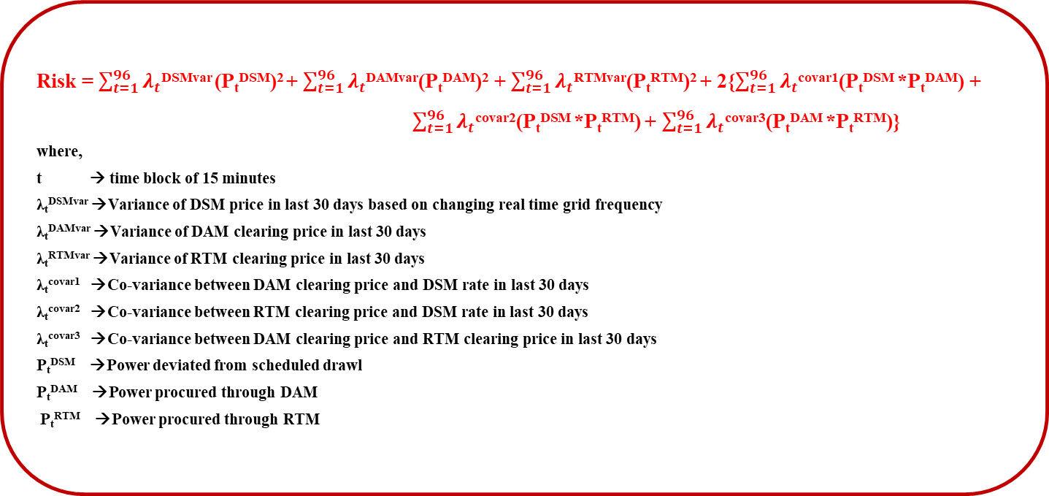
MATHEMATICAL MODEL
Risk modelling of uncertainties in price [27]
Risk = $\sum_{t=1}^{96}{λ_{t}}$^{DSMvar} (P_{t}^{DSM})² + $\sum_{t=1}^{96}{λ_{t}}$^{DAMvar}(P_{t}^{DAM})² + $\sum_{t=1}^{96}{λ_{t}}$^{RTMvar}(P_{t}^{RTM})² + 2{$\sum_{t=1}^{96}{λ_{t}}$^{covar1}(P_{t}^{DSM} *P_{t}^{DAM}) +
$\sum_{t=1}^{96}{λ_{t}}$^{covar2}(P_{t}^{DSM} *P_{t}^{RTM}) + $\sum_{t=1}^{96}{λ_{t}}$^{covar3}(P_{t}^{DAM} *P_{t}^{RTM})}
where,
t → time block of 15 minutes
λ_{t}^{DSMvar} →Variance of DSM price in last 30 days based on changing real time grid frequency
λ_{t}^{DAMvar} →Variance of DAM clearing price in last 30 days
λ_{t}^{RTMvar} →Variance of RTM clearing price in last 30 days
λ_{t}^{covar1} →Co-variance between DAM clearing price and DSM rate in last 30 days
λ_{t}^{covar2} →Co-variance between RTM clearing price and DSM rate in last 30 days
λ_{t}^{covar3} →Co-variance between DAM clearing price and RTM clearing price in last 30 days
P_{t}^{DSM} →Power deviated from scheduled drawl
P_{t}^{DAM} →Power procured through DAM
P_{t}^{RTM} →Power procured through RTM
12

Slide 13
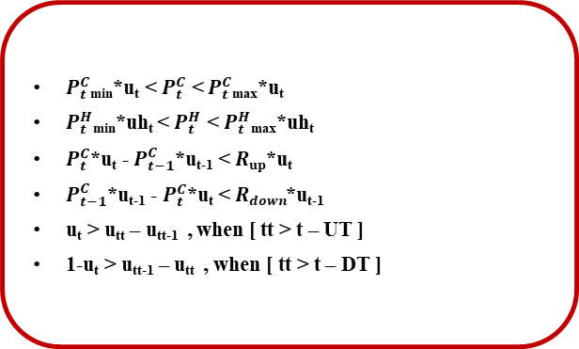
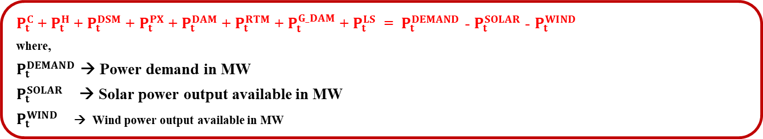
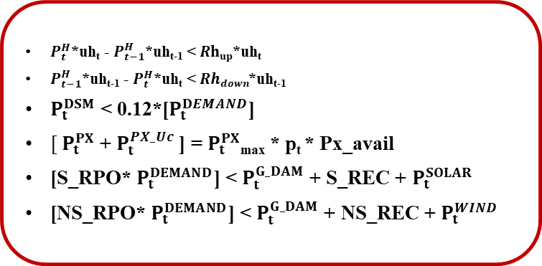
MATHEMATICAL MODEL
Power balance
$P_{t}^{C}$ + $P_{t}^{H}$ + $P_{t}^{DSM}$ + $P_{t}^{PX}$ + $P_{t}^{DAM}$ + $P_{t}^{RTM}$ + $P_{t}^{G_DAM}$ + $P_{t}^{LS}$ = $P_{t}^{DEMAND}$ - $P_{t}^{SOLAR}$ - $P_{t}^{WIND}$
where,
$P_{t}^{DEMAND}$ → Power demand in MW
$P_{t}^{SOLAR}$ → Solar power output available in MW
$P_{t}^{WIND}$ → Wind power output available in MW
Constraints
$P_{t}^{C}$_{min}*u_{t} < $P_{t}^{C}$ < $P_{t}^{C}$_{max}*u_{t}
$P_{t}^{H}$_{min}*uh_{t} < $P_{t}^{H}$ < $P_{t}^{H}$_{max}*uh_{t}
$P_{t}^{C}$*u_{t} - $P_{t−1}^{C}$*u_{t-1} < $Rup$*u_{t}
$P_{t−1}^{C}$*u_{t-1} - $P_{t}^{C}$*u_{t} < $Rdown$*u_{t-1}
u_{t} > u_{tt} – u_{tt-1} , when [ tt > t – UT ]
1-u_{t} > u_{tt-1} – u_{tt} , when [ tt > t – DT ]
$P_{t}^{H}$*uh_{t} - $P_{t−1}^{H}$*uh_{t-1} < $Rhup$*uh_{t}
$P_{t−1}^{H}$*uh_{t-1} - $P_{t}^{H}$*uh_{t} < $Rhdown$*uh_{t-1}
$P_{t}^{DSM}$ < 0.12*[$P_{t}^{DEMAND}$]
$[ P_{t}^{PX}$ + $P_{t}^{PX_Uc}$] = $P_{t}^{PX}$_{max} * p_{t} * Px_avail
[S_RPO* $P_{t}^{DEMAND}$] < $P_{t}^{G_DAM}$ + S_REC + $P_{t}^{SOLAR}$
[NS_RPO* $P_{t}^{DEMAND}$] < $P_{t}^{G_DAM}$ + NS_REC + $P_{t}^{WIND}$
13

