Slide 1
LOAD AND DEMAND FORECASTING

Slide 2
Table of Contents
Electric Load Forecasting
Load Forecasting Categories and Classifications
Duration based Forecasting
Simple and Advanced Techniques
End Use Method
Econometric Approach
Input Output Model
Scenario based Approach
ANN based Approach
Hybrid Approach
Energy Demand Analysis

Slide 3
Electric Load Forecasting
Smart Grid, EVs and RES integration with increasing population and living standards improvement
Demand pattern is complex due to the deregulation of markets
Electricity is a clean, efficient source of energy suitable for environment-friendly society
Has different characteristics compared to material products like cannot be stored in bulk
Accuracy of forecasting is important to save O&M costs and make correct decisions for future development of grid
Factors affecting Accuracy
Weather
Time
Economy
Random disturbances
Consumer practices
Climate Change
Electricity Load Forecasting
Capacity Scheduling
Power Systems Management
Economic development
National Security
Daily Operation of society

Slide 4
Load Forecasting Categories and Classifications
Load forecasting is divided in terms of the prediction duration into three categories as
Short-Term Forecasts
Medium-Term Forecasts and
Long-Term Forecasts
Sometimes as four groups
Long-Term Forecasts (1-20 years)
Medium-Term Forecasts (1 week to 1 year)
Short-Term Forecasts (1 hour to 1 week) and
Very Short-Term Forecasts (Few mins to 1 hour)
Long-term load forecasting (LTLF) is fundamental for strategic planning, construction of new generations, and develops the power supply and delivery system (generation units, transmission system, and distribution system)
Medium-term load forecasting (MTLF) is used for maintenance scheduling, planning fuel purchases, energy trading and revenue assessment for the utilities.

Slide 5
Short-term load forecasting (STLF) is very important for day-to-day operations of a utility, schedule the generation and transmission of electricity.
Very short-term load forecasting (VSTLF) is used for real-time control
Regression analysis is still widely used and efficient for long-term forecasting.
For short-term predictions, machine learning or artificial intelligence-based models like
Artificial Neural Networks (ANN),
Support Vector Machines (SVM), and
Fuzzy logic
Electric load forecasting models can be divided into two types
multi-factor forecasting methods and
time series forecasting methods
Multi-factor/cross-sectional forecasting method focuses on the search of the causal relationships between different influencing factors and forecasting values
Time series forecasting method is depending more on the historical series
Time series forecasting method is used to forecast electric load since it is easier and quicker which also avoids the complicated and non-objective factors
Time series forecasting models can be divided into three subcategories
statistical models
machine learning models and
hybrid models

Slide 6
Duration based Forecasting
Medium/Long-term Load Forecasting Methods
End-use approach and
Econometric approach
End-use Approach
Directly estimates energy consumption by using extensive information on end use and end users, such as appliances, the customer use, their age, sizes of houses, and so on
Focus on the various uses of electricity in the residential, commercial, and industrial sector
Based on the principle that electricity demand is derived from customer's demand for light, cooling, heating, refrigeration, etc.
Explain energy demand as a function of the number of appliances in the market
Econometric Approach
Combines economic theory and statistical techniques for forecasting electricity demand
Estimates relationships between energy consumption (dependent variables) and factors influencing consumption

Slide 7
Short–term Forecasting Methods
Similar day approach
Regression models
Time series models
Neural networks
Expert systems
Fuzzy logic and
Statistical learning algorithms
Similar-day Approach
Based on searching historical data for days within one, two, or three years with similar characteristics to the forecast day
Similar characteristics include weather, day of the week, and the date
Regression Methods
Most widely used statistical technique
Used to model the relationship of load consumption and other factors such as weather, day type, and customer class
Time Series models
Used in fields of economics, digital signal processing, as well as electric load forecasting
ARMA (autoregressive moving average), ARIMA (autoregressive integrated moving average), ARMAX (autoregressive moving average with exogenous variables), and ARIMAX (auto regressive integrated moving average with exogenous variables) are the most often used classical time series methods

Slide 8
Neural Networks
Non-linear circuits that have the demonstrated capability to do some linear or nonlinear mathematical function of its inputs
Inputs may be the outputs of other network elements as well as actual network inputs
Network elements are arranged in a relatively small number of connected layers of elements between network inputs and outputs
Feedback paths are sometimes used
Should select type of architectures (e.g. Hopfield, back propagation, Boltzmann machine), the number and connectivity of layers and elements, use of bi-directional or unidirectional links, and the number format (e.g. binary or continuous) to be used by inputs and outputs, and internally
Most popular ANN architecture for electric load forecasting is back propagation
Fuzzy Logic
A generalization of the usual Boolean logic used for digital circuit design
Under fuzzy logic an input has associated with it a certain qualitative ranges
Fuzzy logic allows to deduce outputs from fuzzy inputs
Technique for mapping inputs to outputs
Absence of a need for a mathematical model mapping inputs to outputs and the absence of a need for precise or even noise free inputs
Expert Systems
Applies rules which have been generated by experts in the field
Procedures and rules are transformed into software, which can automatically make forecasts about electricity demand
For the software to be efficient, expert forecasters will have to work hand in hand with software developers to include all expert information into the software
Software developers will be involved in coding all the information obtained from experts in forming software rules
Fast, accurate and easy to use as it involves the use of software applications, which usually run at the click of a button

Slide 9
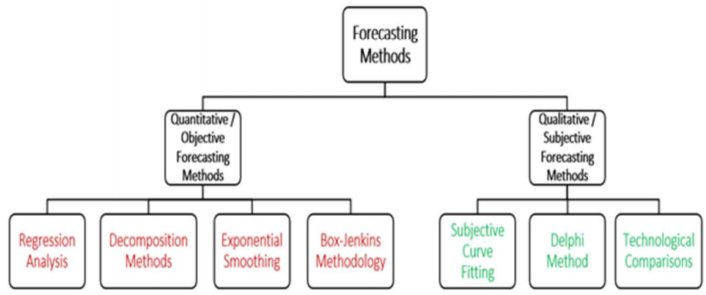
Major Types of Basic Forecasting Methods

Slide 10
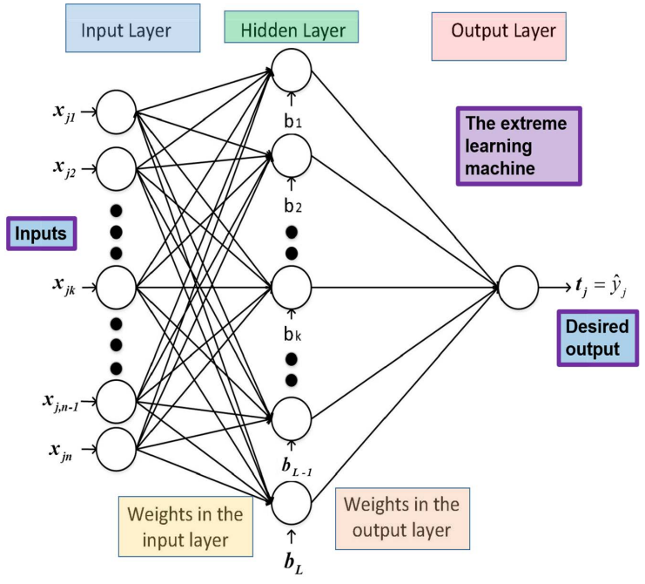
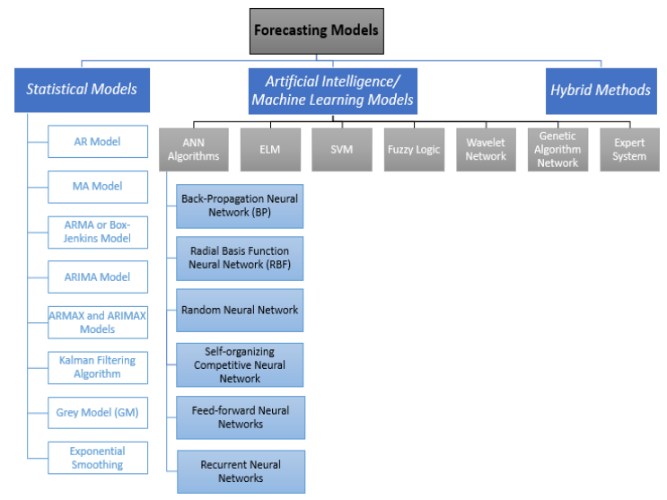

Slide 11
Simple and Advanced Techniques
Traditional/Simple forecasting techniques
• Regression approach
• Multiple regression
• Exponential smoothing
• Iterative reweighted least-squares
• Stochastic time series
Modern/Advanced forecasting techniques
• Artificial Neural Networks (ANN)
• Rule based expert system
• Fuzzy Logic system
• Support vector machine
• Genetic Algorithm
• Particle Swarm Optimization (PSO) Algorithm

Slide 12
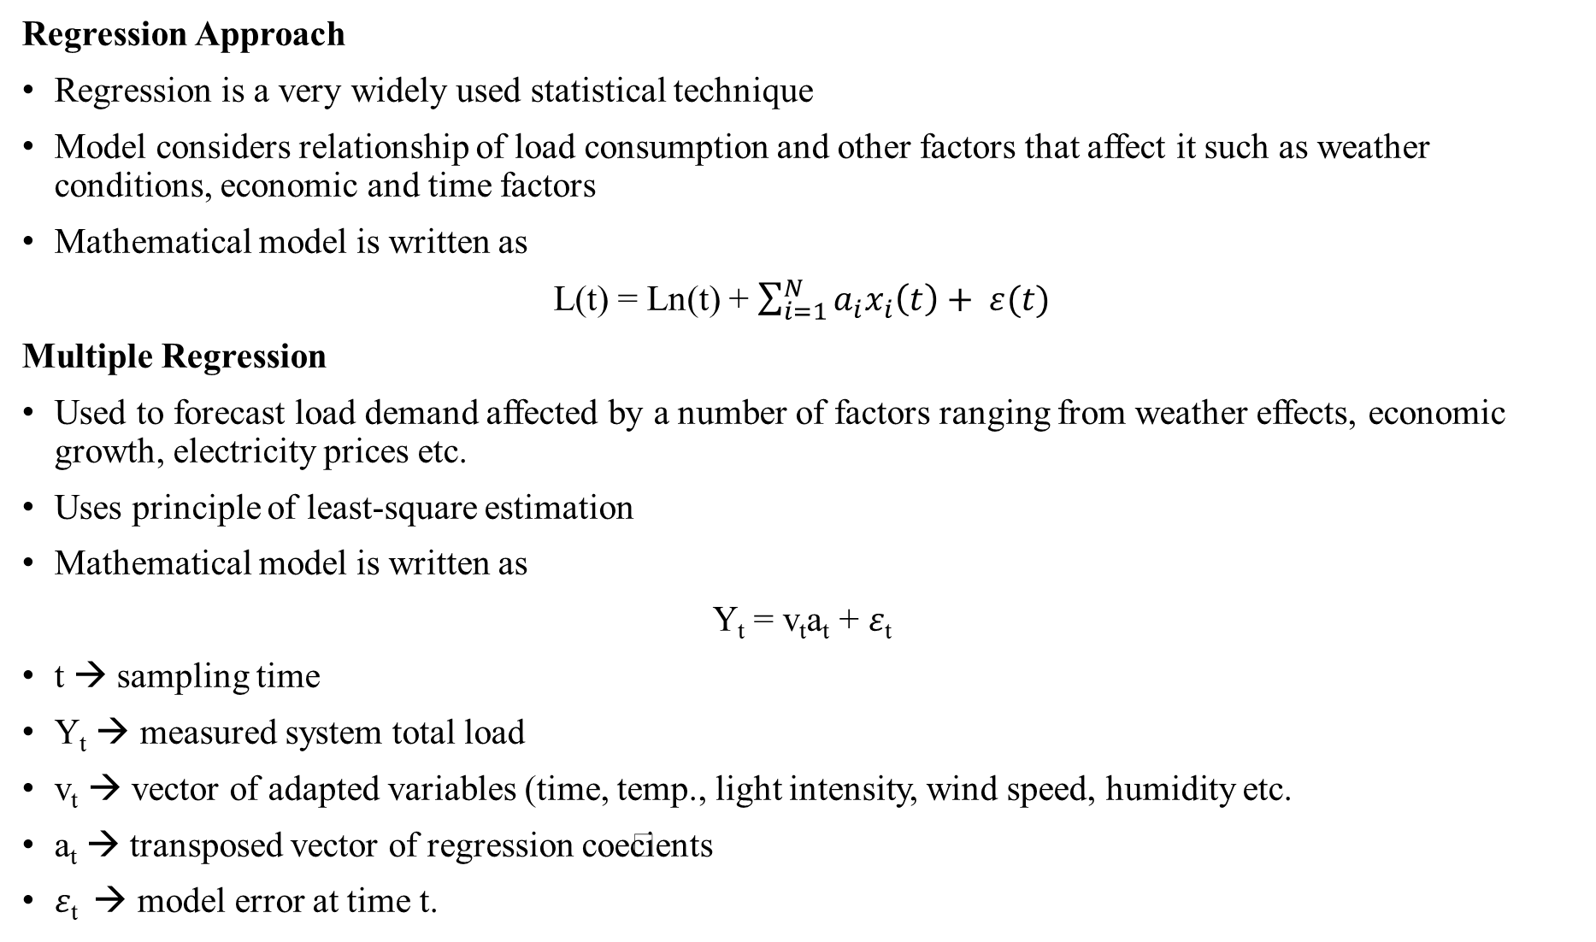
Regression Approach
Regression is a very widely used statistical technique
Model considers relationship of load consumption and other factors that affect it such as weather conditions, economic and time factors
Mathematical model is written as
L(t) = Ln(t) + $\sum_{i=1}^{N}{a_{i}x_{i}\left(t\right)+ ε(t)}$
Multiple Regression
Used to forecast load demand affected by a number of factors ranging from weather effects, economic growth, electricity prices etc.
Uses principle of least-square estimation
Mathematical model is written as
Y_{t} = v_{t}a_{t} + $ε$_{t}
t → sampling time
Y_{t} → measured system total load
v_{t} → vector of adapted variables (time, temp., light intensity, wind speed, humidity etc.
a_{t} → transposed vector of regression coecients
$ε$_{t} → model error at time t.

Slide 13
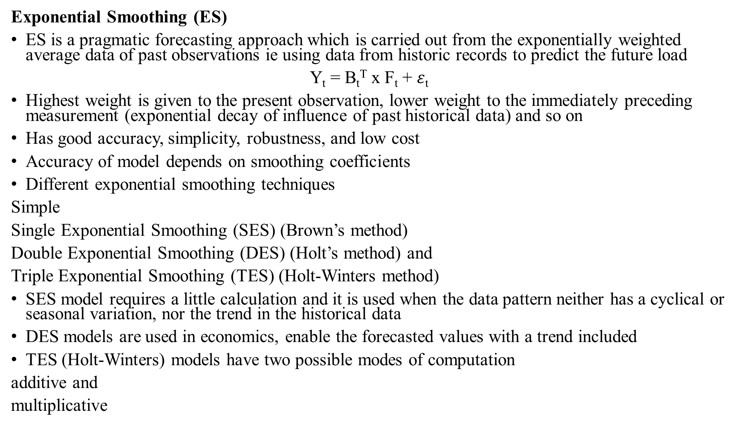
Exponential Smoothing (ES)
ES is a pragmatic forecasting approach which is carried out from the exponentially weighted average data of past observations ie using data from historic records to predict the future load
Y_{t} = B_{t}^{T} x F_{t} + $ε$_{t}
Highest weight is given to the present observation, lower weight to the immediately preceding measurement (exponential decay of influence of past historical data) and so on
Has good accuracy, simplicity, robustness, and low cost
Accuracy of model depends on smoothing coefficients
Different exponential smoothing techniques
Simple
Single Exponential Smoothing (SES) (Brown’s method)
Double Exponential Smoothing (DES) (Holt’s method) and
Triple Exponential Smoothing (TES) (Holt-Winters method)
SES model requires a little calculation and it is used when the data pattern neither has a cyclical or seasonal variation, nor the trend in the historical data
DES models are used in economics, enable the forecasted values with a trend included
TES (Holt-Winters) models have two possible modes of computation
additive and
multiplicative

Slide 14
Additive model is used if the original data are showing stable seasonal fluctuations
Multiplicative models are used when the original data are reflecting the significant variations of the seasonal fluctuations
Basic Holt-Winters method tends to produce over forecasts or under-forecasts, particularly for the longer forecasting horizons
A new parameter φ associated with the trend component which dampens the trend to a flat line when the future becomes more distant
Holt-Winters Damped Additive model is given in the following form, including the four parameters α, β, γ and φ
Level l(t) = α.( y(t)-s(t-m) ) + (1- α).[ l(t-1) + ϕ.b(t-1) ]
Growth b(t) = β.[ l(t)-l(t-1) ] + (1-β).ϕ.b(t-1)
Seasonality s(t) = γ.( y(t)-l(t-1) - ϕ.b(t-1) ) + (1-γ).s(t-m)
Forecast ŷ(t+h|t) = l(t) + ϕ_{h}.b(t) + s(t-m+h_{m}⁺)
where ϕ_{h} = ϕ + ϕ² + … + ϕ^{h}
h_{m}⁺ = [ (h-1)mod m ] + 1
m → no. of seasons | year
h → time points of the future horizon
y → observed time series

Slide 15
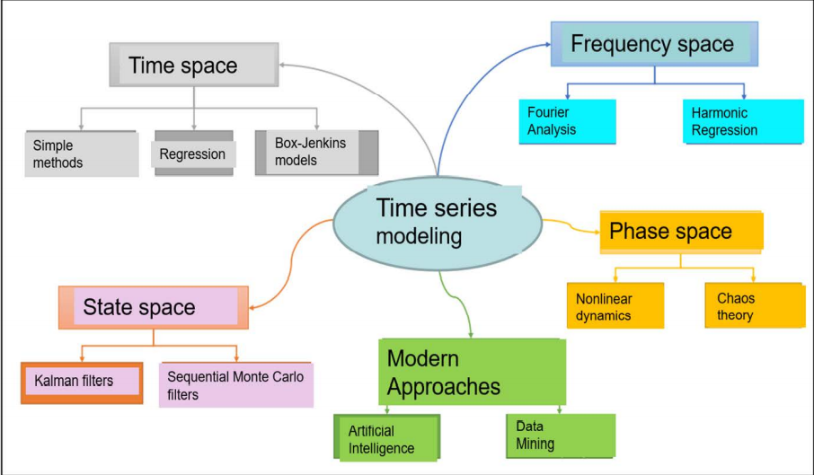
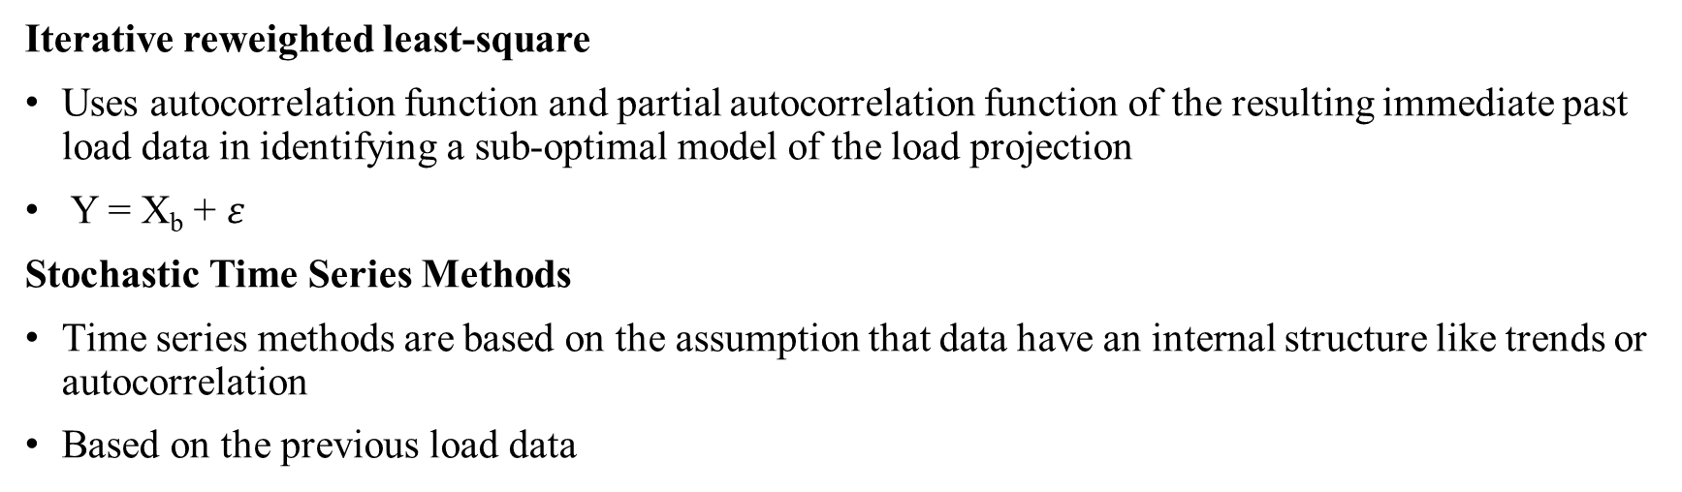
Iterative reweighted least-square
Uses autocorrelation function and partial autocorrelation function of the resulting immediate past load data in identifying a sub-optimal model of the load projection
Y = X_{b} + $ε$
Stochastic Time Series Methods
Time series methods are based on the assumption that data have an internal structure like trends or autocorrelation
Based on the previous load data

Slide 16
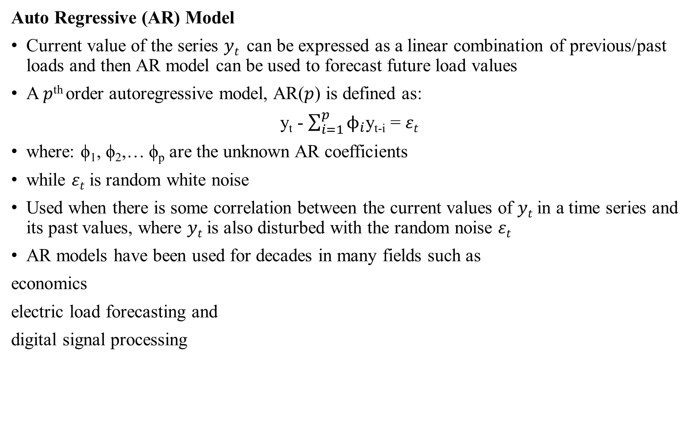
Auto Regressive (AR) Model
Current value of the series 𝑦_{𝑡} can be expressed as a linear combination of previous/past loads and then AR model can be used to forecast future load values
A 𝑝^{th} order autoregressive model, AR(𝑝) is defined as:
y_{t} - $\sum_{i=1}^{p}{ϕ_{i}}$y_{t-i} = 𝜀_{𝑡}
where: ϕ₁, ϕ₂,… ϕ_{p} are the unknown AR coefficients
while 𝜀_{𝑡} is random white noise
Used when there is some correlation between the current values of 𝑦_{𝑡} in a time series and its past values, where 𝑦_{𝑡} is also disturbed with the random noise 𝜀_{𝑡}
AR models have been used for decades in many fields such as
economics
electric load forecasting and
digital signal processing

Slide 17
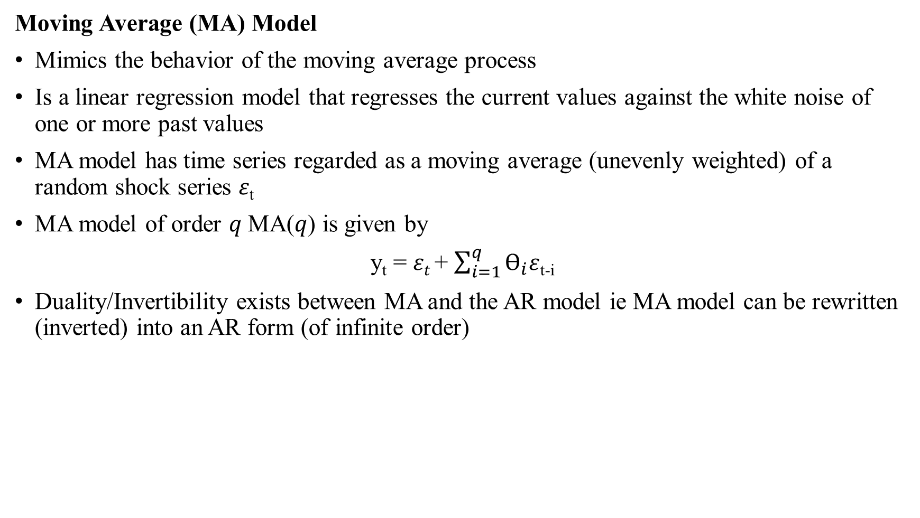
Moving Average (MA) Model
Mimics the behavior of the moving average process
Is a linear regression model that regresses the current values against the white noise of one or more past values
MA model has time series regarded as a moving average (unevenly weighted) of a random shock series 𝜀_{t}
MA model of order 𝑞 MA(𝑞) is given by
y_{t} = 𝜀_{𝑡} + $\sum_{i=1}^{q}{Ɵ_{i}\text{ε}}$_{t-i}
Duality/Invertibility exists between MA and the AR model ie MA model can be rewritten (inverted) into an AR form (of infinite order)

Slide 18
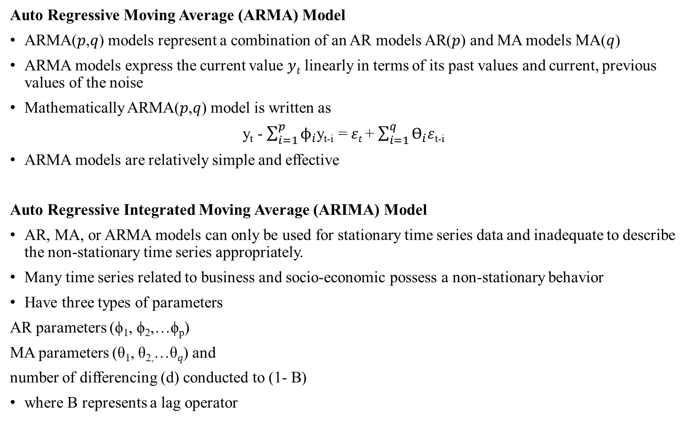
Auto Regressive Moving Average (ARMA) Model
ARMA(𝑝,𝑞) models represent a combination of an AR models AR(𝑝) and MA models MA(𝑞)
ARMA models express the current value 𝑦_{𝑡} linearly in terms of its past values and current, previous values of the noise
Mathematically ARMA(𝑝,𝑞) model is written as
y_{t} - $\sum_{i=1}^{p}{ϕ_{i}}$y_{t-i} = 𝜀_{𝑡} + $\sum_{i=1}^{q}{Ɵ_{i}\text{ε}}$_{t-i}
ARMA models are relatively simple and effective
Auto Regressive Integrated Moving Average (ARIMA) Model
AR, MA, or ARMA models can only be used for stationary time series data and inadequate to describe the non-stationary time series appropriately.
Many time series related to business and socio-economic possess a non-stationary behavior
Have three types of parameters
AR parameters (ϕ₁, ϕ₂,…ϕ_{p})
MA parameters (θ₁, θ_{2,}…θ_{𝑞}) and
number of differencing (d) conducted to (1- B)
where B represents a lag operator

Slide 19
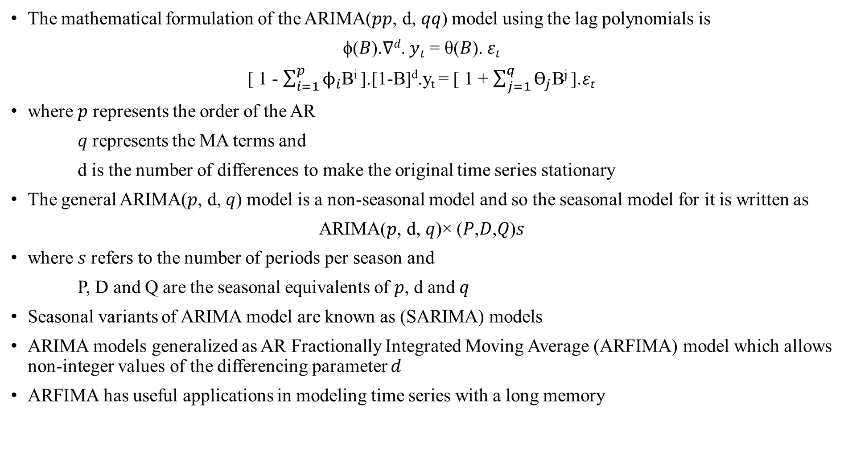
The mathematical formulation of the ARIMA(𝑝𝑝, d, 𝑞𝑞) model using the lag polynomials is
ϕ(𝐵).∇^{𝑑}. 𝑦_{𝑡} = θ(𝐵). 𝜀_{𝑡}
[ 1 - $\sum_{i=1}^{p}{ϕ_{i}}$B^{i} ].[1-B]^{d}.y_{t} = [ 1 + $\sum_{j=1}^{q}{Ɵ_{j}}$B^{j} ].𝜀_{𝑡}
where 𝑝 represents the order of the AR
𝑞 represents the MA terms and
d is the number of differences to make the original time series stationary
The general ARIMA(𝑝, d, 𝑞) model is a non-seasonal model and so the seasonal model for it is written as
ARIMA(𝑝, d, 𝑞)× (𝑃,𝐷,𝑄)𝑠
where 𝑠 refers to the number of periods per season and
P, D and Q are the seasonal equivalents of 𝑝, d and 𝑞
Seasonal variants of ARIMA model are known as (SARIMA) models
ARIMA models generalized as AR Fractionally Integrated Moving Average (ARFIMA) model which allows non-integer values of the differencing parameter 𝑑
ARFIMA has useful applications in modeling time series with a long memory

Slide 20
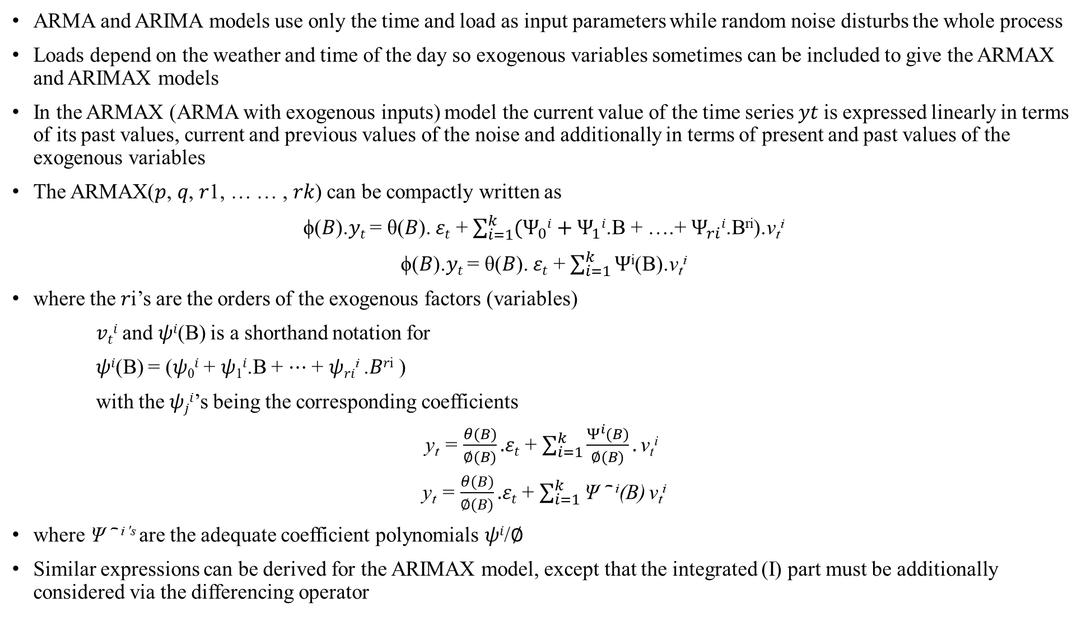
ARMAX and ARIMAX Models
ARMA and ARIMA models use only the time and load as input parameters while random noise disturbs the whole process
Loads depend on the weather and time of the day so exogenous variables sometimes can be included to give the ARMAX and ARIMAX models
In the ARMAX (ARMA with exogenous inputs) model the current value of the time series 𝑦𝑡 is expressed linearly in terms of its past values, current and previous values of the noise and additionally in terms of present and past values of the exogenous variables
The ARMAX(𝑝, 𝑞, 𝑟1, … … , 𝑟𝑘) can be compactly written as
ϕ(𝐵).𝑦_{𝑡} = θ(𝐵). 𝜀_{𝑡} + $\sum_{i=1}^{k}{{(Ψ}_{0}i}+Ψ_{1}i$.B + ….+ $Ψ_{ri}i$.B^{ri}).v_{t}^{i}
ϕ(𝐵).𝑦_{𝑡} = θ(𝐵). 𝜀_{𝑡} + $\sum_{i=1}^{k}{Ψ}$^{i}(B).v_{t}^{i}
where the 𝑟i’s are the orders of the exogenous factors (variables)
𝑣_{𝑡}^{𝑖} and 𝜓^{𝑖}(B) is a shorthand notation for
𝜓^{𝑖}(B) = (𝜓₀^{𝑖} + 𝜓₁^{𝑖}.B + ⋯ + 𝜓_{𝑟𝑖}^{i} .𝐵^{𝑟i} )
with the 𝜓_{𝑗}^{𝑖}’s being the corresponding coefficients
y_{t} = $\frac{θ(B)}{∅(B)}.$𝜀_{𝑡} + $\sum_{i=1}^{k}{\frac{Ψ^{i}(B)}{∅(B)}}.\text{v}\text{t}\text{i}$
y_{t} = $\frac{θ(B)}{∅(B)}.$𝜀_{𝑡} + $\sum_{i=1}^{k}{\text{Ψ} \text{︢} \text{i}\text{(}\text{B}\text{)}}\text{v}\text{t}\text{i}$
where $\text{Ψ} \text{︢} \text{i}\text{ ′}\text{s}$are the adequate coefficient polynomials 𝜓^{𝑖}/∅
Similar expressions can be derived for the ARIMAX model, except that the integrated (I) part must be additionally considered via the differencing operator

Slide 21
Kalman Filtering Algorithm
Long-term forecasting, is characterized by a high level of uncertainty due to its high dependence on socioeconomic factors and an error level up to 10% is acceptable
Applying a Kalman filtering algorithm minimizes the mean of the squared model’s error
Kalman Filter (KF) is a set of mathematical equations in the state space that can provide an efficient computational (recursive) means to estimate the state of an observed process
It is used for tracking in interactive computer graphics, motion prediction and for multi-sensor (inertial-acoustic) fusion
It supports estimations of past, present, and future states, as well as it can do so even when the precise nature of the modeled system is unknown while also controlling the noisy systems
Main elements that affect the electric load behavior can be classified as follows
Weather
Time
Economy
Random disturbances and
Customer factors
Complex inputs (c, d, e) are given as inputs while weather and time factors are usually included in the KF
The KF is a discrete-time linear dynamic system

Slide 22
KF’s mechanism works in a two-step process
predictor step (PS) and
corrector step (CS)
In PS, the KF estimates the current load’s state on the basis of its previous state, together with its covariance uncertainty
Once the new Smart Meter Device’s measurement is observed, the estimated state vector is updated by deploying a weighted average (higher weight is given to estimate with a higher certainty)
PS and CS steps continue to proceed recursively
Linear KF cannot handle nonlinearities so its nonlinear variants like Extended Kalman filter (EKF), Unscented Kalman filter (UKF) are used
Grey Models (GM)
Grey System Theory (GST) was firstly introduced by Deng in 1982
Deals with observed systems that have partially unknown parameters
GM need only a limited amount of the data to estimate the unknown system’s behavior

Slide 23
GST extracts convincing governing laws of the observed system on the basis of the available data
GM(1,1) is one of the most frequently used grey models which produces forecasts of the future primitive data points
It is a time series forecasting model with differential equation (DE) having the time-dependent varying coefficients
By deploying Accumulated Generation (AG) it is possible to smoothen and lower the intensity of the uncertainty in system
When the DE is solved, the n-step ahead predicted value of the system can be obtained
Inverse AG (IAG) can be applied to extract the predicted values of the original data
GM based on GST are used in networks since they are capable of using random variations as the grey quantity which changes in certain interval
The DE of GM is essential here since it provides means to forecast power load
When derived model is successfully tested against adequate reliability, stability, and accuracy, it can be deployed to forecast the future load
GM are suitable for short-term, medium-term and long-term forecasting
GMs can be developed without considering load distribution and changed load’s trend
They are appropriate only for solutions of prevailing exponential growth trend problems

Slide 24
Extreme Learning Machines (ELM)
ELM represent the special class of the Feed Forward ANNs and are appropriate for regression, classification, clustering, feature learning, and sparse approximation
Huang, Zhu, and Siew proposed the extreme learning machines in 2004
They usually address a single-hidden layer FF neural network
Weights of hidden layer nodes are randomly selected, and a least-squares solution can analytically determine the output weights of ELM
Besides the weights that are connecting inputs to hidden nodes, the parameters of the hidden nodes need not be adjusted as well
Hidden nodes can be randomly allocated and, afterward, never updated
The output weights of the hidden nodes are usually settled in a single step, which substantially decreases the time needed for the learning of the ANN
ELM networks are capable of producing good generalization performance and can learn even thousands of times quicker than the competitive networks, which are trained using backpropagation
ELM models can outperform support vector machines, which are providing the sub-optimal solutions in both regression and classification problems

Slide 25
Support Vector Machines (SVM)
SVMs are regression and classification mechanisms first presented by Vapnik in 1992
SVMs were developed to deal with pattern classification problems (e.g., a face identification, optical character recognition, early medical diagnostics, the text classification, etc.)
SVMs were extended to be deployed for the regression algorithms as well (i.e., the support vector regression - SVR) as for the forecasting purposes and solving of the time series prediction problems
To deduct a specific decision rule with a satisfactory generalization ability by choosing some specific subset of training data, called support vectors
A nonlinear mapping of the input space into a higher dimensional feature space is deployed, and afterward, an optimally separating hyperplane is extracted
Complexity and quality of the SVM solutions do not directly depend on the input space
SVM solutions appear to be always globally optimal and unique
SVMs requires an enormous amount of computations, and consequently, the time complexity of the solutions is radically increased
SVMs to predict the next day's electricity load of public buildings
SVMs combined with the immune algorithm to forecast the electric load
SVM forecasting model, whose parameters were adjusted by a firefly based memetic algorithm, can significantly outperform the other evolutionary-based SVR models
SVMs based on the particle swarm optimization to apply a short-term load forecasting
When addressing the SVM models, the structured risk minimization risk principle is considered instead of finding the minimum empirical errors

Slide 26
Fuzzy Logic
Fuzzy logic is a generalization of the conventional Boolean theory, but instead of getting a value of 0 or 1 for input, it has associated with it specific qualitative ranges
A temperature may be low, medium, or high; however, using fuzzy logic allows outputs to be deduced from noisy or fuzzy inputs and without a need to specify a precise mapping of inputs to outputs
Fuzzy methods are very useful for handling uncertainties and are essential for the knowledge acquisition of human experts
A membership function can be represented for every fuzzy set, where a function for any fuzzy set, or a membership function, exhibits a specific continuous curve that is changing from 0 to 1 or vice versa, while a corresponding transition’s region represents a fuzzy boundary of the term
Fuzzy theory is often combined with the other methods to achieve good prediction results
Fuzzy logic can be used in such cases where
The mathematical model does not exist, or it exists but is too difficult to encode
The mathematical model is too complex to be evaluated fast enough for real-time operation
The mathematical model includes too much memory on the designated chip architecture
The expert is available who can specify the rules underlying the system behavior and the fuzzy sets that represent the characteristics of each variable
The system has uncertainties in either its inputs or definition
The systems are too complicated, too non-linear, or with too much uncertainty to implement using the traditional techniques
Avoid using fuzzy logic for systems in which conventional control equations and models are already optimal or entirely adequate

Slide 27
Wavelet Neural Networks (WNN)
Wavelet theory is a mathematical theory that has been proposed by Grossman and Morlet in the 1980s
Wavelet Neural Network (WNN) in 1992 in order to take advantage of both the wavelet functions and the widely used neural network
WNNs are advocated as an alternative to the feedforward neural networks (FFANNs) for approximating the arbitrary nonlinear functions by means of a wavelet transform theory
A WNN takes the wavelet space in the spirit of feature space for pattern recognition and it can recognize a feature extraction of the signal by calculating the internal product of the wavelets base and the signal vector
WNN can efficiently learn the input and output characteristics of the system without too much prior information
The signal in WNN is transmitted forward and the error is proliferated backward, by which a more accurate predictive value of the signal is achieved
WNNs possess rough capability and are robust for approximating the non-linear functions

Slide 28
Genetic Algorithms (GA)
To develop a population of possible solutions to a given problem with the help of operators, which mimic a genetic variation and natural selection
John Holland was the first who has introduced genetic algorithms and developed his idea in a book entitled “Adaptation in natural and artificial systems”
David Goldberg finally popularized the GAs in 1989
Genetic algorithms have become one of the most popular and used techniques of evolutionary computation
GAs represent a plethora of optimization and search techniques based on the principle of genetics and natural selection
They allow the population to be composed of more individuals exposed to specific selection rules that maximize the success of the solution or minimize the cost function
Holland presented GA as a heuristic (metaheuristic) method based on the principle of 'survival of the best’
GA represents a type of optimization algorithm to find the optimal solution to a given computational problem that maximizes or minimizes a criterion function

Slide 29
Basic components of GA are
A fitness function for optimization
the function that the algorithm is trying to optimize and
A population of chromosomes; chromosome refers to values that represent a candidate solution to the problem we are trying to solve
GA starts with a randomly chosen set of chromosomes, which serves as the first generation or initial population
Each chromosome in the population is evaluated by the fitness function to test how well it solves the problem
A selection of which chromosomes will reproduce; based on a probability distribution defined by the user
A crossover to produce the next generation of chromosomes; the crossover operator resembles the biological crossing over and recombination of chromosomes in cell meiosis
A random mutation of chromosomes in the new generation that randomly flips individual bits in the new chromosomes
GA are frequently well-suited with nonlinear systems and they conduct a particular optimization based on the natural selection of the optimal solutions found from a wide range of the forecasting model candidates’ populations
Such kind of GA-based optimization is usually deployed during the model selection procedure when the most appropriate parameters of the forecasting model must be found

Slide 30
Expert Systems Based
Expert systems are new techniques that have emerged as a result of advances in the field of artificial intelligence
An expert system is a computer program that has the ability to reason, explain, and have its knowledge base expanded as new information becomes available to it
To build the model, the knowledge engineer extracts load forecasting knowledge from an expert in the field by what is called the knowledge base component of the expert system
This knowledge is later codified as facts and IF-THEN statements
It constitutes a set of relationships between the changes in the system load and changes in the exogenous factors that affect the load
It consists of the set of relationships between the changes in the system load and changes in natural and forced condition factors that effect the use of electricity
This rule base is used daily to generate the forecasts
Some of the rules do not change over time, while others have to be updated continually.
Expert systems combine rules and procedures used by human experts
An expert’s knowledge must be convenient for codification into software rules
Experts must be able to explain their decision process to programmers

Slide 31
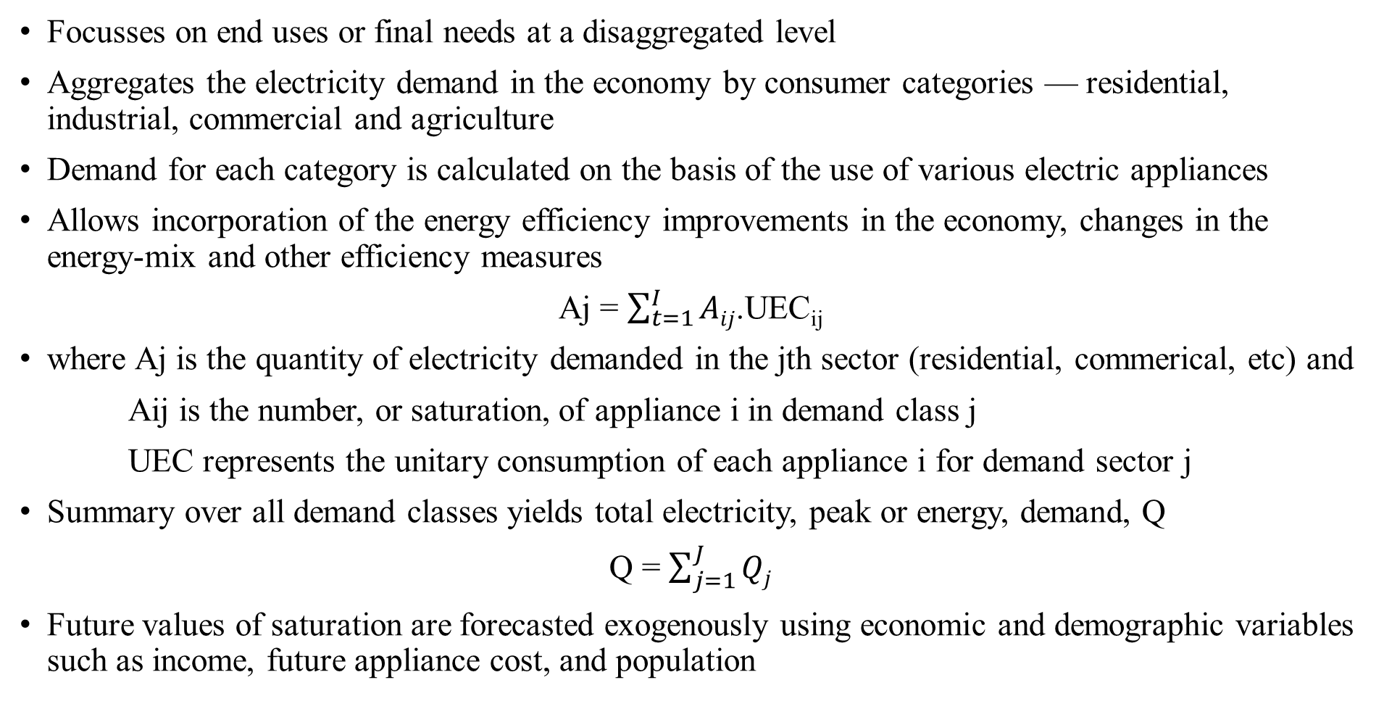
End Use Method
Focusses on end uses or final needs at a disaggregated level
Aggregates the electricity demand in the economy by consumer categories — residential, industrial, commercial and agriculture
Demand for each category is calculated on the basis of the use of various electric appliances
Allows incorporation of the energy efficiency improvements in the economy, changes in the energy-mix and other efficiency measures
Aj = $\sum_{t=1}^{I}{Aij}$.UEC_{ij}
where Aj is the quantity of electricity demanded in the jth sector (residential, commerical, etc) and
Aij is the number, or saturation, of appliance i in demand class j
UEC represents the unitary consumption of each appliance i for demand sector j
Summary over all demand classes yields total electricity, peak or energy, demand, Q
Q = $\sum_{j=1}^{J}{Qj}$
Future values of saturation are forecasted exogenously using economic and demographic variables such as income, future appliance cost, and population

Slide 32
Future appliance saturation is theorized to grow along an S-shaped curve
Past surveys help identify where one is at on the curve and future saturations are extrapolated from there
Electricity consumption of an appliance can be calculated exogenously to measure its annual energy use finding its contribution to peak demand
End use models, then, can be used to forecast either type of electricity demand ie energy and power.
They mostly under forecast actual electricity use
Most engineering models are based on end use method which is a Bottom-up approach
End consumers are the bottom most segment of power system network, and are beneficiaries of the utility
Requires analysis of the utility function of consumers belonging to every segment
Energy consumption patterns of different type of consumers are analyzed from historical data and technological advancements leading to energy efficient products as well as demand side management are integrated to predict future energy consumption

Slide 33
Econometric Approach
Econometrics is the integration of economics, mathematics and statistics with an objective to provide numerical values to the parameters of economic relationships
Used to obtain the values of parameters which are essentially the coefficients of the mathematical form of the economic relationships
Statistical methods which help in explaining the economic phenomenon are adapted as econometric methods
Whenever there is a need of finding the stochastic relationship in mathematical format, the econometric methods and tools are used
A model is a simplified representation of a real-world process
To have a simple model to explain a complex phenomenon without unrealistic assumptions
All the relevant variables to explain the phenomenon are included in the model and rest of them are dumped as disturbances or random variables
This is the main difference between economic modeling and econometric modeling also between mathematical modeling and statistical modeling
Mathematical model is exact while statistical model contains a stochastic term
An econometric model consists of
a set of equations containing observed variables and disturbances describing the behavior
a statement about the errors in the observed values of variables
a specification of the probability distribution of disturbances.

Slide 34
Various types of data is used in estimation of the model are
Time series data
Cross section data
Panel data
Dummy variable data
Important role of econometrics is to provide the tools for modeling on the basis of given data
Regression models can be either linear or non-linear
Outcome of any process is denoted by a random variable y (dependent variable) depends on k independent variables denoted by X1,X2…Xk
y = f (X1,X2,X3,…Xk,β1, β2,β3… βk) + 𝜀
where f is a well-defined function
β1, β2,β3… βk characterize role and contribution of X1,X2,X3,…Xk
𝜀 reflects the stochastic nature of the relationship between y and X1,X2,X3,…Xk
When 𝜀=0 model is mathematical else statistical
If all the partial derivatives of y with respect to each of the parameters β1, β2,β3… βk are independent of the parameters, then the model is called as a linear model
Different statistical estimation procedures like method of maximum likelihood, principle of least squares, method of moments etc. are used to estimate the parameters of the model
Regression analysis is a tool to determine the values of the parameters given the data on y and X1,X2,X3,…Xk
We move in the backward direction ie the collected data is used to determine the unknown parameters β1, β2 etc. of the model where such an approach is termed as regression analysis.

Slide 35
Steps in regression analysis
Statement of the problem under consideration
Choice of relevant variables
Collection of data on relevant variables
Specification of model
Choice of method for fitting the data
Fitting of model
Model validation and criticism
Using the chosen model for the solution of the proposed problem.

Slide 36
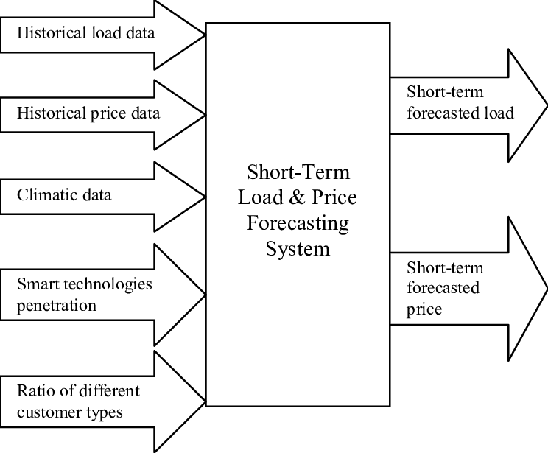
Input Output Model
Provide a framework that is able to capture the direct as well as indirect energy demands through inter-industry transactions
Highly data-intensive approach

Slide 37
Scenario based Approach
Aim is to generate forecasts based on plausible scenarios
Resulting forecast is intended to be a likely outcome in Delphi approach whereas each scenario-based forecast may have a low probability of occurrence
Scenarios are generated by considering all possible factors or drivers, their relative impacts, the interactions between them, and the targets to be forecast
Building forecasts based on scenarios allows a wide range of possible forecasts to be generated and some extremes to be identified
It is usual for “best,” “middle” and “worst” case scenarios to be presented, although many other scenarios will be generated
Thinking about and documenting these contrasting extremes can lead to early contingency planning.
Decision makers participate in the generation of scenarios
May lead to some biases but it can ease the communication of the scenario-based forecasts, and lead to a better understanding of the results.
Development of conceptual scenario of future based on well defined set of assumptions
Development of plausible scenarios that could capture structural changes, emergence of new economic activities or disappearance of activities
After different scenarios have been developed the decision maker determines which is most likely to occur in future and makes decision accordingly

Slide 38
ANN based Approach
ANN approach was discovered in 1990 by Warren McCulloch and Walter Pitts as an alternative mechanism to the time series forecasting
ANNs have been successfully applied in many different areas for forecasting and classification purposes
Neural network is a non-linear circuit that is capable of doing non-linear curve fitting
It represents an information processing paradigm that was inspired by the way the biological systems of humans, such as the brain, are able to process a certain piece of information
ANNs try to recognize regularities and patterns in the input data, learn from experience, and then provide generalized results based on their known previous knowledge
ANN is composed of several interconnected Processing Elements (PE), called neurons, which are changing their dynamic state response with respect to external inputs
Simplest form of ANN contains input, hidden and output layers

Slide 39
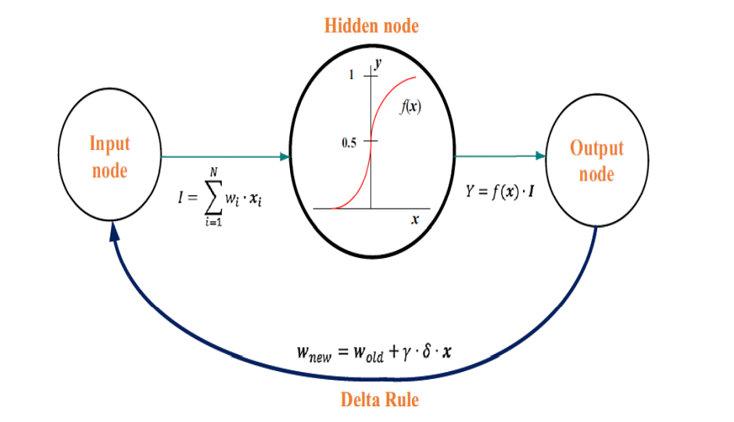
Simple neuron scheme in an ANN
Input values to the hidden node (I), associated weights (wi), hidden layer function f(x), and the output results (Y) can be seen in above fig.
By changing the weights of the ANNS, the preferred output from a specific input can be achieved
Such a process, where the weights of the ANNs are adjusted, is an iterative training process
Commonly employed ANN algorithms for electric load forecasting are
Feed-Forward (FF) neural networks
NARX (Nonlinear Auto Regressive with exogenous inputs) neural networks

Slide 40
Back-Propagation (BP) neural networks
Radial Basis Function (RBF) neural networks
Random neural networks
Recurrent neural networks and
Self-organizing competitive neural networks
ANN models classified into two main groups
First group includes those ANNs that have only one output node, used to forecast the next hour’s load, next day’s peak load, or next day’s total load
Second group involves models that have several output nodes to forecast a sequence of hourly loads, typically 24 nodes, with a purpose to predict the next day’s entire load profile
Second group has strong robustness and strong learning ability
ANN quickly falls into the local minimum because of the restriction on the generalization ability and cannot make full use of information due to the small sample size selected
Learning convergence speed is slow
NARX ANNs usually outperform the classical neural networks
NARX networks, together with the RBF networks possess simplicity, reliability, low % error, high accuracy and ability to create the nonlinear relationships between variables
NARX and RBF ANNs provide highly accurate EL forecasts for five days ahead, while the relative error is below the reasonable level between 0.1% to 3.9%

Slide 41
Hybrid Approach
Hybrid or combination models and methods can obtain better forecasting performance than the single model
Integrates the advantages of different single forecasting models
Attempt to reduce the methodological divergence between the econometric and engineering models by combining the features of the two traditions
Numerous available forecasting methods, optimization algorithms, and data processing techniques for developing different hybrid models
Modern hybrid methods are presented in order to cover the new technological frameworks
There are no confessed references on how to select different methods to build a hybrid model
Advance the time series forecasting by combining the best of statistical and machine learning methods
Effectiveness of statistical methods with limited data availability can counteract the extensive data requirements of machine learning methods
Consideration of a prior knowledge can simplify the expected forecasting task and decrease the computational effort
Hybrid methods can incorporate cross-learning, a capability that many statistical methods lack
Provide a solution to the dilemma of the assumption of linearity
Real-world time series may be purely linear, purely nonlinear, or often contain a combination of those two patterns so hybrid methods can be effective where traditional approaches reach their limits

Slide 42
Energy Demand Analysis
First step towards determining whether it is feasible to put-together an energy supply mixes compatible with the achievement of a sustainable world at the projected energy demand levels
It considers the activities in individual energy­ consuming sectors of the economy
Relates macro­economic developments to the energy needed to sup­port those developments in each sector
Demand analysis enables a disaggregated, end use approach to analyze the energy requirements
It uses economic, demographic and energy use information to compute and report on total and disaggregated consumption of various end use fuels
It plays a sequential, intermediate, and iterative role in energy planning
Follows the phase of database establishment, the output of which serves as input to energy policy analysis and finally, demand analysis occurs iteratively
Two major approaches of energy demand analysis are
macro and
sectoral demand analysis
Macro demand analysis considers demand as a function of popula­tion, income, and prices
Sectoral demand analysis examines the structure of sectors and sub-sectors and their energy consuming activities, including the equipment

Slide 43
The issues associated with energy demand analysis are:
Most energy planning exercises are carried out with aggregate data at national level while at regional level, there have been fewer efforts for energy planning
Energy resources and demand are spatially distributed
Studies of traditional fuel sources are needed to focus on issues such as, changes in supply and demand of biomass fuels, determinants of use of biomass sources as fuel, fodder and fertilizer, changes in efficiencies of conversion and utiliza­tion, processes of generation and use of traditional sources of energy in the context of socio-political characteristics of a location
Meeting the basic energy needs of population at a reasonable cost would be an important policy ob­jective
There is a need to review the method and collate the results of available studies on energy demand analysis and management
Review should collate empirical information on the role of energy prices, possibilities of inter fuel and inter factor substitution, and economics of conservation.
Analysis of various methods of estimating energy shortages or unfulfilled demand for different sec­tors and categories of consumers
Estimates should be made of energy shortages and the processes through which the shortages have been managed
The impact of shortages on agricultural output, industrial output, employment, regional development, income distributions, con­sumer welfare, consumer health, etc., should be quantified.
There is a need to evaluate the social profitability of the allocation of various scarce resources to conserve rather than augment

