Slide 1

Object Oriented Programming with Java
Sandeep Kulange

Slide 2
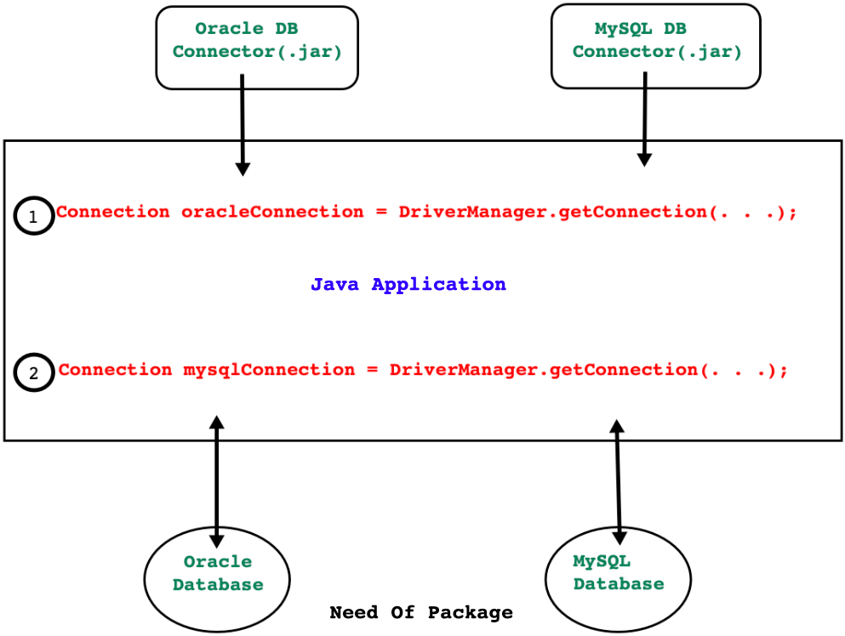
Package

Slide 3
Package
Package is a Java language feature which helps developer to:
To group functionally equivalent or related types together.
To avoid naming clashing/collision/conflict/ambiguity in source code.
To control the access to types.
To make types easier to find( from the perspective of java docs ).
Consider following class:
java.lang.Object
Here java is main package, lang is sub package and Object is type name.

Slide 4
Package
Not necessarily but as shown below, package can contain some or types.
Sub package
Interface
Class
Enum
Exception
Error
Annotation Type

Slide 5
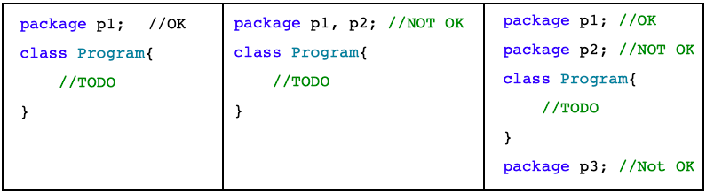
Package Creation
package is a keyword in Java.
To define type inside package, it is mandatory write package declaration statement inside .java file.
Package declaration statement must be first statement inside .
If we define any type inside package then it is called as packaged type otherwise it will be unpackaged type.
Any type can be member of single package only.

Slide 6
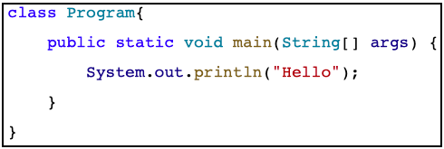
Un-named Package
If we define any type without package then it is considered as member of unnamed/default package.
Unnamed packages are provided by the Java SE platform principally for convenience when developing small or temporary applications or when just beginning development.
An unnamed package cannot have sub packages.
In following code, class Program is a part of unnamed package.

Slide 7
Naming Convention
For small programs and casual development, a package can be unnamed or have a simple name, but if code is to be widely distributed, unique package names should be chosen using qualified names.
Generally Package names are written in all lower case to avoid conflict with the names of classes or interfaces.
Companies use their reserved internet domain name to begin their package names. For example : com.example.mypackage
Following examples will help you in deciding name of package:
java.lang.reflect.Proxy
oracle.jdbc.driver.OracleDriver
com.mysql.jdbc.cj.Driver
org.cdac.sunbeam.dac.utils.Date

Slide 8
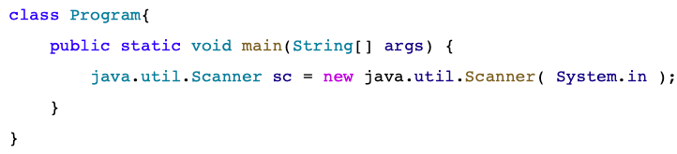
How to use package members in different package?
If we want to use types declared inside package anywhere outside the package then
Either we should use fully qualified type name or
import statement.
If we are going to use any type infrequently then we should use fully qualified name.
Let us see how to use type using package name.

Slide 9
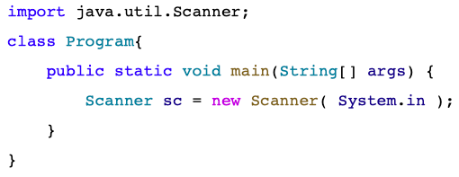
How to use package members in different package?
If we are going to use any type frequently then we should use import statement.
Let us see how to import Scanner.

Slide 10
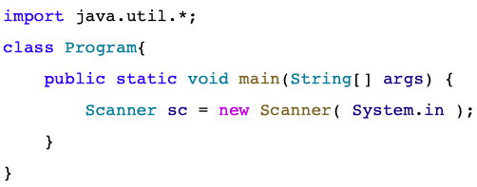
How to use package members in different package?
There can be be any number of import statements after package declaration statement
With the help of( * ) we can import entire package.

Slide 11
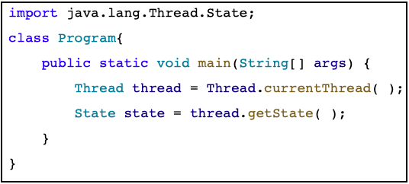
How to use package members in different package?
Another, less common form of import allows us to import the public nested classes of an enclosing class. Consider following code.
Note : java.lang package contains fundamental types of core java. This package is by default imported in every .java file hence to use type declared in java.lang package, import statement is optional.

Slide 12
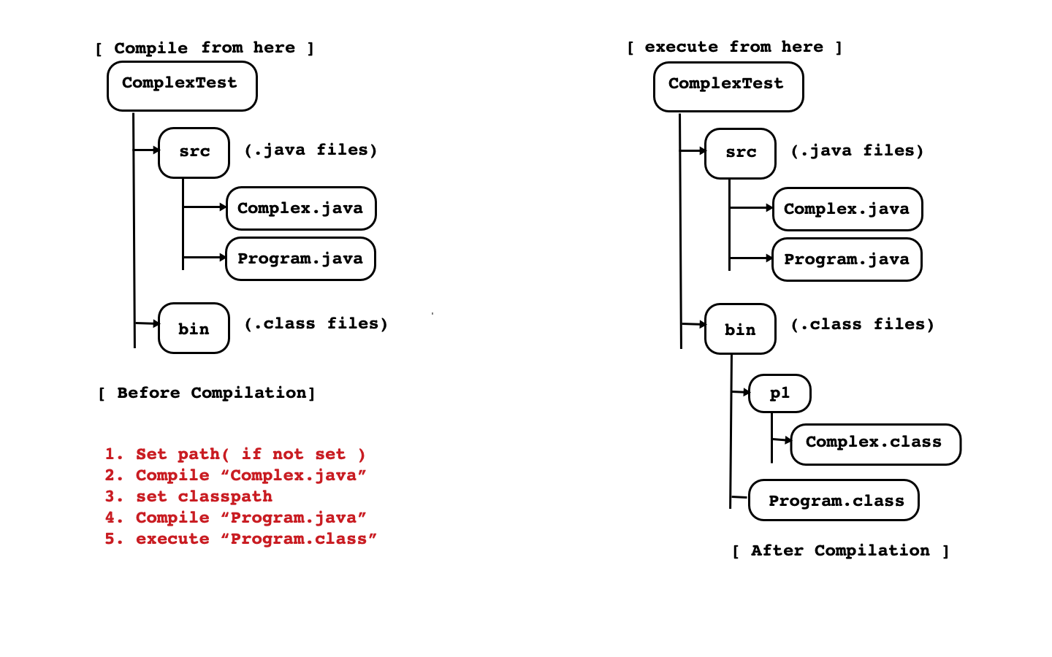
Example 1

Slide 13
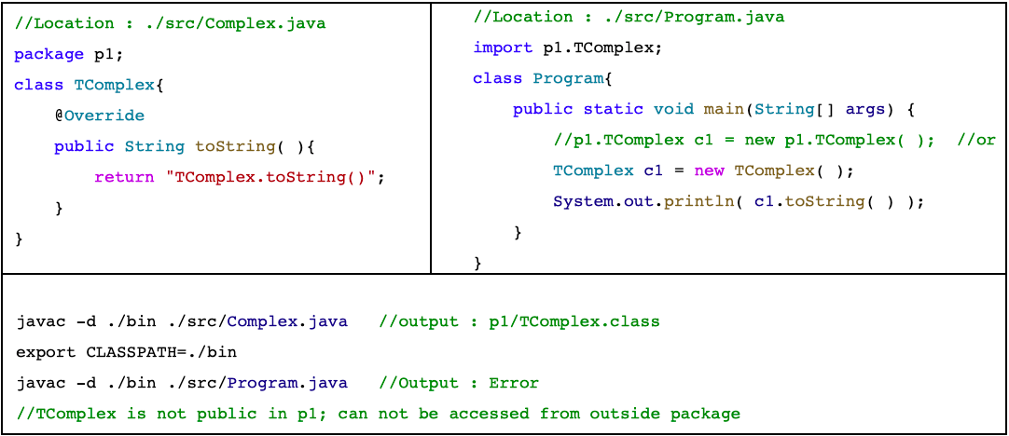
Example 1

Slide 14
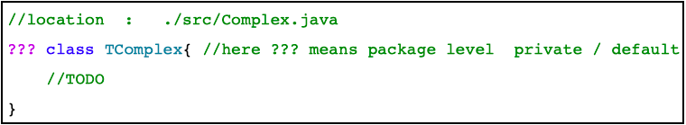
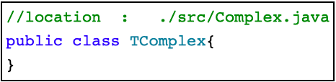
Example 1
Package name is physically mapped to the folder.
Point to Remember : default access modifier of any type is package level private which is also called as default.
If we want to use any type inside same package as well as in different package then access modifier of type must be public.
Access modifier of type(class/interface) can be either package level private/public only. In other words, type can not be private or protected.
If we compile then compiler generates error.

Slide 15
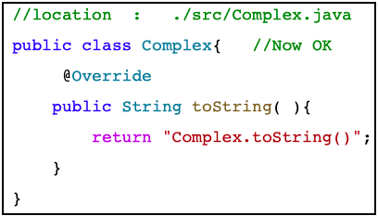
Example 1
According to Java Language Specification(JLS), name of public type and name of .java file must be same. It means that, .java file can contain multiple non public types but only one public type.
Let us recompile above code:
javac -d ./bin ./src/Complex.java //output : p1/Complex.class
export CLASSPATH=./bin
javac -d ./bin ./src/Program.java //Output : Program.class
java Program //Output : Complex.toString()
Conclusion : It is possible to use packaged type from unpackaged type.

Slide 16
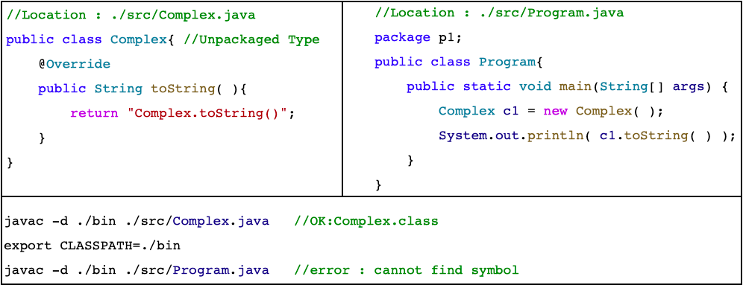
Example 2
If we define any type without package then it is considered as a member of default package.
Conclusion : Since we can not import default package, it is not possible to use unpackaged type from packaged type.

Slide 17
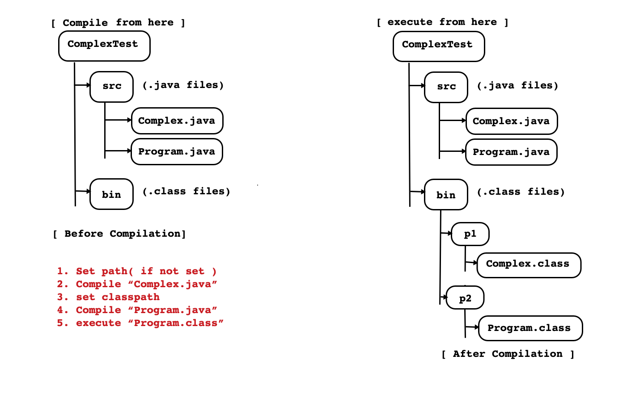
Example 3

Slide 18
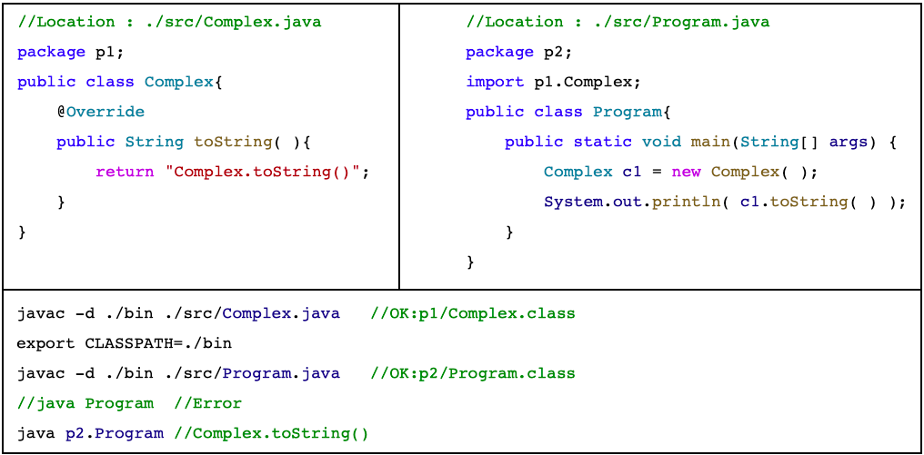
Example 3
Conclusion : We can define types into separate package. It is possible to use packaged type from another packaged type.

Slide 19
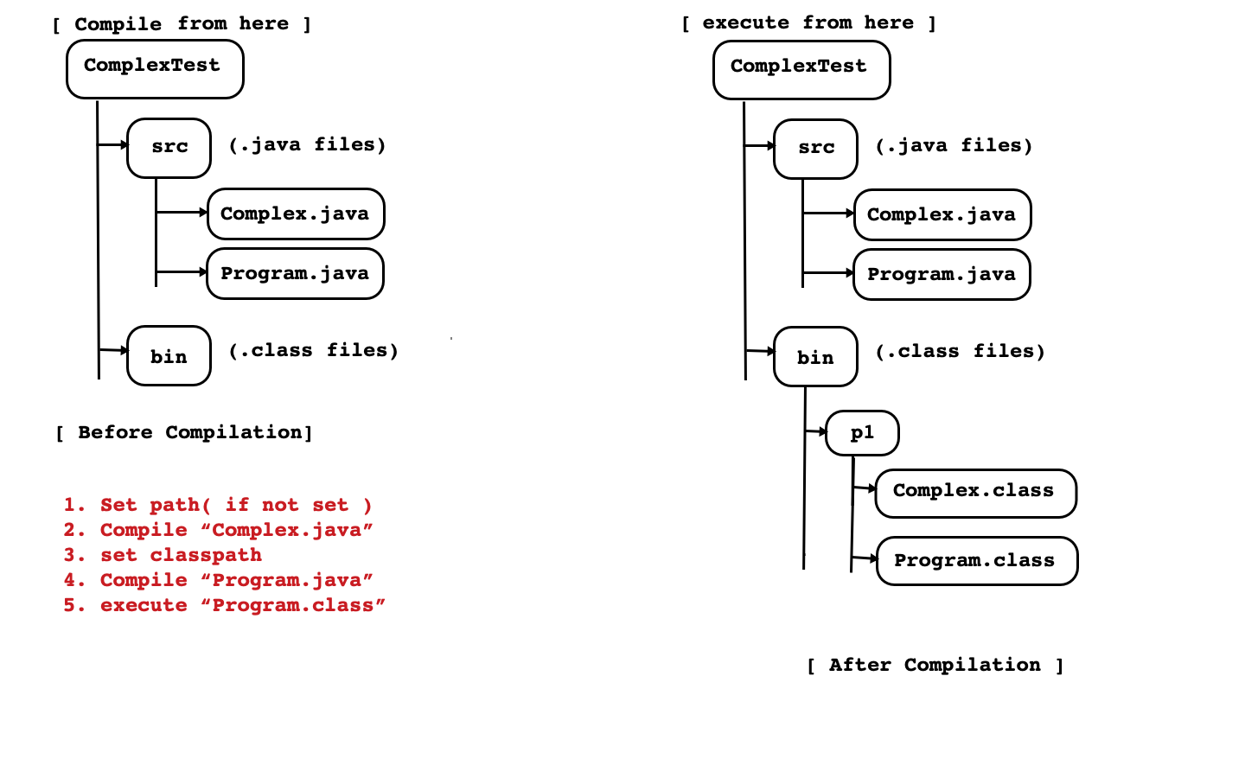
Example 4

Slide 20
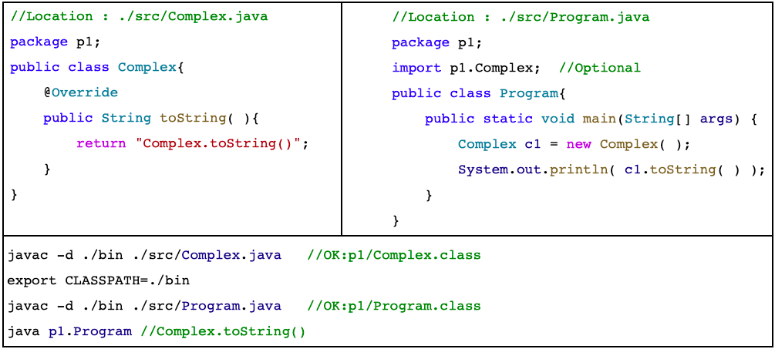
Example 4
Conclusion : We can define all types into single package. In this case, to use one type into another type, use of import statement is optional.

Slide 21
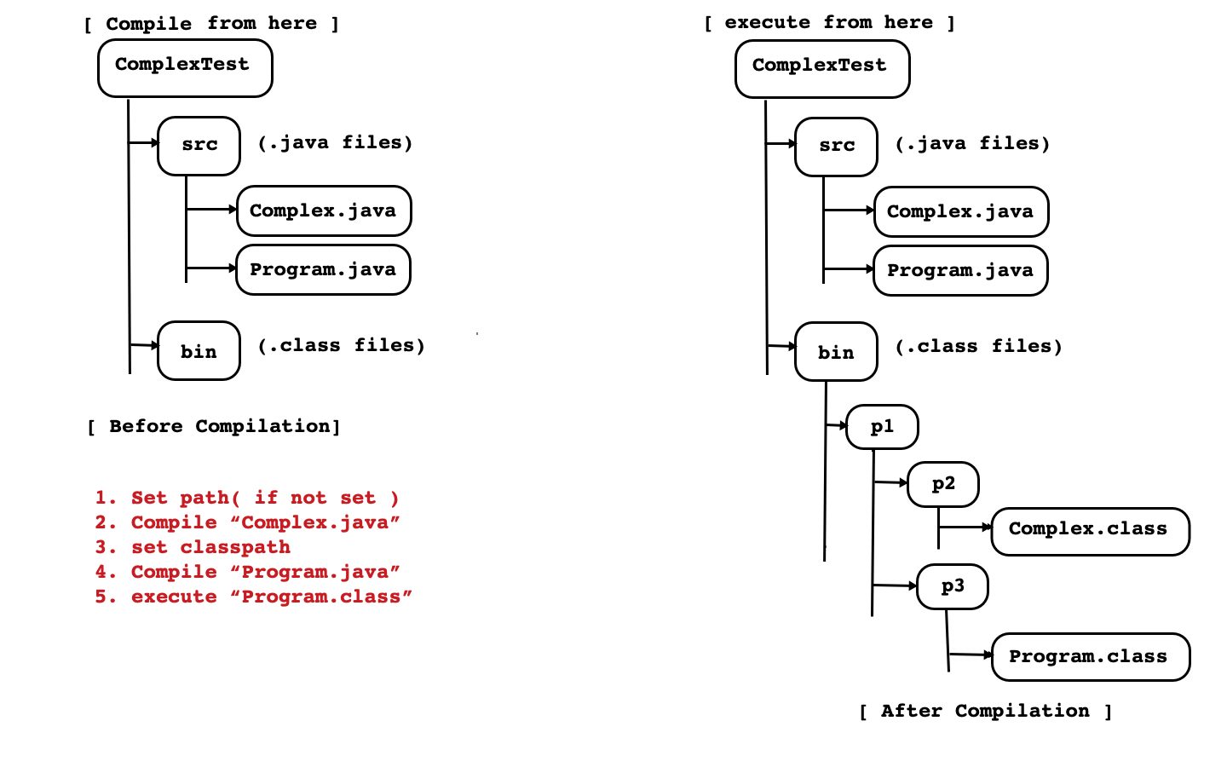
Example 5

Slide 22
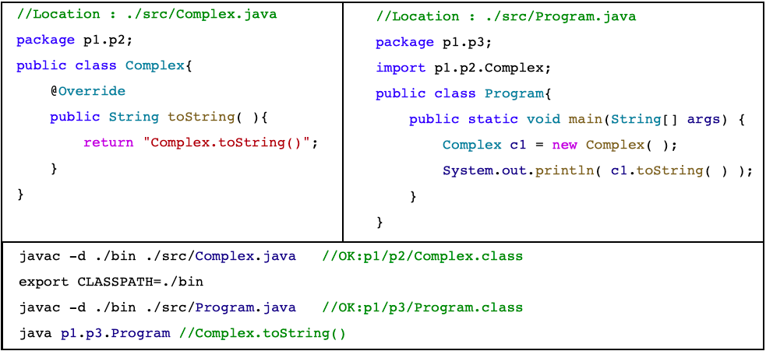
Example 5
Conclusion : We can create package inside package. It is also called as sub package.

Slide 23
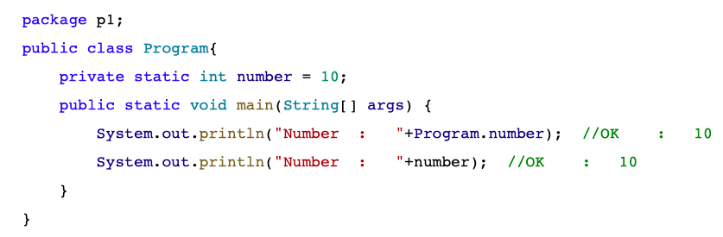
Static Import
If static members belonging to the same class then use of type name and dot operator is optional.

Slide 24
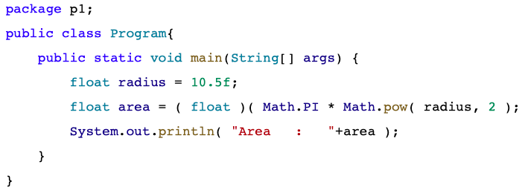
Static Import
If static members belonging to the different class then use of type name and dot operator is mandatory.
PI and pow are static members of java.lang.Math class. To use Math class import statement is not required.
Consider Following code:

Slide 25
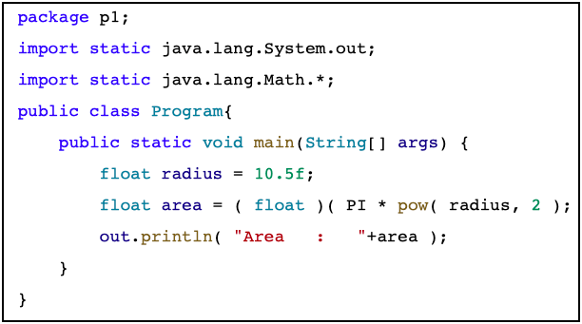
Static Import
There are situations where you need frequent access to static final fields (constants) and static methods from one or two classes. Prefixing the name of these classes over and over can result in cluttered code. The static import statement gives you a way to import the constants and static methods that you want to use so that you do not need to prefix the name of their class.
Consider code:

Slide 26

Thank You.
[sandeepkulange@sunbeaminfo.com]

