Slide 1
Web Search Engine
INDEX.HTML

Slide 2
Advanced Computing Concepts (COMP – 8547)
Team members : Avadh Patel (110074366)
Jay Paresh Patel (110074516)
Nishant Chandubhai Pansuriya (110074312)
Sanket Pravinkumar Patel (110074218)
Guided By : Dr. Olena Syrotkina
Presented By: ACC(Winter 2022)_Section3_Group5

Slide 3
/TABLE OF CONTENTS
/01
Introduction
/02
Role of Members
/03
Workflow
/04
Key Features
/05
Project Demo
INDEX.HTML

Slide 4
/INTRODUCTION
Web Search Engine is the web system that allows users to search for information on the World Wide Web.
By scanning and indexing information on several different websites, the search engine can present relevant pages to the user when they submit a search query.
Search Engines can be used to find different kinds of information, and they find this information and rank the pages they feel are relevant according to defined algorithms.
INDEX.HTML

Slide 5
Key Features
Web Crawler
HTML to Text
Pattern Searching
Frequency Count
Spell Checker
Word Suggestion
Dictionary
Page Ranking

Slide 6
Role of Members
Jay patel
Sanket Patel
Nishant Pansuriya
Avadh Patel
Web Crawler
HTML to Text
Pattern Searching
Frequency Count
Spell Checker
Word Suggestion
Dictionary
Page Ranking

Slide 7
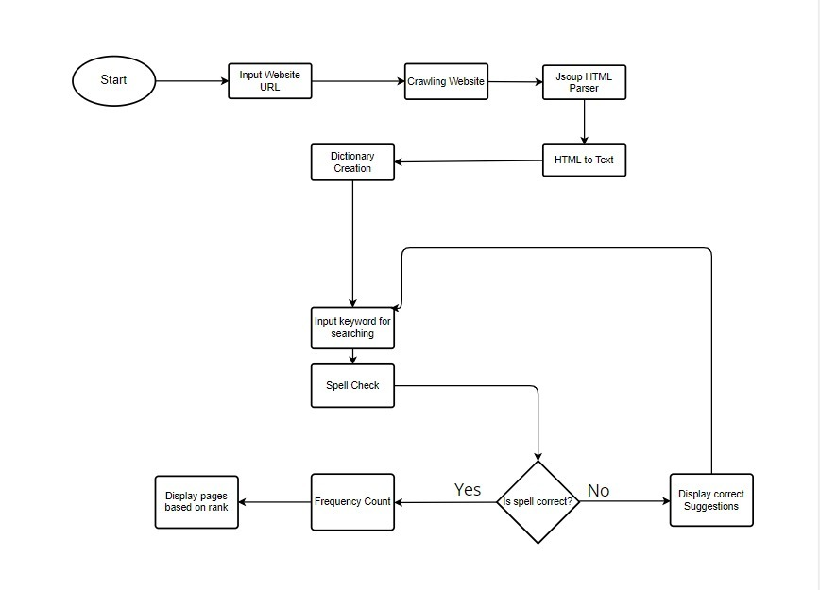
Workflow

Slide 8
Web Crawler
A web crawler, often known as a spider, is a bot that downloads and indexes content from all over the internet.
In this project, we have created a robust web crawler which will traverse through all the hyperlinks in a HTML document until a certain depth & save all the documents in local directory.
We have used the hashset data structure in the web crawler to track how many times a specific URL was visited.

Slide 9
HTML to Text
Jsoup Library is used in this project to parse HTML documents & convert them to text documents.
Jsoup provides DOM (Document Object Model) like methods to find, extract & edit HTML documents.
The Jsoup parser parses all HTML files retrieved by the web crawler, extracting text data and removing unnecessary characters and HTML tags.

Slide 10
Pattern Searching
Pattern Searching feature searches the text files for the specified user input.
It uses Boyer-Moore Algorithm, which is best for pattern searching, in order to find the given pattern by the user.
It has 2 heuristics i.e Looking-glass heuristic and Character-jump heuristic.
It reads the entire file and compare the given user pattern.
Finally, it returns the position of found pattern, if exists.

Slide 11
Frequency Count
Frequency count feature counts the number of matched pattern.
It displays the frequency of given word in each file.
In order to find the count of matched patterns, we have used pattern matching technique.
First, it scan the entire file and creates the matcher object.
Every time when the given pattern matches with the matcher objects , the count is increased by one and the final count is returned.

Slide 12
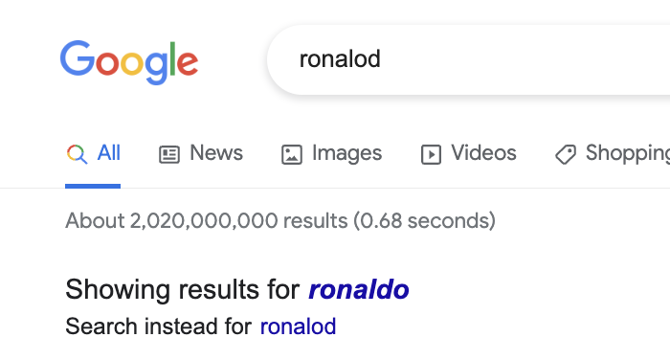
Spell Checker
Spell checker simply checks if the input’s spelling is correct or not.
It also checks if the word is outside the scope of dictionary
When user gives an input, it compares it with the dictionary file and if it doesn't find a match, it runs a suggestion function.

Slide 13
Word Suggestion
It uses Edit Distance method to find the alternate word suggestions.
It calculates the edit distance of input string with every string present in dictionary and finds the string with the minimum edit distance.
Then it shows the final word as alternate word to the input word.

Slide 14

Dictionary
Dictionary is generated from the text files, which are converted from HTML files. It stores all the unique words present in the files.
Java uses classes such as HashSet, HashMap, which implements a (key, value) pair interface.
It uses sorting method that can sort the elements of Array, linked list, and many more data structures.

Slide 15
Page Ranking
Page ranking is the priority that is given to the different links on the result of the Web Search Engine.
Page ranking can be created by any customized algorithms. For example, Google has PageRank algorithm.
One may get different results of same query in two different web search engines. High ranking pages will be displayed on top of the result page. So, it is essential feature of any search engine.

Slide 16
Project Demo

Slide 17
Thank You

Slide 18
Future Works
We can add multiple page ranking factors to improve search accuracy.
We can add web and mobile based UI to make it more user-friendly.
We can store search history to Database and show results based on most searched queries.

