Slide 1
PN Junction Diode
Under the guidance of
Prof. Sandip Lashkare EE
TA: Yashan Kumar
by Nishant Pandey (23110221)
Electrical Engineering IITGN

Slide 2
Motivation
This project was motivated by my interest in understanding the physics and design principles of semiconductor devices used for Electrostatic Discharge (ESD) protection in integrated circuits. During the Electronic Devices course, I developed a foundational understanding of PN junction behavior, carrier transport mechanisms, depletion region formation, and electric field distribution in semiconductor materials.
However, theoretical derivations alone do not fully demonstrate how these physical principles influence the operation and reliability of real semiconductor protection structures. In modern integrated circuits, ESD protection devices rely heavily on PN junction behavior and breakdown mechanisms to safely dissipate high transient voltages. Therefore, understanding the electrical characteristics of PN junctions is essential for designing robust ESD protection devices.
Through this project, I aimed to:
Apply the concepts learned in the Electronic Devices course to a practical TCAD simulation environment.
Study how doping concentration, junction profiles, and device geometry influence electric field distribution and breakdown characteristics.
Understand the fundamental operation of PN junctions as the core building block of ESD protection devices.
Gain hands-on experience with TCAD tools used in semiconductor device and reliability design.
Develop intuition about how microscopic semiconductor physics translates into macroscopic ESD protection performance.
Studying the PN junction diode serves as a critical starting point because many ESD protection structures—such as diode-based ESD clamps, snapback devices, and other protection elements—are fundamentally based on PN junction behavior.

Slide 3
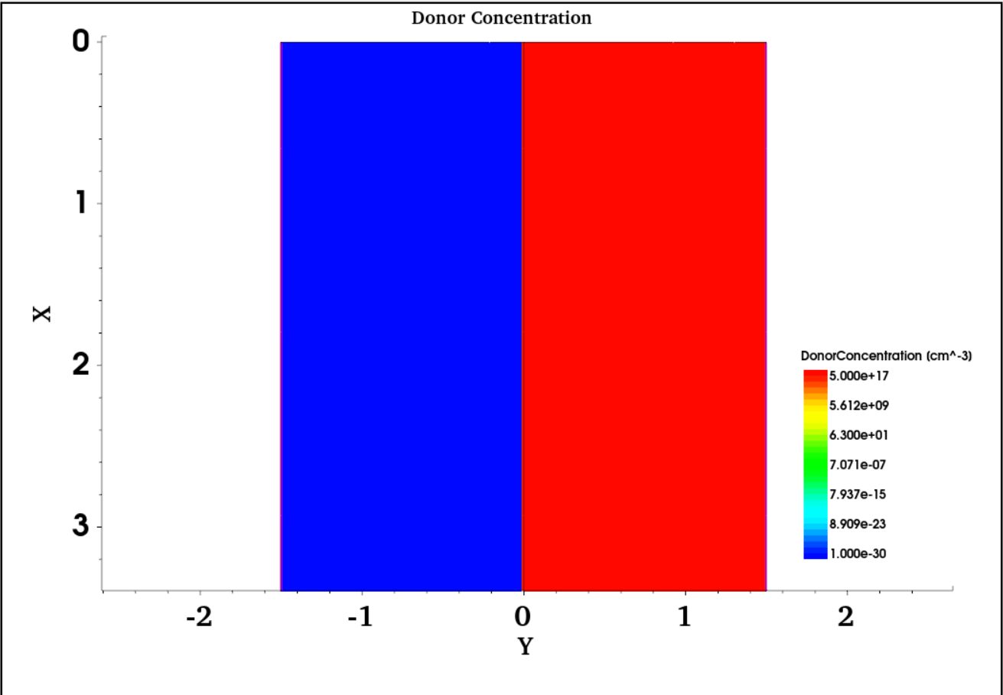
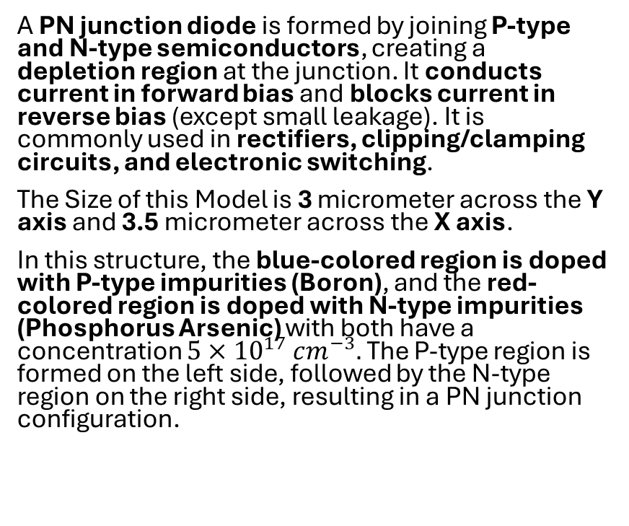
PN diode Sdevice model
A PN junction diode is formed by joining P-type and N-type semiconductors, creating a depletion region at the junction. It conducts current in forward bias and blocks current in reverse bias (except small leakage). It is commonly used in rectifiers, clipping/clamping circuits, and electronic switching.
The Size of this Model is 3 micrometer across the Y axis and 3.5 micrometer across the X axis.
In this structure, the blue-colored region is doped with P-type impurities (Boron), and the red-colored region is doped with N-type impurities (Phosphorus Arsenic) with both have a concentration $5×{10}^{17} cm^{−3}.$ The P-type region is formed on the left side, followed by the N-type region on the right side, resulting in a PN junction configuration.
PN Junction Diode doping concentration in Equilibrium

Slide 4
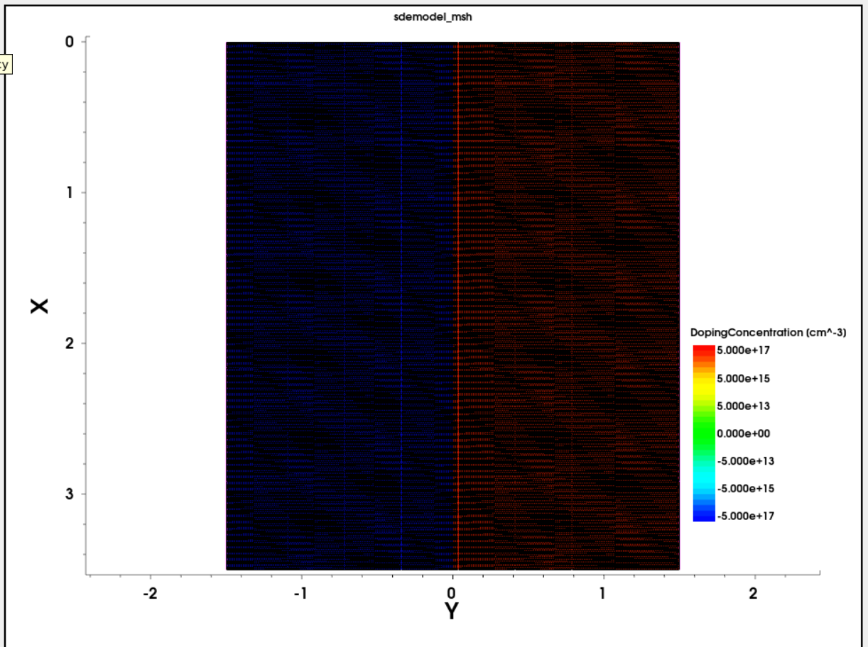
Meshing in the device
In TCAD simulations, meshing divides the PN junction device into small discrete elements, allowing numerical solution of fundamental equations such as Poisson’s equation and the carrier transport equations. Proper mesh refinement ensures accurate calculation of I–V characteristics, depletion region width, and electric field distribution. In contrast, inadequate or coarse meshing may produce inaccurate results and cause convergence problems during simulation.
PN Diode with Meshing

Slide 5

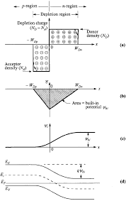
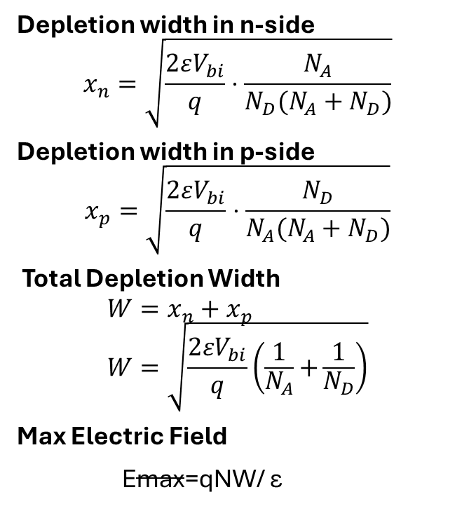
Expression for Depletion Widths
Depletion width in n-side
$$x_{n}=\sqrt{\frac{2εV_{bi}}{q}⋅\frac{N_{A}}{N_{D}(N_{A}+N_{D})}}$$ Depletion width in p-side
$$x_{p}=\sqrt{\frac{2εV_{bi}}{q}⋅\frac{N_{D}}{N_{A}(N_{A}+N_{D})}}$$
Total Depletion Width
$$W=x_{n}+x_{p} \\ W=\sqrt{\frac{2εV_{bi}}{q}\left(\frac{1}{N_{A}} + \frac{1}{N_{D}}\right)}$$
Max Electric Field
Emax​=qNW​/ ε

Slide 6
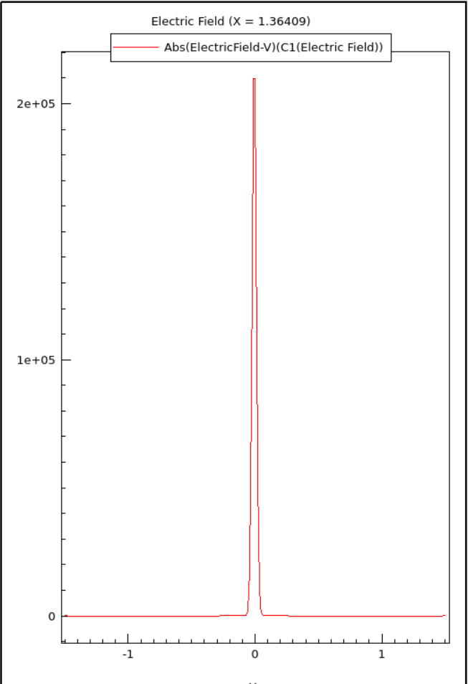
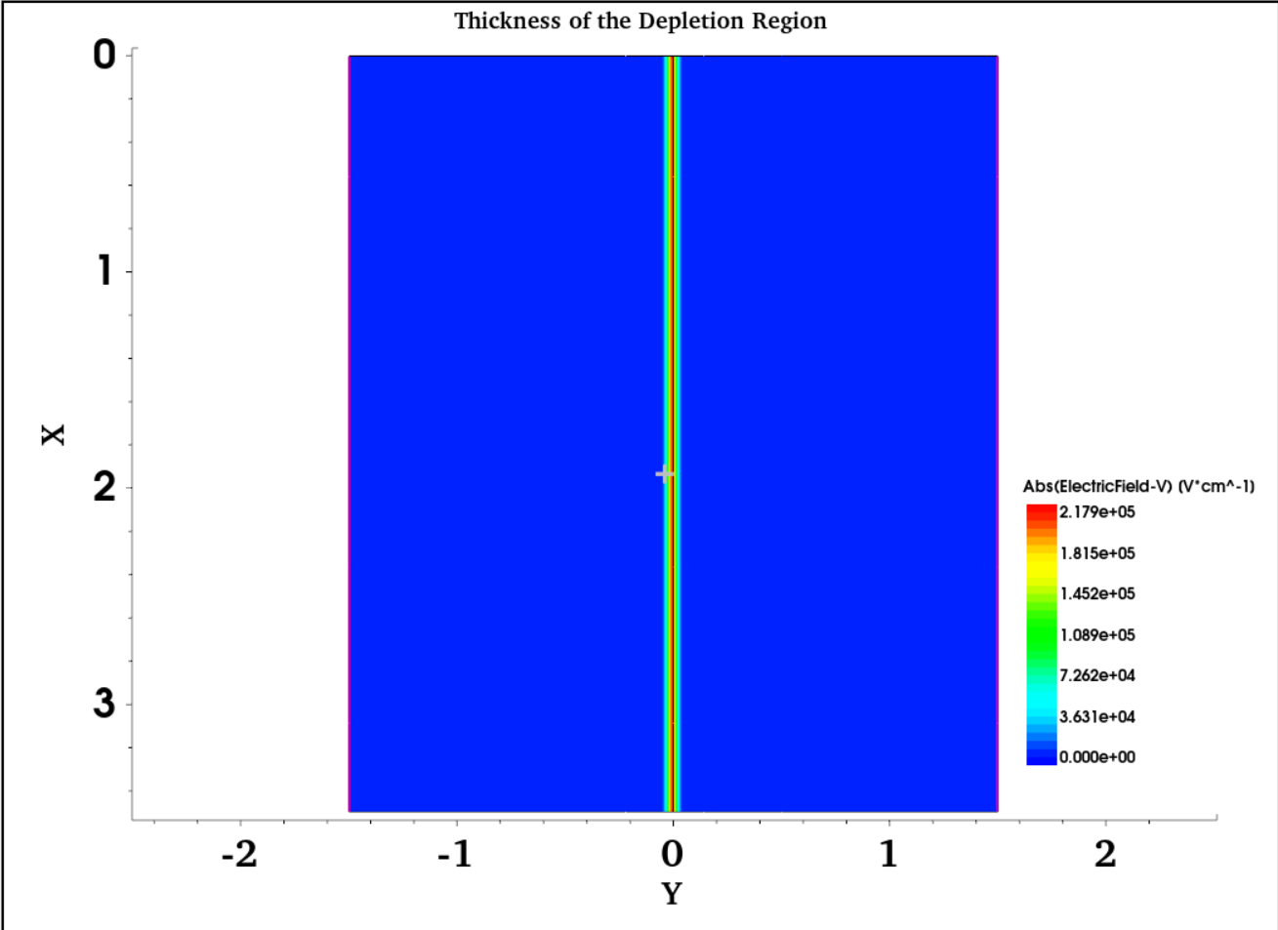
Electric Field and Thickness of Depletion Region
Max Electric field = 2.179 $×{10}^{5} V/cm$ and depletion region width = 0.067 µm

Slide 7
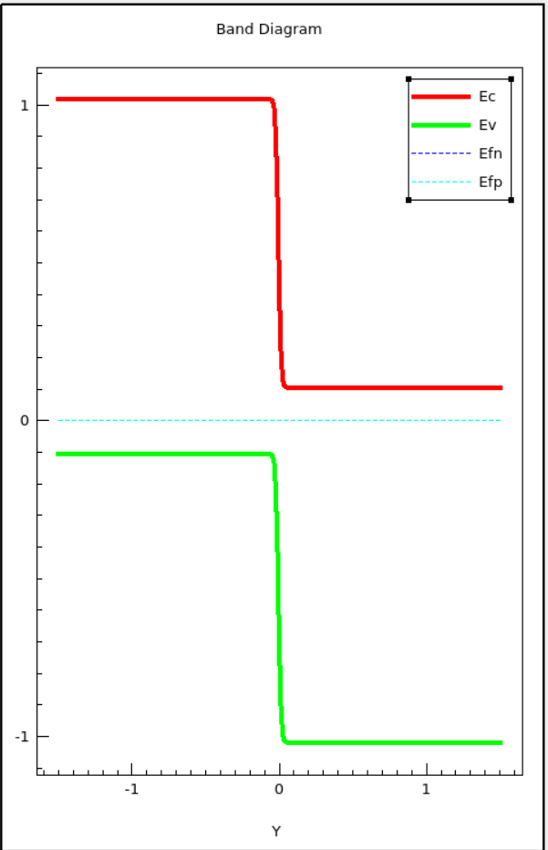

Bandgap for $donor concentration 5×{10}^{17} cm^{−3}$
The energy band diagram of the PN junction diode illustrates the variation of the conduction band (Ec) and valence band (Ev) across the junction. When the P-type and N-type regions are joined, carrier diffusion causes band bending near the junction, forming a depletion region.
The bandgap (Eg) of silicon remains approximately 1.12 eV and does not change across the junction. However, the conduction and valence bands bend near the depletion region due to the internal electric field.

Slide 8
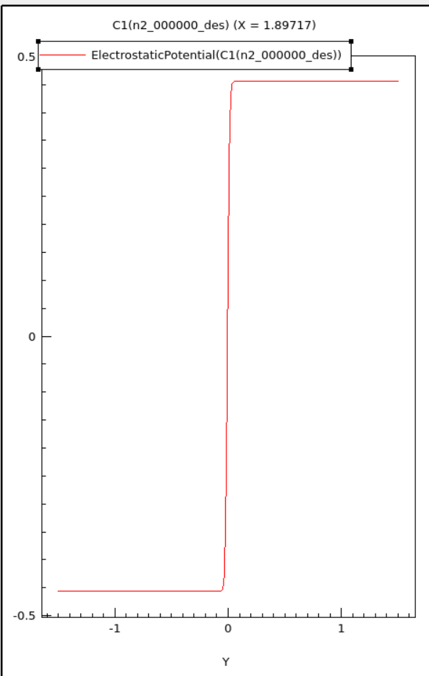
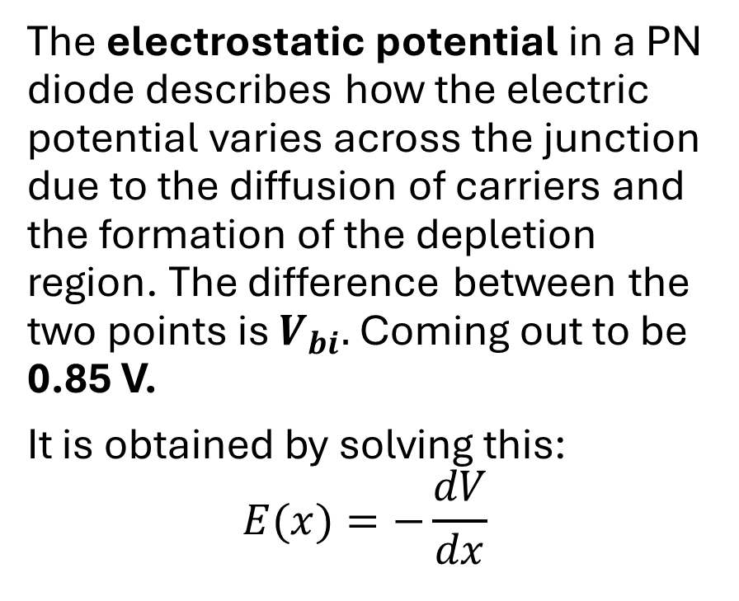
Electrostatic potential of PN diode
The electrostatic potential in a PN diode describes how the electric potential varies across the junction due to the diffusion of carriers and the formation of the depletion region. The difference between the two points is $V_{bi}.$ Coming out to be 0.85 V.
It is obtained by solving this:
$$E(x)=−\frac{dV}{dx}$$

Slide 9
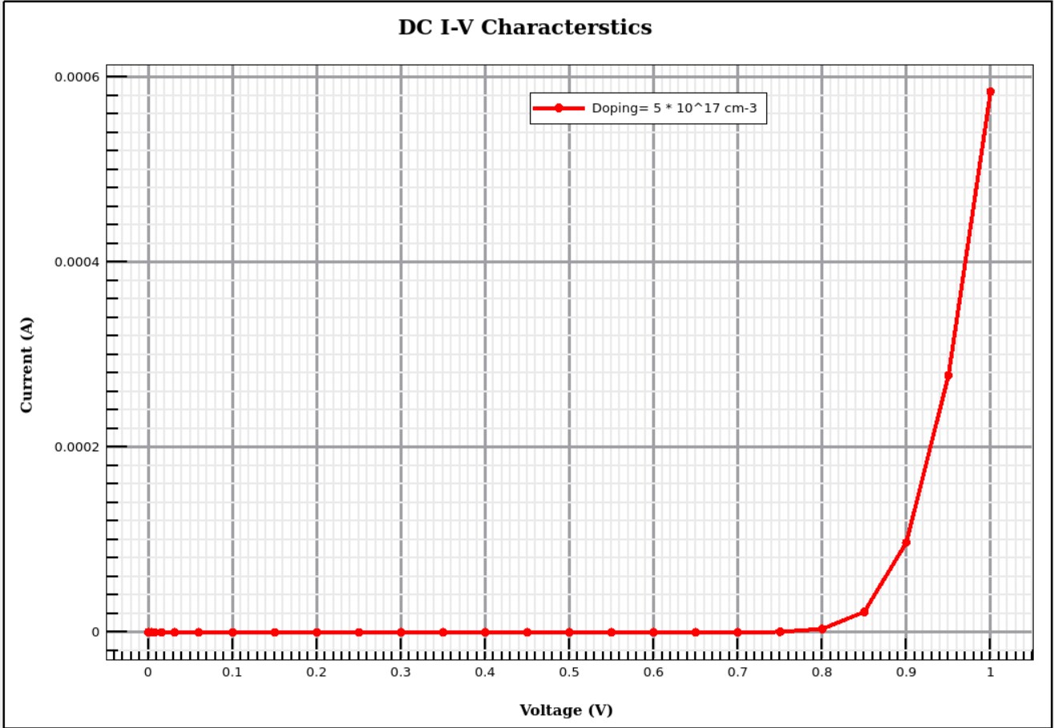
DC IV Characteristic for the pn junction diode for 0-1 V
This graph shows the forward bias I–V characteristic of the simulated PN junction diode. The built-in voltage of the junction is approximately 0.85 V, which represents the potential barrier formed at equilibrium due to charge diffusion.
For applied voltages below 0.85 V, the current remains very small because the external voltage is not sufficient to completely overcome the built-in potential barrier. As the applied voltage approaches and exceeds 0.8 V, the barrier height reduces significantly, allowing majority carriers to cross the junction more easily.

Slide 10
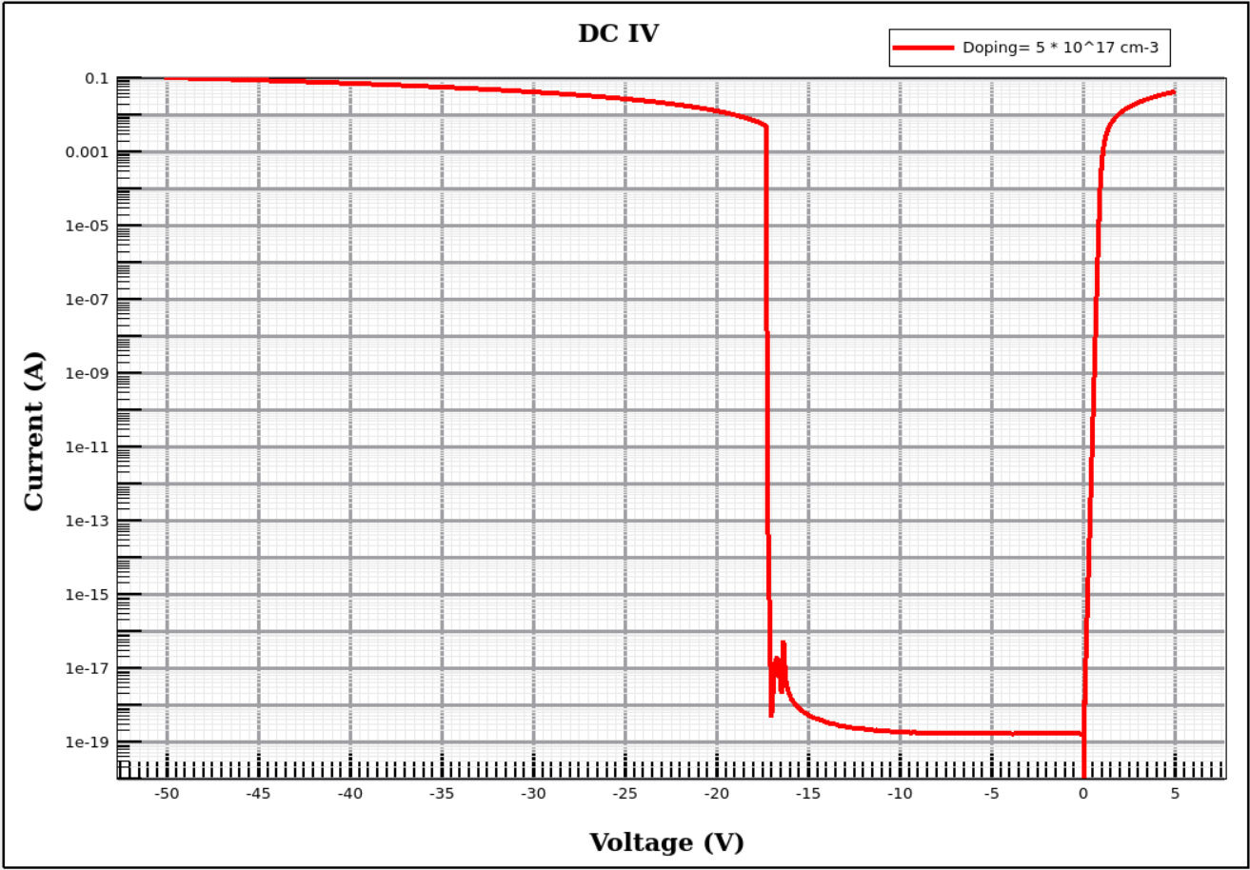
Reverse Bias I-V Characteristics of PN junction Diode (-50 to 5 volts)
1. Region: 0 V to +5 V (Forward Bias) In this region, the diode is forward biased. The applied voltage reduces the potential barrier, allowing majority carriers (electrons and holes) to cross the junction easily. As a result, the current increases rapidly with voltage, showing the typical exponential rise of a PN junction diode.
2. Region: 0 V to −18 V (Reverse Bias – Leakage Region) When the voltage becomes negative, the diode operates in reverse bias. The applied voltage increases the potential barrier and widens the depletion region, pulling majority carriers away from the junction. Only a very small reverse saturation current flows due to minority carriers, and this current remains almost constant despite increasing reverse voltage.
3. Region: −18 V to −50 V (Strong Reverse Bias) Beyond approximately −18 V, the diode enters a strong reverse-bias region. The depletion region widens significantly, further restricting carrier movement. The current becomes extremely small and nearly stable, indicating minimal carrier conduction. At −50 V, the depletion region thickness increases to about 1.101 µm, showing strong junction separation under high reverse voltage.

Slide 11
Cause of Breakdown in reverse Bias
In reverse Bias at high voltages the electric field accelerates the minority carriers. These carriers with high energy collides with lattice to form an electron hole pair now these pair will form a new pair on there own causing an avalanche kind of disturbance. The depletion with need to be wide means for low doping Avalanche breakdown occurs and voltage requirement need to be high.
For Zener, the depletion region is very thin. With very high electric field the electrons pull from valance band to conduction band by quantum tunneling. So, for Zener the doping need to be very high and voltage is less than avalanche.

Slide 12
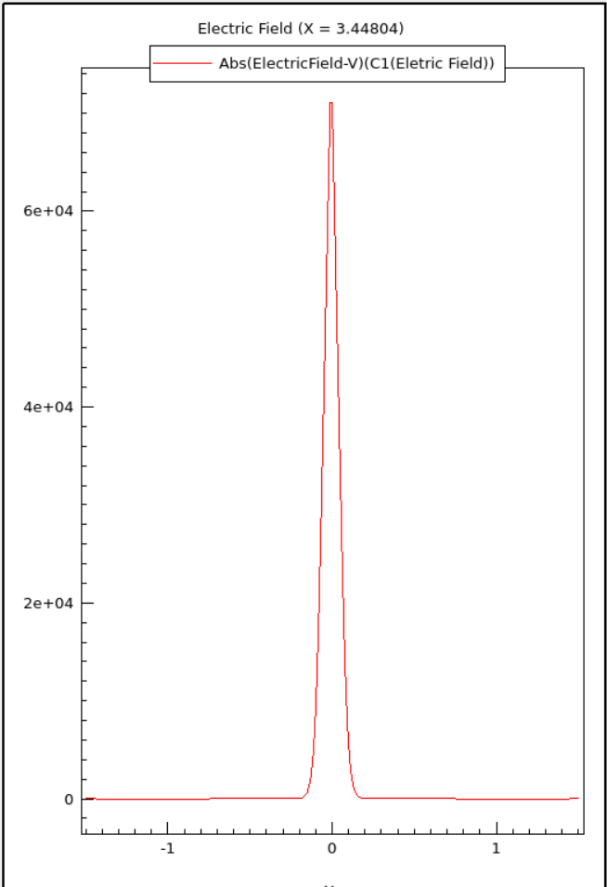
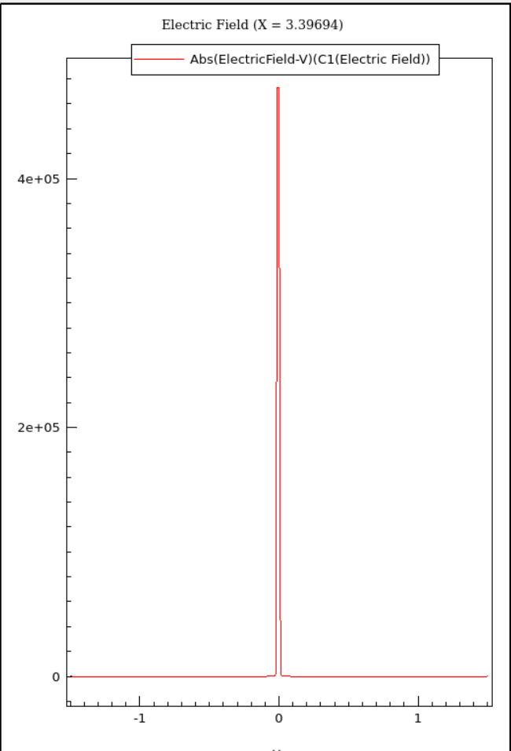

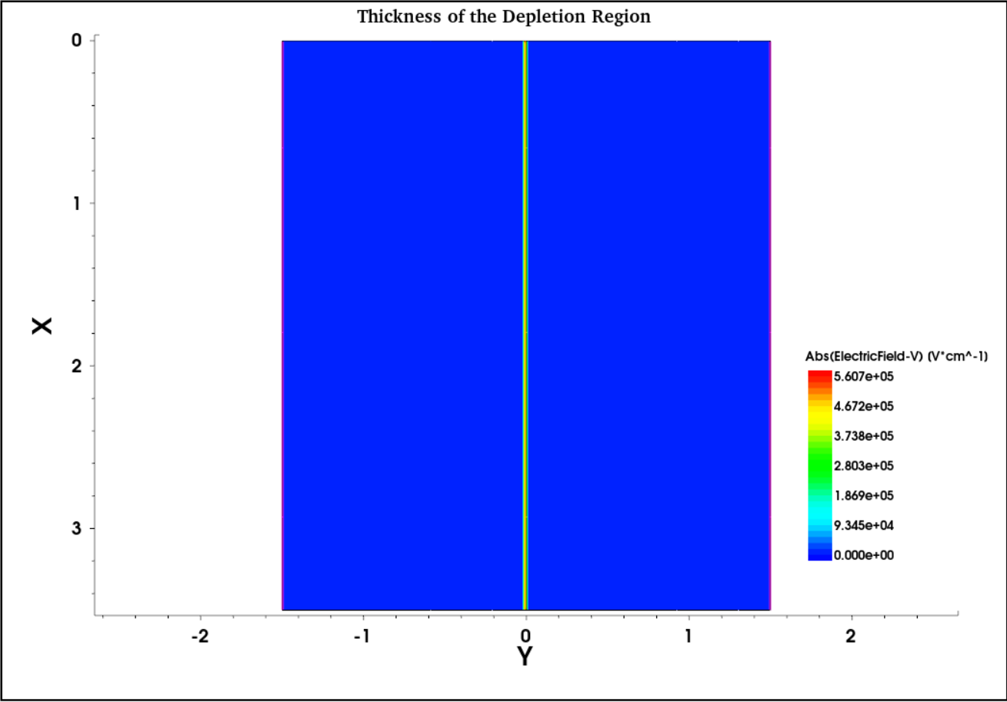
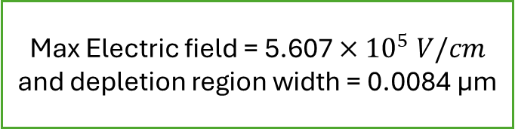
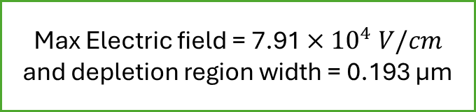
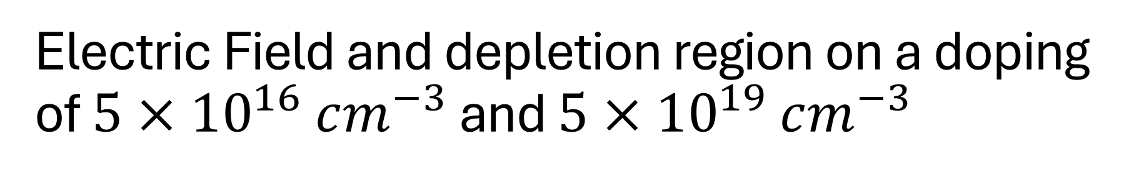
Electric Field and depletion region on a doping of $5×{10}^{16} cm^{−3}$ and $5×{10}^{19} cm^{−3}$
Max Electric field = 7.91 $×{10}^{4} V/cm$ and depletion region width = 0.193 µm
Max Electric field = 5.607 $×{10}^{5} V/cm$ and depletion region width = 0.0084 µm

Slide 13
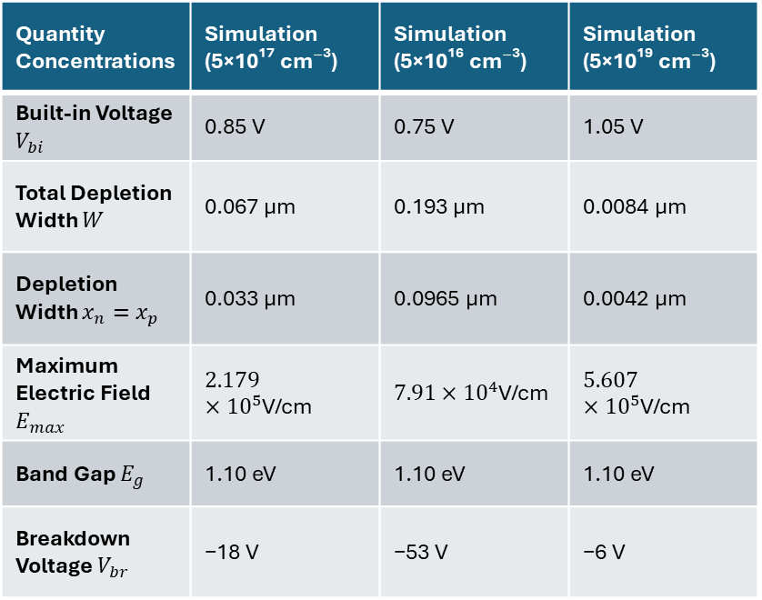
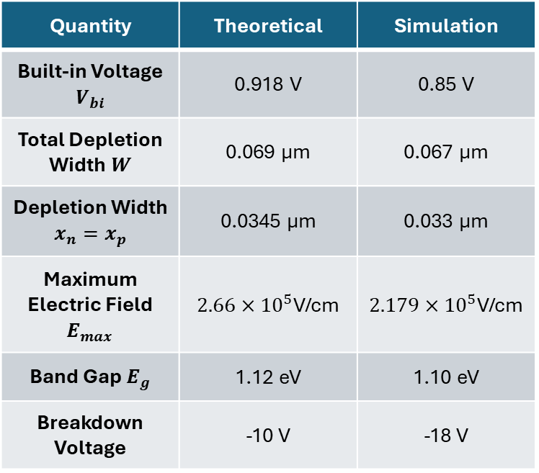
Table and Comparison
Quantity | Theoretical | Simulation
Built-in Voltage $V_{bi}$ | 0.918 V | 0.85 V
Total Depletion Width $W$ | 0.069 µm | 0.067 µm
Depletion Width $x_{n}=x_{p}$ | 0.0345 µm | 0.033 µm
Maximum Electric Field $E_{max}$ | $2.66×{10}^{5}$V/cm | $2.179×{10}^{5}$V/cm
Band Gap $E_{g}$ | 1.12 eV | 1.10 eV
Breakdown Voltage | -10 V | -18 V
Quantity Concentrations | Simulation (5×10¹⁷ cm⁻³) | Simulation (5×10¹⁶ cm⁻³) | Simulation (5×10¹⁹ cm⁻³)
Built-in Voltage $V_{bi}$ | 0.85 V | 0.75 V | 1.05 V
Total Depletion Width $W$ | 0.067 µm | 0.193 µm | 0.0084 µm
Depletion Width $x_{n}=x_{p}$ | 0.033 µm | 0.0965 µm | 0.0042 µm
Maximum Electric Field $E_{max}$ | $2.179×{10}^{5}$V/cm | $7.91×{10}^{4}$V/cm | $5.607×{10}^{5}$V/cm
Band Gap $E_{g}$ | 1.10 eV | 1.10 eV | 1.10 eV
Breakdown Voltage $V_{br}$ | −18 V | −53 V | −6 V

Slide 14
Future Work
The present work focused on understanding the PN junction diode and the effect of doping concentration on device characteristics. In the future, this work can be extended in several directions:
1. Extension to NPN Structure
The next step is to simulate a three-layer NPN structure, which forms the basic structure of a Bipolar Junction Transistor (BJT). This will help study carrier injection, current gain, and transistor operation.
2. Material Comparison (Silicon → Germanium)
The current simulations use silicon as the semiconductor material. Future work will involve replacing silicon with germanium to analyze how material properties such as:
bandgap
carrier mobility
intrinsic carrier concentration
affect device performance.
3. Electrostatic Discharge (ESD) Analysis
Future simulations can investigate ESD protection behavior of PN junctions. This includes studying how the diode responds to high-voltage transient pulses and how it can protect integrated circuits from electrostatic damage.
4. Punch-Through Effect
Another important phenomenon to study is punch-through, which occurs when the depletion regions extend through the entire device under high reverse bias. Understanding punch-through is important for device reliability and scaling in semiconductor devices.

