Slide 1
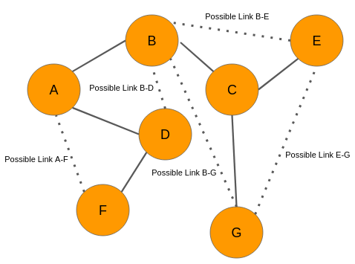
LINK PREDICTION PROBLEM
Presented by: Guided by:
Ashutosh Pandey Amit Nanavati
Nishant Chauhan Sougata Mukherjea
Pratik Wadhwa

Slide 2
Problem Statement
Let’s say we have an instance of a network, can we infer which new links or interactions between the nodes are likely to occur?
Link prediction methods anticipate the likelihood of a future connection between two nodes in a given network.

Slide 3
Prior Work
Link prediction has made massive strides and plays an important role in many research areas. For example, new friends through link prediction can be found in social network [1].
Many of link prediction researches only concentrate on unweighted networks, but actually, many real-world networks can be weighted.
https://jwcn-eurasipjournals.springeropen.com/articles/10.1186/s13638-019-1561-7#sec2
https://www.cs.cornell.edu/home/kleinber/link-pred.pdf

Slide 4
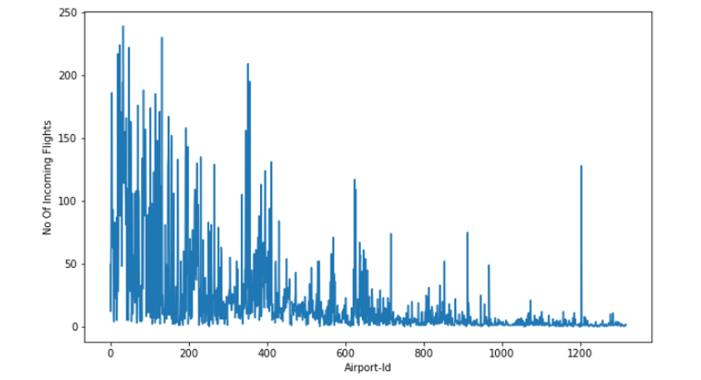
Summary of Incoming Flights at each Airport

Slide 5
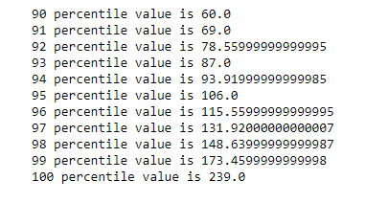
Number Incoming Flights at each Airport

Slide 6
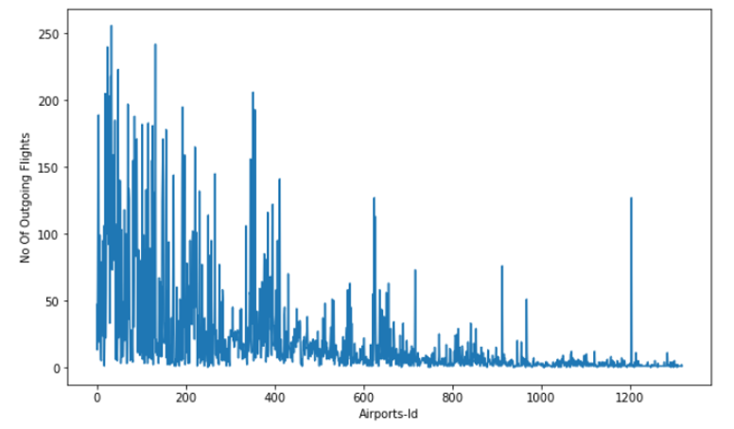
Summary of Outgoing Flights at each Airport

Slide 7
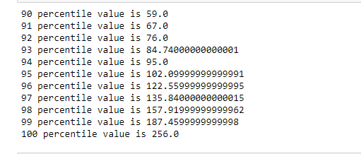
Number Outgoing Flights at each Airport

Slide 8
GRAPH VISUALISATION

Slide 9
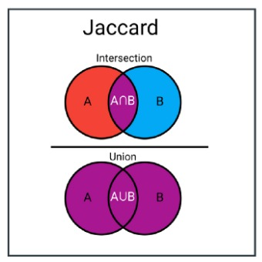
Jaccard Coefficient
The Jaccard index, also known as the Jaccard similarity coefficient, is a statistic used for gauging the similarity and diversity of sample sets.
If the ratio of common flights and total flights between two airports is more then it is more likely of having flight between them.

Slide 10

Adamic Adar Index
Let's say we have two intersection of 2 airports a and b i.e. u1 and u2. If u1 has a large neighborhood then it might happen that it is main airport and a,b doesn't need to have flight between them. But if it has a small neighborhood then it is not the main airport so a,b should be connected. Hence a and b should have a flight between them.

Slide 11
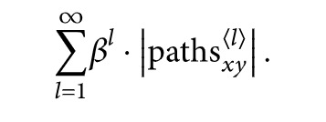
Katz Centrality
A measurement that takes all paths between two nodes in consideration while rating short paths more heavily. The measurement exponentially reduce the contribution of a path to the measure in order to give less weightage longer paths. Therefore it uses a factor of l where l is the path length.
If katz value between two nodes have a large value then this means there should be an edge(flight) between them.

Slide 12
Weakly Connected
if there is an direct flight between airport a and b then we will first remove that edge from the
graph and then we will find shortest path between a and b if it exists. if there exist a shortest path between them then we will return 1 it means they are in same wcc and have something in common else we will return 0 which means they are in different wcc. and same for flight b to a.

Slide 13

Page Rank
Page rank finds the nodes of high importance i.e airports with large no of incoming flights so there is a high chance that new airports will be connected to this important airport.

Slide 14

Preferential Attachment
Preferential attachment means that the more connected a node is, the more likely it is to receive new links.
N(u) is the set of nodes adjacent to u. A value of 0 indicates that two nodes are not close, while higher values indicate that nodes are closer.

Slide 15
Intersection
If there is flight from A to {C,D...} and B to {C,D...} then there are high chances of flight to be present between A to B as they have a high intersection between their neighbours

Slide 16

SVM
Support vector machines (SVMs) are a set of supervised learning methods used for classification, regression and outliers detection.
Accuracy obtained: 87.74 %

Slide 17
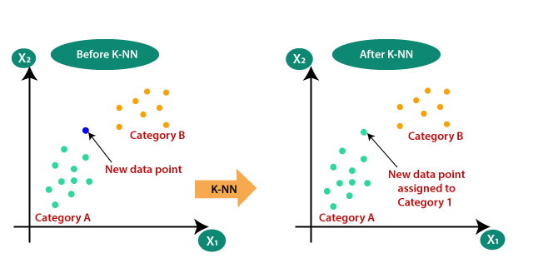
KNN
Accuracy=89.30 %
K=20 neighbours

Slide 18
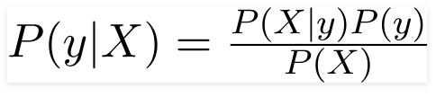

Naïve Bayes
A Naive Bayes classifier is a probabilistic machine learning model that’s used for classification task. The crux of the classifier is based on the Bayes theorem
Variable X represent the parameters/features. In our case, the class variable(y) has only two outcomes, yes or no.
The assumption made here is that the predictors/features are independent. That is presence of one particular feature does not affect the other. Hence it is called naïve
Accuracy: 95.90%.

Slide 19
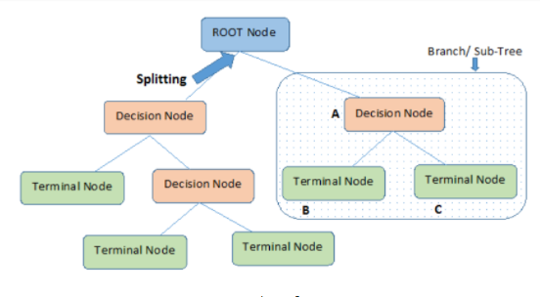
Decision Trees
Decision trees can be used for classification as well as regression problems. The name itself suggests that it uses a flowchart like a tree structure to show the predictions that result from a series of feature-based splits. It starts with a root node and ends with a decision made by leaves
Accuracy:95.36%

Slide 20
Result and Findings
ALGORITHM | ACCURACY
SVM | 88.04
KNN | 89.30
NAÏVE BAYES | 95.29
DECISION TREES | 95.62
Jacard distance and Adar index was giving quite good results on the other hand preferential attachment was not giving the good result.
Naïve Bayes and Decision Trees gave the best performance. On the other hand SVM and KNN were not up to the mark.

Slide 21
Future Work
We have implemented this on around 10 features and used 4 different algorithms to perform link prediction. More relevant features can be added to the link prediction model which would improve the link prediction accuracy, furthermore different algorithms can also be used which would perform better on this model. So in future we can predict which airports can be connected.

Slide 22
References
1)https://jwcn-eurasipjournals.springeropen.com/articles/10.1186/s13638-019-1561-7#sec2
2)https://www.cs.cornell.edu/home/kleinber/link-pred.pdf
3)https://www.transtats.bts.gov/
4)http://www.cs.cornell.edu/courses/cs4780/2015fa/web/lecturenotes/lecturenote05.html
5)https://www.cs.cornell.edu/courses/cs4780/2018fa/lectures/lecturenote17.html
6)http://image.diku.dk/imagecanon/material/cortes_vapnik95.pdf
7)https://ecommons.cornell.edu/bitstream/handle/1813/31637/BU-1065-MA.pdf;jsessionid=B819F2B1B8036A42D9551925F716E95C?sequence=1

Slide 23


