Slide 1

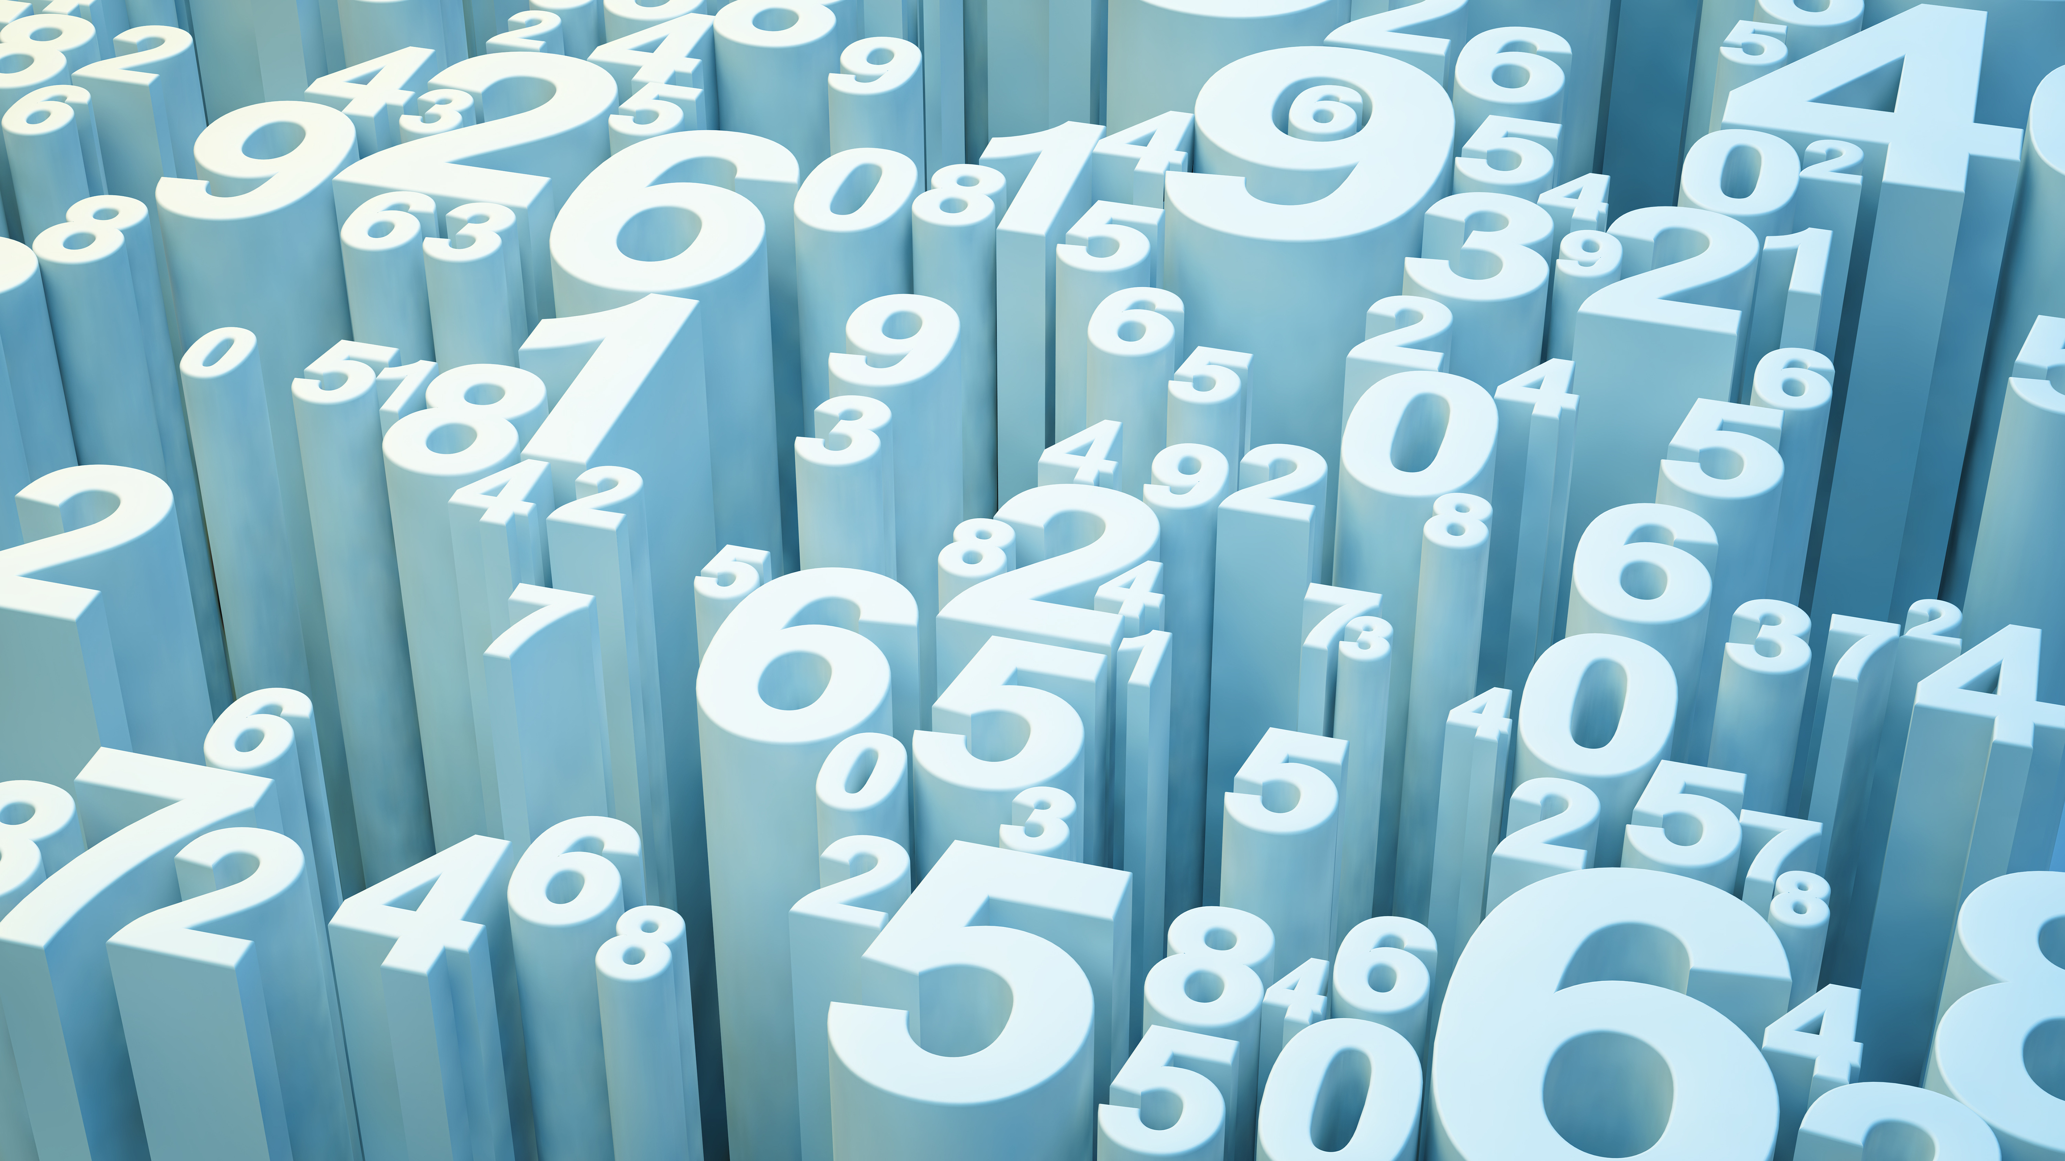
DataZen: Back-end-Task
Nishant Rajadhyaksha
KJ Somaiya College Of Engineering
First-Year(Btech-CSE)
Roll no:-16010120131

Slide 2
Outcomes Achieved
Used Django as Web Development Framework
Used Bootstrap5 framework for styling
Created Robust Authentication system including sign-up,log-in,log-out,etc Pages
Created a Data-Scientist Personality Quiz Which Displays The Trait Pertaining to The Specific User
Created Blogs App So Users Can exhibit Their Knowledge For the benefit of the DataZen Community.

Slide 3
Authentication Systems
Used 3rd party Apps such as Allauth, CrsipyForms to create an authentication system as third party apps are more reliable in security terms because they have been tested by the millions of members of the Django develepor community
Created a CustomUser Form by inheriting AbstractUser Class in Django.
Updated settings files to make it point to Custom Users model as Default model

Slide 4
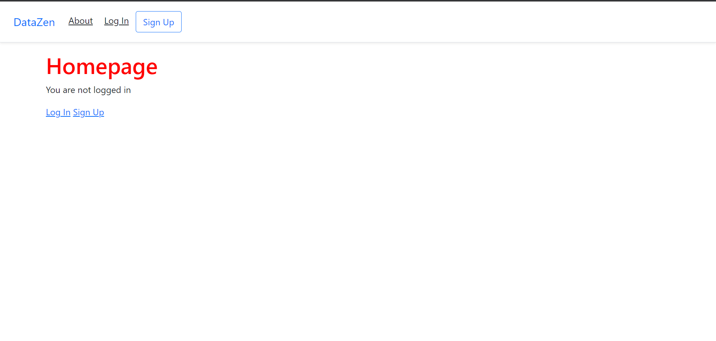

Slide 5
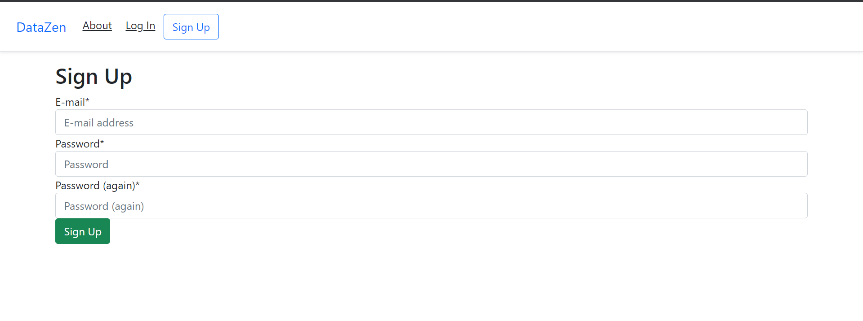

Slide 6
Mixins
Restricted Accsess to pages to Only Logged-in Users using Mixins Classes.

Slide 7
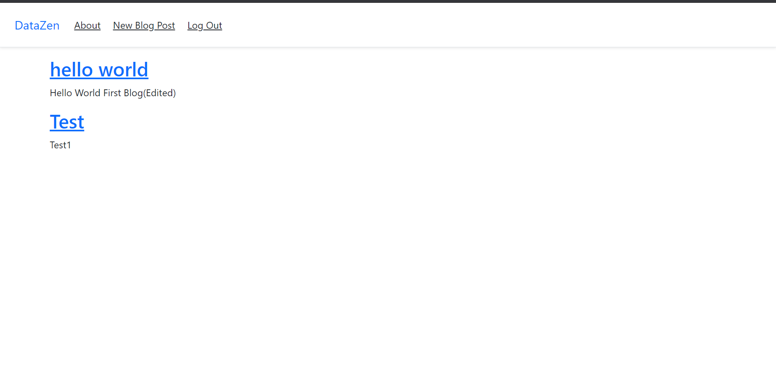
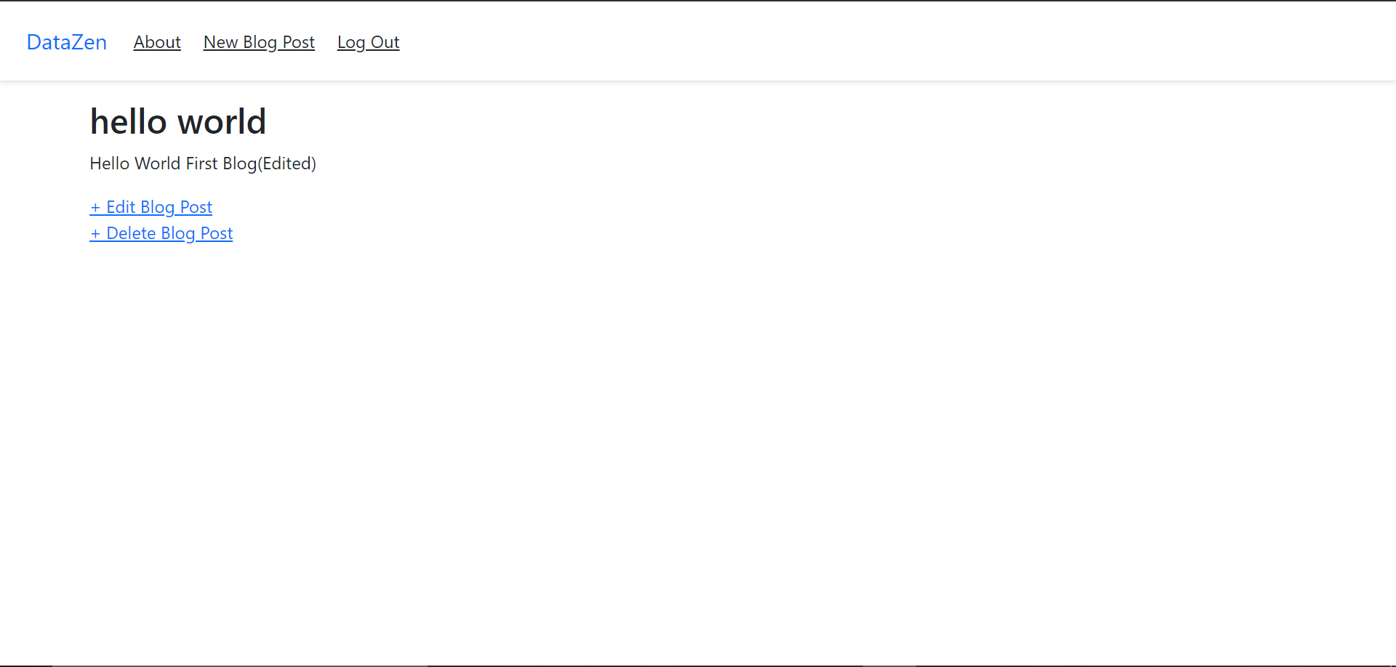
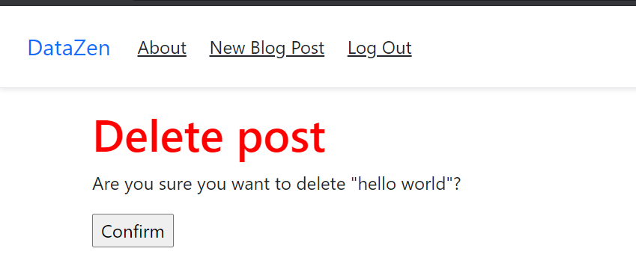

Slide 8
Blog App
Uses Class Based Views such as templateViews, ListViews etc and after the usual Django Tango between Views ,Templates, and Urls displays blog Entries Succesfully.
Has The CRUD(Create-Read-Update-Delete) Functionality To It.
Data Stored to the Post Model residing in the Models File using sqllite databse

Slide 9
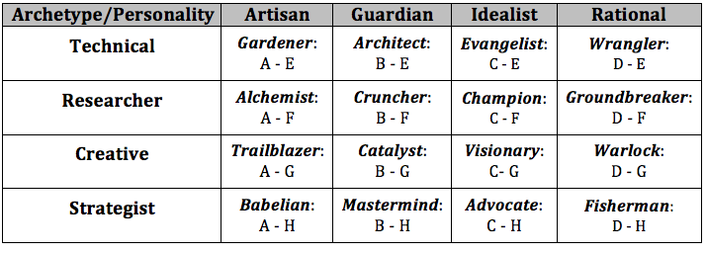
Data-Scientist Personality Test

Slide 10
For Data Scientist Persnality Test Parameters Visit https://francesco-ai.medium.com/data-scientists-personality-test-deeb56c856ce
A user is asked to answer Some questions and according to the answers a label is assigned to the specific user
The label is displayed successfully After answering the questions.

Slide 11
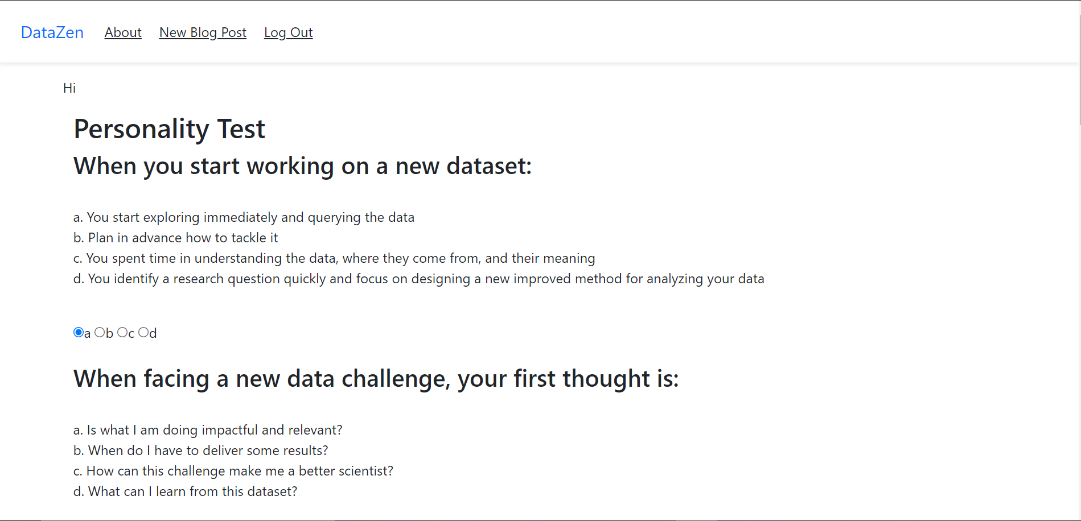
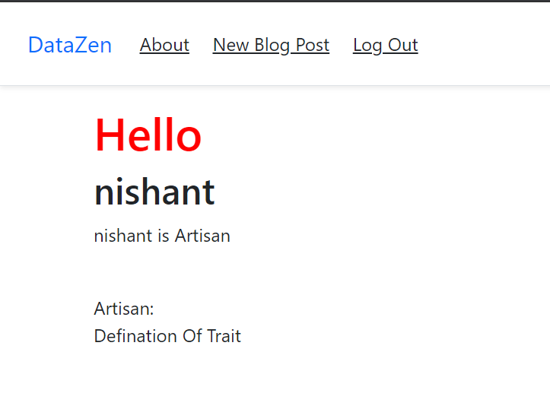

Slide 12
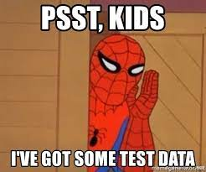
I would Like to Thank The Datazen team for providing me with the opportunity to create This Project As it was Loads of fun.
Id like to conclude with a sentence we Data scientist love to hear the most

Slide 13
Thank You

