Slide 1


fsffsfsfsfsfff
Sudoku Visualizer: A Java Implementation
Welcome to the world of Sudoku visualization! This presentation will delve into the fascinating process of solving Sudoku puzzles using a Java program. We'll explore the logic behind the algorithm and the techniques employed to visualize each step of the solution, creating an engaging and informative experience for the user.

Slide 2

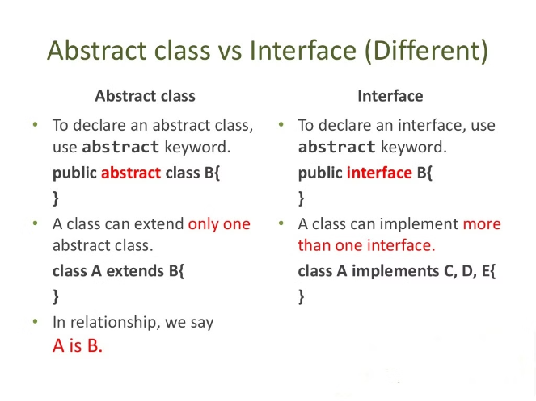

Overview of the Java Language
Java is a versatile programming language known for its readability and platform independence. It's an excellent choice for developing Sudoku solvers due to its robust data structures and powerful libraries, making it easy to manage complex Sudoku logic.
Data Structures
Arrays are used to represent the Sudoku board, allowing efficient access to individual cells.
Control Flow
Loops and conditional statements control the execution of the algorithm, enabling the exploration of possible values.
Object-Oriented Programming
Java's object-oriented nature allows for modular code organization, making it easier to maintain and extend the solver.

Slide 3

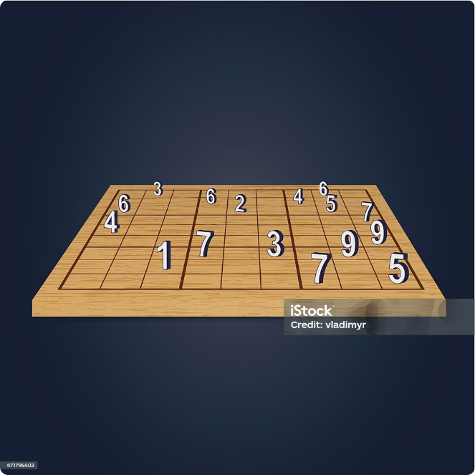
Step 1: Initializing the Sudoku Board
The Sudoku board is represented as a 2D array in Java, with each cell holding a number between 1 and 9. The initial configuration is loaded from a file or input, defining the starting puzzle.
1
Input Format
The Sudoku puzzle is read from a file or user input, with each line representing a row of the board.
2
Array Initialization
A 2D array is created to store the board's numbers, with each element corresponding to a cell.
3
Data Validation
The input is validated to ensure that the puzzle is valid and conforms to Sudoku rules.

Slide 4
Step 2: Identifying Empty Cells
The algorithm needs to identify empty cells on the board to determine potential values. These empty cells are often referred to as "candidates" or "unassigned cells."
Iterating the Board
Candidate List
The algorithm iterates through each cell of the board using nested loops.
A list or data structure is used to keep track of the coordinates of all empty cells on the board.
If a cell is empty (value is 0), it's added to a list of candidates.
This list is then used by the solver to determine potential values for these empty cells.

Slide 5




Step 3: Determining Possible Values
For each empty cell, the algorithm must determine the possible values that can be placed in that cell without violating Sudoku rules.
Row Check
Column Check
3x3 Box Check
The algorithm checks all values present in the same row.
It checks all values present in the same column.
Finally, it checks all values present in the 3x3 box containing the cell.

Slide 6

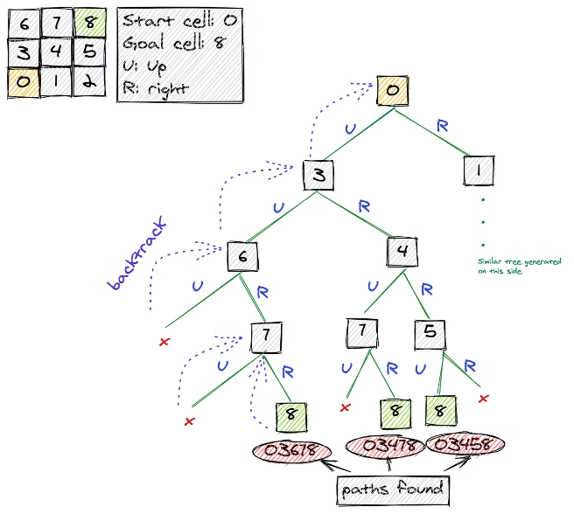
Step 4: Implementing Backtracking Algorithm
The backtracking algorithm is a recursive approach used to systematically explore all possible solutions. It involves placing a possible value in an empty cell, checking for validity, and recursively exploring further placements.
1
Recursive Call
The algorithm recursively calls itself for each candidate cell, trying to place a valid value.
2
Check for Conflicts
After placing a value, it checks if the move creates any conflicts with Sudoku rules.
3
Backtracking
If a conflict is detected, the algorithm backtracks, removing the last placed value and trying a different one.

Slide 7
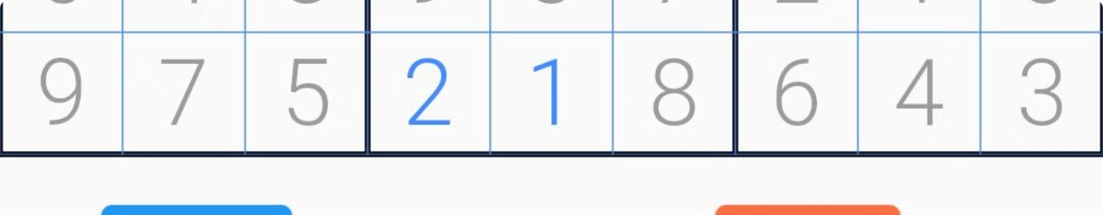
Visualizing Correct and Wrong Moves
To enhance user engagement, the visualizer should clearly distinguish between correct and incorrect moves during the solution process. This can be achieved through color coding, animations, or other visual cues.
Correct Moves
Green or a similar color can be used to highlight correct placements.
Incorrect Moves
Red or another contrasting color can signify an invalid move, guiding the user.

Slide 8




Conclusion and Takeaways
This presentation provided an overview of how a Sudoku solver can be implemented using Java. The key concepts discussed include board representation, candidate identification, value determination, and the backtracking algorithm.
Code Optimization
User Interface
Algorithm Variations
Code optimization techniques like data structure choice and algorithm refinement can enhance efficiency.
A user-friendly interface with intuitive visualizations can enhance user engagement and understanding.
Exploring different algorithms and techniques can lead to faster and more efficient solvers.

