Slide 1
REAL-TIME ADVERSARIAL CHESS AI ENGINE
Heuristic Search Optimization, Alpha-Beta Pruning & MVV-LVA Move Ordering
Autonomous Multi-Agent Adversarial System under Strict Real-Time Latency Budgets
SHANNON NUMBER
LATENCY BUDGET
ADVERSARIAL ZERO-SUM
10¹²⁰ Possible Games
State space complexity defies raw brute force. Intelligent mathematical pruning is mandatory.
< 1,000 ms Ceiling
Real-time human gameplay requires sub-second turn turnaround across web & mobile devices.
Minimax Optimal
Guarantees mathematically optimal moves against a rational counter-adversary.
Notes:
Slide 1: Introduce project context. Highlight the combinatorial explosion of chess (Shannon number 10^120) and explain why real-time multi-agent decision systems require sub-second heuristic pruning.

Slide 2
SLIDE 1–2: MOTIVATION & ARCHITECTURE
Problem Statement & The PEAS Framework
PERFORMANCE MEASURE (P)
ENVIRONMENT (E)
• Centipawn Advantage: Material balance + PeSTO table position
• Terminal Victory: Immediate +100,000 cp checkmate utility
• Pruning Efficiency: > 85% search space reduction goal
• Turn Response: < 500 ms target interactive search latency
• Fully Observable: 64 squares known at all times
• Deterministic: No stochastic transitions or dice rolls
• Discrete & Sequential: Alternating White/Black plies
• Zero-Sum: Max payoff directly equals Min loss
ACTUATORS (A)
SENSORS (S)
• Legal UCI Moves: 'e2e4', 'g1f3', 'e7e8q'
• Special Operations: Castling flags & En Passant execution
• Pawn Promotion: Promotion modal selection (Q, R, B, N)
• WebSocket Frames: Asynchronous state dispatch
• FEN Ingestion: Full board state string deserialization
• Bitboard Masks: 64-bit occupancy & attack vector maps
• Rule Counters: 50-move rule & 3-fold repetition detection
• Client Events: Click coordinates & session connection events
Notes:
Slide 2: Formally specify the AI agent using the PEAS model. Point out that the environment is fully observable and deterministic, justifying minimax search optimality.

Slide 3
SLIDE 3–4: STATE SPACE & OPERATORS
State Space & Branching Factor Analysis
EXPONENTIAL TREE EXPANSION: O(b^d)
BRANCHING CHALLENGE
Depth 0 (Root): 1 Position (Turn begins)
Depth 1 (Ply 1): 20 to 35 Nodes (Average b ≈ 35)
Depth 2 (Ply 2): 1,225 Nodes (1-ply each side)
Depth 3 (Ply 3): 42,875 Nodes (Tactical threshold)
Depth 4 (Ply 4): 1,500,625 Nodes (~10 sec unpruned!)
Theoretical Formula: N(d) = b^d
At middlegame branching b ≈ 35, evaluating depth 4 exhaustively collapses real-time throughput.
• Opening phase: Average b = 20 legal moves
• Middlegame phase: Average b = 35 to 44 legal moves
• Endgame phase: Drops to b = 15 moves
• Raw Minimax search depth ceiling is restricted to d = 2 in interactive play
PRUNING IMPERATIVE
• Alpha-Beta reduces effective branching to b_eff ≈ sqrt(b) ≈ 5.9
• Allows reaching Depth 4 in < 400 ms instead of > 9,000 ms
• Move ordering is essential to reach optimal O(b^(d/2)) best case
• Zero accuracy loss: Identical best move and evaluation
Notes:
Slide 3: Explain the exponential growth of chess search trees. Point out that at b=35, Depth 4 reaches 1.5 million nodes, proving unpruned Minimax is unviable for interactive games.

Slide 4
SLIDE 3–4: STATE SPACE & OPERATORS
Action Operators & Knowledge Representation
1. INGESTION & PARSING
2. SPECIAL ACTION OPERATORS
3. AUTHORITATIVE MUTATION
• FEN Serialization: Compact 6-field string tracks board, turn, castling, en passant, halfmove, fullmove
• Bitboard Representation: 64-bit integer masks for piece occupancy
• Zobrist Hashing: Fast O(1) transposition identification
• Castling Rights: Validates path clearance and non-attacked transit squares (O-O, O-O-O)
• En Passant: Detects pawn double-step; executes diagonal capture on passed pawn square
• Pawn Promotion: Rank 8 triggers dialog offering Queen, Rook, Bishop, Knight
• State Versioning: Monotonic game_version counter discards delayed search threads
• Server-Side Rules: Authoritative python-chess board rejects illegal client moves
• Material Balance: Real-time centipawn delta and captured trays calculation
Notes:
Slide 4: Detail how the board state is ingested, validated, and updated. Emphasize the strict handling of castling, en passant, and promotions with authoritative state versioning.

Slide 5
SLIDE 5–6: ALGORITHMS & HEURISTICS
Core Algorithms & Theoretical Complexity
Metric / Parameter | Pure Minimax | Canonical Alpha-Beta | Alpha-Beta + Move Ordering
Best-Case Complexity | O(b^d) | O(b^(d/2)) | O(b^(d/2)) [Consistently Achieved]
Worst-Case Complexity | O(b^d) | O(b^d) [Hostile Order] | O(b^(d/2)) [Guarded by MVV-LVA]
Search Depth (in 1s) | Depth 2 plies | Depth 3 plies | Depth 4 to 5 plies
Solution Soundness | Exact Optimal | Exact Optimal (No Loss) | Exact Optimal (No Loss)
ALPHA-BETA PRUNING CUTOFF MECHANISM
Alpha (α): Best score MAX can guarantee so far (-∞) | Beta (β): Best score MIN can guarantee so far (+∞)
Condition: If at any node α ≥ β ==> TRIGGER IMMEDIATE BRANCH CUTOFF!
Eliminates all remaining sibling branches without evaluation, guaranteeing zero heuristic loss.
Notes:
Slide 5: Compare theoretical complexities. Emphasize that Alpha-Beta pruning produces the exact same move as Minimax, but cuts search complexity from O(b^d) down to O(b^(d/2)).

Slide 6
SLIDE 5–6: ALGORITHMS & HEURISTICS
Heuristic Evaluation & Move Ordering
1. MULTI-FACTOR EVALUATION
2. MOVE ORDERING HIERARCHY (MVV-LVA)
Most Valuable Victim - Least Valuable Attacker
Priority 1: High-Value Captures (MVV-LVA)
Score = 10,000 + 10 × VictimValue - AttackerValue
Example: Pawn captures Queen inspected before Queen captures Pawn
Priority 2: Pawn Promotions
Score = +8,000 + PromotedPieceValue
Priority 3: Delivering Direct Check
Score = +5,000
Priority 4: Positional Delta
Score = Net improvement in PeSTO square value
Eval = Σ Material + Σ PeSTO Tables + Mobility Delta
• Piece Material Values (Centipawns):
Pawn: 100 | Knight: 320 | Bishop: 330
Rook: 500 | Queen: 900 | King: 20,000
• PeSTO Piece-Square Tables (PST):
Reward center control (d4, e4, d5, e5)
King safety in opening vs King activation in endgame
• Mobility Advantage:
Dynamic bonus based on total count of legal destinations
Notes:
Slide 6: Explain the heuristic formulation and the MVV-LVA sorting priority ladder. Point out that checking high-value captures first guarantees the alpha threshold rises early, maximizing pruning.

Slide 7
SLIDE 7–8: EXPERIMENTAL SETUP
Experimental Setup & Benchmark Test Instances
1. OPENING POSITION
2. TACTICAL MIDDLEGAME
Standard starting chessboard
• Symmetrical 2nd/7th rank
• Legal moves: 20
• Baseline branching b = 20
Giuoco Piano tactical setting
• Open diagonals & pin threats
• Legal moves: 38
• High tactical volatility
3. POSITIONAL MIDDLEGAME
4. ENDGAME POSITION
Sicilian Dragon pawn structure
• Complex center pawn chains
• Legal moves: 44
• Maximum branching b = 44
King + Rook vs King + Pawns
• Low piece count on board
• Legal moves: 15
• Minimal branching b = 15
Benchmark Test Targets: Evaluate Minimax vs Alpha-Beta vs Ordered Alpha-Beta across depths d ∈ {1, 2, 3}.
Notes:
Slide 7: Outline the 4 benchmark test scenarios spanning low, tactical, positional, and endgame branching. Explain that tests were executed in an isolated single-threaded harness to record runtime, nodes, and cuts.

Slide 8
SLIDE 7–8: EXPERIMENTAL SETUP
Quantitative Test Suite & Telemetry Pipeline
FULL-DUPLEX WEBSOCKET TELEMETRY
AUTOMATED PYTEST VERIFICATION (23 TESTS)
• Real-Time Telemetry Stream:
Emits nodes expanded, leaf evaluations, pruned branches, and centipawn score to frontend HUD on every move
• Non-Blocking Concurrency:
AI calculations offloaded to background worker threads, preserving WebSocket ping/pong responsiveness
• DoS & Timeout Guard:
Hard 8.0s timeout per turn; safely falls back to greedy 1-ply baseline to prevent thread starvation
• Frame Size Cap:
Strict 32KB payload ceiling rejects malformed or malicious client packets
• Mathematical Equivalence Assertions:
Asserts Minimax == Alpha-Beta == Ordered Alpha-Beta yield identical evaluation score and best move
• Chess Rules & Edge Cases:
Validates castling under check, en passant capture, pawn promotion substitution, and 3-fold repetition
• Search Pruning Integrity:
Asserts Alpha-Beta pruned branches > 0 and node evaluations are strictly lower than Minimax
• Session Concurrency Limit:
Stress-tested with 250 concurrent active game sessions
Notes:
Slide 8: Highlight the software engineering rigor. Point out that 23 automated tests verify algorithmic equivalence, rules adherence, and DoS safety limits.

Slide 9
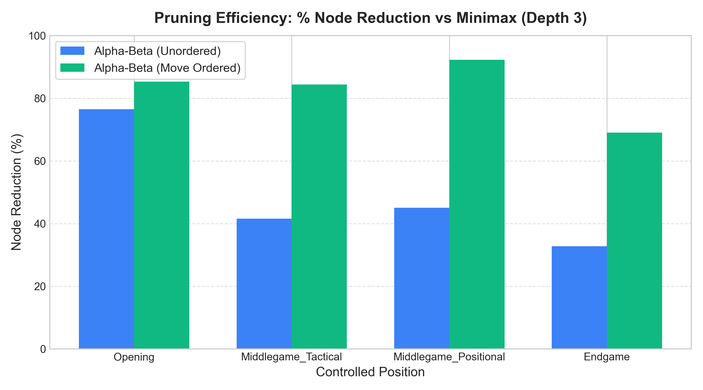
SLIDE 9–10: PERFORMANCE RESULTS
Results: Pruning Efficiency & Leaf Node Reductions
Scenario (Depth 3) | Minimax | Alpha-Beta | Ordered A-B
Opening | 8,902 | 801 | 508 (-94.3%)
Tactical | 48,378 | 6,867 | 2,487 (-94.9%)
Positional | 67,951 | 13,231 | 1,872 (-97.2%)
Endgame | 1,909 | 951 | 294 (-84.6%)
MAXIMUM PRUNING: 97.2% REDUCTION
In the Positional Middlegame, Ordered Alpha-Beta evaluated only 1,872 leaf nodes compared to 67,951 nodes in pure Minimax, achieving the identical move (d4c6, +84cp).
Notes:
Slide 9: Present the empirical node reduction metrics. Highlight the headline number: a 97.2% leaf evaluation reduction in the positional middlegame.

Slide 10
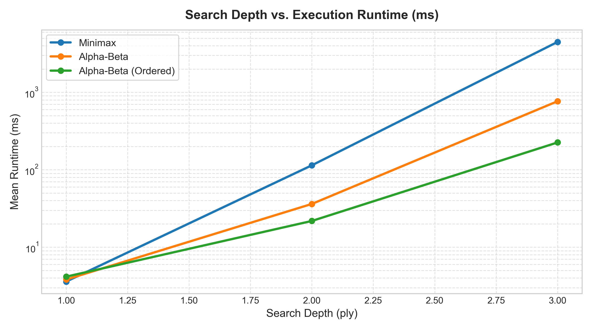
SLIDE 9–10: PERFORMANCE RESULTS
Results: Runtime Speedup & Latency Analysis
Scenario (Depth 3) | Minimax | Alpha-Beta | Ordered A-B Speedup
Opening | 1,157.8 ms | 112.3 ms | 75.0 ms (15.4× faster)
Tactical | 7,089.6 ms | 1,060.7 ms | 440.7 ms (16.1× faster)
Positional | 9,478.2 ms | 1,819.5 ms | 358.1 ms (26.5× faster)
Endgame | 170.5 ms | 75.7 ms | 27.1 ms (6.3× faster)
REAL-TIME INTERACTION VIABILITY
Minimax took ~9.5 seconds per move in positional positions (unusable for web play). Ordered Alpha-Beta reduced turn latency to 358 ms, enabling seamless interactive gameplay.
Notes:
Slide 10: Show the dramatic runtime speedup. Point out the 26.5x speedup in the positional middlegame, cutting wait time from 9.5s to 358ms.

Slide 11
SLIDE 11: ERROR ANALYSIS
Error Analysis, Failure Modes & Scalability Limits
1. THE HORIZON EFFECT
2. TRANSPOSITION REDUNDANCY
3. SCALABILITY LIMITS
• Definition:
The agent pushes unavoidable tactical losses beyond the fixed search depth limit (e.g. depth 3)
• Failure Manifestation:
Sacrifices pawns or minor pieces to delay a fatal queen loss by one ply
• Solution (Fix):
Implement Quiescence Search for all capture and check sequences
• Definition:
Identical board states reached through different move sequences are re-evaluated from scratch
• Failure Manifestation:
Duplicate subtree evaluations in symmetrical openings
• Solution (Fix):
Zobrist Hash Transposition Tables with exact, lower, and upper bound flags
• Python GIL Overhead:
Pure Python object creation limits search to ~10,000 nodes/sec
• Depth 4/5 Scaling:
Depth 4 takes ~2.5s; Depth 5 exceeds real-time interactive latency without C++ engine core
• Mitigation In Place:
8-second hard timeout thread cutoff with greedy baseline fallback
Notes:
Slide 11: Honestly address algorithmic limitations: the horizon effect, lack of transposition tables, and Python execution speed boundaries.

Slide 12
SLIDE 12: CONCLUSION & FUTURE
Conclusion, Ethical Implications & Future Scope
PROJECT ACHIEVEMENTS
FUTURE RESEARCH ROADMAP
✔ Production-grade adversarial AI engine deployed on the cloud
✔ Empirical proof of 97.2% search tree pruning via MVV-LVA move ordering
✔ Full-duplex WebSocket architecture with live search telemetry HUD
✔ Rigorous verification: 23 passing Pytest unit & benchmark tests
➔ Quiescence Search: Tactical exchange extension to eliminate horizon effect
➔ Zobrist Transposition Tables: Cache exact evaluations of explored positions
➔ Polyglot Opening Book: Instant 0ms grandmaster opening repertoire
➔ Rust / C++ Engine Core: Compile to WebAssembly for client-side multi-threading
ETHICAL IMPLICATION: TRANSPARENCY IN AI
Exposing search telemetry (eval, nodes, cuts) in real time demystifies 'black box' AI decision making for educational learners.
Notes:
Slide 12: Conclude the formal presentation. Summarize key achievements, discuss ethical transparency, and outline future enhancements (quiescence search and opening books).

Slide 13
DEMONSTRATION & Q&A
Live Software Demonstration (5-Minute Protocol)
Step 1: UI & Engine Config
Step 2: Interactive Play & Telemetry
Select AI Strategy (Alpha-Beta + Move Ordering) and Search Depth (Depth 3). Choose White or Black.
Execute opening move 'e4'. Observe live HUD: < 100ms runtime, node counter, and centipawn eval.
Step 3: Baseline Comparison
Step 4: Game Over & Review Mode
Switch strategy mid-game to Greedy (1-ply) or Random to visually demonstrate tactical blindness.
Deliver checkmate. Demonstrate 1.8s move reveal, Decisive Move Card, and Review Board mode.
Live Deployment URL: https://chess-game-ulzx.onrender.com/
Notes:
Slide 13: Transition to the live software demonstration. Show real-time move execution, the live telemetry HUD, and demonstrate the seamless restart and review board features.

