Slide 1
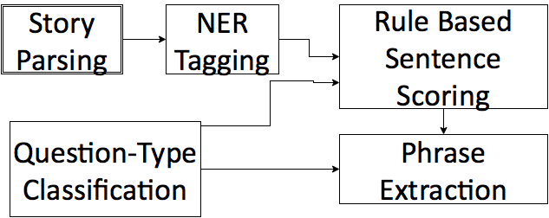
Pythonhunters
Nishant Agarwal Krishna Gaurav
System:
NLTK
Stanford NER Tagger
WordNet Lemmatizer
We followed the following steps to implement the project
1. " A Rule based Question answering system for Reading Comprehension Tests”.
2. Parsing and NER tagging.
3. Question type classification followed by sentence scoring.
4. Phrase extraction from best sentence.
What worked well?
1. WordNet Lemmatizer.
2. Context Window for Phrase Extraction.
What did not work well?
1. Generalized grammar for phrase extraction.
2. Generalization of phrase extraction for a specific question type to a single kind of answer type in each category.

