Slide 1

Project FINAL Report
0/1 Knapsack problem
CS546 – Parallel and Distributed Processing
Aude LAURENT – A20387679
Rishabh Shah – A20381143

Slide 2
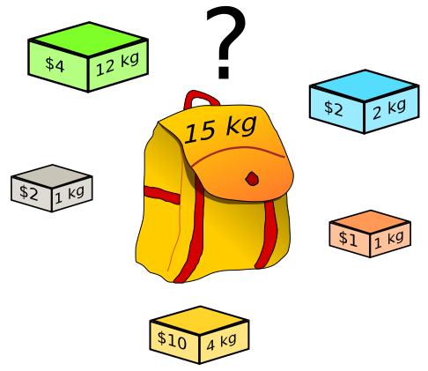
0/1 KNAPSACK PROBLEM
Problem of combinatorial optimization
A set of items with a weight and a value
+ a knapsack with a maximum weight it can carry
→ Find which items to take to get the best value but not exceed the knapsack capacity

Slide 3
Our Objective
Develop a program including three separate algorithms using parallelism from a sequential algorithm
Using MPI, openMP & Hadoop
Test and compare efficiency, reliability and speedup of sequential and parallel solutions

Slide 4
ProBLEM Representation
Each cell contains the best value for its column’weight and its row and above items
At the end: best value in cell [item n-1][max weight]
 | 1 | 2 | 3 | … | Max weight
Item 0
Item 1
…
Item n-1

Slide 5
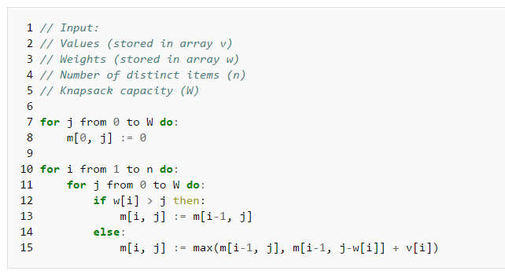
SEQUENTIAL ALGORITHM
For each cell: value = maximum value between
Same weight whithout the new item -> [i-1][j]
Using the item: item value + best value of remaining weight -> [i-1][j- item’s weight]

Slide 6
Sequential results(UNIT seconds)

Slide 7
Dependencies Analysis
Task dependencies impossible → Data parallelism
Column independent
Dependencies between the rows
→ Column parallelization: for each row iteration: all column are compute simultaneously

Slide 8
OPENMP PROGRAM
Steps for Computation
Generating new instance of knapsack problem.
Parallelizing the code by using parallel for directive.
Main improvement over the original version is that it only uses an array of two rows because for every element to be computed, we only need two elements from the previous row.
Finding maximum profit.
Calculating individual time as well as overall time.

Slide 9
Openmp program
int solve(int N, int C, int *w, int *v) { int i, j;
int dp[2][MAX];
for (j=0 ; j<=C ; j++) {
dp[0][j] = 0;
dp[1][j] = 0; }
// Start on the second row.
int curr = 1;
for (i=1 ; i<=N ; i++) {
# pragma omp parallel for num_threads(thread_count)
for (j=1 ; j<=C ; j++) {
dp[curr][j] = dp[!curr][j];
if (j-w[i-1] >= 0) {
dp[curr][j] = max(dp[curr][j], v[i-1] + dp[!curr][j-w[i-1]]);
}}
// Swap the rows
curr = !curr;
}return dp[!curr][C]; }

Slide 10
HADOOP PROGRAM
Steps for computation
Setting up a single instance cluster on AWS EC2.
Installing hadoop in EC2 instance and change CFG file of mapreduce.
Using functionality of cross over and mutation for knapsack 0/1.
Read input or generate random solutions.
Cross over between the selected inputs.
Mutation on the inputs.
Calculate profit.

Slide 11
MPI PROGRAM
Steps of the computation;
Compute the maximum value achievable using the new item
Compute the value without the new item
Find the maximum and save it in the cell
Send to all the processers that could need it the new value
Quite simple algorithm but a lot a message sent

Slide 12
RESULTS AND PERFORMANCE – MPI

Slide 13
RESULTS AND PERFORMANCE – MPI – Analyze
No optimisation at all (100x worst)
Reason:
Number of message exchange
Data set too small
Coherence in results if only looking at MPI graph

Slide 14
RESULTS AND PERFORMANCE – OPEN MP
Sequential: n=20: 0.10ms / n=1000: 1.669ms
Sequential: n=20: 0.164ms / n=1000: 5.667ms

Slide 15
RESULTS AND PERFORMANCE – OPEN MP – ANALYSIS
Fully Optimization.
Parallel version works much faster then the sequential version on all nodes.
As the number of nodes increases computation time decreases for large amount of dataset.
Reason:
Able to solve dependencies between the rows.
Loop which was use for generating the maximum weight has been parallelized increasing speedup of the system.

Slide 16
RESULTS AND PERFORMANCE – SPEED UP

Slide 17
NUMBER OF ITEMS / MAXIMAL WEIGHT INFLUENCE
« Cross » the data to see what influences the more the execution time
High number of item OR
High maximum weight
On sequential: number of items influences the most
On MPI & openMP: maximum weight influences the most
Makes sens with parallelization
 |  | Sequential | OpenMP (4) | MPI (4)
1000 items * weight 10 |  | 1,24 | 0,00 | 9,52
20 items * weight 10000 |  | 0,16 | 0,31 | 10,35

Slide 18
FutUre EnhAncement
Running the knapsack 0/1 on Hadoop Cluster
Compare with a cuda based program
Bigger data set (order 10,000/100,000/ … )

Slide 19
CONCLUSION
Put into practice technics and methods learnt during the semester
Throught understanding of the 0/1 knpasack problem
Implment ation of 3 algorithms
Unexpected results for MPI
Very good results for openMP

