Slide 1

A Neural Network for the Identical Kuramoto Equation: Architectural Considerations and Performance Evaluation
- Presenting author: Nishantak Panigrahi
Authors: Nishantak Panigrahi, Mayank Patwal
Affiliation: Vellore Institute of Technology (VIT), Vellore
Paper ID: 284
Date: 18 Sep 2025

Slide 2
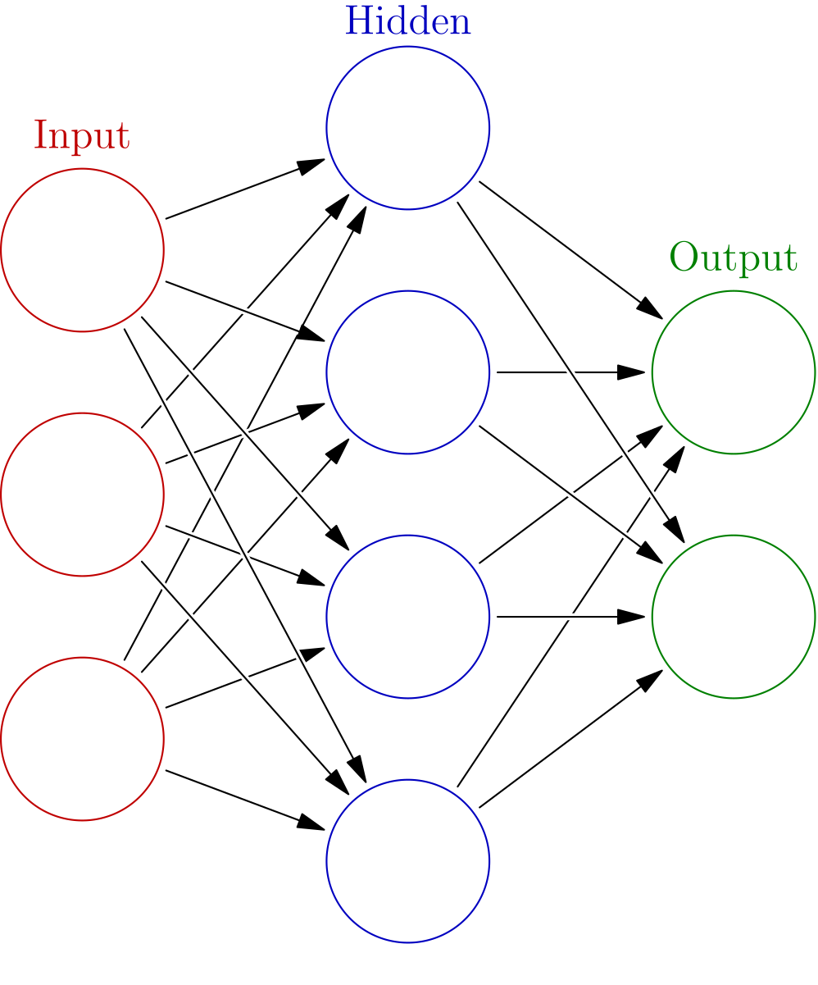
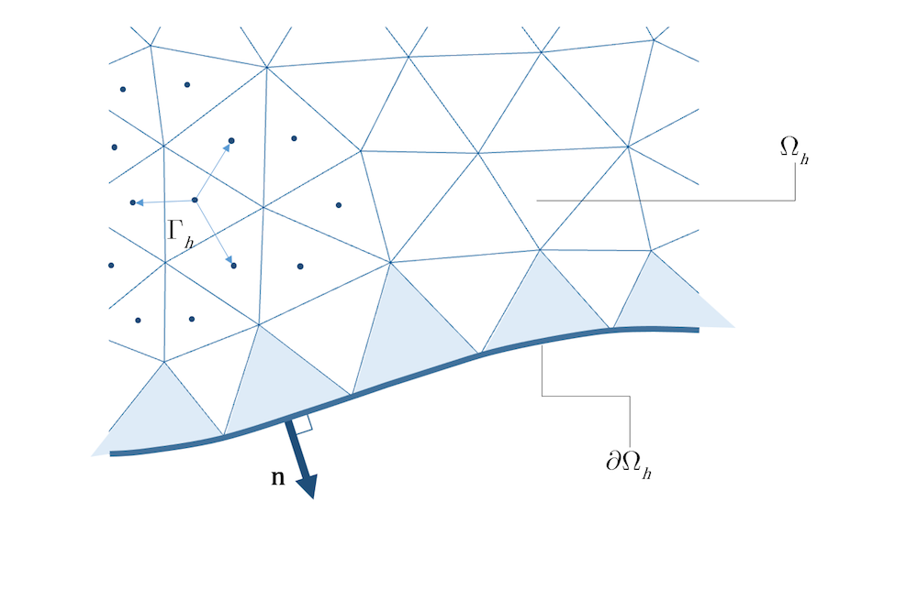
The Big Question ?
Activation?
Depth?
Width?
Loss?
Performance?
Numerical Solvers?
Accurate
But, SLOW!
Partial Differential Equations (PDEs)
But?
Fast
Mesh free
Neural Networks?

Slide 3
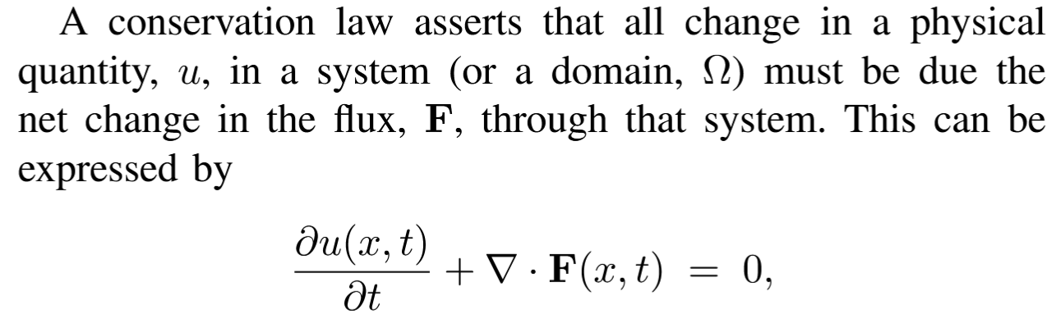

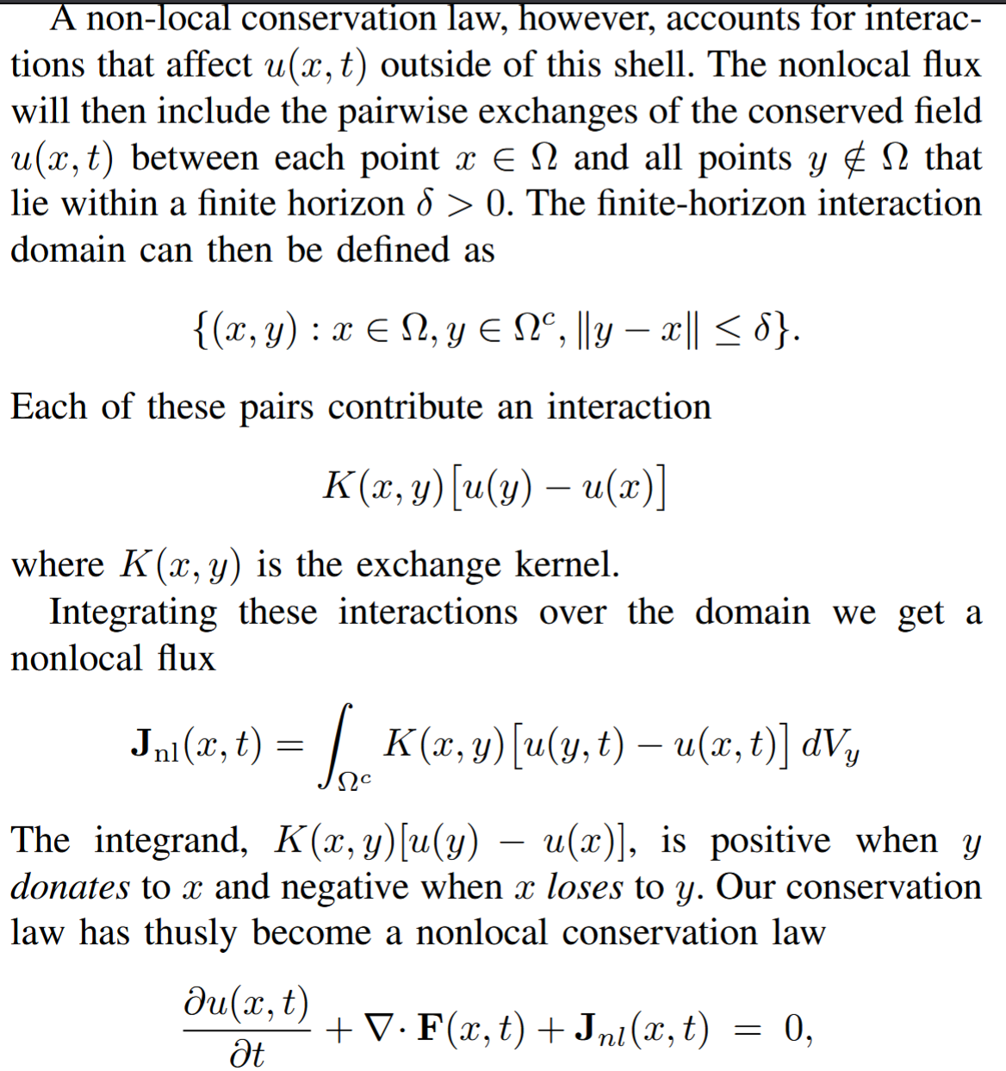
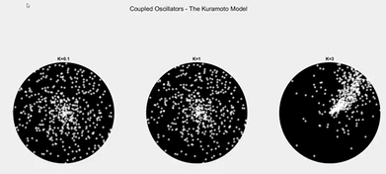
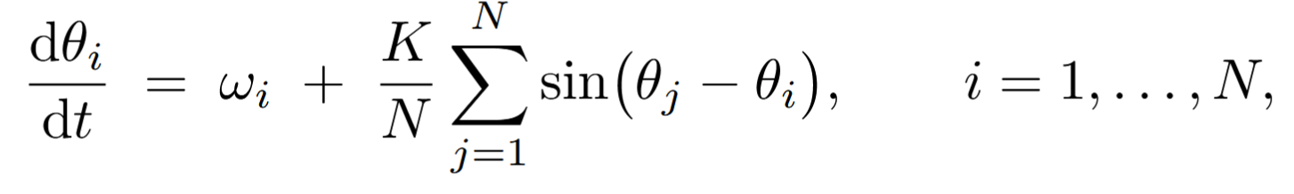
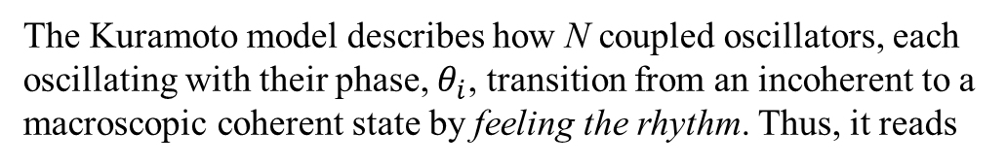
The Kuramoto Model Nonlocal Conservation Laws
In a nonlocal conservation law, the change in u is also attributed to the sum of pairwise interactions, J_{nl}, from particles at a distance.
The Kuramoto model describes how N coupled oscillators, each oscillating with their phase, $θ_{i}$, transition from an incoherent to a macroscopic coherent state by feeling the rhythm. Thus, it reads
Ref: https://www.youtube.com/watch?v=Ow7cFh7bAaE
Simple phase oscillator
Other Nodes
Nonlocal Coupling
(flux)

Slide 4
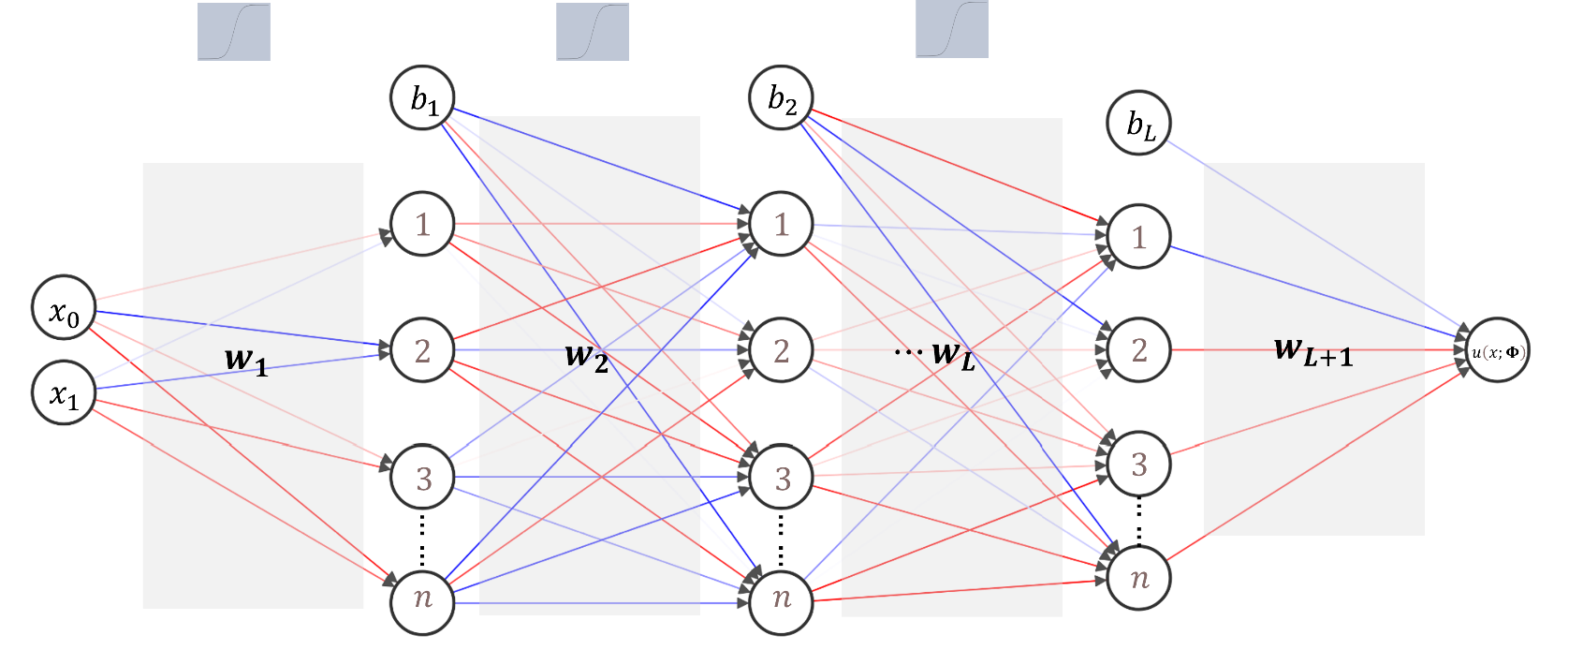



The Neural Network
Architecture and Formulation
$σ$ (Non-linear activation)
Output: $ℝ$
Input: $ℝ^{d}$ ; (d=2)
L Hidden Layers (Depth)
n Units (Width)
> By training parameters, $Φ=\left\{W, b\right\}$, the network learns a mapping: $ℝ^{d}$ $→$ $ℝ$, such that the learnt output approximates $u(θ, t)$.
4

Slide 5
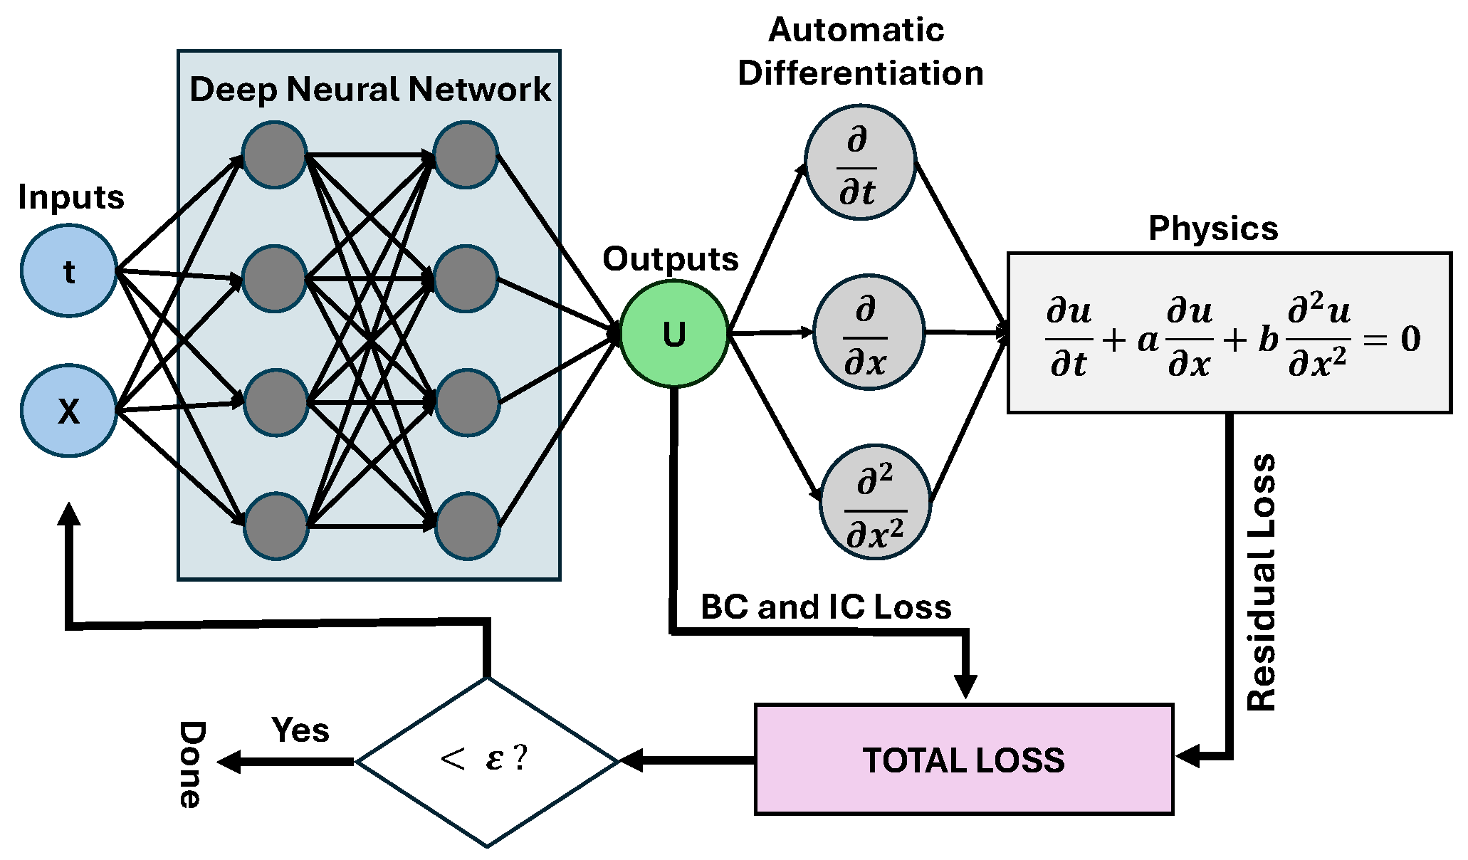
The Neural Network
Physics-Informed approach
5

Slide 6
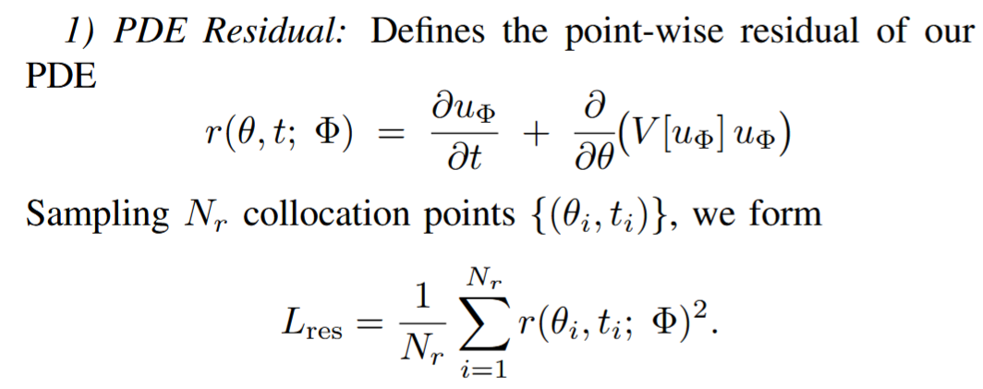
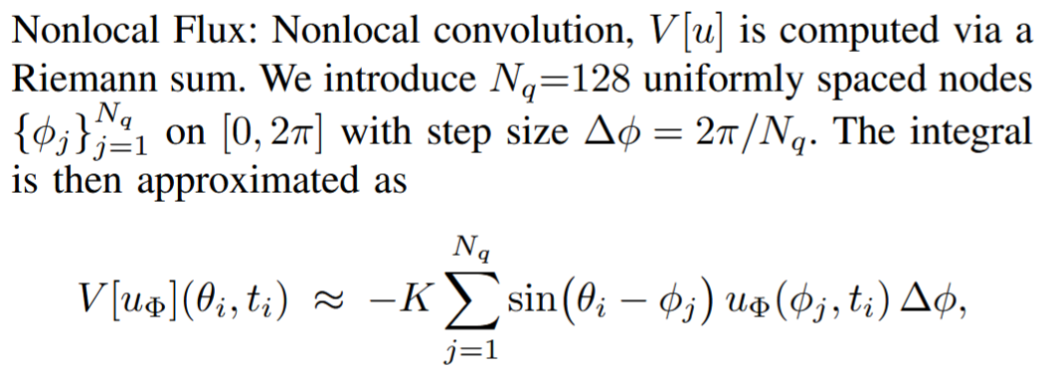
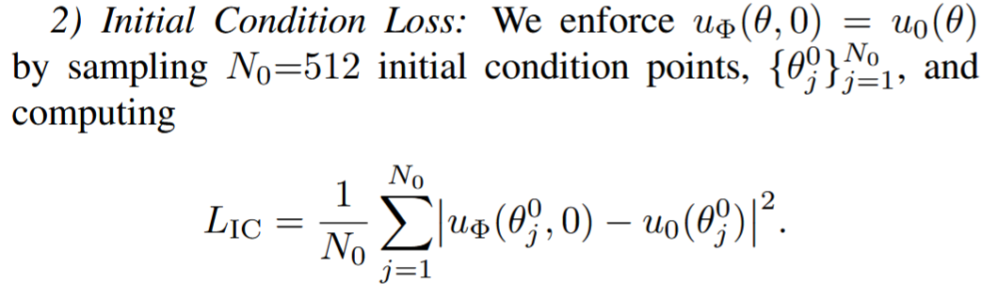
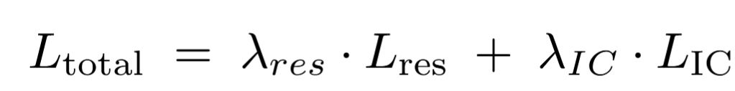
The Neural Network
Learning the Kuramoto Model
6

Slide 7
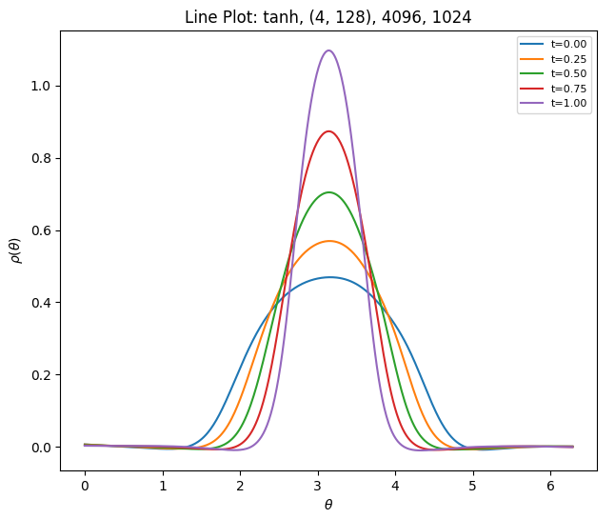
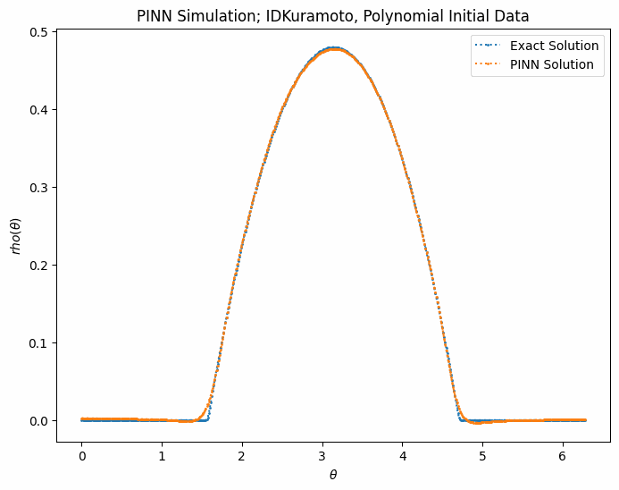
The Neural Network
Learning the Kuramoto Model
Dataset: purely synthetic, approximating different order of smoothnesses occurring in nature
Optimiser: Adam Optimiser (learning rate = 1 X 10⁻³)
7

Slide 8
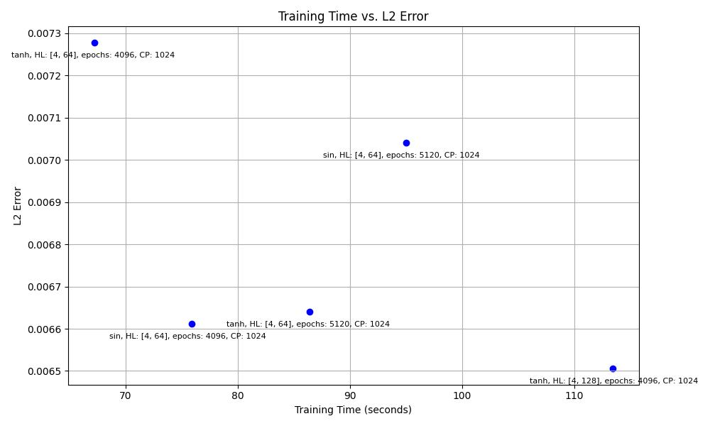
Results
Evaluation Metrics: L2 Error against high-resolution (512 point) Finite Volume Solver
~10% lower
Caution must be exercised with wider networks to prevent the networks from memorising solutions on the known domain
~13% faster
8

Slide 9
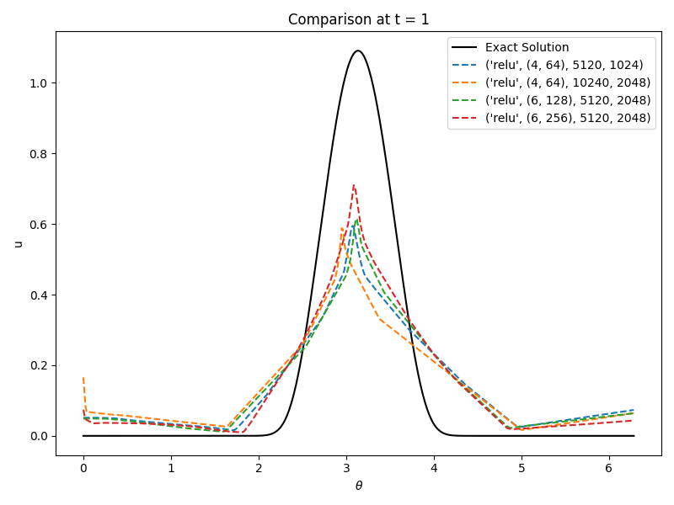
Results
ReLU Activation
9

Slide 10
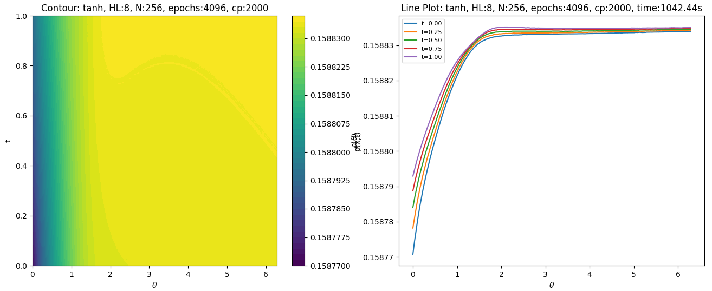
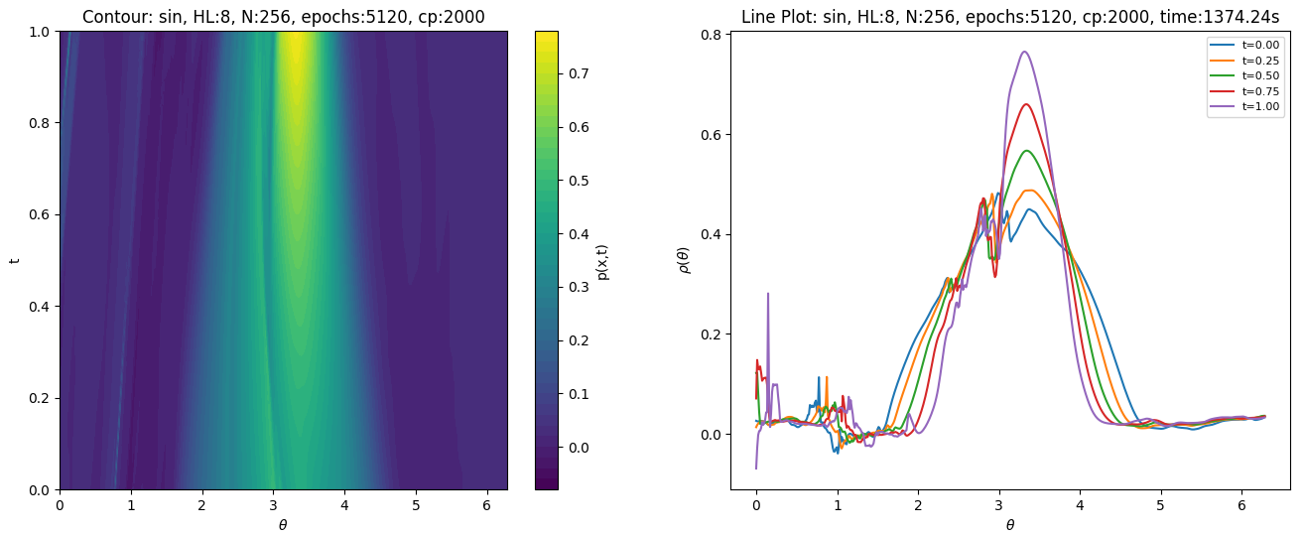
Results
5%
Non Physical Artefacts
Occur in architectures with excessive depth and width
10%
10

Slide 11
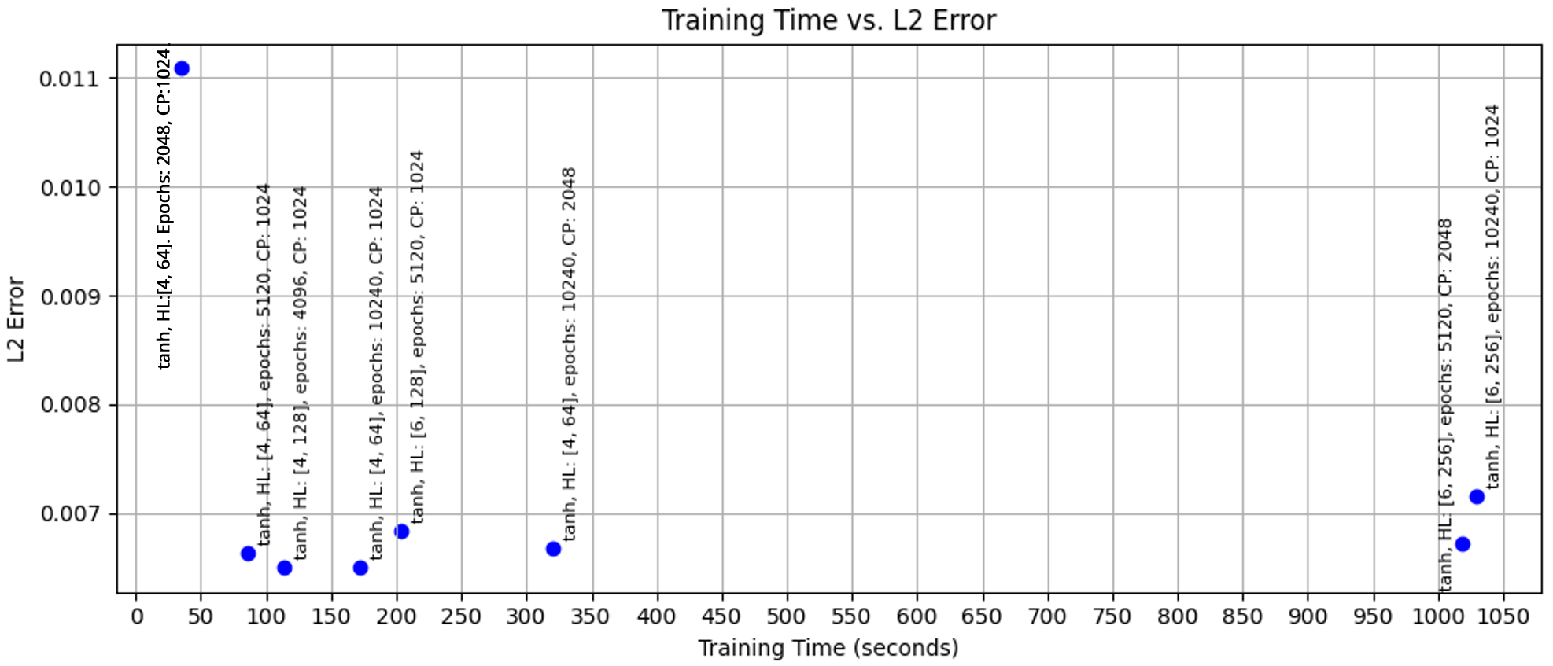
Results
Impact of Depth and Width
Diminishing returns
11

Slide 12
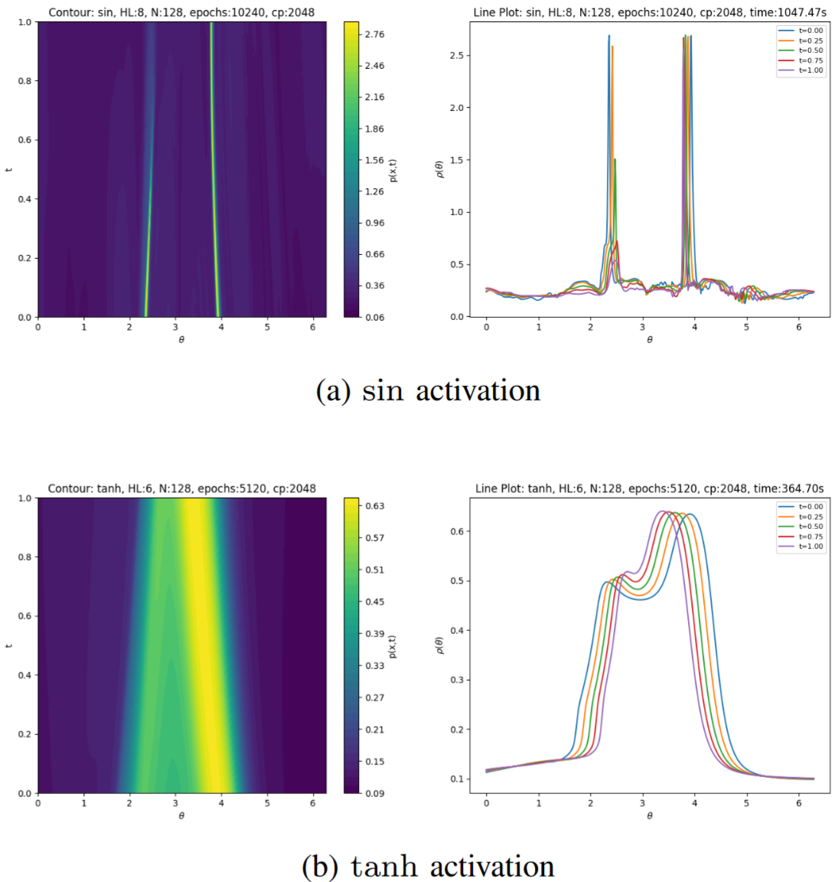
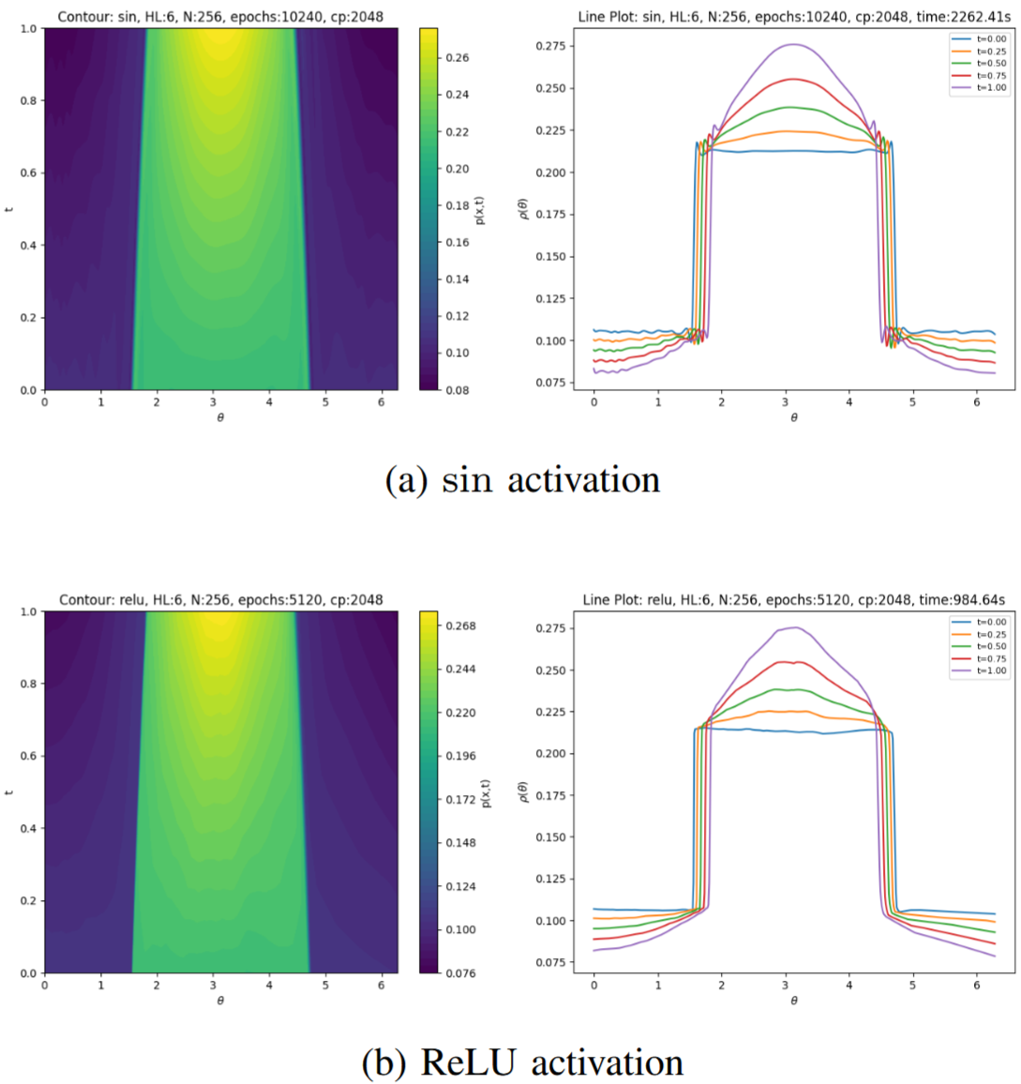
Limitations and Future Directions
Closest solution profiles for Initial data with singular masses
Closest solution profiles for Initial data with discontinuities
12

Slide 13
Limitations and Future Directions
Problem: Due to smooth activation functions (sin, tanh), the approximated solution, u($θ$, t), lies in the C$∞$ class of infinitely-differentiable functions. Thus, failing to approximate solutions with delta spikes (singular masses) and discontinuities.
Remedies:
Weak or variational loss formulations: integrate PDE residual against test functions to capture distributional (weak-form) derivatives at jumps.
Domain decomposition: train separate subnetworks on subdomains to localise shocks and prevent global smoothing, but this requires prior knowledge of domain/solution structure.
Enriched input embeddings: use Fourier features or wavelets to improve network expressivity and capture steep gradients.
Quantum machine learning (parameterised quantum circuits): quantum effects in PQCs might model nonlocal correlations, offering new possibilities for handling discontinuities.
Future work will explore these techniques to extend DNNs’ applicability to scientific computing problems featuring discontinuities and singular measures.
13

