Slide 1


ICDE-JOB HIVE
Connecting Careers, Empowering Success
COEN-6311
Software Engineering
Presented by Team 4:
Student Name | Student ID
Bhargav Patel | 40220250
Merlin Mary Abraham | 40220549
Nishant Arora | 40220453
Nishant Barua | 40267821

Slide 2
Problem Statement
The ICDE - Job Hive Application is designed to help streamline job searching for users.
The application accepts search criteria & web crawl to find latest & most relevant job postings.
The ICDE - Job Hive tracks user search activities to generate job & skills recommendations to suit user profile.
Additionally, we provide a resume building section with an integrated ChatGPT prompt to display skill recommendations to the user.

Slide 3
ICDE-JobHive Requirements
Top 3 User Requirements:
Register, login & manage profile on their personal Job-Hive account.
Search for & View latest job listings based on user profile, keywords & location search.
Receive recommendations for jobs based on their search history.
Top 3 System Requirements:
Allow users to register, login & manage profile.
Fetch & display latest job listings based on user profile, received keywords.
Track user profile data & activities to generate job recommendations.

Slide 4
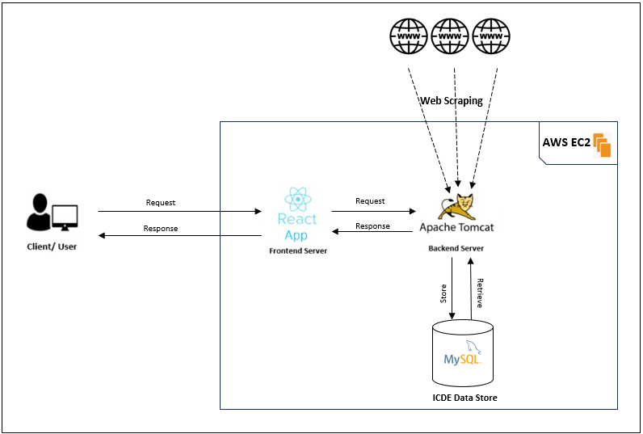
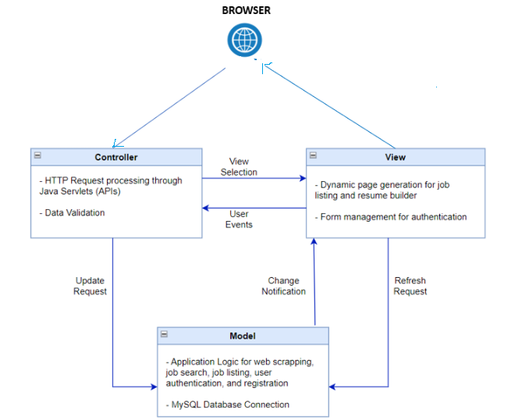
Architectural Design
Fig: System Architecture.
Fig: MVC Design Pattern.

Slide 5
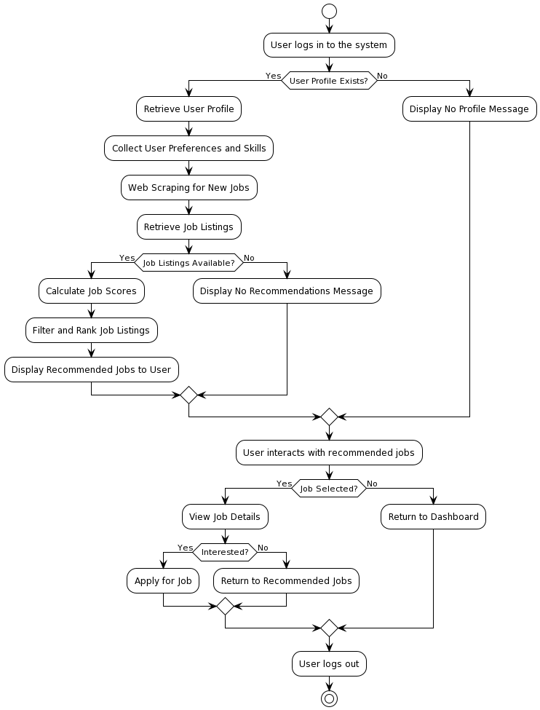
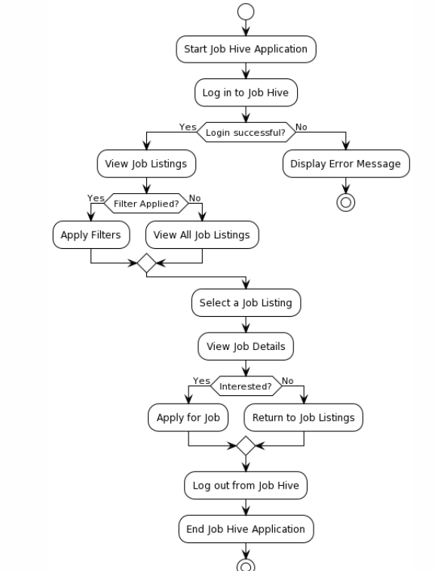
Major System Designs
Req: 1
Req: 2
Req: 3

Slide 6
Software Metrics
Particulars Vs Tasks |  | Register | Login | Manage Profile | Search | Job Recommend | Data Capture | View Jobs | Skill Recommend | Skill Recommend | Resume Builder
Front-end | React Components | 4 | 3 | 1 | 7 | 1 | 1 | 1 | 2 | 2 | 8
 | LOC | 378 | 183 | 48 | 320 | 318 | 246 | 253 | 73 | 73 | 770
 | Framework | ReactJS
Back-end | Java Class | 4 | 5 | 3 | 4 | 3 | 4 | 3 |  | 3 | NA
 | LOC | 158 | 43 | 125 | 190 | 150 | 160 | 110 |  | 163
 | Libraries | 5 | 6 | 14 | 16 | 2 | 3 | 3 |  | 3
 | Packages | 1 | 1 | 1 | 2 | 1 | 1 | 1 |  | 1
 | Frameworks | MySQL , J2EE
Test Units | Test Class | 1 | 1 | 1 | 1 | 1 | 1 | 1 |  | NA | NA
 | LOC | 75 | 78 | 54 | 35 | 45 | 32 | 46
 | Framework | JUnit 4, Mockito, Power Mockito
Platforms |  | Docker, AWS

Slide 7
Incremental Agile Development
Specification:
1. Problem Statement defined for the project.
2. Product Roadmap built outlining product feature overview.
3. Requirement Gathering to decide software tools.
Design:
1. Product Design defined using architecture diagram & MVC design pattern.
2. User Stories via activity diagrams from our defined product features.
3. Backlog Creation to prioritize & organize user stories for implementation.
Implementation:
1. Sprint Planning done based on prioritised backlog items.
2. Task Breakdown into defined tasks (pre & post conditions) for implementation.
3. Sprint Backlog to select tasks & implement during the sprint cycle.
4. Iterative Development & Release of web application in each sprint.
Validation:
1. Testing performed on implemented tasks for each sprint cycle.
2. Sprint Review to identify completed & pending tasks.
3. Groom Backlog based on sprint review for next sprint cycle, following the incremental development process.
Specification Stage:
18th Sept’ – 16th Oct’
Design & Implementation:
16th Oct’ – 2nd Nov’
Implementation & Validation:
3rd Nov’ – 23rd Nov’

Slide 8







Tools for Software Process
GitHub: Version control & code review via GitHub.
JIRA: Project management tool for planning, tracking milestones & issue tracking.
Visual Studio & Eclipse: IDEs, Visual Studio Code for (React) frontend & Eclipse for (Java) backend.
JUnit 4: Unit testing tool to achieve the required test coverage.
Zoom: Primary communication tool for scrum meetings.
Docker: Tool to containerize our application for deployment.

Slide 9



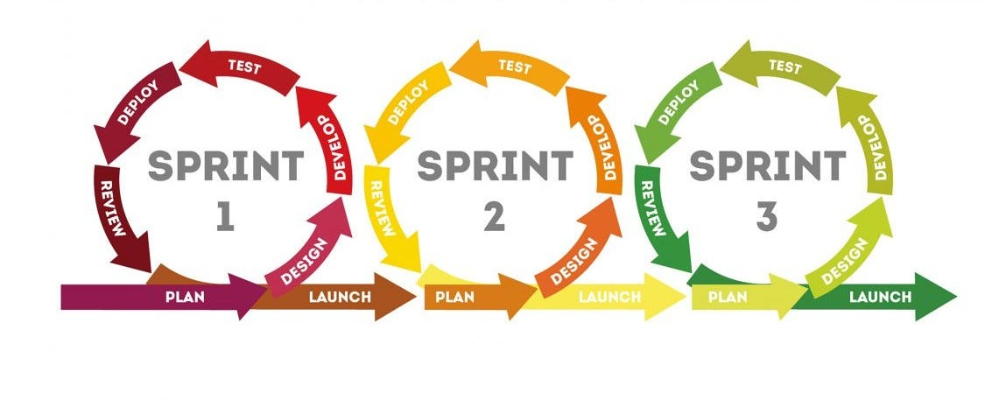
Lessons Learnt
Leveraging the Agile incremental development process helped us understand the following core lessons:
Enhanced Collaboration: Digital tools like JIRA & Zoom emulate current global work environment.
Flexibility: Ability to modify product features to address requirement changes along the development process.
Progress Tracking: Burndown charts, sprint reviews are great ways to measure progress.
Sprint Cycles: Define concrete deliverables, regular incremental developments within set time intervals & effective workload management.
Notes:
Flexibility, these were not decided earlier, but during early implementation, we realized this and modified our approach accordingly:
Prioritize third-party API integration early in the development process.
Allocate additional time for debugging and optimization.

Slide 10
Group Member Role & Contribution
TEAM MEMBER | RESPONSIBILITIES | SKILLS
Bhargav Ashvnibhai Patel | Frontend (UI) development. Responsive UI design. Optimizing frontend performance & security. | Expertise in Frontend Development.
Merlin Mary Abraham | Backend development. Database design & management. API Development. Optimizing backend performance & security. | Expertise in Backend Development.
Nishant Arora | Prioritizing & grooming the product backlog. Refinement of user stories. Backend development. Infrastructure development & management. | Expertise in Backend & Technology Development.
Nishant Barua | Frontend (UI) development. Facilitate scrum events. Remove impediments. Testing of user stories. | Expertise in Testing & Frontend Development.

Slide 11
THANK YOU!

