Slide 1





JobHive Problem Statement
Job seekers seek a personalized job search for tailored recommendations.
Revolutionize resume-building with dynamic, real-time insights aligned with industry demands.
1.
3.
I can do it with
Crafting standout resumes is a perpetual challenge in a competitive job market.
2.

Slide 2

ICDE-JobHive Requirements
Top 3 User Requirements:
Search for and view the latest job listings based on user profile, keywords and location search.
Build a Resume to apply for jobs on JobHive.
Receive job profile recommendations based on the skill sets mentioned on the resume.
Top 3 System Requirements:
Security: Strong Password Policy to prevent unauthorized access.
Performance: Caching the static content to improve the overall performance of JobHive.
Maintainability: Low Cyclomatic Complexity and high reliability through static code.

Slide 3
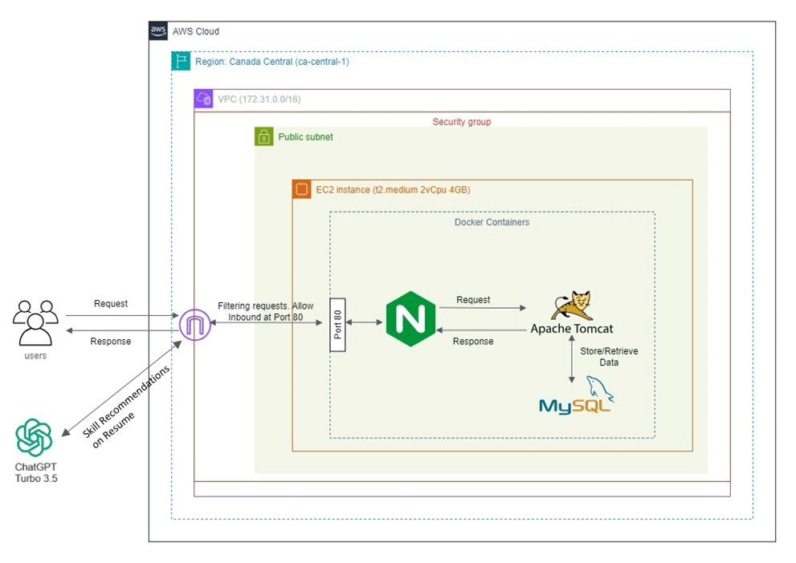
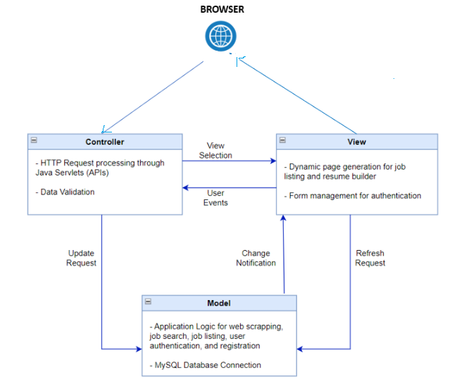
JobHive Architectural Design
Fig: MVC Architectural Pattern.
Fig: JobHive System Architecture

Slide 4
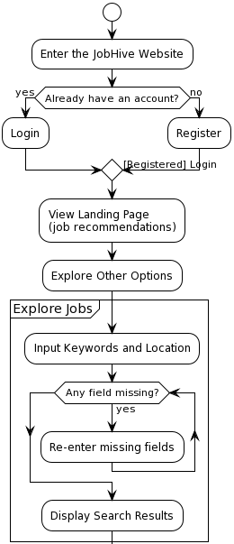
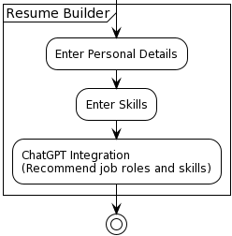
Major System Design of JobHive
2.
3.
1.
A

Slide 5
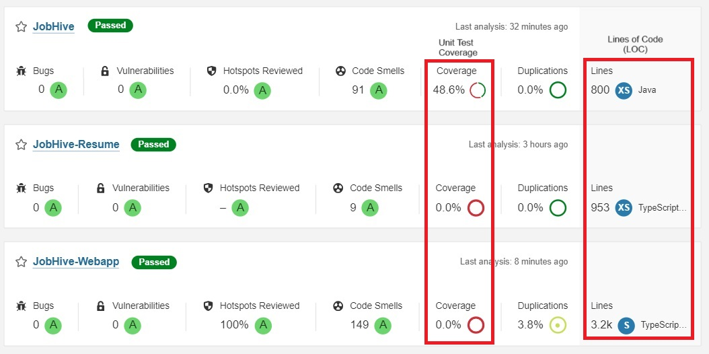



JobHive Software Metrics
Particulars Vs Tasks |  | Register | Login | Manage Profile | Search | Job Recommend | Data Capture | View Jobs | Skill Recommend | Resume Builder
Front-end | React Components | 4 | 3 | 1 | 7 | 1 | 1 | 1 | 2 | 8
 | LOC | 378 | 483 | 487 | 320 | 318 | 396 | 353 | 473 | 953
 | Framework | ReactJS
Back-end | Java Class | 4 | 5 | 3 | 4 | 3 | 4 | 3 | 3 | NA
 | LOC | 84 | 43 | 125 | 65 | 150 | 160 | 91 | 82
 | Libraries | 5 | 6 | 14 | 16 | 2 | 3 | 3 | 3
 | Packages | 1 | 1 | 1 | 2 | 1 | 1 | 1 | 1
 | Frameworks | MySQL , J2EE
Test Units | Test Class | 1 | 1 | 1 | 1 | 1 | 1 | 1 | NA | NA
 | LOC | 75 | 78 | 54 | 35 | 45 | 32 | 46
 | Framework | JUnit 4, Mockito, Power Mockito
Platforms |  | Docker, AWS
How can I measure my JobHive?

Slide 6
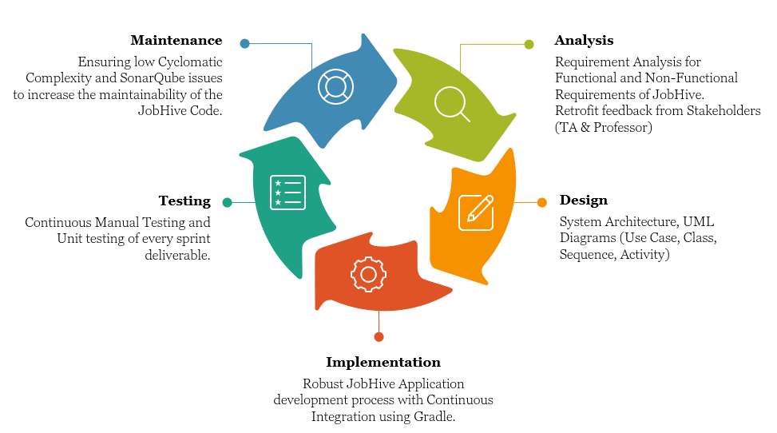
Summary Of Software Processes in JobHive
Sprint-0
18 September – 16 October
Team Registration and Engineering Setup
Sprint-1
17 October - 02 November
Software Specification
Sprint-2
03 November – 23 November
System Model and Design
Sprint-3
24 November – 03 December
Bug Fixes, Deployment, Final Demo
Sprint Duration and Overview in JobHive Release 1.0
Software Process for Each Deliverable in JobHive Release 1.0

Slide 7














Tools for Software Process
Purpose | Tool
Version Control System | GitHub
Ticketing Tool | JIRA
Build Automation | Gradle
Containerization | Docker
Integrated Development Environment (IDE) | Eclipse, Visual Studio Code
Unit Testing | JUnit, Power Mockito, Mockito
Static Code Analysis | SonarQube, CheckStyle
Communication | Zoom
Documentation | Microsoft Word, Microsoft PowerPoint.

Slide 8
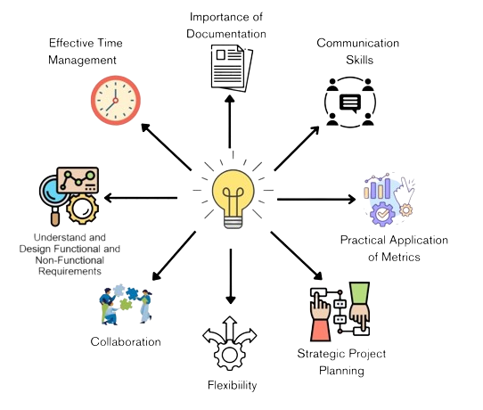
Lessons Learnt
Importance of Documentation
Effective Time Management
Effective
Communication
Requirement Analysis (Functional & NFR)
Practical Application of Metrics
Collaborative Development
Project Planning
Flexibility

Slide 9




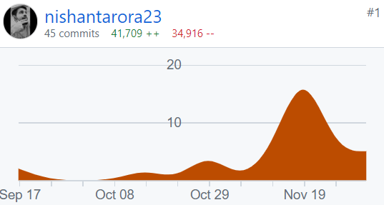
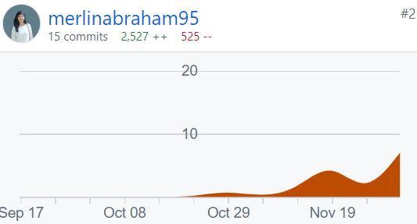
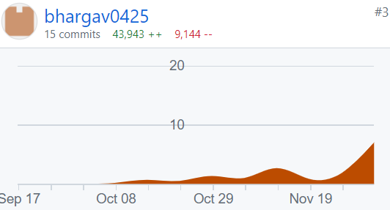
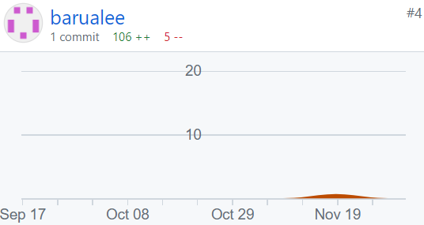
Group Member Role & Contribution
Nishant Arora Project Manager, JobHive | Merlin Mary Abraham Development Team, JobHive | Bhargav Patel Development Team, JobHive | Nishant Barua Scrum Master, JobHive
Prioritizing & grooming the product backlog. Refinement of user stories. DevOps & Cloud development. Infrastructure development & management. | Backend development. Database design & management. API Development. Optimizing backend performance & security. | Frontend (UI) development. Responsive UI design. Optimizing frontend performance & security. | Frontend (UI) development. Facilitate scrum events. Remove impediments. Testing of all user stories.

