Slide 1
AIR QUALITY MONITORING SYSTEM USING I.O.T
Submitted in the partial fulfillment for the award of the degree of
BACHELOR OF ENGINEERING
IN
B.E. C.S.E. (I.O.T)
Submitted by:
Lakshay Yadav 22BIT70026
Nishant Kumar 22BIT70021
Nitin Yadav 22BIT70028
Under the Supervision of:
Dr. Sonal Rattan
Department of AIT-CSE
DISCOVER . LEARN . EMPOWER

Slide 2
Outline
Introduction to Project
Development of IOT
How IOT helped in air pollution managment
Pre-existing Solutions
Results and Outputs
Drawbacks
Conclusion
References
Role of IOT for controlling air pollution

Slide 3
Introduction to Project
We live in a world where the word “pollution” has become part and parcel of our daily life
20+ years of research in the field of cell mutation
Author of “Our Bodies, Our Cells” and several research papers on DNA
Trey Research board member

Slide 4
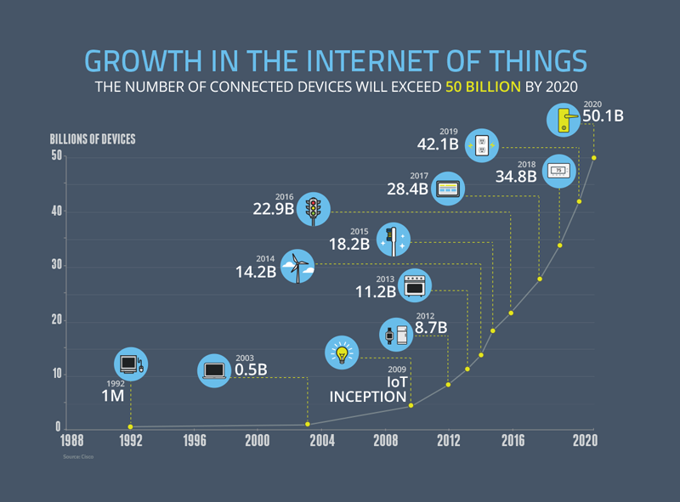

Slide 5
Development of IOT
Normal Sensors v/s Smart Sensors
Increases speed and efficiency
Automation
Accuracy
Space

Slide 6
How IOT has helped in air pollution managment
ARIMA – smart model to predict pollution level from harmful air pollutants.
Effective air monitoring
Detection of toxic gases
Meet air quality standards
Better human health

Slide 7
Pre-existing solutions
Monika Singh Et al. August 2019 proposed on Air Pollution Monitoring System
K.S.E. Phala Et al. In November 2014 presented an air quality monitoring system that consists of air quality monitoring station.
Nitin Sadashiv Desai Et al. In 2017 proposed a system which can detect air pollution using beagle bone.
Harsh Gupta Et al. In 2019 presented an IOT based Air Pollution Monitoring System.

Slide 8
HARDWARE USED
ARDUINO UNO
ESP8266
MQ135 GAS SENSOR
LCD
BEAGLE BONE
GSM MODULE
BUZZER

Slide 9
Drawbacks
There are some disadvantages/drawbacks related to current air pollution monitoring system some of them are as follows:-
These sensors have high power consumption which increases the cost
Ease of Access
As this devices are interconnected via internet there are possibilities that they can get hacked

Slide 10
MORE DRAWBACKS…..
HARDWARE SHAVY IMPLEMENTATION
DEPENDENCY ON CLOUD
NO DOMESTIC USE
COMPLEX DESIGN

Slide 11
Conclusion
“Be a part of the solution not the part of the pollution”
The above mentioned solutions have been proven highly effective to combat against air pollution. Air pollution is the major affecting factor to our environment and also affects the human health.
By using IOT we can fight the risk of spread air borne diseases, global warming and many such problems to a larger extent

Slide 12
References
Harsh Gupta, Dhananjay Bhardwaj, Himanshu Agrawal, Vinay Anand Tikkiwal, Arun Kumar,(2019)‘An IoT Based Air Pollution Monitoring System for Smart Cities’, ICSETS.
Monika Singh, Misha Kumari,Pradeep Kumar Chauhan, (2019) ‘IoT Based Air Pollution Monitoring System using Arduino’, International Research Journal of Engineering and Technology, IRJET.
Nitin Sadashiv Desai, John Sahaya RaniAlex, (2017)‘IoT based air pollution monitoring and predictor system on Beagle Bone Black’, International Conference on Nextgen Electronic Technologies, ICNET.

