Slide 1

P-219- Hourly Energy Consumption Forecast
Presenting By: Group 6

Slide 2
GROUP 6 Mentor’s Name: Pallavi Bapuram and Madishetti Rajashekar
Team members :- Mr. Nishant Vasant Dalvi
Mr. Shubham Rajendra Tiwari
Ms Safreena K H
Ms Harshali Rajesh Singh
Mr. Kalathuri Roopesh Reddy

Slide 3

Business Problem To predict power consumption over the trends
Objective
The project's goal is to leverage time series analysis to predict hourly power consumption for the city of US and the District of Columbia.

Slide 4
Project Architecture
Sarima
Hourly
History
Seasonal
Differencing
Random Forest
Daily
Forecast
Selection of model
Linear Regression
EDA
Aggregation to Daily
XG Boost

Slide 5
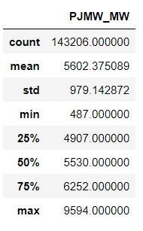
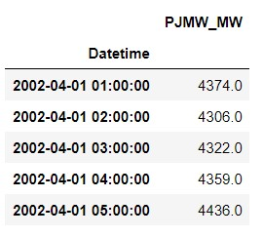
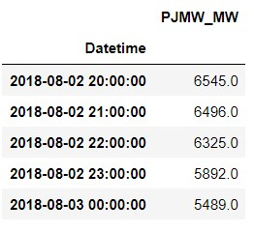
Overview of Dataset
It’s a hourly power consumption data from 2002 April1 to 2018 August 3.
The dataset name is PJMW_hourly.csv.
Rows: 143206 , column: 1 which is the power consumption value with datetime as index.
Maximum power consumption is 9594 and it was in 2015
Minimum power consumption is 487 and it was in 2003
Missing hours : 30
Duplicate hours : 4
Outlier : 1
Data description
Head (5) :
Tail (5) :

Slide 6
Exploratory Data Analysis (EDA),Visualization and Feature Engineering
j

Slide 7
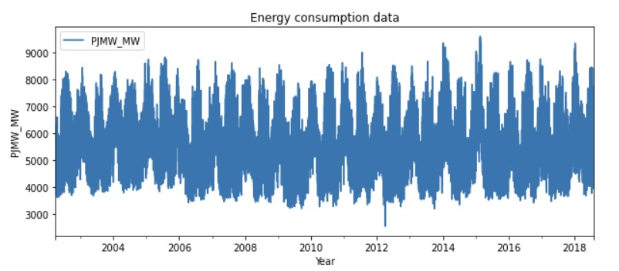
EDA
Sorted the data to arrange it in ascending order.
Removed the duplicate hours.
Imputed the missing hours with the average of above and below power consumption data using interpolation method.
Replaced the outlier using the interpolation linear method.
Extracted the hour, day, month, year and week name into separate column for checking the seasonality.
The cleaned data set is plotted as:

Slide 8
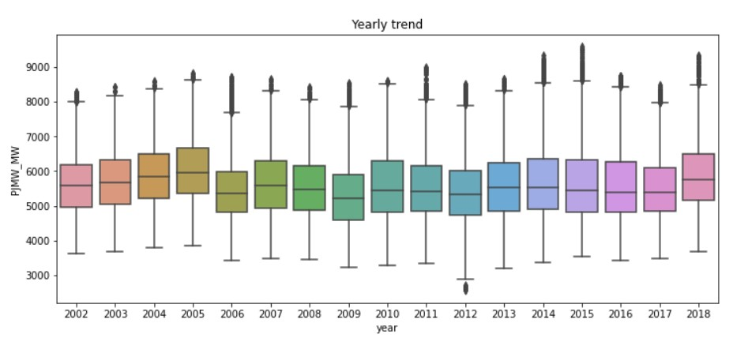
Yearly trend
Yearly trend analysis:
The plotted graph shows that 2005 have the highest and 2009 have the lowest power consumption.
Yearly trend

Slide 9
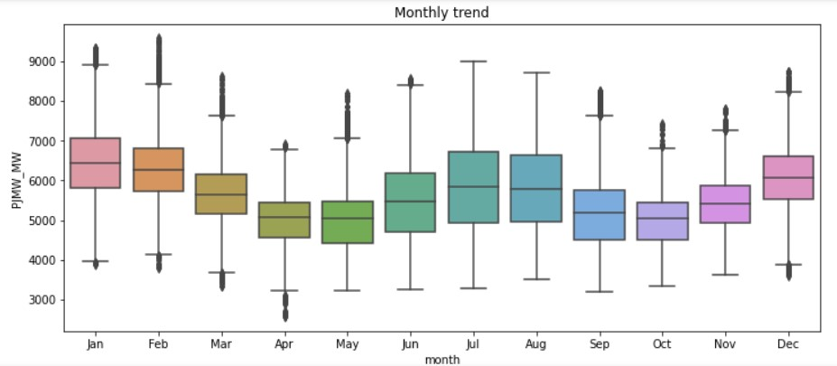
Monthly trend
Monthly trend analysis:
Decrease in power consumption is visible in the month of March, April, May and September, October, November.

Slide 10
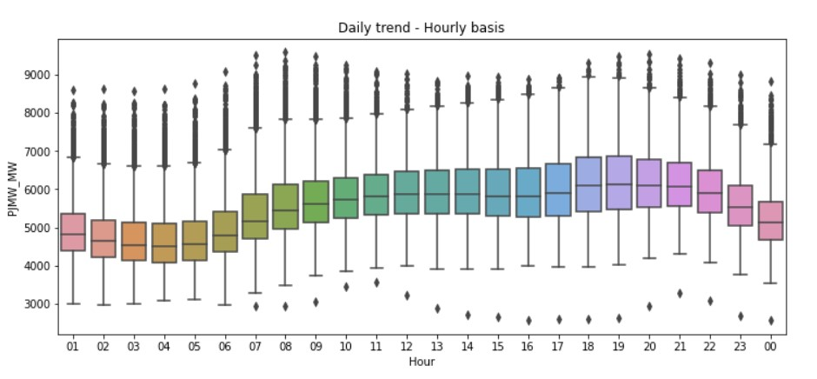
Hourly trend
Hourly trend Analysis:
Day time the power consumption seems to be increasing as compared to night.

Slide 11
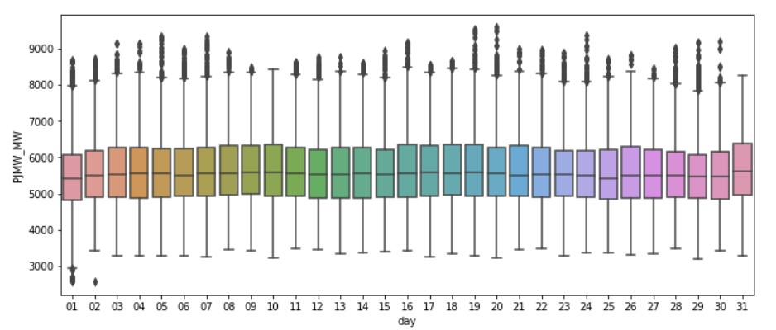
Daily trend
Daily trend Analysis:
Power consumption seems to be constant in daily basis

Slide 12
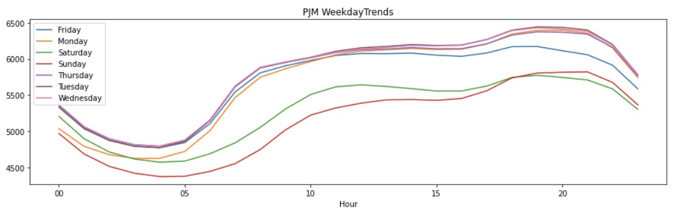
Weekly Trend
Weekly trend Analysis :
The weekends shows less consumption than weekdays.

Slide 13
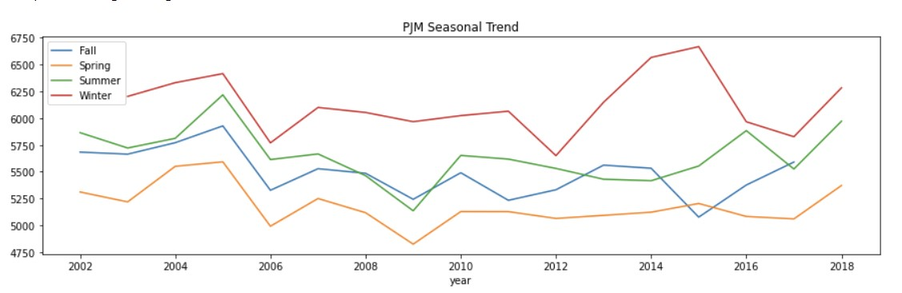
Seasonal Trend
Seasonal trend Analysis :
Winter and summer seasons found to be having higher power consumption than Spring and fall.

Slide 14
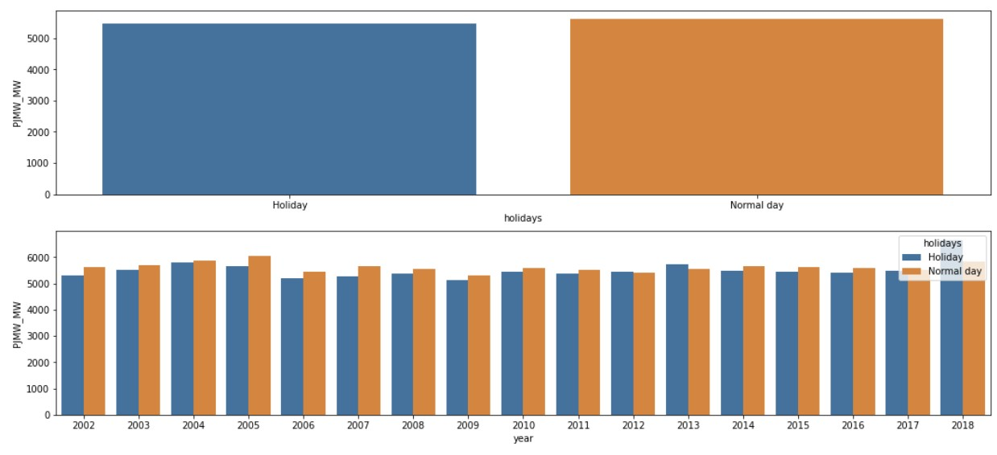
Holiday Trend
Holiday trend Analysis :
The plot shows that more power is consumed in Normal day comparing with Holidays

Slide 15
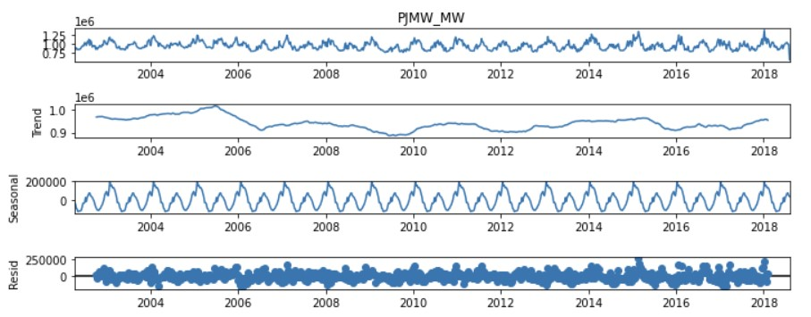
Decomposition
There is no trend since it is neither increasing nor decreasing. Seasonal pattern is consistent. Residuals are whatever is left after fitting the trend and seasonal components to the observed data and are showing some wavy pattern.

Slide 16
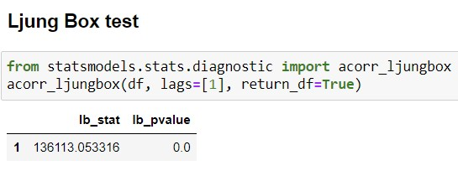
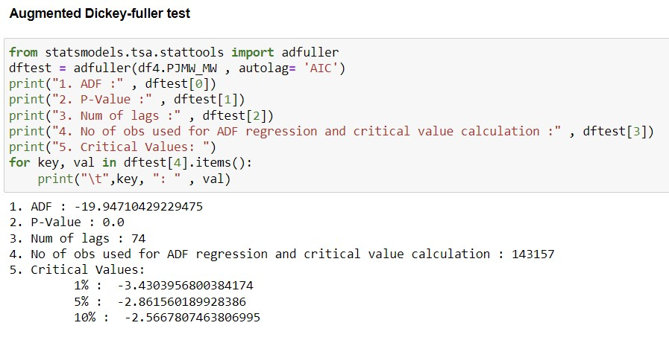
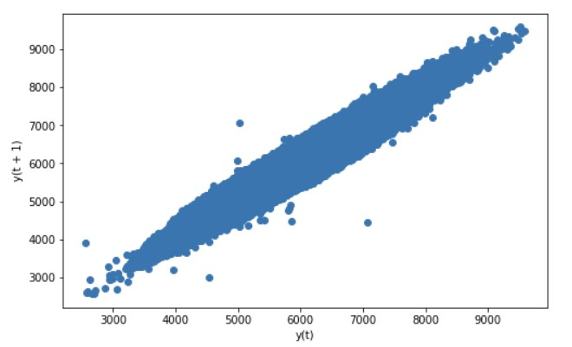
Ljung Box test: Since lb_pvalue < 0.05, residuals are uncorrelated.
Lag Plot: Our data has moderate Autocorrelation as the lag plot is in elliptical shape.
Stationarity Checks: Both mean and variance are constant.
Coefficient of Variation: CV < 0.75 Hence its a low variability process
Augmented Dickey-fuller test: Our p-value is definitely less than 0.05 and can assume our data is stationary.

Slide 17
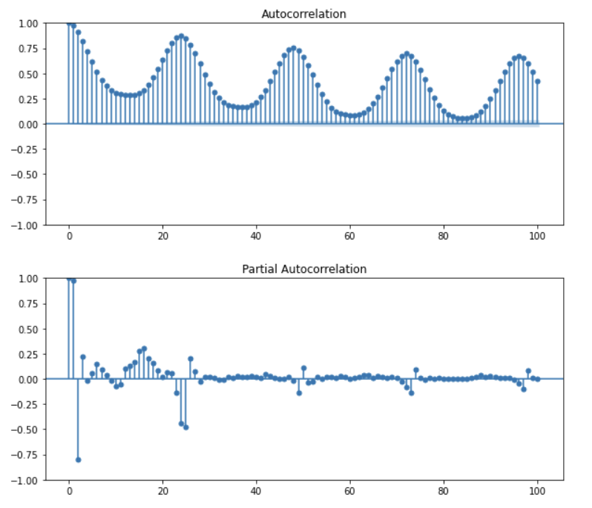
ACF AND PAC Plots:
An ACF measures and plots the average correlation between data points in time series and previous values of the series measured for different lag length.
A PACF is similar to an ACF except that each partial correlation controls for any correlation between observations of a shorter lag length. And for Auto regression the PACF graph has been seen.
Observation:
As per ACF plot time series show autocorrelation, observed time series are not white noise

Slide 18
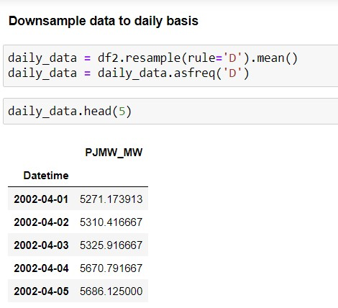
Down sampling of data
We downsize our hourly data into daily using resample rule for better prediction of the model.

Slide 19
Model Building- SARIMA

Slide 20
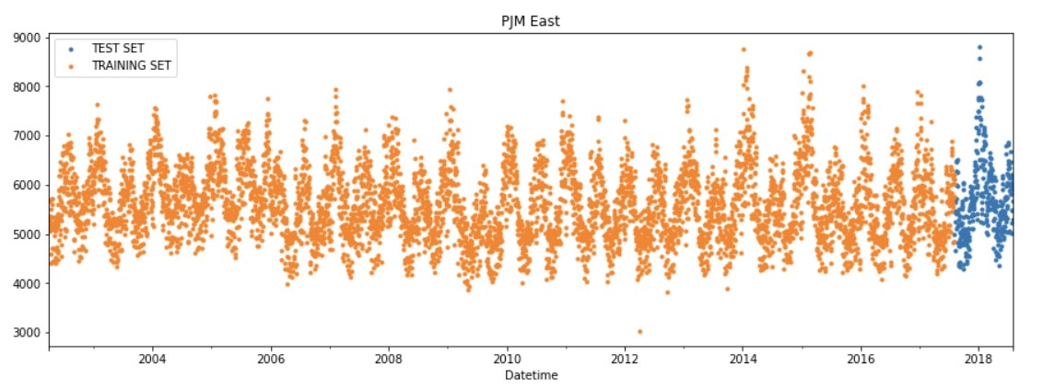
Train – test Split
Split the data into train and test by taking the last 1 year power consumption as test data.

Slide 21
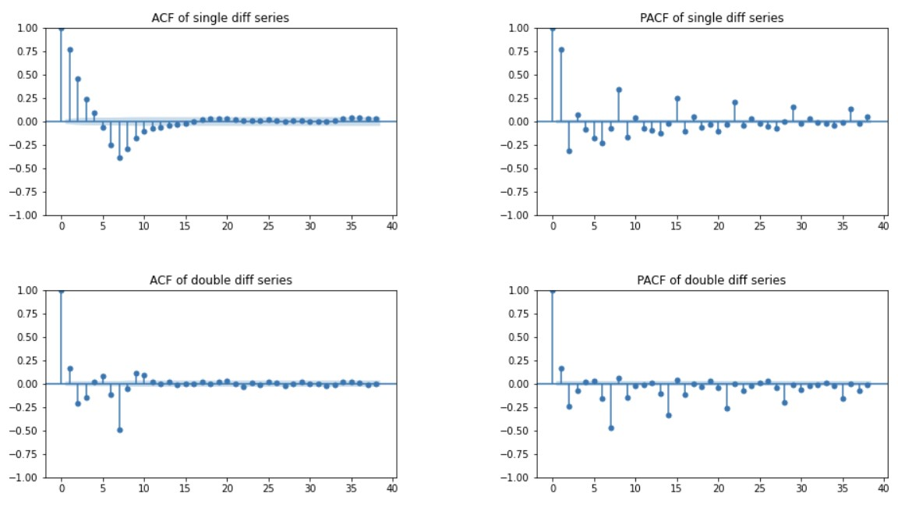
Double differencing – Lag 7
Double differencing with lag 7 to remove the weekly seasonality.

Slide 22
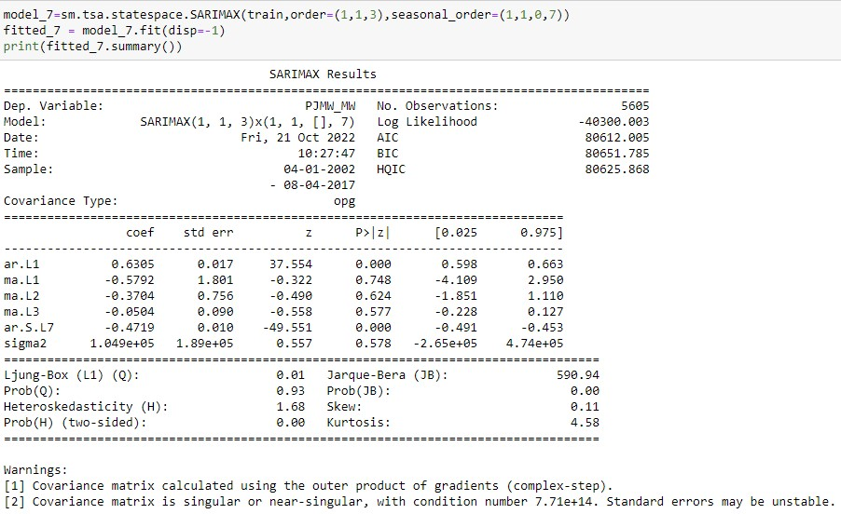
SARIMA Model with weekly seasonality
(p,d,q) = (1,1,3)
(P,D,Q) = (1,1,0)
m = 7

Slide 23
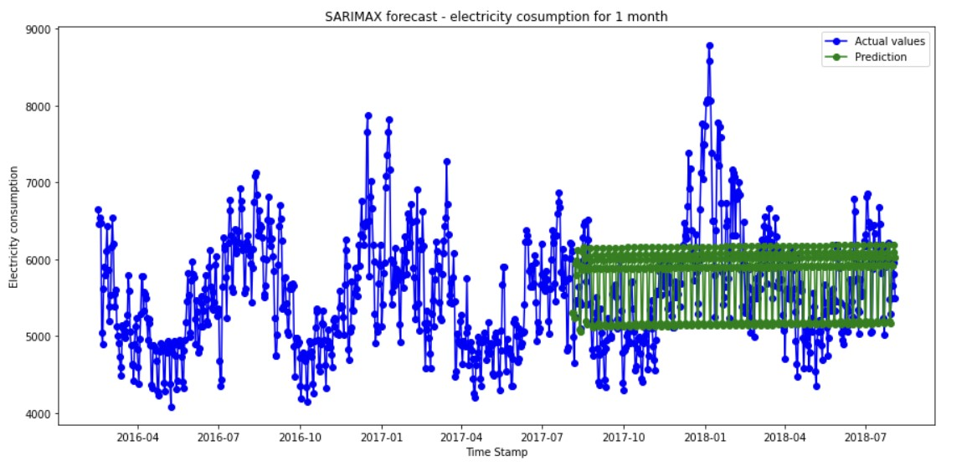
SARIMA Model with weekly seasonality
Model Evaluation
The model captures the weekly seasonality

Slide 24
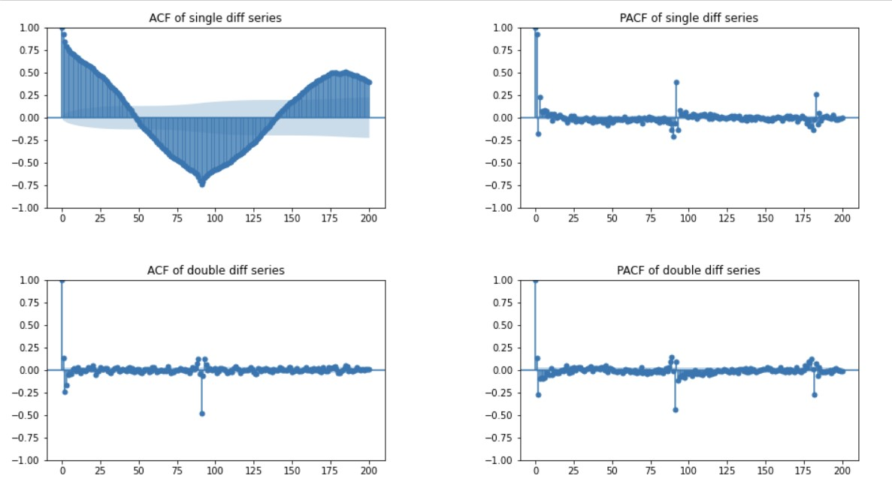
Double differencing – Lag 90
Double differencing with lag 90 to remove the Quarterly seasonality.

Slide 25
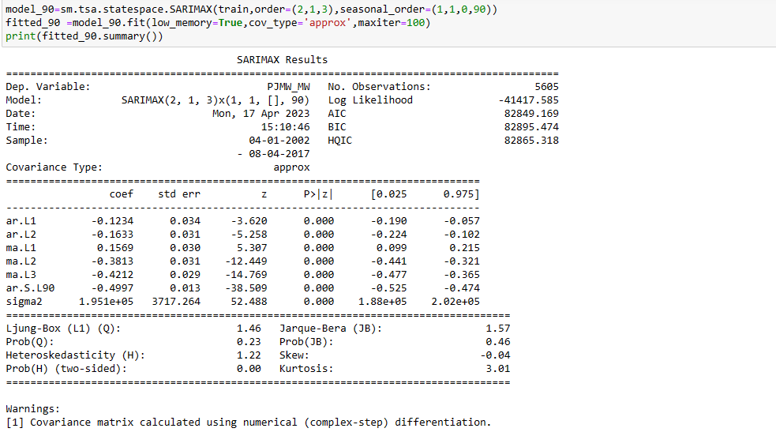

SARIMA Model with Quarterly seasonality
(p,d,q) = (2,1,3)
(P,D,Q) = (1,1,0)
m = 90

Slide 26
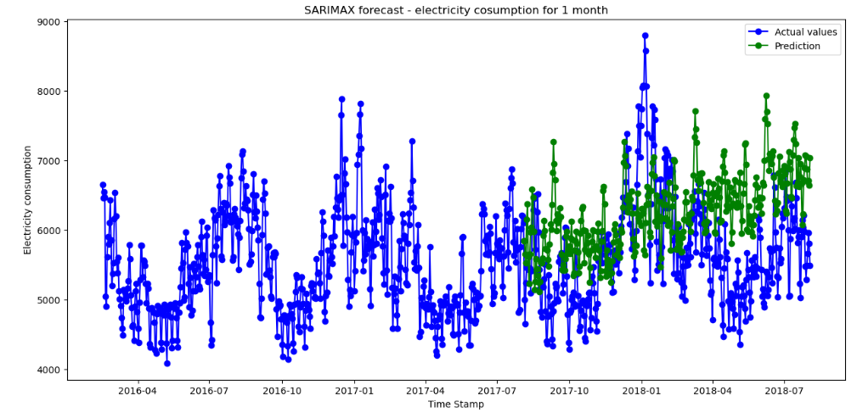
SARIMA Model with Quarterly seasonality
Model Evaluation
The model captures the quarterly seasonality

Slide 27
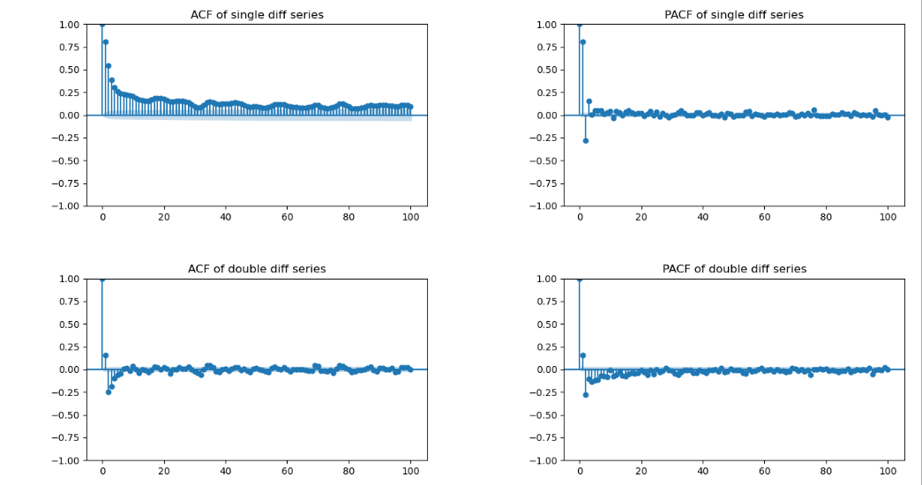
Double differencing – Lag 364
Double differencing with lag 364 to remove the Yearly seasonality.

Slide 28
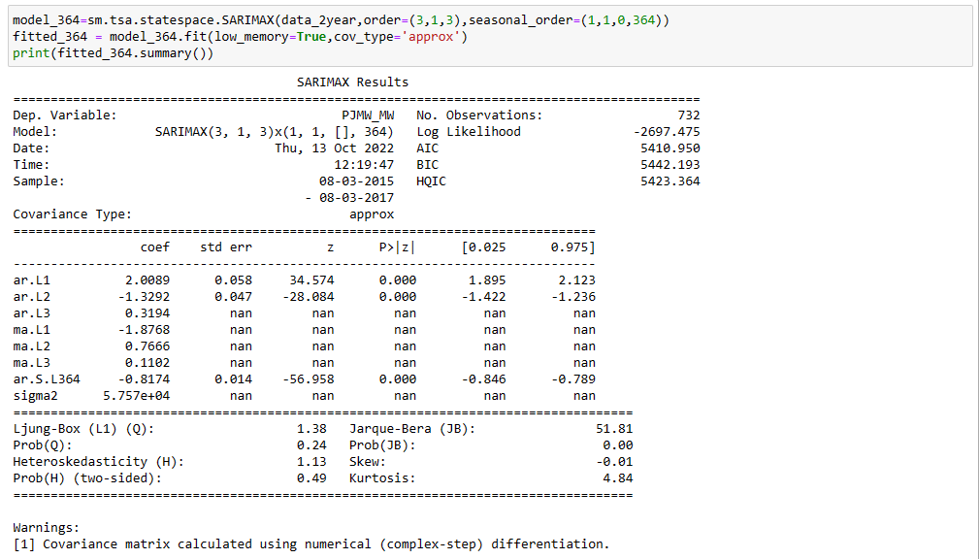
SARIMA Model with Yearly seasonality
(p,d,q) = (3,1,3)
(P,D,Q) = (1,1,0)
m = 364

Slide 29
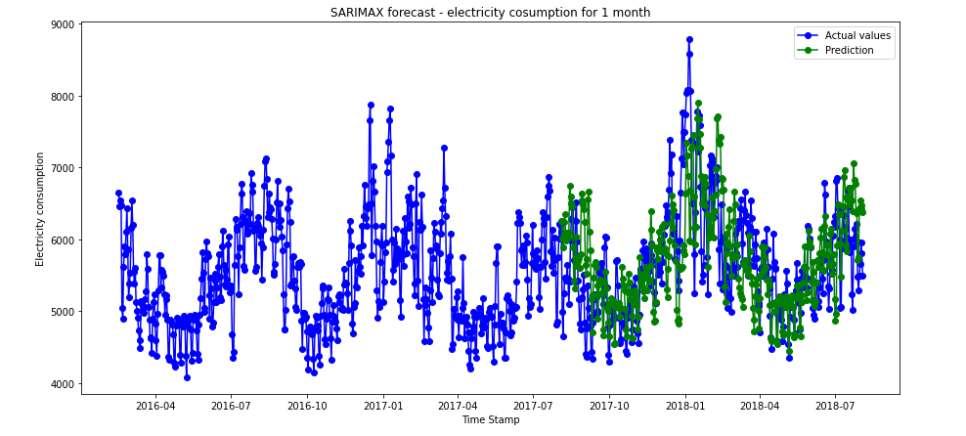
SARIMA Model with Yearly seasonality
Model Evaluation
The model captures the yearly seasonality

Slide 30
OBSERVATIONS
The calculated MAPE, MAE and RMSE values of the SARIMA models are given below:
Differencing | SARIMA Models | RMSE | MAE | MAPE
7 - Weekly | S(1,1,3),(1,1,0,7) | 767.34 | 684.23 | 12.06
90 - Quarterly | S(2,1,3)(1,1,0,90) | 1035.72 | 893.36 | 16.42
364 - Yearly | S(3,1,3)(1,1,0,364) | 678.82 | 802.73 | 14.07

Slide 31
REGRESSION MODELS
Linear Regression
Random Forest
XG Boost

Slide 32
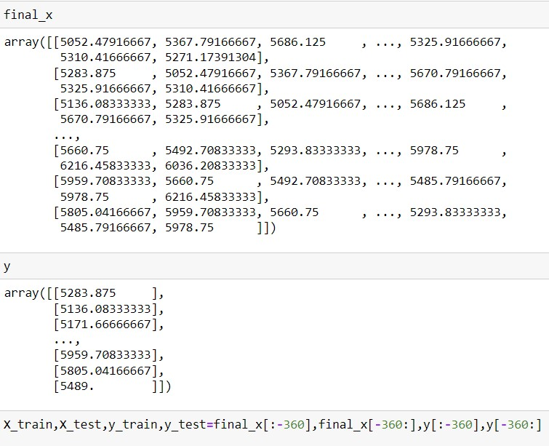
DATA SET
Created x value taking the 7 day shift and y value with the power consumption data.
Split train and test taking last 1 year
Created X_train, X_test, y_train, Y_test
Fitted Linear regression, Random Forest and XG Boost regressor

Slide 33
OBSERVATIONS
The calculated MAPE, RMSE and MAE values of regression models are tabled.
Forecasting MAPE, RMSE and MAE values are also calculated and tabled.
Predicted model error values
Model | RMSE | MAE | MAPE
Linear Regression | 354.203 | 274.3 | 4.766
Random Forest | 368.625 | 282.91 | 4.878
XG Boost | 369.54 | 279.77 | 4.787
Forecast model error values
Model | RMSE | MAE | MAPE
Linear Regression | 588.8 | 461.53 | 8.25
Random Forest | 540.81 | 425.21 | 7.57
XG Boost | 575.28 | 448.09 | 7.95

Slide 34
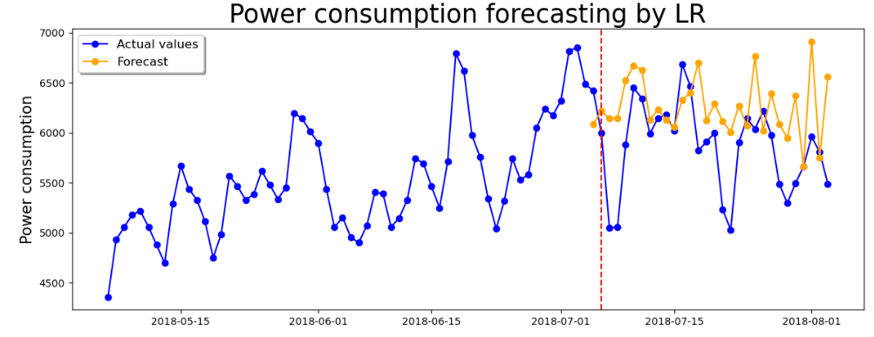
FORECASTED LINEAR REGRESSION MODEL
RMSE = 588.8

Slide 35
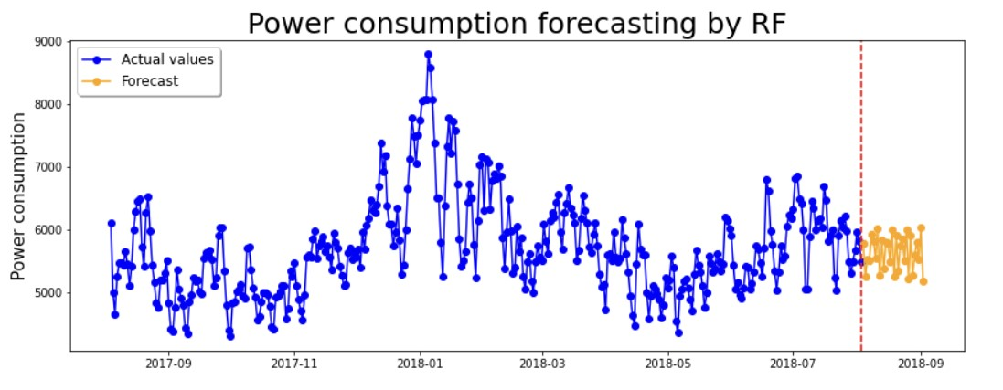
FORECASTED RANDOM FOREST MODEL
RMSE= 540.81

Slide 36
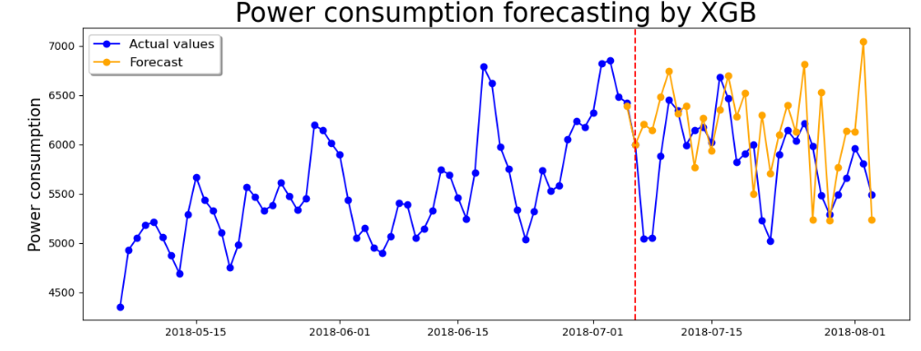
FORECASTED XG BOOST MODEL
RMSE= 575.28

Slide 37
Model Deployment using Streamlit
Streamlit is a free and open-source framework to rapidly build and share beautiful machine learning and data science web apps. It is a Python-based library specifically designed for machine learning engineers.

Slide 38
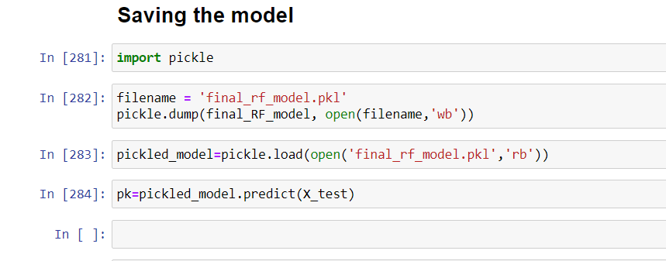
For model deployment first we have saved the model which is well generalized. So, we have taken the RandomForest model for our future predictions.

Slide 39
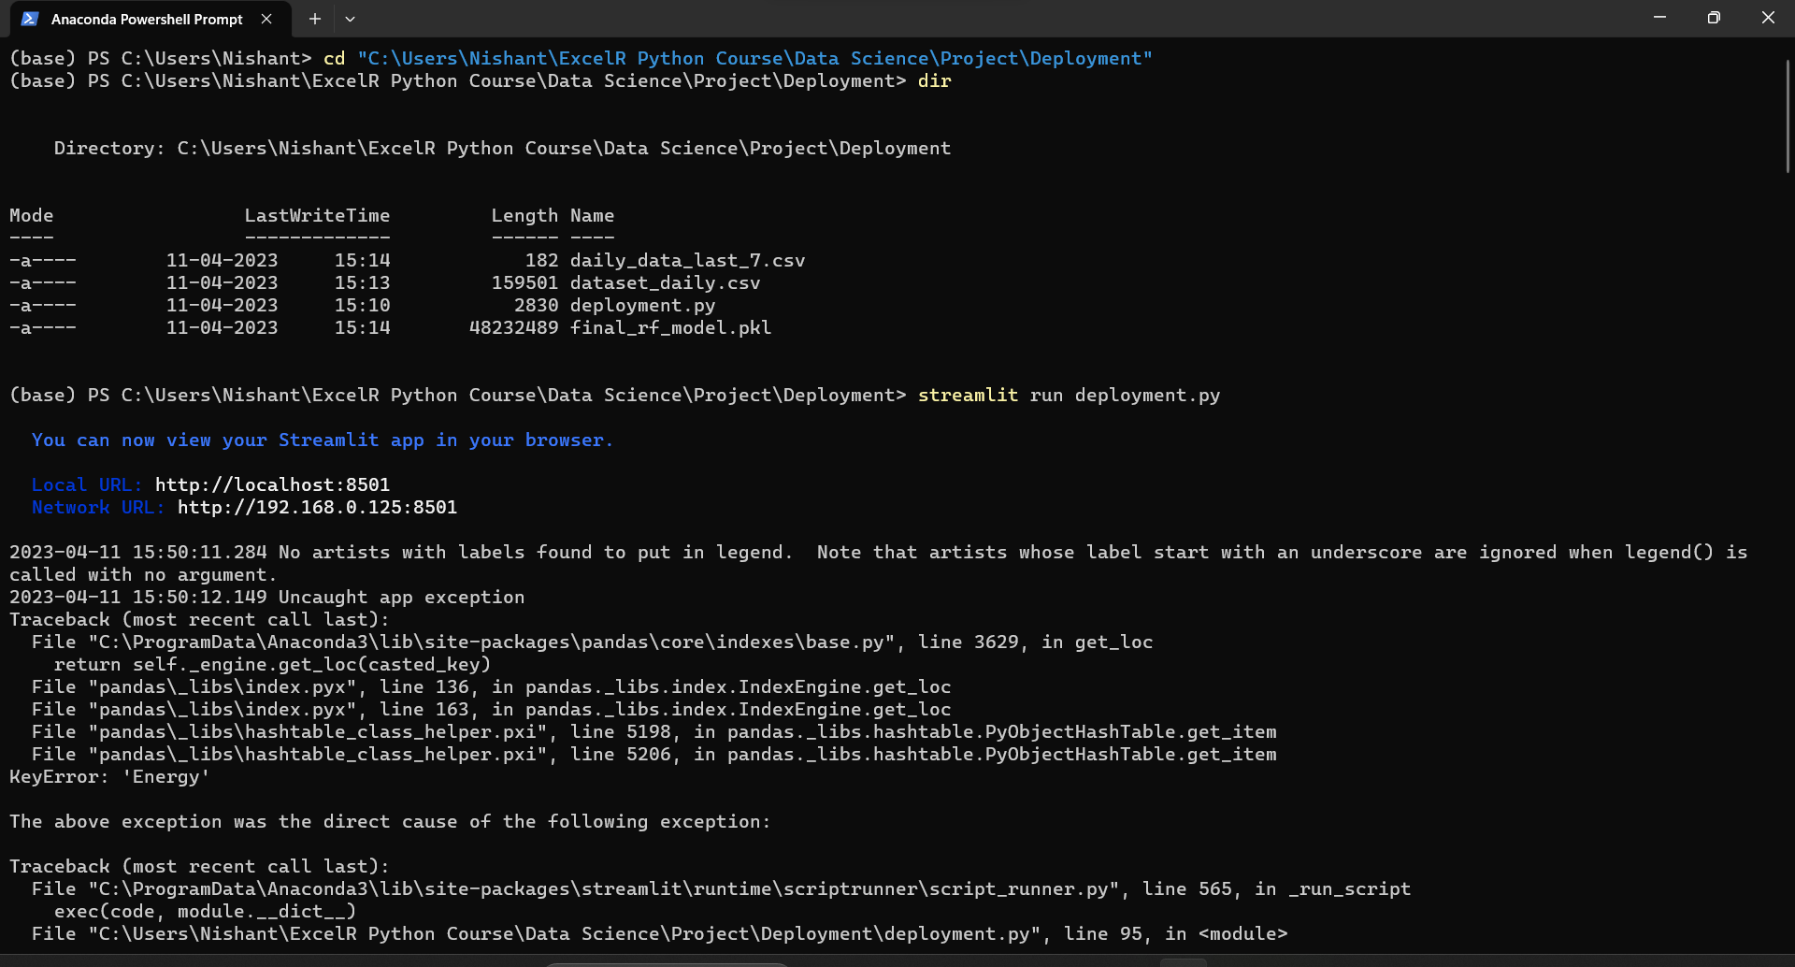
So, using anaconda prompt we have first install the streamlit library then using streamlit run command we opened the file in default browser.

Slide 40
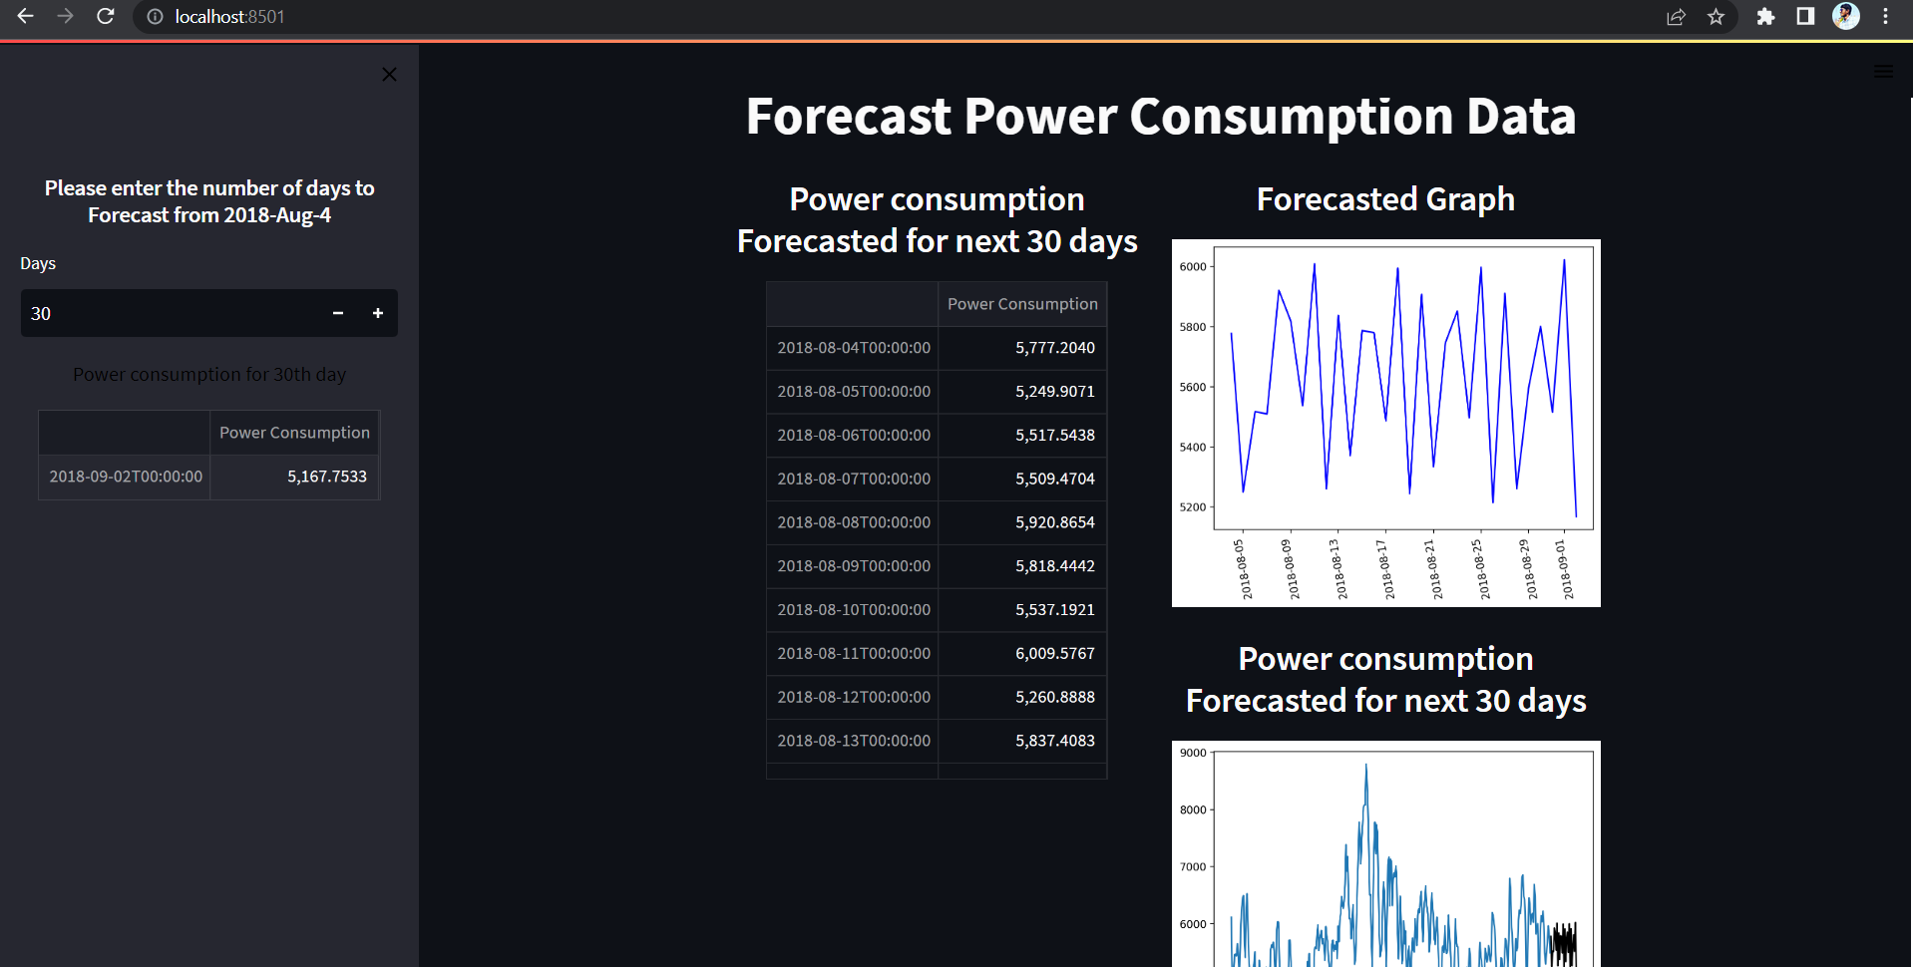
We have forecast for the next 30 days PJM energy consumption data. Then, we got the data values as well as the line graph of the 30 days energy consumption.
Output :

Slide 41
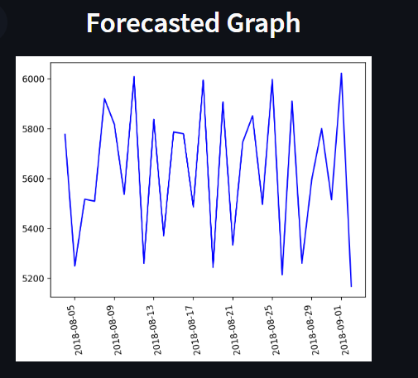
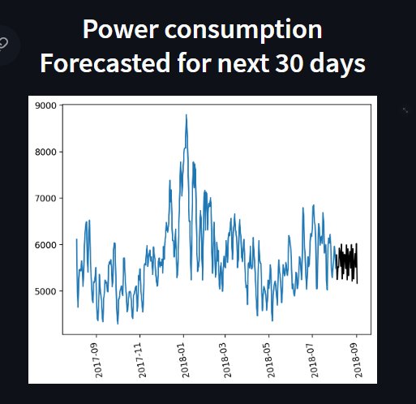

Slide 42
DEPLOYMENT – STREAMLIT APP
The Deployment is done with Streamlit:
deployment · Streamlit

Slide 43
CHALLEAGES Seasonal variations: Energy consumption patterns may vary significantly depending on the time of year, and this can be challenging to capture accurately in a single model. For example, summer energy consumption trends may be very different from winter trends. Complex modeling: The hourly energy consumption data is likely to be complex, with many different variables and factors affecting energy consumption. Developing an accurate and effective model may require advanced modeling techniques and a deep understanding of the energy industry. Uncertainty in external factors: There may be external factors that can impact energy consumption, such as changes in weather patterns, economic conditions, or public policy. These factors may be difficult to predict, and their impact on energy consumption may be uncertain

Slide 44
Thank You

