Slide 1
FoodBridge
Food Donation Platform
RMMM (Risk Mitigation, Monitoring, and Management) Plan
Team Members
1.Nishant Ninad Deshmukh – RA2311030010161
2.Parth Nath Chauhan – RA2311030010162
3.Aryan Yadav – RA2311030010167
1/20

Slide 2
Problem Statement
Large quantities of edible food are wasted daily by restaurants, hostels, event organizers, and households, while a significant portion of the population suffers from hunger.
The absence of a centralized digital platform to efficiently identify surplus food, coordinate timely pickups, and distribute it to NGOs and needy communities leads to decreased food waste and missed opportunities for social impact.
2/20

Slide 3
Agenda
Overview of the RMMM Plan Document
1. What is RMMM?
2. Risk Category & Probability Reference Tables
3. Impact Severity Scale
4. Step 1 — Risk Table (Unsorted)
5. Step 2 — Risk Table (Sorted by Probability)
6. Step 3 — Risk Information Sheets (RIS) for each Risk
7. Suitable Maintenance Process Model & Justification
2/20

Slide 4
What is RMMM?
Risk Mitigation, Monitoring, and Management
Risk Mitigation
Risk Monitoring
Risk Management
Proactive strategies to reduce
the probability or impact of
identified risks before they occur.
Continuous tracking of risk
indicators and triggers throughout
the project lifecycle.
Contingency plans and corrective
actions executed when a risk
materializes.
Example: Implementing automated
expiry checks to prevent delivery
of expired food.
Example: Monitoring database
response times and server
CPU utilization.
Example: Activating a standby
database server during
PostgreSQL outage.
3/20

Slide 5
Risk Category Reference Table
Short Form | Risk Category | Explanation
PS | Product Size | Risks related to overall size, scale, and complexity of the software
BU | Business Impact | Risks from business constraints — market conditions, competition, management decisions
CU | Customer Characteristics | Risks related to customer behavior, expectations, and communication
PD | Process Definition | Risks due to unclear, undefined, or poorly followed development processes
DE | Development Environment | Risks associated with availability, reliability, and quality of dev tools & infrastructure
TE | Technology to be Built | Risks due to complexity, novelty, or uncertainty of the technology used
ST | Staff Size & Experience | Risks related to skills, experience, and availability of the development team
4/20

Slide 6
Probability & Impact Severity Scales
Probability Scale
Impact Severity Scale
Range | Interpretation
80% – 100% | Very High
60% – 79% | High
40% – 59% | Medium
20% – 39% | Low
< 20% | Very Low
Category | Impact Value | Description
Catastrophic | 1 | Mission failure or costs > $500K
Critical | 2 | Significant degradation, costs $100K–$500K
Marginal | 3 | Secondary mission impact, costs $1K–$100K
Negligible | 4 | Inconvenience, minor cost < $1K
5/20

Slide 7
Step 1: Risk Table (Unsorted)
Identification and classification of project risks
ID | Risks | Category | Prob. | Impact | RMMM
1 | Database server downtime or PostgreSQL connection failures | TE | 65% | 2 | Connection pooling, failover, backups, health monitoring
2 | JWT token security breach or unauthorized access | PS | 55% | 1 | Token rotation, refresh tokens, rate limiting, anomaly detection
3 | Sudden increase in users causing performance degradation | PS | 50% | 2 | Horizontal scaling, load balancing, caching, load testing
4 | Food expiry mismanagement leading to delivery of expired food | BU | 70% | 1 | Expiry alerts, auto-cancellation, countdown timers, validation
5 | Team members lacking experience in React, TypeScript, Prisma | ST | 40% | 3 | Knowledge sharing, documentation, cross-training, backup hiring
6 | Scope creep from adding features (Maps, payments, chat) | BU | 45% | 3 | Change control, MoSCoW method, stakeholder sign-off
7 | CORS policy & API integration failures (frontend ↔ backend) | DE | 60% | 2 | CORS config, API tests, Swagger documentation
8 | Users failing to adopt platform or providing unclear requirements | CU | 35% | 3 | User testing, feedback collection, pilot programs, training
6/20

Slide 8
Step 2: Risk Table (Sorted by Probability — Descending)
Risks ordered from highest to lowest probability of occurrence
ID | Risks | Category | Prob. | Impact | RMMM
4 | Food expiry mismanagement leading to delivery of expired food | BU | 70% | 1 | Expiry alerts, auto-cancellation, countdown timers, validation
1 | Database server downtime or PostgreSQL connection failures | TE | 65% | 2 | Connection pooling, failover, backups, health monitoring
7 | CORS policy & API integration failures (frontend ↔ backend) | DE | 60% | 2 | CORS config, API tests, Swagger documentation
2 | JWT token security breach or unauthorized access | PS | 55% | 1 | Token rotation, refresh tokens, rate limiting, anomaly detection
3 | Sudden increase in users causing performance degradation | PS | 50% | 2 | Horizontal scaling, load balancing, caching, load testing
6 | Scope creep from adding features (Maps, payments, chat) | BU | 45% | 3 | Change control, MoSCoW method, stakeholder sign-off
5 | Team members lacking experience in React, TypeScript, Prisma | ST | 40% | 3 | Knowledge sharing, documentation, cross-training, backup hiring
8 | Users failing to adopt platform or providing unclear requirements | CU | 35% | 3 | User testing, feedback collection, pilot programs, training
7/20

Slide 9
Step 3: Risk Information Sheet (RIS)
Risk ID 4: Food Expiry Time Mismanagement
Risk ID
Date
Probability
Impact
4
03/02/2026
70%
1 (Catastrophic)
Description
Mitigation & Monitoring Strategies
Food expiry time mismanagement leading to delivery of expired or unsafe food to recipients. Inaccurate expiry timestamps or delayed pickups could result in food safety violations and health hazards.
1. Implement automated expiry countdown timers visible to all stakeholders
2. Add server-side cron jobs to auto-change donation status to EXPIRED
3. Send push/email notifications 1 hour before expiry
4. Add food category-wise default expiry limits
5. Prevent claiming donations within 30 minutes of expiry
Refinement & Context
• Donors may enter incorrect or overly optimistic expiry times when listing food donations
• Delays in donation workflow (claim → pickup → delivery) may exceed the food's actual shelf life
• Lack of automated expiry enforcement means expired donations could remain visible and claimable
Contingency Plan & Management
Trigger
1. Immediately cancel all pickups/claims for expired donations
2. Implement food safety incident reporting module
3. Establish partnerships with food safety authorities
4. Add donor rating system penalizing incorrect expiry entries
When donation's expiryTime is approaching or passed while still in AVAILABLE/CLAIMED status
Status & Assignment
Status: Resolved ✓ (Mitigated on 15/02/2026)
Assigned To: Scrum Master | Originator: Risk Management Team
8/20

Slide 10
Step 3: Risk Information Sheet (RIS)
Risk ID 1: Database Server Downtime
Risk ID
Date
Probability
Impact
1
07/02/2026
65%
2 (Critical)
Description
Mitigation & Monitoring Strategies
PostgreSQL connection failures disrupting platform operations. The application relies on a single PostgreSQL instance via Prisma ORM — any outage renders the platform non-functional.
1. Set up PostgreSQL replication with standby server for automatic failover
2. Configure Prisma connection pooling parameters appropriately
3. Implement automated daily database backups with PITR
4. Set up health monitoring with alerts for CPU, memory, disk, connections
5. Test migrations in staging environment first
Refinement & Context
• Single PostgreSQL database without replication creates a single point of failure
• Prisma connection pool exhaustion under high load could cause timeouts
• Unplanned maintenance, disk space exhaustion, or corrupted migrations
Contingency Plan & Management
Trigger
1. Activate standby database and redirect connections
2. Restore from latest backup if data corruption occurs
3. Implement read-only mode during recovery
4. Notify all users about temporary service disruption
When DB response time > 5 seconds or connection failures exceed 3 consecutive attempts
Status & Assignment
Status: Resolved ✓ (Mitigated on 21/02/2026)
Assigned To: Scrum Master | Originator: Risk Management Team
9/20

Slide 11
Step 3: Risk Information Sheet (RIS)
Risk ID 7: CORS & API Integration Failures
Risk ID
Date
Probability
Impact
7
12/02/2026
60%
2 (Critical)
Description
Mitigation & Monitoring Strategies
CORS policy violations and API integration failures between React frontend (localhost:5173) and Express backend (localhost:3001), causing broken user interactions and data flow disruptions.
1. Maintain centralized CORS configuration with environment-specific origins
2. Implement automated API integration tests using Playwright
3. Use Swagger/OpenAPI for API contract documentation
4. Add comprehensive error interceptors in frontend API layer
5. Implement API versioning to prevent breaking changes
Refinement & Context
• Misconfigured CORS headers may block legitimate frontend API requests during deployment
• API contract mismatches between React Query hooks and Express controllers
• JWT token transmission issues causing authentication failures across protected routes
Contingency Plan & Management
Trigger
1. Revert to last known working CORS configuration
2. Enable detailed backend logging for debugging
3. Deploy temporary API proxy to bypass CORS issues
4. Conduct post-incident review to update procedures
When frontend console reports CORS errors or API responses show 4xx/5xx on critical endpoints
Status & Assignment
Status: Resolved ✓ (Mitigated on 27/02/2026)
Assigned To: Scrum Master | Originator: Risk Management Team
10/20

Slide 12
Step 3: Risk Information Sheet (RIS)
Risk ID 2: JWT Security Breach
Risk ID
Date
Probability
Impact
2
17/02/2026
55%
1 (Catastrophic)
Description
Mitigation & Monitoring Strategies
JWT token security breach or unauthorized access to user accounts. The platform handles sensitive user data and food donation workflows — a breach could compromise trust and safety.
1. Reduce JWT expiry to 1 hour + implement refresh token mechanism
2. Migrate from localStorage to httpOnly secure cookies
3. Implement rate limiting (5 login attempts/min/IP)
4. Enforce strong password policies (8+ chars, mixed case, special chars)
5. Add API request logging and anomaly detection
Refinement & Context
• JWT token with 7-day expiration increases vulnerability window if compromised
• Insufficient input validation could allow attackers to bypass authentication
• Lack of rate limiting enables brute-force attacks (weak default passwords: admin123)
Contingency Plan & Management
Trigger
1. Immediately invalidate all tokens by rotating JWT_SECRET
2. Force password reset for all affected accounts
3. Conduct security audit to identify breach vector
4. Notify all users about the security incident
Suspicious login activity, unusual API patterns, or user reports of unauthorized access
Status & Assignment
Status: Resolved ✓ (Mitigated on 05/03/2026)
Assigned To: Scrum Master | Originator: Risk Management Team
11/20

Slide 13
Step 3: Risk Information Sheet (RIS)
Risk ID 3: Performance Degradation Under Load
Risk ID
Date
Probability
Impact
3
22/02/2026
50%
2 (Critical)
Description
Mitigation & Monitoring Strategies
Sudden increase in users and donation traffic causing severe performance degradation. Concurrent users and real-time donation activities could overwhelm the single-server architecture.
1. Implement Node.js clustering to utilize multiple CPU cores
2. Add Redis-based caching for frequently accessed data
3. Optimize Prisma queries with indexing and cursor-based pagination
4. Tune React Query stale time and cache time parameters
5. Set up APM tools to track response times and throughput
Refinement & Context
• Single Node.js Express server without clustering creates a bottleneck
• React Query caching may become inefficient with rapidly changing donation data
• Large admin dashboard datasets without pagination could cause memory issues
Contingency Plan & Management
Trigger
1. Scale horizontally with additional server instances + load balancer
2. Implement request throttling during traffic spikes
3. Optimize queries and add indexes from slow query logs
4. Restrict non-essential features to preserve core functionality
When API response time > 2 seconds or server CPU > 80% for sustained periods
Status & Assignment
Status: Resolved ✓ (Mitigated on 10/03/2026)
Assigned To: Scrum Master | Originator: Risk Management Team
12/20

Slide 14
Step 3: Risk Information Sheet (RIS)
Risk ID 6: Scope Creep
Risk ID
Date
Probability
Impact
6
26/02/2026
45%
3 (Marginal)
Description
Mitigation & Monitoring Strategies
Scope creep due to continuous addition of features — real-time notifications (WebSocket), Google Maps, mobile apps (React Native), payment integration, and chat — pushed into current sprint.
1. Define and document clear project scope with stakeholder sign-off
2. Implement formal change control — all requests need impact analysis
3. Prioritize features using MoSCoW method
4. Track scope changes and report deviations in sprint retrospectives
5. Maintain separate 'future enhancements' backlog
Refinement & Context
• Stakeholders may demand Google Maps integration for real-time volunteer tracking
• Payment integration introduces regulatory, security, and third-party risks
• WebSocket notifications require significant changes to REST-only architecture
Contingency Plan & Management
Trigger
1. Escalate changes to sponsor with revised timeline/resources
2. Negotiate deferral of non-critical features to next release
3. Allocate a buffer sprint for approved scope changes
4. Reallocate team from lower-priority tasks
When > 2 unplanned features added to sprint or velocity drops below 70% of plan
Status & Assignment
Status: Resolved ✓ (Mitigated on 17/03/2026)
Assigned To: Scrum Master | Originator: Risk Management Team
13/20

Slide 15
Step 3: Risk Information Sheet (RIS)
Risk ID 5: Staff Skill Gaps
Risk ID
Date
Probability
Impact
5
03/03/2026
40%
3 (Marginal)
Description
Mitigation & Monitoring Strategies
Team members leaving or lacking experience in React 18, TypeScript, Prisma ORM, PostgreSQL, TanStack Query, and Tailwind CSS/shadcn — resulting in slowdowns and quality issues.
1. Weekly knowledge-sharing sessions on Prisma, React Query, TypeScript
2. Maintain comprehensive inline documentation and ADRs
3. Implement pair programming and mandatory code reviews
4. Create onboarding documentation with project-specific setup guides
5. Track velocity and individual task completion rates
Refinement & Context
• Lack of Prisma ORM experience leading to schema design issues
• TypeScript strict mode may slow developers unfamiliar with strong typing
• Sudden departure of member owning critical modules creates knowledge silos
Contingency Plan & Management
Trigger
1. Engage external consultants with required expertise
2. Reassign tasks to redistribute workload
3. Use official docs (shadcn/ui, TanStack Query) for self-learning
4. Implement 2-week handover period policy for departing members
When a member resigns or task completion rate drops below 60%
Status & Assignment
Status: Resolved ✓ (Mitigated on 22/03/2026)
Assigned To: Scrum Master | Originator: Risk Management Team
14/20

Slide 16
Step 3: Risk Information Sheet (RIS)
Risk ID 8: Low User Adoption / Unclear Requirements
Risk ID
Date
Probability
Impact
8
08/03/2026
35%
3 (Marginal)
Description
Mitigation & Monitoring Strategies
Donors, NGOs, or volunteers failing to adopt the platform or providing unclear, conflicting requirements — resulting in low engagement and feature-reality gaps.
1. Conduct user interviews and usability testing before major releases
2. Implement role-specific onboarding with guided tutorials
3. Set up in-app feedback mechanism (surveys, contact forms)
4. Track engagement metrics (DAU, completion rates, time-to-claim)
5. Run pilot program with 5–10 partner organizations
Refinement & Context
• Donors may resist due to overhead of listing food with expiry and pickup details
• NGOs may request customizations conflicting with the standardized workflow
• Volunteers may find pickup/delivery workflow cumbersome without navigation
Contingency Plan & Management
Trigger
1. Simplify donation listing/claiming process based on feedback
2. Provide dedicated support and training for partner organizations
3. Redesign UI based on usability test findings
4. Offer incentives (badges, impact stats) to boost engagement
When adoption < 30% of target in first month or > 50% of feedback reports usability issues
Status & Assignment
Status: Resolved ✓ (Mitigated on 28/03/2026)
Assigned To: Scrum Master | Originator: Risk Management Team
15/20

Slide 17
Suitable Maintenance Process Model
Iterative Enhancement Model
1. Chosen Model: Iterative Enhancement Model
The Iterative Enhancement Model treats each maintenance cycle as a mini-development iteration — analyzing existing code, designing modifications, implementing and testing changes, and then delivering the enhanced system. This aligns perfectly with FoodBridge's agile, sprint-based workflow.
2. Justification:
• FoodBridge has a backlog of planned enhancements (WebSocket notifications, Google Maps, payment integration, React Native apps) — the model supports incremental additions
• The React + TypeScript component-based architecture and Prisma ORM schema naturally support modular, iterative modifications without full system redesign
• Sprint-based Agile process already used by the team maps directly to the iteration cycles of this model (analyze → design → implement → test → deliver)
• Risk mitigation strategies (e.g., adding expiry automation, scaling database, fixing CORS) can be treated as individual enhancement iterations
• Each iteration builds on the previous stable release, reducing the risk of introducing regressions — critical for a food safety platform
16/20

Slide 18
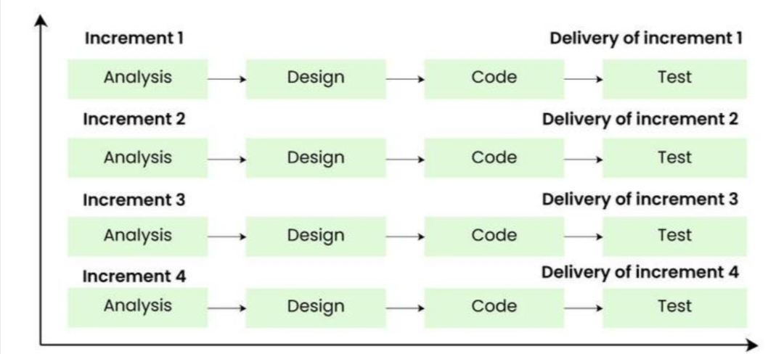
Suitable Maintenance Process Model
16/20

Slide 19
Suitable Maintenance Process Model
FoodBridge utilizes the Iterative Enhancement Model.
This model treats each maintenance cycle as a mini-development iteration, which involves analyzing existing code, designing modifications, implementing and testing changes, and then delivering the enhanced system.
Why this is the right model for FoodBridge:
Agile Alignment: It aligns perfectly with FoodBridge's agile, sprint-based workflow.
Incremental Growth: FoodBridge has a backlog of planned enhancements (like WebSocket notifications, Google Maps), and this model inherently supports incremental additions.
Architectural Fit: The React and TypeScript component-based architecture, alongside the Prisma ORM schema, naturally supports modular, iterative modifications without requiring a full system redesign.
Safety & Stability: Each iteration builds on the previous stable release, reducing the risk of introducing regressions, which is critical for a food safety platform.
16/20

Slide 20
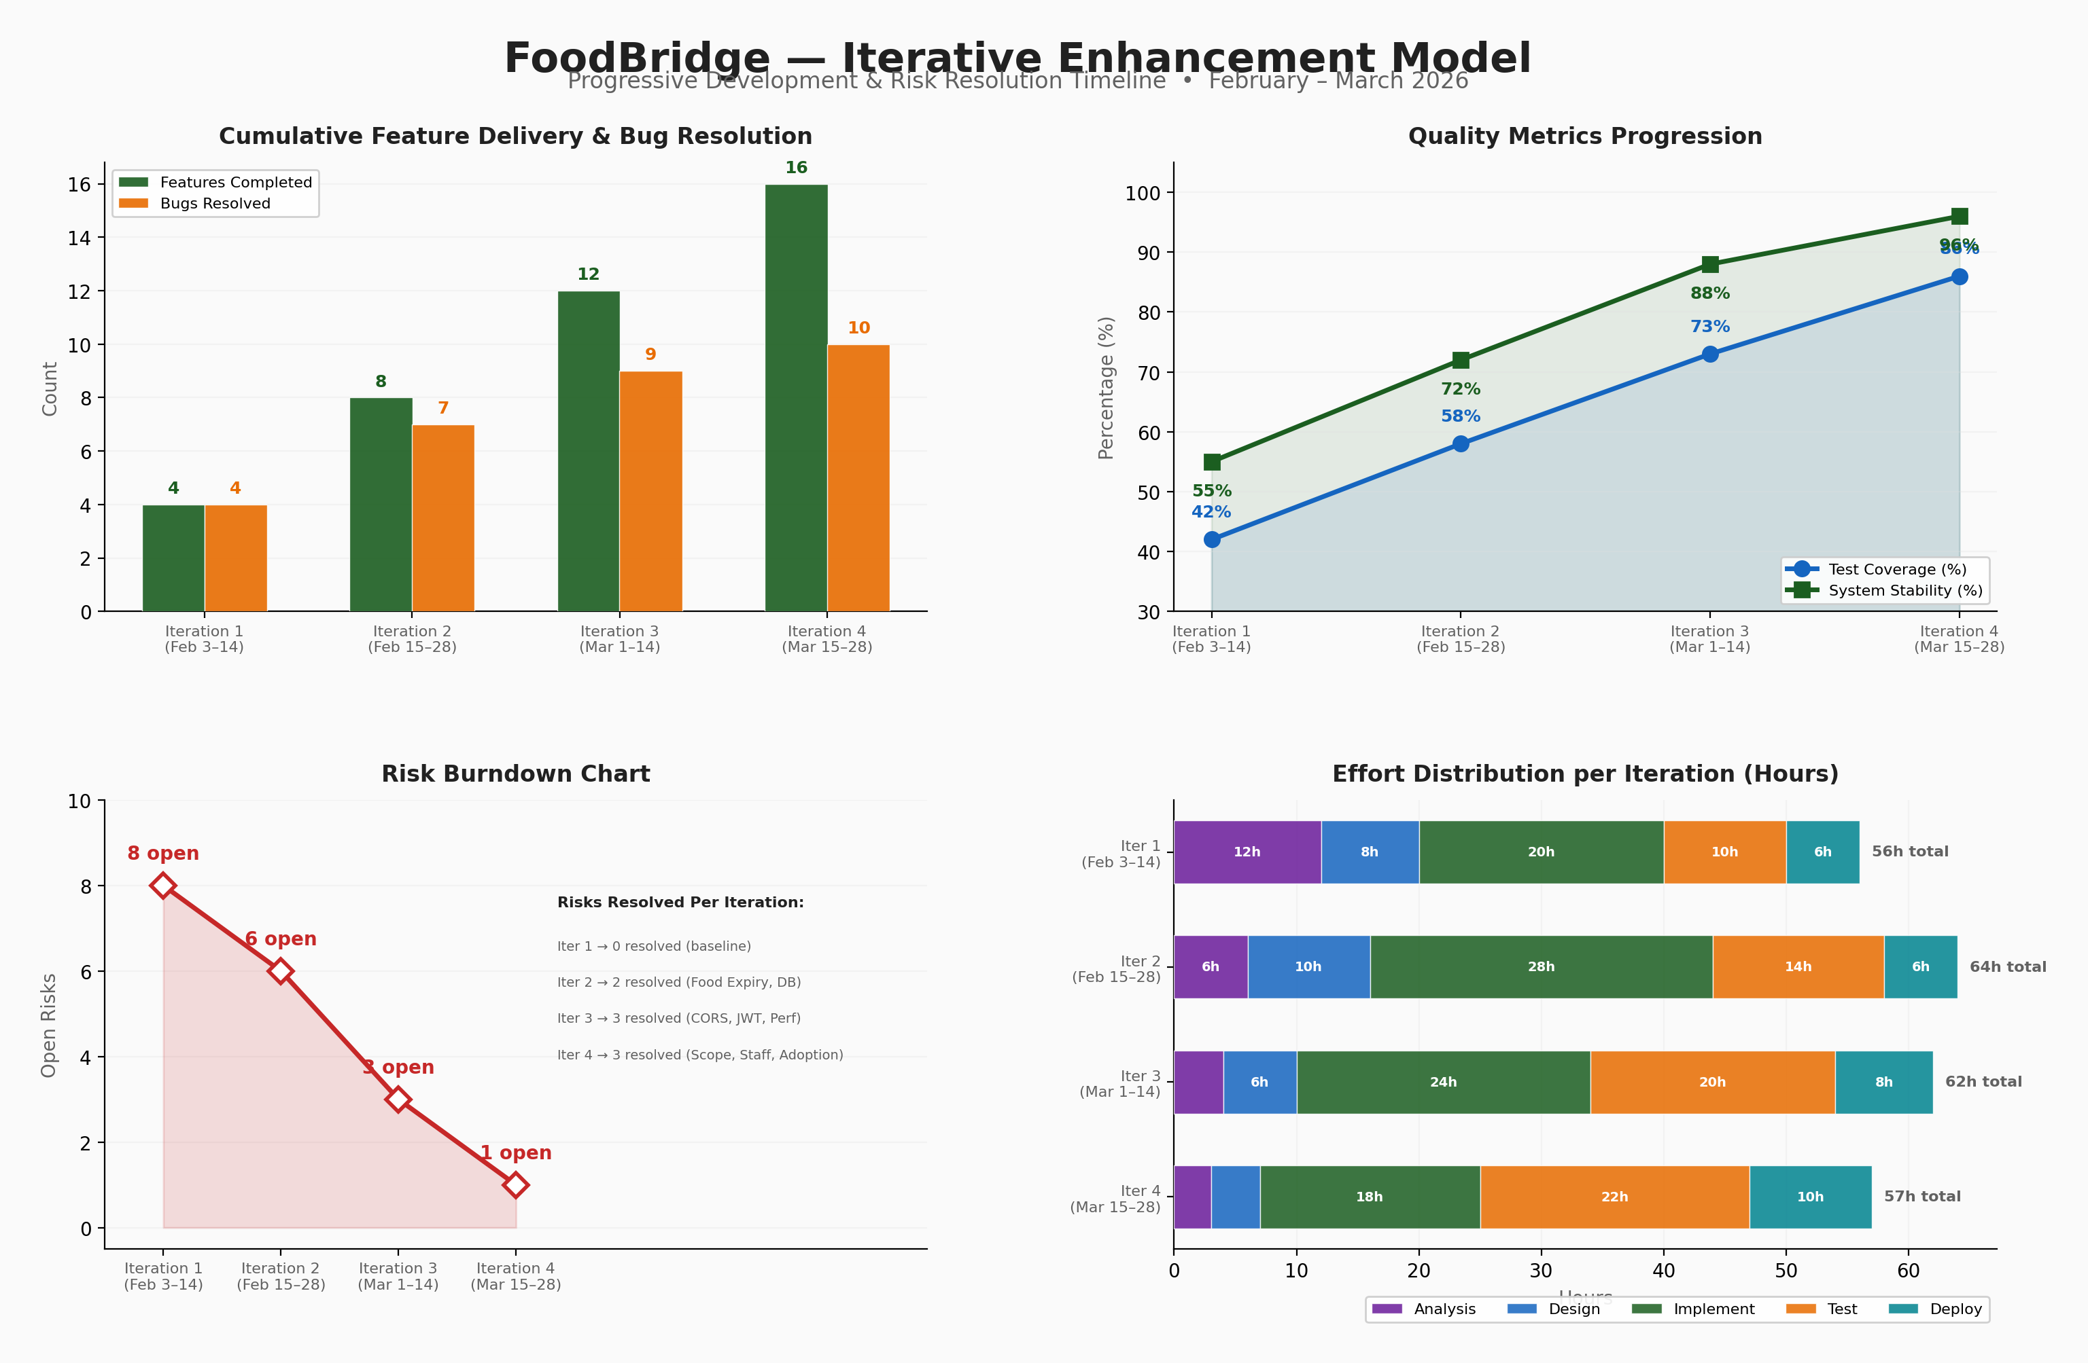
Iterative Enhancement Model — FoodBridge
Progressive development metrics across 4 iterations (February – March 2026)
20/20

