Slide 1

Introduction to JavaScript

Slide 2
History of JavaScript
World wide web was originally a bunch of pages.
Netscape was the popular browser.
Branden Eich developed new Language for Netscape.
It was originally called LiveScript
JavaScript Made it’s debut in version 2 of Netscape.
Microsoft invented it’s own language JScript
ECMAScritpt was introduced for standardisation

Slide 3

Browser war started

Slide 4

New Browsers introduced

Slide 5

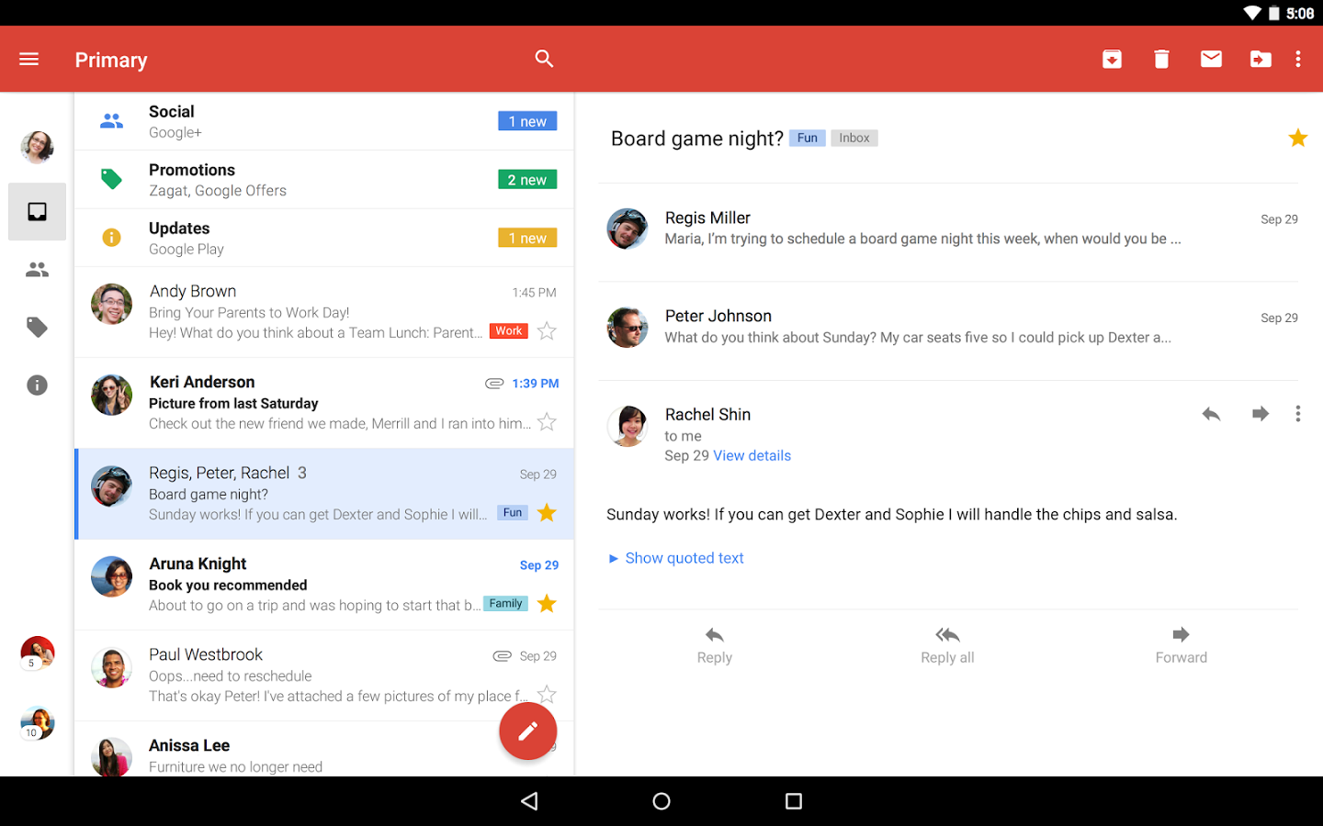

WEB 2.0

Slide 6
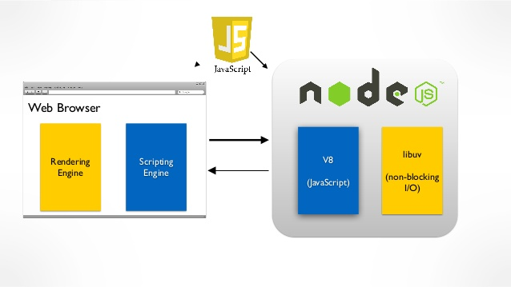

Slide 7


New Frameworks

Slide 8
further reading
JavaScript: Novice to Ninja By Darren Jones

