Slide 1
First step is Create a deliveries table.
create table deliveries(
id int not null,
inning int not null,
over int not null,
ball int not null,
batsman varchar not null,
non_striker varchar not null,
bowler varchar not null,
batsman_runs int not null,
extra_runs int not null,
total_runs int not null,
is_wicket int not null,
dismissal_kind varchar not null,
player_dismissed varchar not null,
fielder varchar not null,
extras_type varchar not null,
batting_team varchar not null,
bowling_team varchar not null );
copy deliveries from 'C:\Program Files\PostgreSQL\16\data\dataset\IPL_Ball.csv' CSV header ;

Slide 2
Second we create a Matches table
create table Matches(
id int not null,
city varchar not null,
date date not null,
player_of_match varchar not null,
venue varchar not null,
neutral_venue int not null ,
team1 varchar not null,
team2 varchar not null,
toss_winner varchar not null,
toss_decision varchar not null,
winner varchar not null,
result varchar not null,
result_margin int,
eliminator varchar not null,
method varchar not null,
umpire1 varchar not null,
umpire2 varchar not null);
copy Matches from 'C:\Program Files\PostgreSQL\16\data\dataset\IPL_Matches.csv' CSV header ;

Slide 3
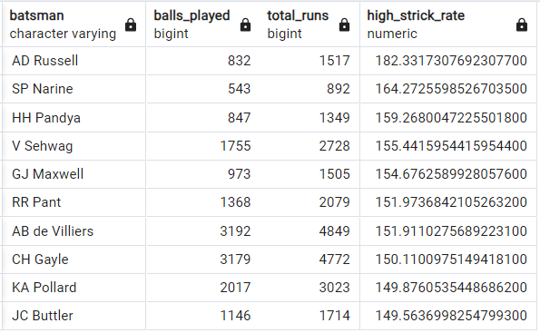
Task 1 - our first priority get 2-3 player with higher strike rate who faces atleast 500 balls and we have to make a list of 10 player who want to bit in auction.
select
batsman,
count(ball) as Balls_played,
sum(batsman_runs) as Total_runs,
(sum(batsman_runs):: decimal)/count(ball) *100
as High_Strick_rate
from deliveries
where extras_type != 'wides'
group by batsman
having count(ball) >= 500
order by High_Strick_rate desc
limit 10 ;

Slide 4
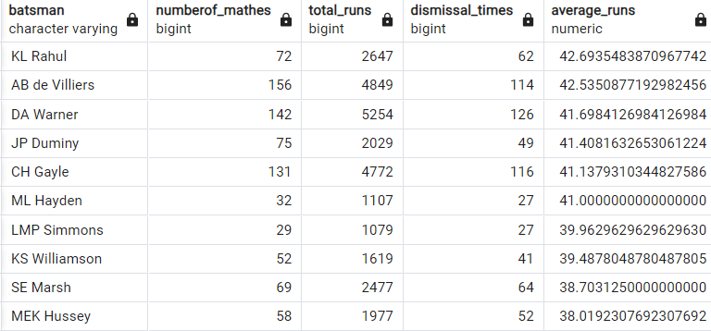
Task 2 - Now you need to get 2-3 players with good Average who have played more the 2 ipl seasons. And to do that you have to make a list of 10 players you want to bid in the auction.
select
batsman,
count(distinct id) as numberof_mathes,
sum(batsman_runs) as Total_runs,
sum(is_wicket) as dismissal_times,
(sum(batsman_runs) :: decimal)/sum(is_wicket)
as Average_runs
from deliveries
group by batsman
having count(distinct id)>28
order by Average_runs desc
limit 10;

Slide 5
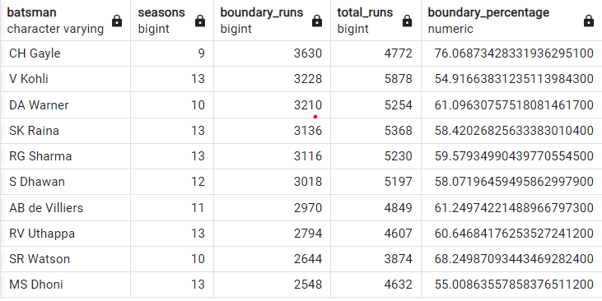
Task 3 - Now you need to get 2-3 Hard-hitting players who have scored most runs in boundaries and have played more the 2 ipl season. To do that you have to make a list of 10 players you want to bid in the auction.
select
Batsman,
count(distinct id)/14 as Seasons,
SUM(CASE WHEN batsman_runs IN (4, 6)
THEN batsman_runs ELSE 0 END)
AS boundary_runs,
SUM(batsman_runs) AS total_runs,
CASE WHEN SUM(batsman_runs) > 0 THEN
SUM(CASE WHEN batsman_runs IN (4, 6)
THEN batsman_runs ELSE 0 END) /CAST(SUM(batsman_runs)
AS DECIMAL) * 100 ELSE 0
END AS boundary_percentage
FROM deliveries
GROUP BY batsman
having count(distinct id)>2
ORDER BY boundary_runs DESC
LIMIT 10;

Slide 6
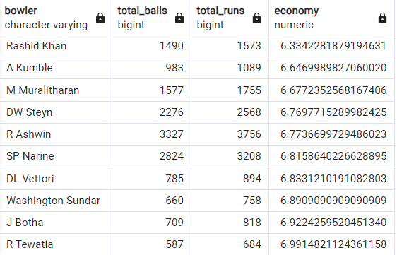
Task 4 - our first priority is to get 2-3 bowlers with good economy who have bowled at least 500 balls in IPL so far. To do that you have to make a list of 10 players you want to bid in the auction.
select
bowler,
count(ball) as total_balls,
sum(total_runs) as total_runs,
(sum(total_runs)/(count(ball)/6.0)) as economy
from deliveries
group by bowler
having count(ball)>500
order by economy asc
limit 10;

Slide 7
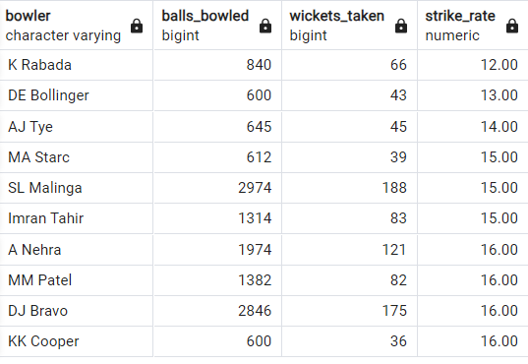
Task 5 - Now you need to get 2-3 bowlers with the best strike rate and who have bowled at least 500 balls in IPL so far.To do that you have to make a list of 10 players you want to bid in the auction.
SELECT
bowler,
COUNT(ball) AS balls_bowled,
SUM(CASE WHEN is_wicket = 1
THEN 1 ELSE 0 END)
AS wickets_taken,
ROUND(COUNT(ball) / NULLIF(SUM(CASE
WHEN is_wicket = 1
THEN 1 ELSE 0 END), 0) , 2)
AS strike_rate
FROM deliveries
GROUP BY bowler
HAVING COUNT(ball) > 500
ORDER BY strike_rate asc
LIMIT 10;

Slide 8
Task 6 - Now you need to get 2-3 All_rounders with the best batting as well as bowling strike rate and who have faced at least 500 balls in IPL so far and have bowled minimum 300 balls.To do that you have to make a list of 10 players you want to bid in the auction
Select
a.*,b.* from
(select batsman as player,count(ball) as total_ball_faced,
sum(batsman_runs) as total_runs_scored,
round(cast(sum(batsman_runs) as decimal )/count(ball)*100,2) as batting_strike_rate from deliveries
group by batsman
having count(ball)>500
order by batting_strike_rate desc)
as a inner join
(select round(cast(count(ball) as decimal )/sum(is_wicket),2) as bowling_strike_rate,
sum(total_runs) as total_runs_conceded,
count(ball) as total_deliveries,
sum(is_wicket) as total_wicket_taken,
bowler as player
from deliveries group by bowler
having count(ball) >300
order by bowling_strike_rate) as b
on a.player = b.player
limit 10;

Slide 9
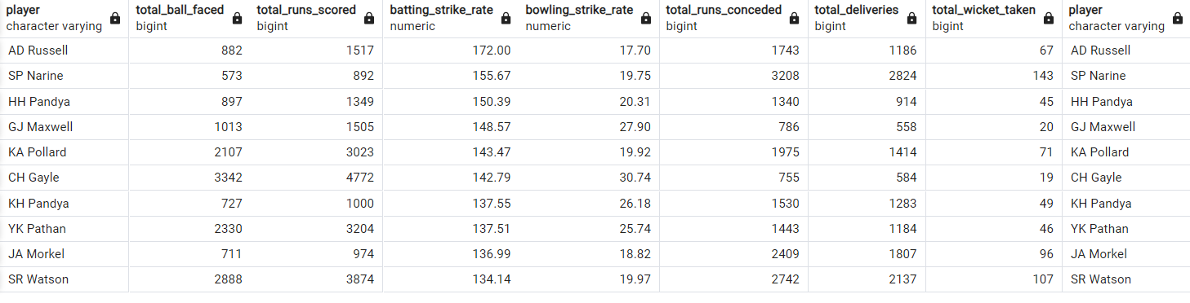
Task 6 output and visualization

Slide 10
Additional Questions for Final Assessment
1. Get the count of cities that have hosted an IPL match.
select count(distinct city) as city_count from Matches;

Slide 11
2. Create table deliveries_v02 with all the columns of the table ‘deliveries’ and an additional column ball_result containing values boundary, dot or other depending on the total_run (boundary for >= 4, dot for 0 and other for any other.
create table deliveries_v02 as
select *, case when total_runs >= 4
then 'boundary'
when total_runs = 0 then 'dot'
else 'other'
end as ball_result
from deliveries;

Slide 12
3. Write a query to fetch the total number of boundaries and dot balls from the deliveries_v02 table.
select
sum(case when ball_result = 'boundary' then 1 else 0 end)
as total_boundaries,
sum(case when ball_result = 'dot' then 1 else 0 end)
as total_dots
from deliveries_v02;

Slide 13
4.Write a query to fetch the total number of boundaries scored by each team from the deliveries_v02 table and order it in descending order of the number of boundaries scored.
select
bowling_team,
sum(case when ball_result = 'boundary' then 1 else 0 end)
as total_boundaries
from deliveries_v02
group by bowling_team
order by total_boundaries desc;

Slide 14
5. Write a query to fetch the total number of dot balls bowled by each team and order it in descending order of the total number of dot balls bowled.
select
bowling_team,
sum(case when ball_result = 'dot' then 1 else 0 end)
as total_dots
from deliveries_v02
group by bowling_team
order by total_dots desc;

Slide 15
6. Write a query to fetch the total number of dismissals by dismissal kinds where dismissal kind is not NA.
select
dismissal_kind,
count(*) as total_dismissals
from deliveries
where dismissal_kind != 'NA'
group by dismissal_kind;

Slide 16
7.Write a query to get the top 5 bowlers who conceded maximum extra runs from the deliveries table.
select
bowler,
sum( extra_runs) as total_extra_runs
from deliveries
group by bowler
order by total_extra_runs desc
limit 5;

Slide 17
8. Write a query to create a table named deliveries_v03 with all the columns of deliveries_v02 table and two additional column (named venue and match_date) of venue and date from table matches.
create table deliveries_v03 as
select d.*,
m.venue,
m.Date
from deliveries_v02 as d
join matches as m
on d.id = m.id;

Slide 18
9. Write a query to fetch the total runs scored for each venue and order it in the descending order of total runs scored.
select
venue,
sum(total_runs) as total_runs_scored
from deliveries_v03
group by venue
order by total_runs_scored desc;

Slide 19
10. Write a query to fetch the year-wise total runs scored at Eden Gardens and order it in the descending order of total runs scored.
select
extract(year from date) as year,
sum(total_runs) as total_runs_scored
from deliveries_v03
where venue = 'Eden Gardens'
group by year
order by total_runs_scored desc;

