Slide 2

AED Project: KIVA Non-Profit Organization
Kunal Chugh 001255820
Nishant Gohel 001644850
Karan Dutt 001229215

Slide 3
Problem Statement
To start or grow a small business, access to clean drinking water or build a school generally require some funding to bring ideas into reality.
The lack of funding could hinder growth of new ideas into businesses especially in remote areas with no proper access to funding organization.

Slide 4
Proposed Solution
Kiva is a non-profit that allows people to lend money via the internet to low-income entrepreneurs and students.
A borrower applies for a loan directly or through a Field Partner, which after approval is posted on the Kiva website.
Lenders crowdfund the loans in increments of $25 or more.
Lending platform with 0% Interest.

Slide 5
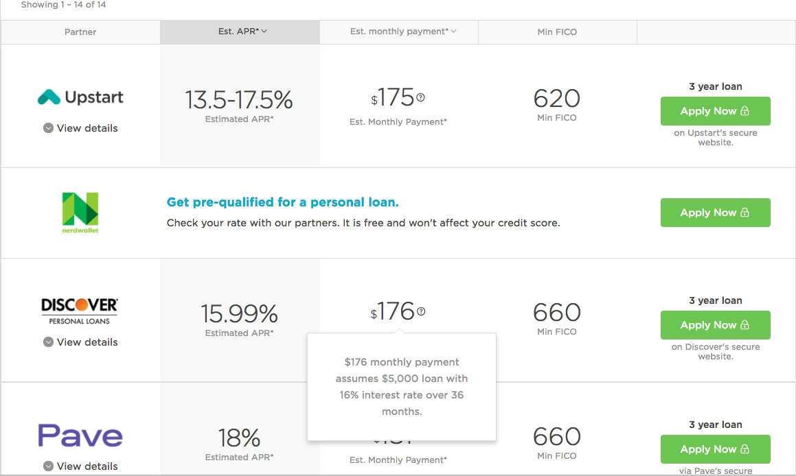
Real World Example with a high Annualized Percentage Rate
Source: https://www.nerdwallet.com/personal-loans

Slide 6
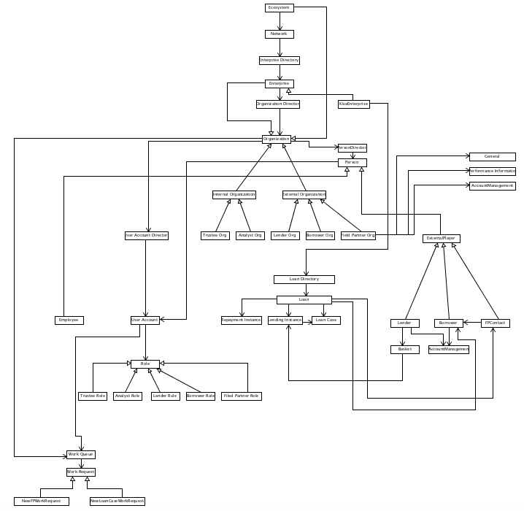
Object Model

Slide 7
Key Responsibilities
ROLES | RESPONSIBILITIES
Enterprise-admin | Creates account for Analyst Creates account for Trustee Creates account for Field Partner
Field Partner | Creates Borrower Profile Creates Borrower Account Adds Borrower
Trustee | Approves Borrower Rejects Borrower Approves Field Partner Rejects Field Partner Views Revenue Collection
Lender | Adds Borrower to Cart with amount Proceeds checkout and lends money to borrower
Borrower | Views Loan Case Status Views Repayment schedule
Analyst | Authenticates Borrower Case Authenticates Field Partner Case
Sysadmin | Creates Enterprise Creates Network

Slide 8
Key Features
WORK REQUESTS | DETAILS | PUSH/PULL | SENDER | RECEIVER
NewFieldPartner WorkRequest | After the analyst authenticates the Field Partner Case Request, it is sent to the Trustee for further authentication. | Push | Analyst | Trustee (Trustee Organization Common Queue)
NewFieldPartner WorkRequest | To approve or reject the Field Partner Case. | Pull | Analyst | Trustee (Trustee Organization Common Queue)
NewFieldPartner WorkRequest | On approval of New Field Partner by the Trustee | Push | Trustee | Enterprise Admin

Slide 9
Key Features
WORK REQUESTS | DETAILS | PUSH/PULL | SENDER | RECEIVER
NewLoanCase WorkRequest | Work Request for a particular loan case approval. | Push | Field Partner | Analyst (Analyst Organization Common Queue)
NewLoanCase WorkRequest | To approve the loan case sent by the Field Partner. | Pull | Field Partner | Analyst (Analyst Organization Common Queue)

Slide 10
Use Cases
USE CASE | USE CASE DESCRIPTION
FieldPartnerFormJPanel → AnalystWorkAreaJPanel → AnalyseFieldPartnerJPanel → TrusteeWorkAreaJPanel → TrusteeViewFieldPartnerJPanel | The Field Partner fills out a form to be a part of the KIVA Ecosystem. This form is validated by the Analyst who logs in and checks the Request and sends it to the Trustee for a second validation. The Request is either Approved or Rejected by the Trustee by logging in the system.
SignUpBorrowerJPanel → FieldPartnerWorkAreaJPanel -> AddBorrowerDetailsJPanel -> AnalystWorkAreaJPanel → AnalyseLoanCaseJPanel → ViewFieldPartnerJPanel → TrusteeWorkAreaJPanel → TrusteeViewLoanCaseJPanel | A Borrower who is in need of a loan fills up the form which is validated by the Analyst which is then sent to the Trustee. The Trustee views the Borrower Loan case and approves or rejects the case.
SignUpLenderJPanel → LenderWorkAreaJPanel → ViewBorrowerLoanCaseJPanel → BasketJPanel | A Lender who wishes to lend money to a borrower logs in the KIVA system. The lender can view the borrower loan case and/or proceed to the checkout and add money to the cart.

Slide 11
Use Cases
USE CASE | USE CASE DESCRIPTION
BorrowerWorkAreaJPanel -> LoanCaseStatusJPanel -> RepaymentJPanel | Once the borrower has sufficient funds, he adds credit to his KIVA Account and makes a repayment which is directed to his loan’s lenders directly with no interest charged.

Slide 12
THANK YOU ☺

