Slide 1

Customer Shopping Behavior Analysis
Uncovering insights from 3,900 purchases to guide strategic business decisions through data-driven analysis of spending patterns, customer segments, and product preferences.

Slide 2
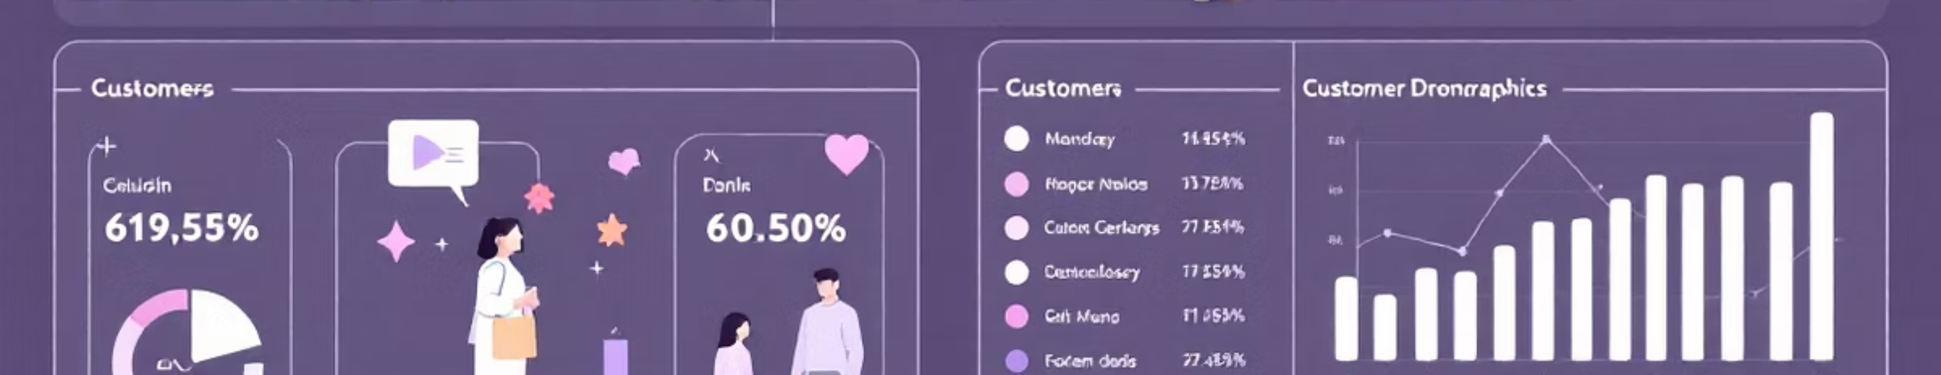
Dataset Overview
3,900
18
50
25
Total Purchases
Data Features
Locations
Product Types
Comprehensive transactional data analyzed
Customer demographics and shopping behavior
Geographic diversity across customer base
Diverse inventory across four categories

Slide 3

Data Preparation & Analysis
Python Data Cleaning
Key Statistics
Loaded dataset using pandas
Average Purchase: $59.76
Imputed 37 missing Review Rating values using median
Age Range: 18-70 years
Standardized columns to snake case
Average Rating: 3.75/5.0
Previous Purchases: 1-50 per customer
Created age_group and purchase_frequency features
Integrated with PostgreSQL database

Slide 4

Revenue Insights
Gender Revenue Gap
Male customers generated $157,890 vs. female customers at $75,191 — more than double the revenue contribution.
Shipping Preferences
Express shipping users spend $60.48 on average vs. $58.46 for Standard — indicating premium service preference.

Slide 5


Subscription Analysis
27%
Despite similar average spend ($59.49 vs. $59.87), non-subscribers drive significantly higher total revenue due to volume.
Subscribers
1,053 customers
Opportunity: Converting just 10% more customers
to subscriptions could unlock substantial recurring
revenue.
73%
Non-Subscribers
2,847 customers

Slide 6
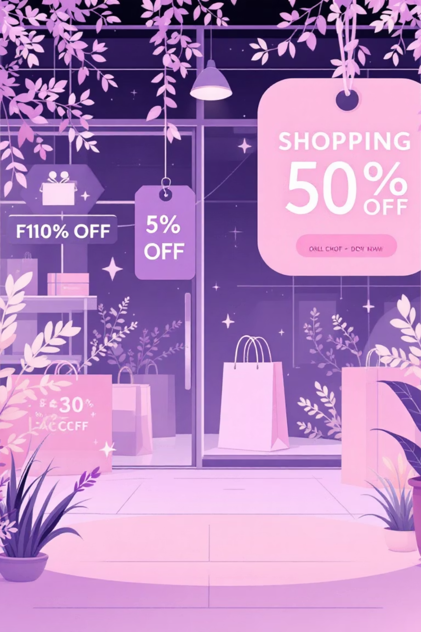
Smart Discount Users
High-Value Discount Shoppers
839 customers used discounts but still spent above the $59.76 average purchase amount.
Discount-Dependent Products
Hats lead at 50% discount rate, followed by Sneakers (49.66%), Coats (49.07%), Sweaters (48.17%), and Pants (47.37%).

Slide 7


Top-Rated Products
77%
77%
76%
Gloves
Sandals
Boots
Highest rated at 3.86/5.0
Strong performance at 3.84/5.0
Solid rating at 3.82/5.0
76%
76%
Hat
Skirt
Customer favorite at 3.80/5.0
Well-received at 3.78/5.0

Slide 8



Customer Segmentation
New
1
83 customers
Returning
2
701 customers
Loyal
3
3,116 customers
The majority are loyal customers, but 958 repeat buyers (>5 purchases) remain unsubscribed — a key conversion opportunity.

Slide 9
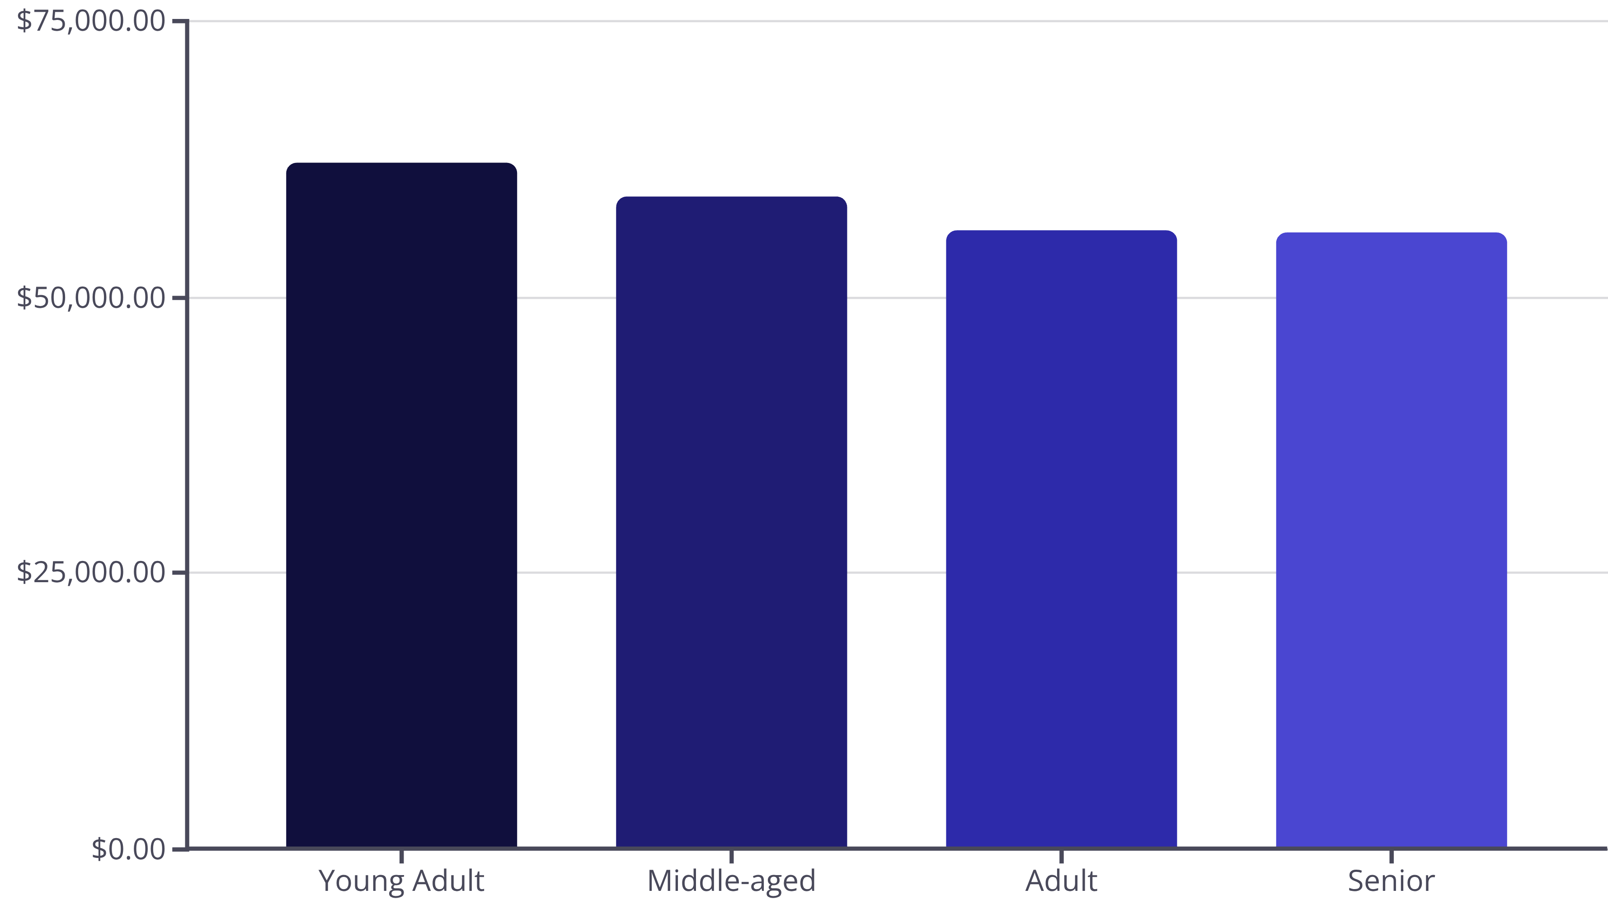
Category & Age Performance
Young Adults drive the highest revenue. Top products per category: Jewelry and Blouse (Accessories/Clothing), Sandals (Footwear), and Jacket (Outerwear).

Slide 10
Strategic Recommendations
01
02
03
Boost Subscriptions
Loyalty Programs
Optimize Discounts
Promote exclusive benefits targeting the 958 repeat buyers without subscriptions.
Reward returning customers to accelerate their journey into the loyal segment.
Balance promotional sales with margin control, especially for discount-dependent products.
04
05
Product Positioning
Targeted Marketing
Highlight top-rated items like Gloves and Sandals in marketing campaigns.
Focus on Young Adults and express-shipping users for maximum revenue impact.

