Slide 1

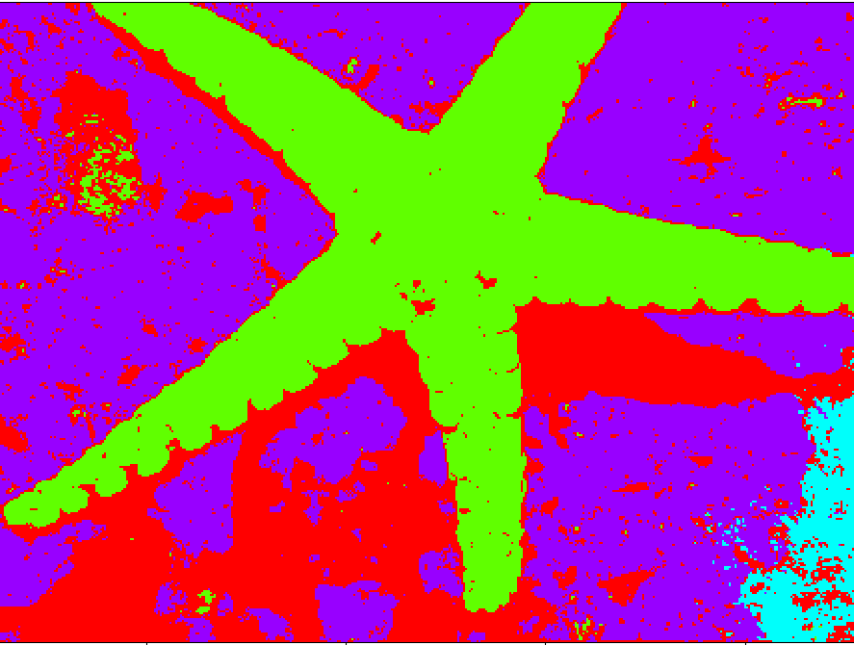
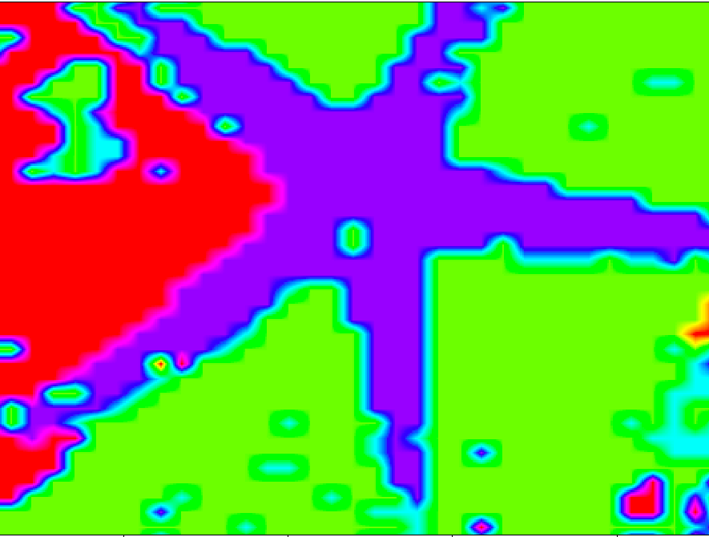
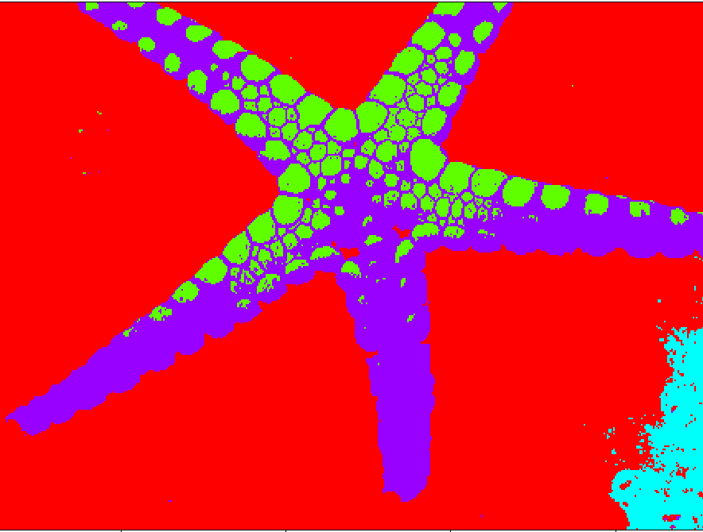
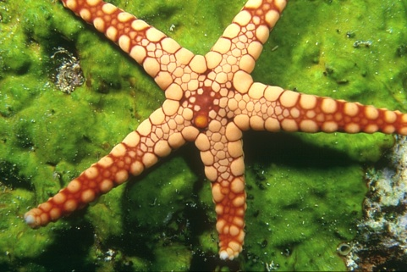

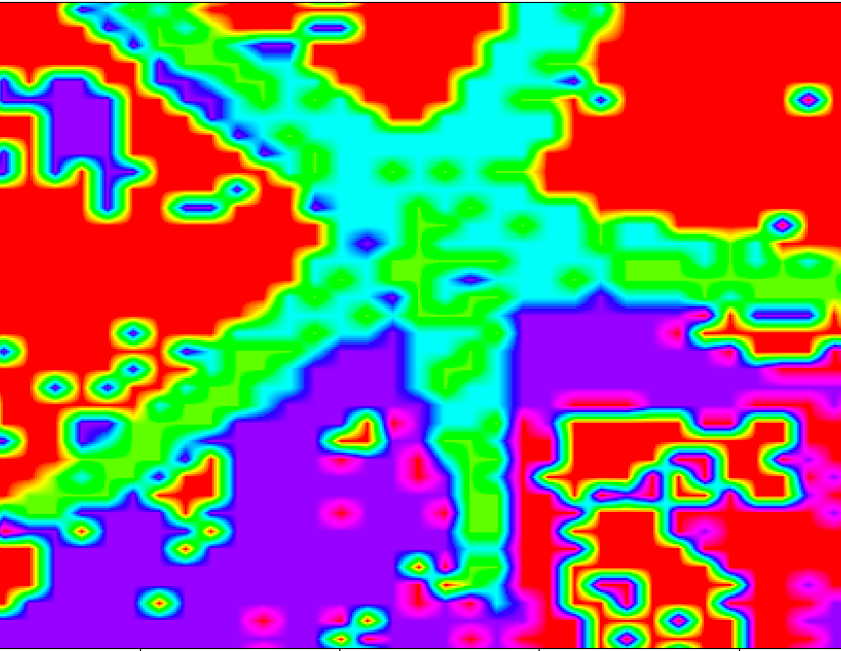
Image Segmentation and Bayesian Inference
- Nishant Gurunath, Soham Kelkar (21)
Spectral Segmentation
GMM Segmentation
Bayesian GMM
Boundary Segmentation
Mean Shift Segmentation
Original
Know the no of segments?
Very few segments
No clue on segments?
Discrete Objects?
Gaussian Mixture Models
- Speaker Identification
Spectral Segmentation
- Detection of tumour
Mean Shift Segmentation
- Satellite Detection
Boundary Segmentation
- Number plate detection
Notes:
Dataset: The Berkeley Segmentation Dataset and Benchmark
https://www2.eecs.berkeley.edu/Research/Projects/CS/vision/bsds/
References:
[1] Dorin Comaniciu and Peter Meer. 2002. Mean Shift: A Robust Approach Toward Feature Space Analysis. IEEE Trans. Pattern Anal. Mach. Intell. 24, 5 (May 2002), 603-619.
[2] Jianbo Shi and J. Malik, "Normalized cuts and image segmentation," in IEEE Transactions on Pattern Analysis and Machine Intelligence, vol. 22, no. 8, pp. 888-905, Aug. 2000.
[3] P. Arbelaez, M. Maire, C. Fowlkes and J. Malik. Contour Detection and Hierarchical Image Segmentation. IEEE TPAMI, Vol. 33, No. 5, pp. 898-916, May 2011.
[4] D. Martin and C. Fowlkes and D. Tal and J. Malik. A Database of Human Segmented Natural Images and its Application to Evaluating Segmentation Algorithms and Measuring Ecological Statistics. Proc. 8th Int'l Conf. Computer Vision, Vol. 22, pp. 416-423, July 2001.
[5] Ji Won Yoon. An Efficient Model Selection for Gaussian Mixture Model in a Bayesian Framework. CoRR, abs/1307.0995, 2013.
Additional Notes:
MSS -
No parameters required, same hyperparameters can be used for majority of images based on image size and type
Noisy because it’s a density function
Slow; time complexity
Different hyper parameters required depending on feature
Spectral:
Very good for first few segments as other eigenvectors do not minimize the problem
Slow
Less noisy
Number of clusters parameter required, A lot of internal hyper parameters
Sklearn version didn’t work
Difficult to reproduce
Does really bad if first segment is ill-formed
Boundary:
Does not identify class/color based only on edges
Fast
Does not give a lot of meaning
No parameter required
GMM:
Really good performance if K is known
Parameter changes for every image
Really fast
Bayesian GMM:
Robust to value of K to some extent
Performs as good as GMM

