Slide 1


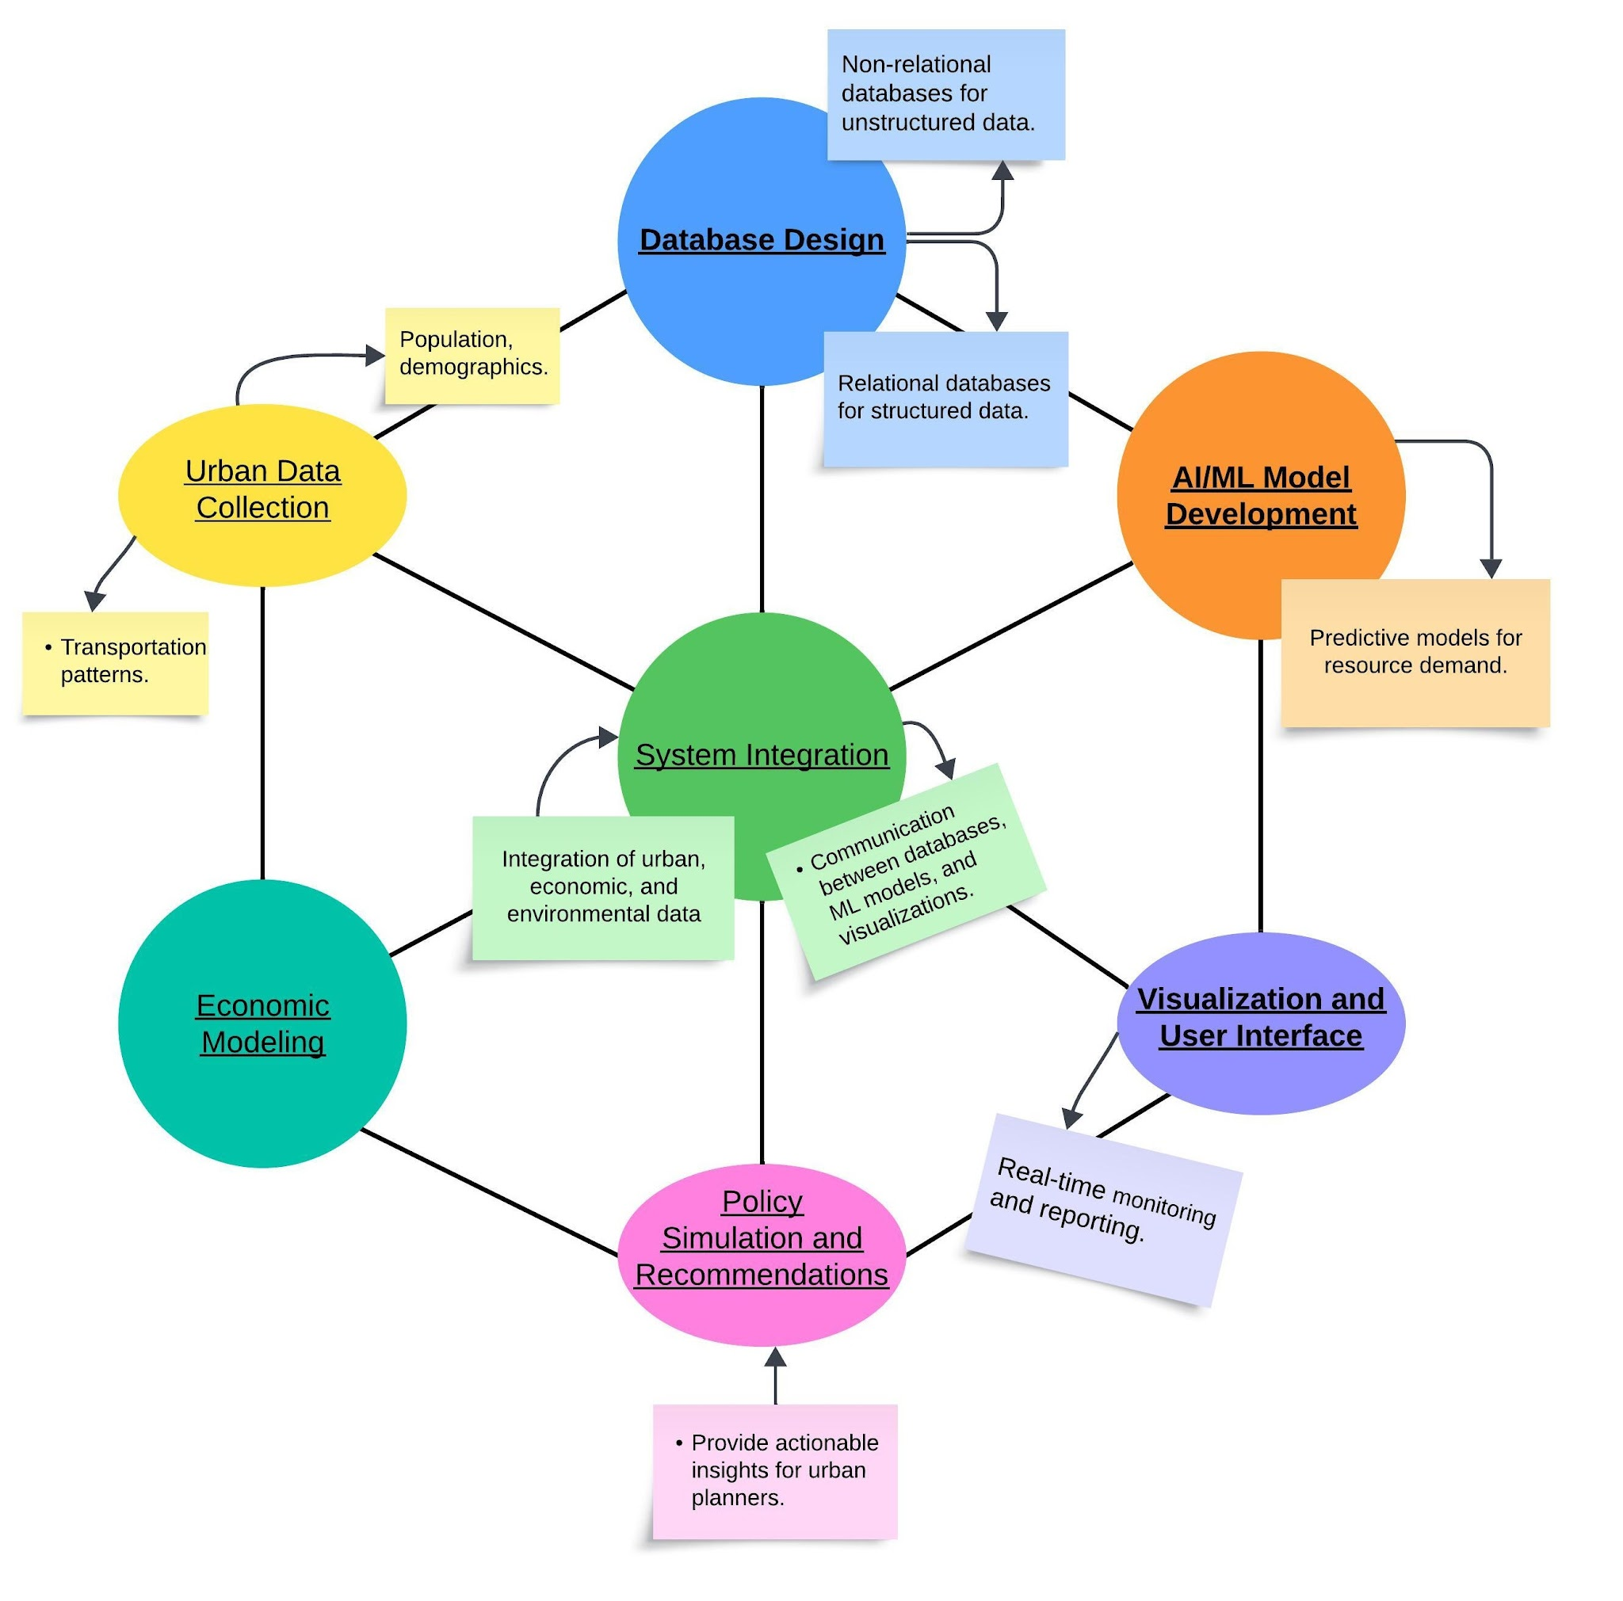
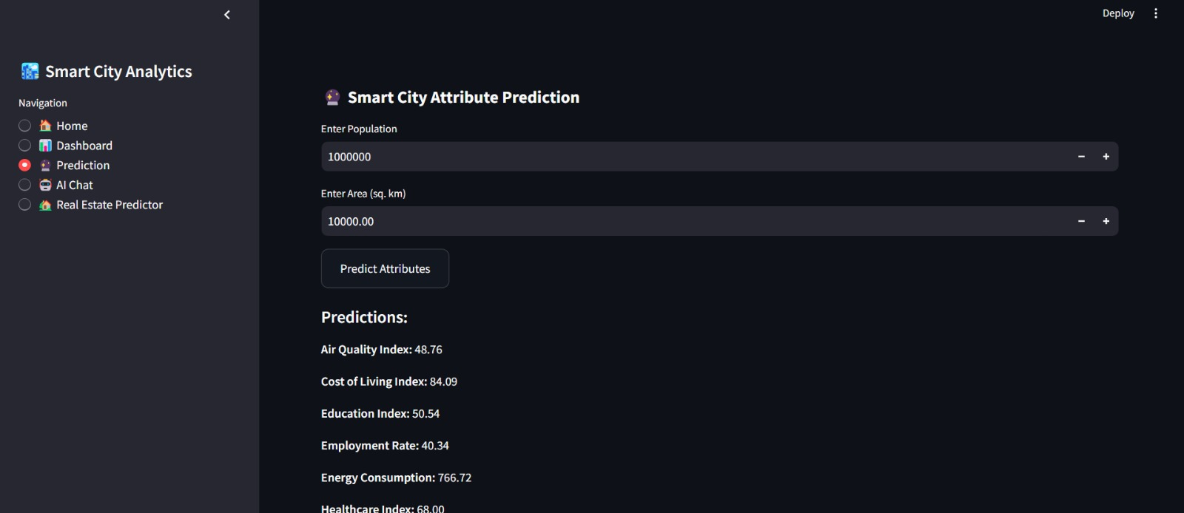
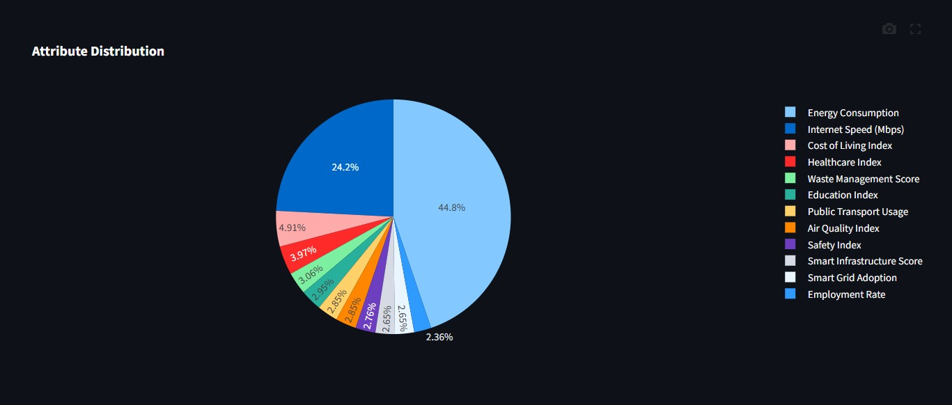
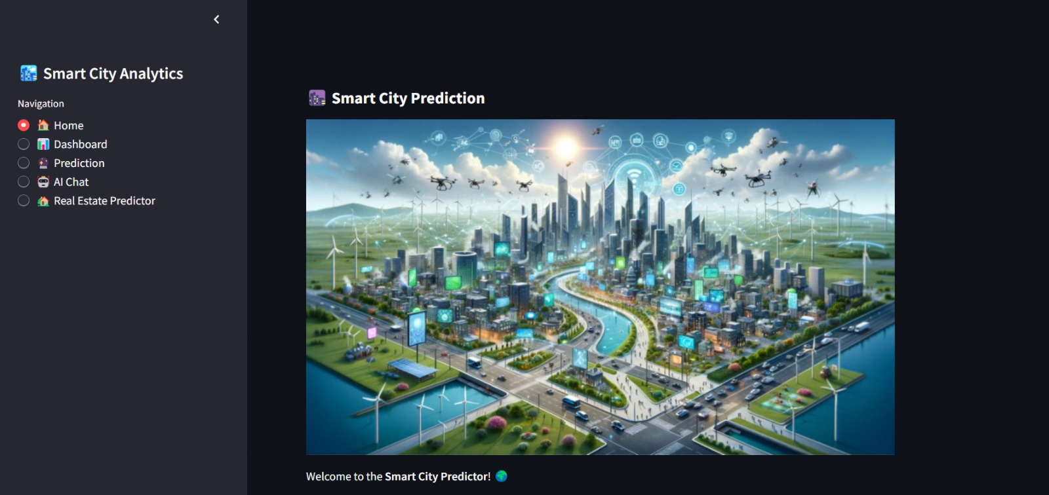
Smart Resource Allocation and Economic Planning System for Sustainable Cities
Subject : INTER DEPARTMENT EXPERIENTIAL LEARNING
INTRODUCTION
MODEL INTERACTIONS
RESULTS
As cities rapidly urbanize, efficient management of resources like water, energy, and public transport becomes crucial. Traditional systems often lead to wastage and high costs. Our AI/ML-powered system aims to optimize resource allocation, reduce waste, and promote sustainability. By using predictive analytics and optimization algorithms, we forecast demand, improve efficiency, and help urban planners make data-driven decisions. This approach ensures economic growth while fostering a greener, more sustainable future for cities.
OBJECTIVES
Optimize Resource Allocation: Use AI/ML to forecast and manage the distribution of water, electricity, and public transport efficiently.
Reduce Resource Wastage: Implement systems to minimize inefficiencies in resource usage and waste.
Enhance Economic Efficiency: Lower operational costs for both urban administrations and citizens through optimized resource management.
Promote Environmental Sustainability: Support eco-friendly practices by integrating green initiatives like renewable energy and efficient transportation.
Support Policymakers: Provide actionable insights and simulations for data-driven urban planning and decision-making.
Methodology
Data Collection & Integration
Gather real-time and historical data from IoT sensors, government databases, and public records.
Key data includes population demographics, resource consumption, transportation patterns, and environmental indicators.
2. Predictive Analytics with AI/ML
Implement time-series forecasting to predict future resource demands.
Use machine learning models to optimize resource allocation proactively.
3. Optimization Algorithms
Develop AI-driven algorithms to efficiently allocate water, electricity, and transport resources.
Adjust distribution dynamically based on real-time demand fluctuations.
4. Policy Simulation & Decision Support
Simulate urban policies like congestion pricing and renewable energy incentives.
Use cost-benefit analysis and game theory to evaluate sustainability strategies.
5. Visualization & Insights
Present data-driven insights through interactive dashboards (Power BI, Tableau, or Plotly).
Provide policymakers with real-time analytics for better urban planning decisions.
MODEL INTERFACE
REFERENCES
Dou, X., & Meenakshi, S. (2023). Machine Learning for Smart Cities: A Comprehensive Review of Applications and Opportunities. International Journal of Advanced Computer Science and Applications, 14(9). Retrieved from The Sai.
Quercia, D., Schifanella, R., & Aiello, L. M. (2023). Artificial Intelligence in Smart Cities—Applications, Barriers, and Opportunities. Journal of Smart Cities, 7(3), 57. Retrieved from MDPI.
Wang, D., Fu, Y., Wang, P., Huang, B., & Lu, C.-T. (2023). Smart City Urban Planning Using an Evolutionary Deep Learning Model. Soft Computing, 28, 447–459. Retrieved from SpringerLink.
Zhang, D., Wang, M., Mango, J., Li, X., & Xu, X. (2024). A Survey on Applications of Reinforcement Learning in Spatial Resource Allocation. arXiv preprint arXiv:2403.03643. Retrieved from ArXiv.
Home 🏠 – The main landing page, providing an overview of the Smart City Prediction system.
Dashboard 📊 – Displays key insights, analytics, and data visualizations related to smart city parameters.
Prediction 🤖 – Uses Random Forest Regression to predict various smart city factors like electricity demand, AQI, transport efficiency, and other urban metrics.
AI Chat 🤖💬 –AI-powered chatbot for answering queries and providing insights about smart city trends.
Real Estate Predictor 🏡 – Uses Linear Regression to predict real estate prices based on various factors such as location, infrastructure, and market trends.
Team Details:
Vidwath H Hosur (1RV22CS231) Tejas Soham (1RV22IS074)
Shriniwas Maheshwari (1RV22CS194) Hrushikesh Koli (1RV22IS022)
Nishanth H R (1RV22AI032)

