Slide 1
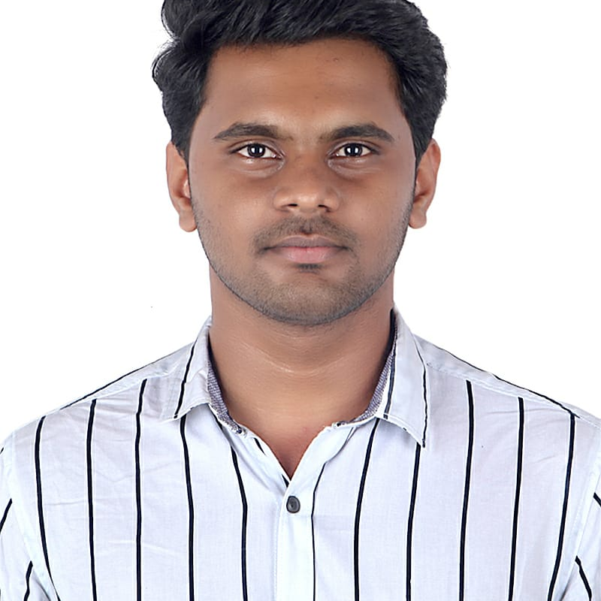


Nishanth R
Analyst/Software Engineer
Bachelor of Technology
Computer Science :2017-2021
Skills Java
JDBC
Spring Boot
Spring MVC
Database
MySQL database
Web Technologies
HTML5
CSS3
Javascript
AddOns
Maven
Postman
Additional skills
Leadership Qualities
Team Management
PUNE
nishanth.ramchandra@CAPGEMINI.COM
+91 9535334535
A4
Eager to work in a team of dedicated people and serve a key role in the enhancement and development of the project.
Software Engineer who is Strong in design and integration with intuitive problem-solving skills. Passionate about implementing and launching new projects..
Has working knowledge on Java Microservice Development using Spring framework on an intermediate level.
Sweet shop management system :
Completed end to end case study of Online Sweet shop management system(product and offer) along with JWT authentication, Swagger and payment testing. Material-UI and React used for user interface.
Designed static webpage using HTML CSS JAVASCRIPT
Developed website with HTML and CSS along with javascript to make website more interactive and dynamic
https://github.com/nishanth-24/Nishanth.git

