Slide 1

GENESIS
IDEATHON
TEAM & DOMAIN
Team Name – Idealogists
Team Members –
  Gopammagari Manu Deep Reddy – CB.SC.U4CSE26618
  P Nishanth – CB.SC.U4CSE26146
  P Dhivyes – CB.SC.U4CSE26145
  V Ragghul – CB.SC.U4CSE26163
Selected Domain – Domain 4 [Climate Action, Water and Environmental Resilience]
Problem Statement – Fisherfolk Border Alert

Slide 2


DOMAIN PROBLEM IN OUR WORDS
TEAM
IDEALOGISTS
Fisherfolk Border Alert
What exactly needs to be solved?
  Fishermen from Tamil Nadu (especially from coastal areas such as Rameshwaram, Nagapattinam, etc…) unintentionally cross the India – Sri-Lanka marine border during fishing
  This is because the boundary is not physical, but just an invisible line in open water
  Also, most fishing boats are low-cost, so they do not have inbuilt GPS to track the boundaries
  This results in crossing the border, and thereby leading to the Sri-Lankan Navy seizing the Indian fishermen’s boats and arresting them
  The fishermen are not doing this intentionally, they are unaware of the exact placement of the border, and this is an honest mistake, with no safeguard to prevent it
Why is it important right now?
  This is not a one-off issue – it happens every fishing season
  Each arrest / seizure results in a fisherman’s family losing their sole source of income
  India already has its own satellite navigations system NavIC built by ISRO, which can potentially solve this problem, but it is barely being used

Slide 3
WHO IS AFFECTED?
TEAM
IDEALOGISTS
Target users, stakeholders, beneficiaries
Primary users / target group
  Fishermen from Tamil Nadu’s coastal districts, especially those who fish close to the India–Sri Lanka marine boundary
  Small-scale and traditional fishermen using mechanized boats or country boats, since they’re the ones most likely to drift near the boundary without realizing it
Secondary stakeholders
  Fishermen’s families, who also suffer due to the economic and emotional loss
  The Tamil Nadu and Indian government who currently handle these incidents, who would benefit from fewer cases of these types
  Fishing boat manufacturers or equipment sellers, who could eventually integrate this as a standard safety feature
Who benefits if the problem is solved?
  Fishermen could avoid arrest, detention, and loss of their boats
  Families maintain stable income instead of losing weeks or months of earnings per incident
  India–Sri Lanka diplomatic relations ease slightly, since this a common recurring friction point

Slide 4
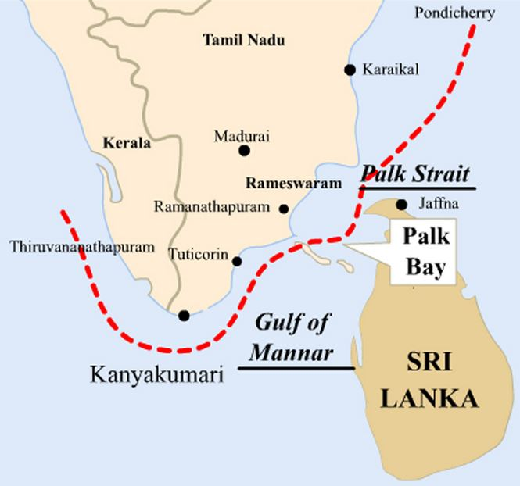
CURRENT SITUATION & CONTEXT
TEAM
IDEALOGISTS
Existing scenario, background and how things work today
Existing scenario and background
  The India–Sri Lanka maritime boundary (IMBL) was fixed in 1974-76, but Palk Bay fishing grounds overlap across it
  The boundary is invisible at sea, so fishermen can’t tell exactly where it is, especially at night
  Boats that drift across, even unintentionally, get intercepted by the Sri Lankan Navy
Relevant data or facts
  Hundreds of Tamil Nadu fishermen are arrested yearly, and seized boats are often never returned
  Repeatedly raised in India–Sri Lanka diplomatic talks, yet keeps recurring
  Most recently, on October 3, 2026, TN CM Vijay wrote to EAM Jaishankar seeking release of 20 fishermen held in Sri Lanka
Current workflow, step by step
  Fisherfolk go out to sea with little or no GPS guidance
  Boat drifts near/across the IMBL while following fish, with no alert
  Sri Lankan Navy intercepts, detains the fisherman, and seizes the boat pending negotiations

Slide 5
KEY CHALLENGES
TEAM
IDEALOGISTS
Main difficulties, bottlenecks, root causes and consequences
Main difficulties and bottlenecks
  No visible marker for the marine border, so fishermen can’t tell when they’re near it
  Most boats have no GPS, so there is no way of knowing if the border is close or not
  Detection and interception only happen after the crossing, never before it; there is no prevention, only a challenging cure
Root causes behind them
  The boundary was drawn as a legal line, not a usable navigational one for fishermen
  Affordable, boundary-specific alert technology was never built or distributed to fishing communities
  Existing responses treat each arrest as a one-off incident rather than fixing the root gap, so there is no active preventive mechanism in place
Consequences of leaving them unsolved
  Fishermen keep losing boats and income every fishing season, causing great distress to them and their families
  India–Sri Lanka relations stay strained by a recurring but preventable issue
  Coastal families remain financially and emotionally vulnerable with no long-term fix available as of now

Slide 6
EXISTING SOLUTIONS / APPROACHES
TEAM
IDEALOGISTS
What is already being done, and where it falls short
Existing methods, systems or alternatives
  Diplomatic talks via the India–Sri Lanka Joint Working Group on Fisheries
  Naval patrolling and coast guard presence by both countries
  Basic GPS devices on some boats which are not boundary specific
  Fishermen association awareness/warnings based on experience
Limitations of each
  Diplomatic talks resolve individual arrests but don’t prevent future ones, so they only serve as stop-gap measures
  Patrolling only catches crossings after they happen and not before, so they don’t come under preventive measures
  Generic GPS shows location but doesn’t flag the marine border specifically or provide real – time alerts
The gap they leave open (Key Challenges)
  No real-time, boundary-specific alert system exists for the fishermen
  Every current approach is reactive (after the crossing) rather than preventive (before the crossing)
  Low-cost, accessible technology for small-scale fishermen remains completely missing

Slide 7
PROBLEM INSIGHTS & OPPORTUNITY AREAS
TEAM
IDEALOGISTS
Resources required to solve the problem
Hardware Requirements
  A GPS receiver module (battery or solar powered, depending on efficiency)
  Alert mechanism — buzzer / LED light / small display for visual and audio warning
  Weatherproof casing, since it will be used in open sea conditions
Software Requirements
  A geofencing algorithm that compares the boat’s live location against the IMBL (marine border) coordinates
  Alert-trigger system (distance-based thresholds — Example: warning at 2 km, alarm at 500m from boundary)
Other resources (Including Human Resources)
  Access to accurate marine border coordinate data (from government / maritime sources)
  Inputs from fishermen communities to design something usable for real sea conditions

Slide 8
INITIAL DIRECTION & EXPECTED OUTCOME
TEAM
IDEALOGISTS
What Is Your Expected Outcome?
What your team intends to do
  Build a low-cost boundary-alert device that fishermen can mount on their boats to warn them in real time as they approach the India–Sri Lanka maritime boundary (IMBL)
  Use India’s own NavIC satellite navigation system
What you want to improve
  Replace the current reactive system with a preventive one (warn before the crossing happens)
  Make boundary-awareness accessible to small-scale fishermen who currently have no GPS or boundary-specific alerts at all
What successful improvement should you achieve
  A working proof-of-concept that demonstrates real-world value beyond defence and logistic use cases

