Slide 1
Segmenting Madrid
Fabián Torres
Applied Data Science Capstone
The Battle of Neighborhoods

Slide 2
Agenda
Introduction
Data
Methodology
Results
Discussion
Conclusion

Slide 3

Introduction
"La Milonguita" is a chain of restaurants located in Buenos Aires, Argentina, it offers typical foods of that country.
The owners wants to expand their chain to Europe and they are very interested in establish a new restaurant in Madrid, Spain.
Madrid is a big city with more than 3 millions inhabitants and a metropolitan area population of about 6.5 millions. It's composed by more than one hundred neighborhoods.
In order to get directions about where to establish their first restaurant in Madrid, the owners of "La Milonguita" has asked us to do an study of different places of the city.
Marketing consultants has determined that we must pay special attention to entertainment services, because they are considered attractive to potential customers.

Slide 4
Data
Various sources of data are used:
  Wikipedia, Madrid page give a list of neigborhoods.
  Geocoder provides services for geolocations.
  Foursquare provides information about places in given areas.

Slide 5
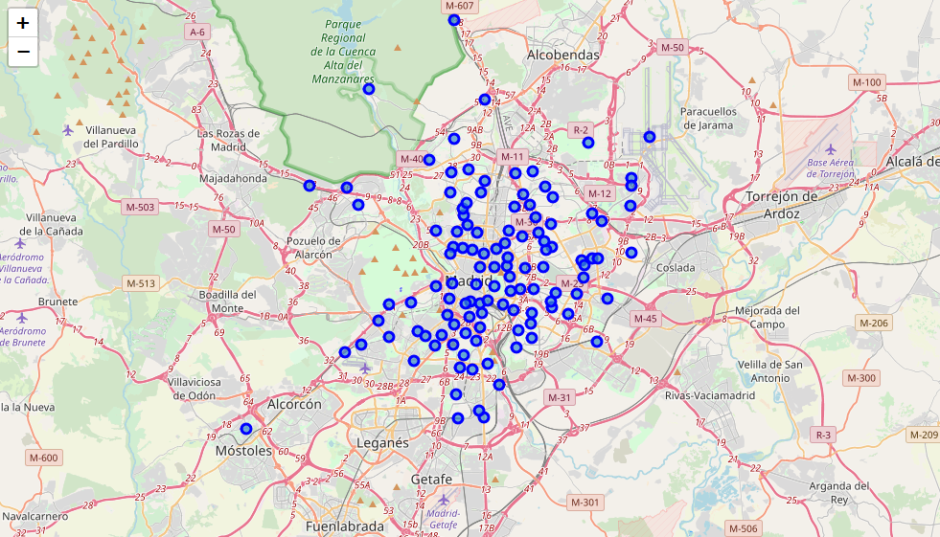
Methodology
Neighborhood geolocation: It’s needed to geographically locate every neighborhood in order to get information about venues. It also permit us to visualize their distribution in a map, like the one show in the figure.

Slide 6
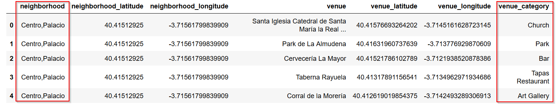
Venues Compilation: Using Foursquare services, we can found venues for every neighborhood. This is our main input in order to be able to classify them in segments.
As result we obtain a list like the following.
Every venue has a “category”. It is the base of the classification process.

Slide 7
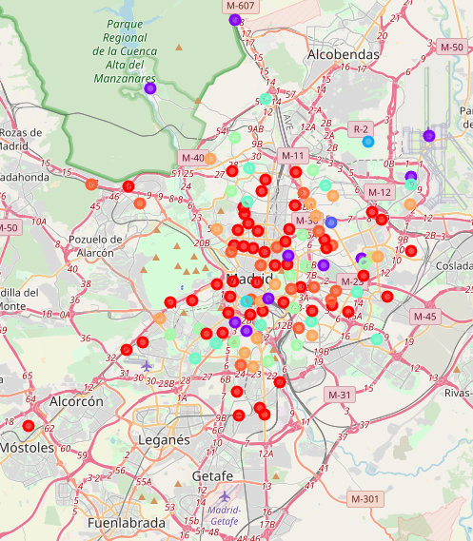
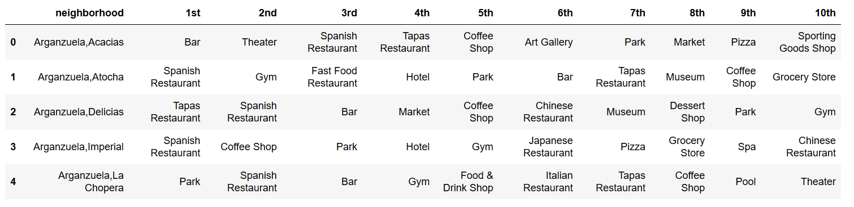
Neighborhood segmentation: In order to classify the neighborhoods a machine learning algorithm is used.
Classification is based on the categories of the found venues.
Results are shown in a map, like the one shown,
among detailed list for venues categories discussed
in separated section in this presentation.
Following an small example of the list, where the ten
most common venues are shown for every neighborhood.

Slide 8
Results
As a result of segmenting Madrid, ten clusters where defined.
Cluster 1: It's a big cluster where Spanish Restaurants together with "Tapas" Restaurants (typical of Spain) and Bars has a dominant presence. Although there are many other interesting places, like Theaters and pub in example, too many rivalry exists, therefore it doesn't appear to be the best option for an starter business.
Cluster 3, 4, 5 and 8: Clustering algorithm produces just one record for each one. Not much useful information for making a decision.
Cluster 2, 7 and 10: These neighborhoods has various kind of restaurants, Spanish, tapas, Chinese and Greek. It has also some pub and bars, but the lack of entertainments makes them not much interesting for our case.

Slide 9
Cluster 9: This cluster has an interesting variety of restaurants, Spanish, Chinese, French, Greek and fast food. Additionally there are bars and theaters. It results interesting to consider for establishing an Argentinian Restaurant.
Cluster 6: This medium sized cluster results very interesting. There are Spanish Restaurants, Fast Foods and Pizza. And also Theaters and Soccer Fields can be found. Soccer is very related to Argentina, because many Argentinian soccer stars are currently playing in Spanish League.
This is definitively the best finding.

Slide 10
Discussion
The objective of this project is found places in Madrid City for establishing the first Argentinian Restaurant of the chain in such city.
Main requirements are that other kind of restaurants exists and also entertainments for potential customers.
Applying a given machine learning clustering algorithm was possible to segment neighborhoods based on their venues and, most important, found a group of them that have high potential.

Slide 11
Conclusion
A group of eleven neighborhood has been selected from more that on hundred that Madrid has.
In such neighborhoods there are Spanish Restaurants, Fast Foods and Pizza. And also Theaters and Soccer Fields can be found.
We consider that in one of them will be able to start the company the next endeavor.
  Arganzuela,Legazpi
  Tetuán,Berruguete
  Fuencarral-El Pardo,Barrio del Pilar
  Fuencarral-El Pardo,Valverde
  Carabanchel,Buenavista
  Carabanchel,Abrantes
  Puente de Vallecas,Portazgo
  Moratalaz,Horcajo
  Hortaleza,Pinar del Rey
  Villa de Vallecas,Santa Eugenia
  Barajas,Corralejos

