Slide 1
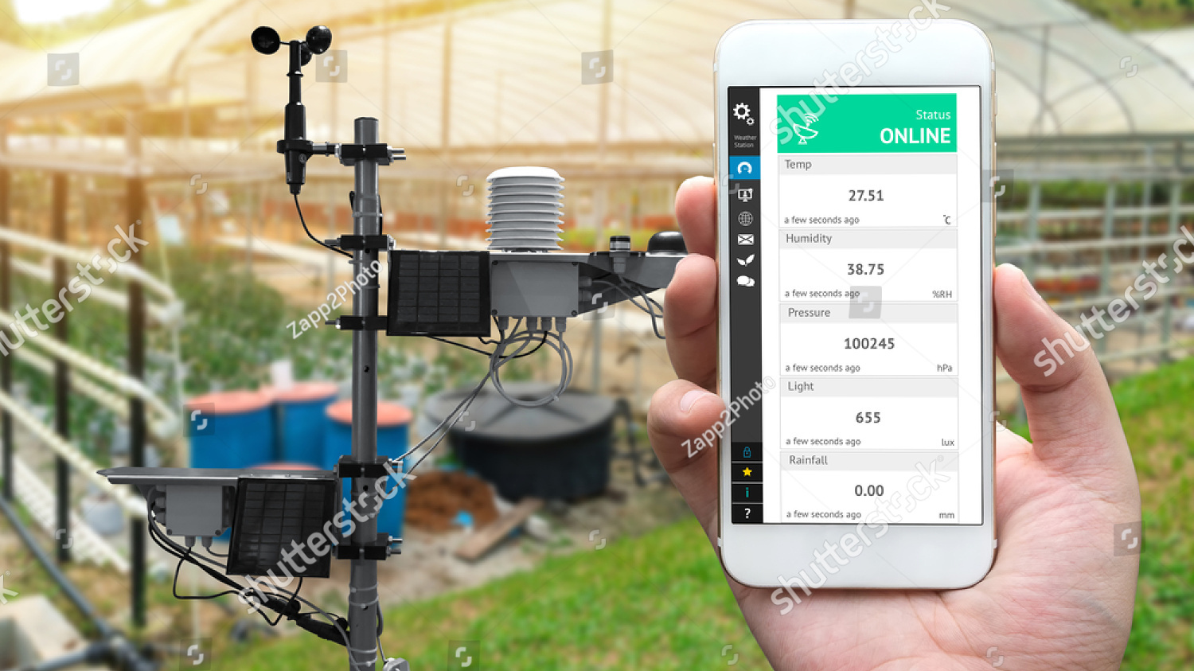
SMART WEATHER MONITORING SYSTEM AND REAL TIME ALERT SYSTEM USING IoT

Slide 2
INTRODUCTION
Present day innovations in technology mainly focus on controlling and monitoring of different devices over wirelessly over the internet such that the internet acts as a medium for communication between all the devices. Most of this technology is focused on efficient monitoring and controlling of different. An efficient environmental monitoring system is required to monitor and assess the weather conditions in case of exceeding the prescribed level of parameters (e.g., noise, CO and radiation levels) and for gathering data for research purposes (amount of rainfall etc.).

Slide 3
EXISTING SYSTEM
The existing weather monitoring systems generally use weather stations that use multiple instruments such as thermometers, barometers, wind vanes, rain gauge etc. to measure weather and climate changes. Most of these instruments use simple analog technology which is later physically recorded and stored in a data base. This information is later sent to news reporting stations and radio stations where the weather report is given.

Slide 4
FEATURES OF PROPOSED SYSTEM
Our proposed ‘Smart weather monitoring system’ unlike conventional weather monitoring instruments is very small and compact allowing it to be installed easily on rooftops.
It is light and portable; this advantage allows us to easily carry it to remote location for installation. Due to its design it can be easily be carried by a weather balloon to measure atmospheric changes at high altitudes.
The power requirements for our system (sensors and boards) is much less compared to the existing instruments in the market hence enabling us to use solar cells as power supply. This not only cuts down on cost but allows us to leave the monitoring system in remote, areas where power is not easily available, for long periods of time. Addition of solar panels also helps our design be eco-friendly.
The sensors used in our product are much cheaper compared to the ones that are used in the existing weather monitoring systems making our design more cost effective.
Due to the presence of fewer moving parts less amount of maintenance will be needed cutting down on maintenance charges.

Slide 5
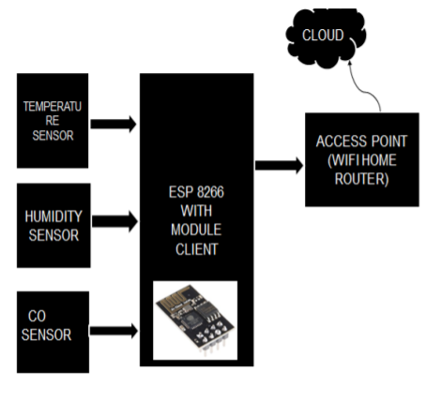
BLOCK DIAGRAM

Slide 6
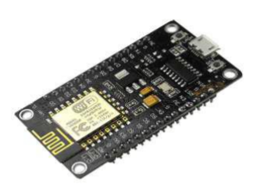
SYSTEM ARCHITECTURE
The implemented system consists of a microcontroller (ESP8266) as a main processing unit for the entire system and all the sensor and devices can be connected with the microcontroller. The sensors can be operated by the microcontroller to retrieve the data from them and it processes the analysis with the sensor data and updates it to the internet through Wi-Fi module connected with it.
ESP8266

Slide 7
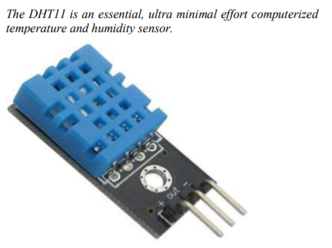
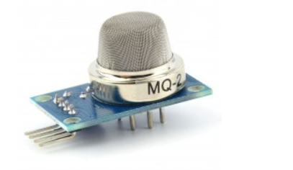
SENSORS
TEMPERATURE SENSOR AND HUMIDITY SENSOR
CARBON MONOXIDE(CO) SENSOR

Slide 8
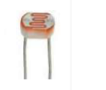
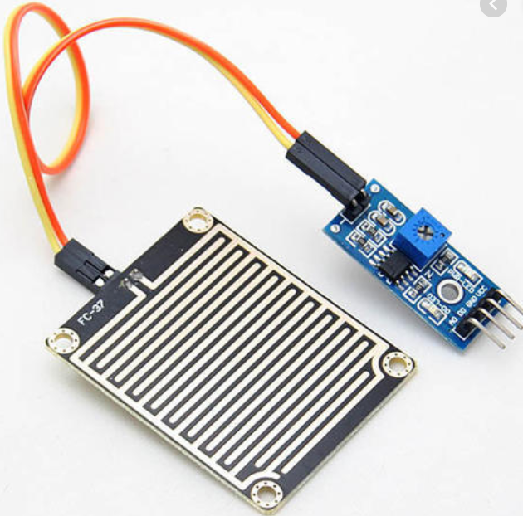
SENSORS CONTINUED…….
Light-Dependent Resistor(LDR)
RAINDROP SENSOR

Slide 9
APPLICATION ARCHITECTURE
The proposed embedded device is for monitoring Temperature, Humidity, light intensity and in the atmosphere to make the environment intelligent or interactive with the objects through wireless communication. The proposed model is more adaptable and distributive in nature to monitor the environmental parameters. The implemented system consists of ESP8266 as a main processing unit for the entire system and all the sensor and devices can be connected with the microcontroller. The sensors can be operated by the microcontroller to retrieve the data from them and it processes the analysis with the sensor data and updates it to the internet through Wi-Fi.

Slide 10
STAGES INVOLVED IN SYSTEM
Sensing:
Various parameters are measured with the help of appropriate sensors; GPS is interfaced with ESP8266 module for gathering location information whose values are transferred to cloud (Ubidots).
2)Data processing and transferring:
ESP8266 module is connected to internet though Wi-Fi module . - Reading sensor values, uploading / transferring sensor values to web page for storing in database and for Real time remote monitoring.
3)Data Display (Options available on Web Server):
Transferred data to database. Continuous display of weather parameters on web page and app includes below. Humidity Temperature Light intensity Air pressure Precipitation - Display of readings using graphs for prediction analysis.
4) Power Supply:
5V as input to ESP8266. Energy can be conserve by using solar panel.

Slide 11
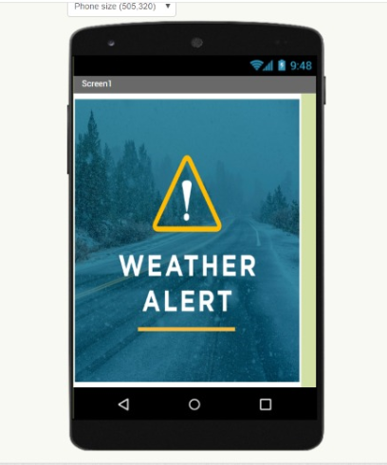
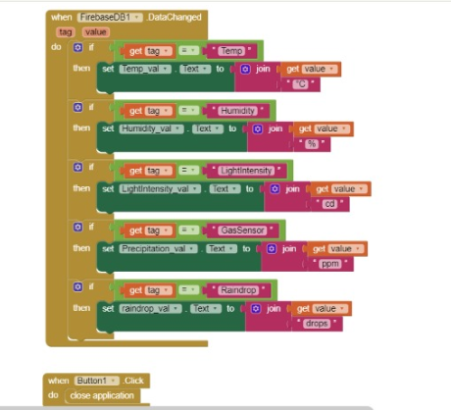
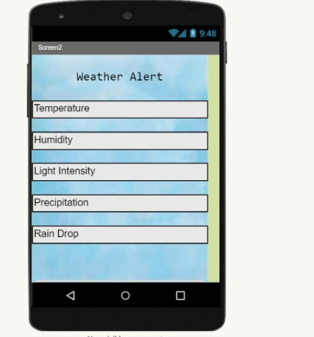
IMPLEMENTATION
SCREEN1
SCREEN2
BLOCK

Slide 12
CONCLUSIONS
To implement this need to deploy the sensor devices in the environment for collecting the data and analysis. By deploying sensor devices in the environment it will record real time data. It can cooperate with other objects through the network. Then the collected data and analysis results will be available to the end user through the Wi-Fi. The smart way to monitor environment and an efficient, low cost entrenched system is presented with different models in this paper.

