Slide 1

AIR QUALITY MONITORING
USING IOT
TEAM MENTOR : | Prabhu
TEAM LEADER : | Visa P
TEAM MEMBERS : | Naveenasri.S Mahalakshmi.M Poojaprakash Nishanth.S

Slide 2

ABSTRACT
Air pollution is one of the biggest threats to the present-day environment.
Everyone is being affected by air pollution day by day including humans, animals, crops, cities, forests and aquatic ecosystems.
Besides that, it should be controlled at a certain level to prevent the increasing rate of global warming.
This project aims to design an IOT-based air pollution monitoring system using the internet from anywhere using a computer or mobile to monitor the air quality of the surroundings and environment.

Slide 3
PROJECT OBJECTIVES
The project aims to deploy a network of IoT sensors capable of measuring key air quality parameters. These sensors will collect data, which will be efficiently transmitted to a central database or cloud platform to ensure data accuracy and integrity.
An alerting system will notify users when air quality becomes unhealthy.
Geospatial mapping features will visually represent air quality data across regions, while user engagement strategies will encourage data sharing.
Security measures will protect sensitive information, and the system will be designed for scalability and low operational costs.
Comprehensive documentation and training will ensure the system's effective use and maintenance, making it a valuable tool for environmental monitoring and public health awareness.

Slide 4
PROJECT DEFINITION
The "Air Quality Monitoring Using IOT" project aims to develop a comprehensive system for monitoring and analyzing air quality in real-time using Internet of Things (IOT) technologies.
This project addresses the increasing concern about air pollution and its impact on public health and the environment.
By deploying IOT sensors and devices, the project provides a scalable and efficient solution for collecting, processing, and visualizing air quality data.

Slide 5
DESIGN THINKING
Empathize: Understand user needs and challenges, including concerns about air quality and environmental impact.
Define: Clearly define the problem and the essential features required for an effective IOT-based air quality monitor.
Ideate: Generate innovative ideas for sensors, data transmission, and user interfaces to enhance the monitor's functionality.
Prototype and Test: Create a working prototype, test it in various environments, gather user feedback, and iterate on the design.
Implement and Improve: Develop a production-ready monitor, launch it, and continuously gather user feedback for ongoing improvements and updates.

Slide 6
TECHNOLOGIES
RFID
WiFi IEEE 802.11
Barcode e QR Code
ZigBee IEEE 802.15.4
Sensors and smartphones

Slide 7
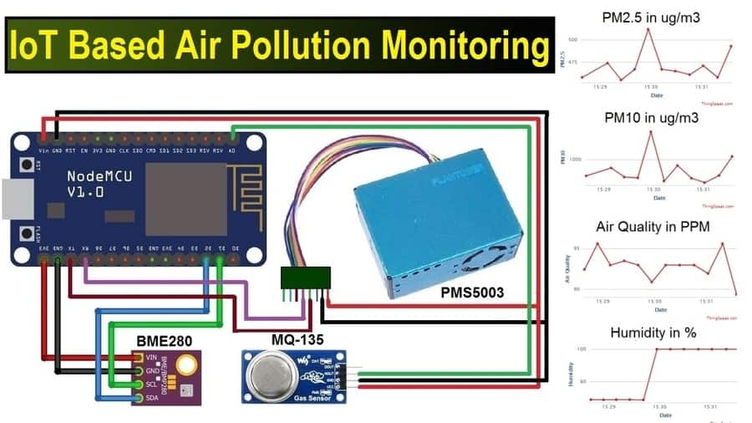
BLOCK DIAGRAM

Slide 8
ADVANTAGES
Air quality monitoring is an important tool for improving air quality, protecting public health, and ensuring compliance with regulations.
It can also be used to identify pollution sources, monitor climate change, or support research and development.

Slide 9
AIM OF THE PROJECT
The Internet of Things (IoT)is nowadays finding profound use in each and every sector, and plays a key role in our air quality monitoring system too.
The setup will show the air quality in PPM on the webpage so that we can monitor it very easily.
In this IoT project, we can monitor the pollution level from anywhere using your computer or mobile.

Slide 10

COMPONENTS USED
Hardware Components
1.ESP32
2. DHT11 Sensor Module
3. MQ-135 Gas Sensor Module
4. Veroboard(KS100)
5. Breadboard
6. Connecting Wires
7. AC-DC Adapters
8. LEDs emitting green, yellow and red colours
9. Resistors
SOFTWARE COMPONENTS
ThinkSpeak Cloud
Arduino IDE

Slide 11
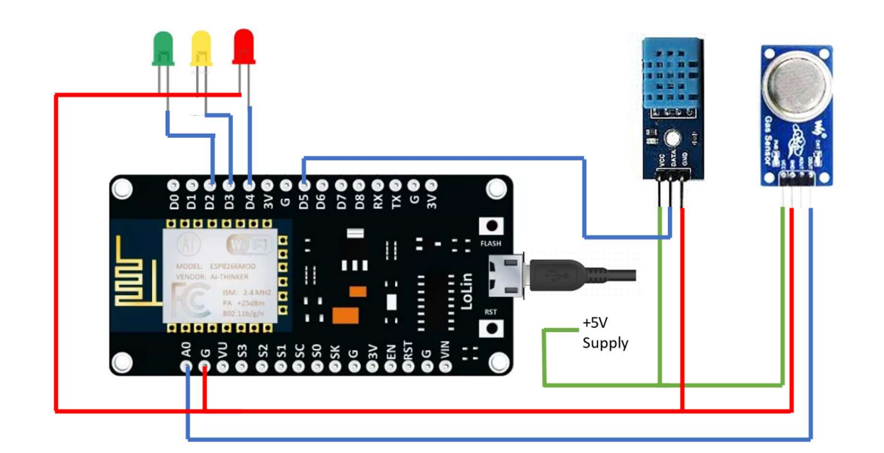
SETUP OF THIS MODEL

Slide 12
WORKING PROCEDURE
STEP 1: Firstly, the calibration of the MQ-135 gas sensor module is done. The sensor is set to preheat for 24 minutes. Then the software code is uploaded to the NodeMCU followed by the hardware circuit to calibrate the sensor has been performed.
STEP 2: Then, the DHT11 sensor is set to preheat for 10 minutes.
STEP 3: The result of calibration found in STEP 1 is used to configure the final working code.
STEP 4: The final working code is then uploaded to the NodeMCU.
STEP 5: Finally, the complete hardware circuit is implemented.

Slide 13
HARDWARE IMPLEMENTATION
The following steps were performed to execute the project:
STEP 1: The Vcc pin of the MQ-135 gas sensor module and DHT11 sensor module was connected via Veroboard with an adapter delivering around 5V.
STEP 2 : The Gnd pin of the MQ-135 gas sensor module, DHT11 sensor module and the cathode of the LED indicators was connected via Veroboard with the Gnd pin of the NodeMCU.
STEP 3 : The analog DATA pin of the MQ-135 gas sensor module was connected withthe A0 Pin of the NodeMCU.
STEP 4 : The DATA pin of the DHT11 sensor module was connected with the D0 pin of the NodeMCU.
STEP 5 : The anode of the three LED indicators (green, yellow, and red) were connected to the D2, D3, and D4 pins of the NodeMCU respectively.
STEP 6 : The software code to execute the project was then uploaded to the NodeMCU.
STEP 7 : The setup was then powered with 9V DC via AC-DC adapter. It can be now turned ON/OFF as per the requirements.

Slide 14
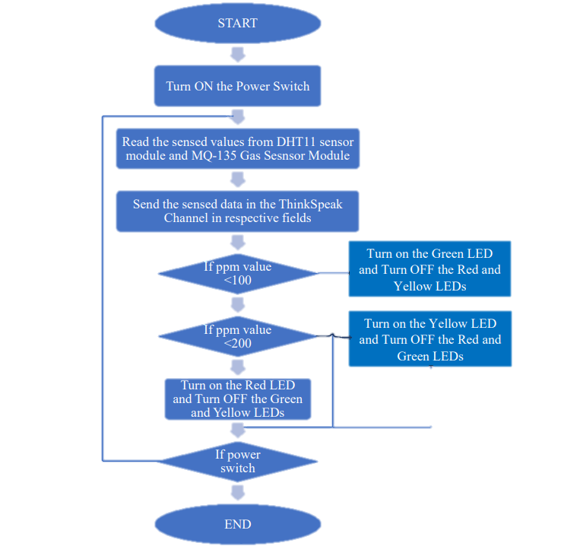
SOFTWARE IMPLEMENTATION

Slide 15

CONCLUSION
The project has proposed the idea of an air quality monitoring system using IOT that can used to support a lot of applications.
An air quality monitoring system contains a connection between wireless communication, sensors and monitoring.

Slide 16

SET-UP OF THIS EXPERIMENT
LED Indicators
DHT11 sensor module
MQ135 gas sensor module
AC-DC Power adapter
NodeMCU

Slide 17
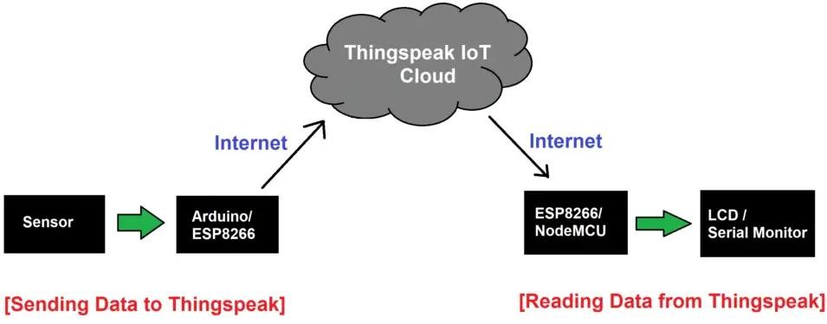
SOFTWARE COMPONENTS
ThinkSpeak Cloud
Arduino IDE

Slide 18
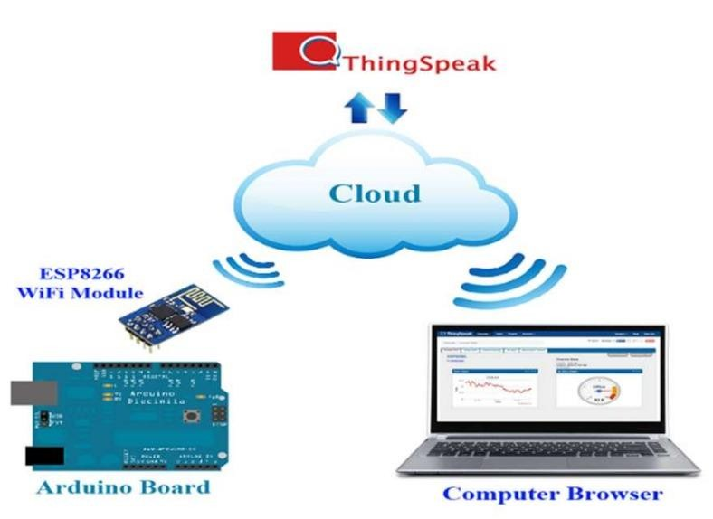
THINKSPEAK CLOUD
ThingSpeak is open-source software written in Ruby which allows users to communicate with internet-enabled devices.
It facilitates data access, retrieval, and logging of data by providing an API to both the devices and social network websites.
ThingSpeak was originally launched by ioBridge in 2010 as a service in support of IoT applications.
ThingSpeak has integrated support from the numerical computing software MATLAB from MathWorks, allowing ThingSpeak users to analyze and visualize uploaded data using MATLAB without requiring the purchase of a MATLAB license from MathWorks.

Slide 19
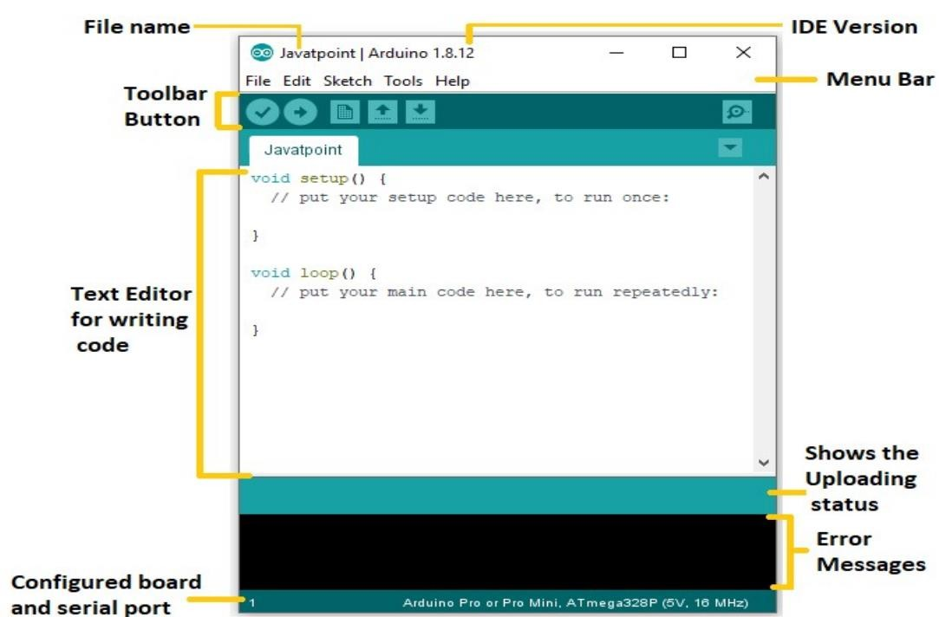
Arduino IDE
The Arduino IDE is open-source software, which is used to write and upload code to the Arduino boards.
The IDE application is suitable for different operating systems such as Windows, Mac OS X, and Linux.
It supports the programming languages C and C++. Here, IDE stands for Integrated Development Environment.
The program or code written in the Arduino IDE is
often called sketching.
We need to connect the Genuino and Arduino board with the IDE to upload the sketch written in the Arduino IDE software. The sketch is saved with the extension '.ino.'

Slide 20
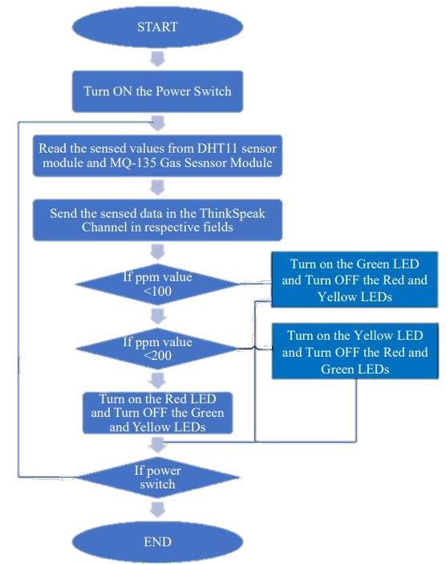
SOFTWARE IMPLEMENTATION
WORKING ALGORITHM:
Yes
No
Yes
No
ON
0FF

Slide 21
SOFTWARE CODE for Calibration of MQ135 Sensor
#using python script
import time
def read_analog(pin):
# Simulate analogRead function for the purpose of this example
# Replace this with your actual method to read analog values
return 512 # Example value, replace with your analog reading logic
def setup():
print("Setting up...")
# You can set up any necessary components or configurations here print("Setup complete")
def loop():
while True:
sensorValue = 0.0
print("Sensor Reading = " + str(read_analog(0)))

Slide 22
for x in range(500):
sensorValue += read_analog(0)
sensorValue /= 500.0
sensor_volt = sensorValue * (5.0 / 1023.0) RS_air = (5.0 / sensor_volt) - 1.0
R0 = RS_air / 3.7
print("R0 = " + str(R0)) time.sleep(1)
if name == " main ":
setup()
try: loop()
except KeyboardInterrupt: print("\nScript terminated by user")

Slide 23
EXECUTION OF THE MAIN PROGRAM
#using python script import time
import requests import Adafruit_DHT import math
import RPi.GPIO as GPIO
# Define your sensor and pin settings DHT_SENSOR = Adafruit_DHT.DHT11 DHT_PIN = 5
MQ_135_PIN = 0 # Analog pin for MQ-135
# Linear regression parameters m = -0.3376
b = 0.7165
R0 = 3.12 # Sensor resistance in fresh air

Slide 24
# ThingSpeak settings
myChannelNumber = 123456 # Channel ID myWriteAPIKey = "API_Key"
# LED pin assignments
LED_GREEN = 2
LED_YELLOW = 3
LED_RED = 4
# Set up LED pins
LED_PINS = [LED_GREEN, LED_YELLOW, LED_RED]
for pin in LED_PINS: GPIO.setup(pin, GPIO.OUT)
# Connect to Wi-Fi WiFi_Name = "Your_SSID"
WiFi_Password = "Your_Password"
# Create a session for ThingSpeak session = requests.Session()
session.verify = False # Disable SSL certificate verification

Slide 25
while True:
# Read DHT sensor values
h, t = Adafruit_DHT.read_retry(DHT_SENSOR, DHT_PIN)
sensorValue = analogRead(MQ_135_PIN) sensor_volt = sensorValue * (5.0 / 1023.0)
RS_gas = (5.0 / sensor_volt) - 1.0
ratio = RS_gas / R0
ppm_log = (math.log10(ratio) - b) / m ppm = math.pow(10, ppm_log)
print("Temperature: " + str(t)) print("Humidity: " + str(h))
print("Our desired PPM = " + str(ppm)
# Upload data to ThingSpeak
session.post(f'https://api.thingspeak.com/update?api_key={myWriteAPIKey}&field1={t}&field2={h}&field3={pp m}')
time.sleep(20)

Slide 26
# Control LEDs based on ppm value if ppm <= 100:
GPIO.output(LED_GREEN, GPIO.HIGH) GPIO.output(LED_YELLOW, GPIO.LOW) GPIO.output(LED_RED, GPIO.LOW)
elif ppm <= 200: GPIO.output(LED_GREEN, GPIO.LOW)
GPIO.output(LED_YELLOW, GPIO.HIGH) GPIO.output(LED_RED, GPIO.LOW)
else:
GPIO.output(LED_GREEN, GPIO.LOW) GPIO.output(LED_YELLOW, GPIO.LOW) GPIO.output(LED_RED, GPIO.HIGH)
time.sleep(2)

Slide 27
INITIAL CODE
Html(index.html):
<!DOCTYPE html>
<html>
<head>
<title>Air Quality Monitoring</title>
<script src="https://cdn.jsdelivr.net/npm/chart.js"></script>
</head>
<body>
<h1>Air Quality Monitoring</h1>
<canvas id="chart"></canvas>
<script src="app.js"></script>
</body>
</html>

Slide 28
Javascript (app.js):
const ctx =
document.getElementById('chart').getContext('2d’);
const data = {
labels: [],
datasets: [{
label: 'Air Quality',
data: [],
borderColor: 'rgba(75, 192, 192, 1)',
borderWidth: 1,
fill: false
}]
};
const config = {
type: 'line’,
data: data,
options: {
scales: {
x: {
display: true,

Slide 29
title: {
display: true,
text: 'Time'
}
},
y: {
display: true,
title: {
display: true,
text: 'Air Quality'
}
}
}
}
};
const chart = new Chart(ctx, config);
// Function to update the chart with new datafunction updateChart(time, airQuality)
{
data.labels.push(time);
data.datasets[0].data.push(airQuality);
// Limit the number of data points displayed
const maxDataPoints = 10;

Slide 30
if (data.labels.length > maxDataPoints)
{
data.labels.shift();
data.datasets[0].data.shift();
}
chart.update();}// Simulate data updates (Replace with actual data from your IoT device)
setInterval(() => {
const time = new Date().toLocaleTimeString();
const airQuality = Math.random() * 100; // Replace with actual sensor data
updateChart(time, airQuality);
}, 5000); // Update data every 5 seconds
This webpage with a line chart that displays randomly generated air quality data at intervals of 5 seconds.This code provides a basic structure for real time data visualization. Continuing from the initial code for a basic web application to display real-time air quality data, the next steps would involve setting up the server, API endpoints, and data integration

Slide 31
Server Setup (Node.js with Express.js):
const express = require('express’);
const app = express();
const port = 3000;
// Choose a port numberapp.use(express.static('public’));
// Serve static files from the 'public' directoryapp.use(express.json()); // Parse JSON requests
app.listen(port, () => { console.log(`Server is running on port ${port}`);
});
API Endpoints (Node.js with Express.js):
const data = {
labels: [],
datasets: [{
label: 'Air Quality’,
data: [],
borderColor: 'rgba(75, 192, 192, 1)’,
borderWidth: 1,
fill: false
}]
};

Slide 32
app.post('/update-chart', (req, res) => { const { time, airQuality } = req.body;
data.labels.push(time);
data.datasets[0].data.push(airQuality);
// Limit the number of data points displayed
const maxDataPoints = 10;
if (data.labels.length > maxDataPoints)
{
data.labels.shift();
data.datasets[0].data.shift();
}
res.sendStatus(200);
});

Slide 33
Data Integration (Node.js with Express.js):
const axios = require('axios’);
// Install 'axios' using npm
// Simulate data updates (Replace with actual data from your IoT device)setInterval(async () => {
const time = new
Date().toLocaleTimeString();
const airQuality = Math.random() * 100;
// Replace with actual sensor data
const response = await axios.post('http://localhost:3000/update-chart', { time, airQuality });
console.log('Data sent to server’);
},
5000); // Update data every 5 second
Install the required packages (e.g., Express.js, axios) using npm if you haven't already:
npm install express axios

Slide 34
THANKING YOU

