Slide 1
Time-Series Forecasting with Autoencoders
Presented by ,
NISHANTHI AKSHAYAA S
NM:au711721205040
KGiSL Institute of Technology
3/21/2024 Annual Review

Slide 2
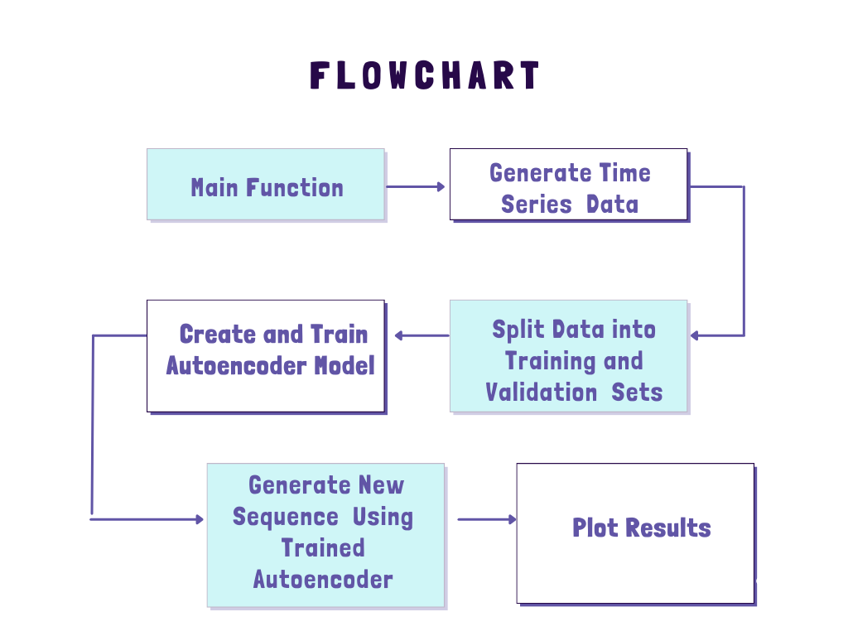
Time-Series Forecasting with Autoencoders
3/21/2024 Annual Review

Slide 3


AGENDA
PROBLEM STATEMENT
PROJECT OVERVIEW
END USERS
SOLUTION AND PROPOSITION
KEY FEATURES
MODELLING APPROACH
RESULT
3/21/2024 Annual Review

Slide 4

PROBLEM STATEMENT
"Develop an autoencoder-based time-series forecasting model to generate future sequences from given time-series data. The model should learn the underlying patterns and relationships within the time-series data to produce accurate and coherent future sequences."
3/21/2024 Annual Review

Slide 5

PROJECT OVERVIEW
Data Generation: The script generates synthetic time-series data composed of two sine waves with random frequencies and offsets, along with some added noise.
Autoencoder Model: A stacked LSTM-based autoencoder model is created and trained on the generated time-series data to learn the underlying patterns and features.
Sequence Generation: The trained autoencoder is used to generate a new time-series sequence based on a seed sequence, and the generated sequence is then plotted alongside the original seed sequence for visualization.
3/21/2024 Annual Review

Slide 6

WHO ARE THE END USERS?
Data Scientists
Machine Learning Engineers
Business Analysts and Domain Experts
Software Developers
End Users of the Application
Researchers and Academics
Data Analysts
3/21/2024 Annual Review

Slide 7

YOUR SOLUTION
The project is implemented using autoencoder-based time-series forecasting model using LSTM layers. The model is trained on synthetic time-series data generated from two sine waves with random frequencies and noise. The autoencoder compresses the input sequence into a latent space and then reconstructs it to generate a new sequence for future forecasting.
3/21/2024 Annual Review

Slide 8
ITS VALUE PROPOSITION
Versatility: The model can capture complex temporal patterns in time-series data, making it suitable for a wide range of forecasting tasks.
Efficiency: By leveraging the power of LSTM layers, the model efficiently learns and represents the underlying patterns in the data, leading to accurate forecasting.
Adaptability: The autoencoder framework allows for unsupervised learning, meaning it can be trained without requiring labeled data, making it versatile for various time-series forecasting scenarios.

Slide 9
THE WOW IN YOUR SOLUTION
Enabling accurate forecasting of future values
Learns meaningful representations from sequential data
Better understanding
Better prediction of complex temporal dynamics
Decision making across various domains
Offers insights into future trends
Improved Accuracy, Scalability and interpretability of forecasts
3/21/2024 Annual Review

Slide 10
MODELLING
AUTOENCODER MODEL:
The autoencoder model consists of LSTM (Long Short-Term Memory) layers.
It takes a sequence of input data points and learns to encode them into a lower-dimensional representation.
The encoded representation is then decoded back to the original sequence using another set of LSTM layers.
The autoencoder is trained to minimize the mean squared error loss between the input and output sequences, effectively learning to reconstruct the input sequence.
SEQUENCE GENERATION MODEL:
After training the autoencoder, a separate function is used to generate new sequences of future data points.
This function takes a seed sequence as input and iteratively generates new data points by feeding the previous data point into the autoencoder.
The autoencoder learns to predict the next data point based on the previous ones, capturing temporal dependencies in the data.
3/21/2024 Annual Review

Slide 11
Data Generation (generate_time_series_data):
Generates synthetic time-series data consisting of two sine waves with random frequencies and offsets, along with some random noise.
n is the number of time-series samples, and timesteps is the length of each time-series sample.
2. Autoencoder Creation (create_autoencoder):
Constructs an autoencoder model using Keras with LSTM layers.
The encoder compresses the input time-series data into a lower-dimensional representation.
The decoder reconstructs the compressed representation back to the original time-series data.

Slide 12
3. Autoencoder Training (train_autoencoder):
Trains the autoencoder using the generated time-series data.
Uses Mean Squared Error (MSE) as the loss function and Adam as the optimizer.
Early stopping is applied to prevent overfitting and reduce training time.
4. Sequence Generation (generate_new_sequence):
Takes a seed sequence from the training data and generates a new time-series sequence using the trained autoencoder.
The seed sequence is fed into the autoencoder to predict the next time step.
The predicted time step is then fed back into the autoencoder to predict the subsequent time step, and this process is repeated for the desired number of future steps.

Slide 13
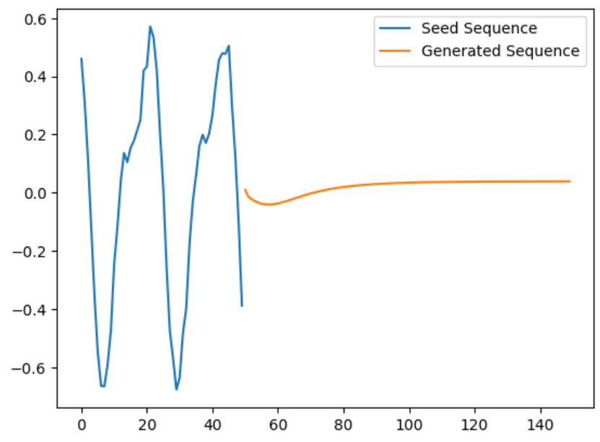
RESULTS
The project's results demonstrate the autoencoder's ability to accurately forecast future values in time-series data, showcasing its effectiveness in capturing temporal patterns and generating precise predictions.
https://drive.google.com/drive/folders/1H_tBWlpW7cd9WW9rgvtgq4Wx0ZSEg8G4
3/21/2024 Annual Review

