Slide 1

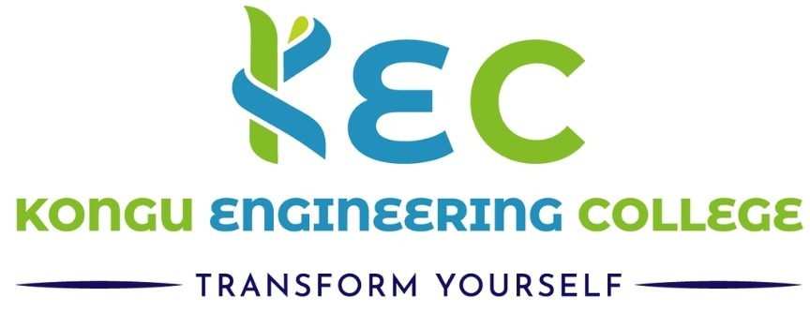

22CSP72 – PROJECT WORK II PHASE I
BASE PAPER 1
Intelligent System for Personalised Interventions and Early Drop-out Prediction in MOOCs
MENTOR :
Dr. M. Geetha
PRESENTED BY:
NISHANTHINI R - 23CSR148
Associate Professor/CSE
1

Slide 2
INTRODUCTION AND PROBLEM STATEMENT
Massive Open Online Courses (MOOCs) have transformed online education by providing flexible, accessible, and self-paced learning opportunities to millions of learners worldwide.
MOOCs experience high dropout rates and low course completion, making student retention a major challenge.
Existing dropout prediction systems often identify at-risk students too late and primarily focus on prediction without offering personalized learning support.
This paper proposes a Hybrid ML-DL framework that enables early dropout prediction, analyzes learner behavior, and delivers personalized interventions.
2

Slide 3
PROPOSED METHODOLOGY
Dataset
KDD Cup 2015 (XuetangX MOOC)
Data Preprocessing
Data Cleaning
SMOTE (Synthetic Minority Oversampling Technique)
Feature Engineering
Hybrid Feature Selection
Chi-Square
Lasso & Ridge
RFE (Recursive Feature Elimination)
Prediction Models
Genetic Algorithm (GA)
Deep Learning (DL)
Output
Early Dropout Prediction
Personalized Intervention
3

Slide 4
PREDICTION MODELS & PERSONALIZED INTERVENTIONS
Genetic Algorithm (GA) – Optimizes model parameters.
Deep Learning (DL) – Predicts early student dropout.
ARIMA(AutoRegressive Integrated Moving Average) –Forecasts weekly dropout probability.
Student Clustering – Groups learners based on learning behaviour.
Personalized Interventions – Recommends targeted learning support.
Goal – Improve student engagement and course completion.
4

Slide 5
RESULTS AND KEY FINDINGS
RESULTS
GA Accuracy: 93.3%
DL Accuracy: 94.3%
Improved AUC-ROC for reliable dropout prediction.
Reduced training time using hybrid feature selection.
KEY FINDINGS
Early prediction improves student retention.
Hybrid Feature Selection enhances model performance.
Personalized interventions increase learner engagement.
Deep Learning outperformed the Genetic Algorithm in prediction accuracy.
5

Slide 6
CONCLUSION AND FUTURE SCOPE
The proposed Hybrid ML-DL framework enables early dropout prediction and personalized learning interventions, improving student engagement and retention. Future work includes Explainable AI, real-time prediction, AI-driven recommendations and adaptive learning support.
6

Slide 7
THANK YOU
7

