Slide 1

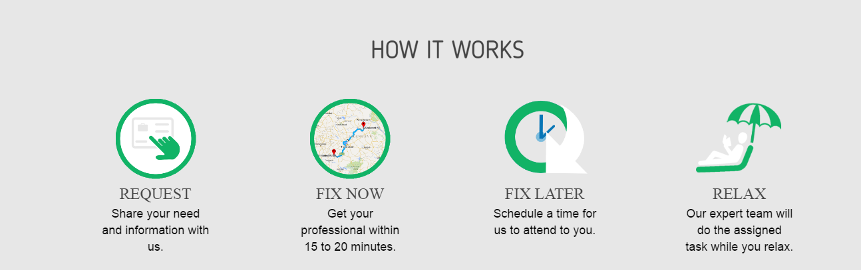

Slide 2

Start-ups which have become our favourite!
Google
Uber
OLA
Dropbox
Snapchat
Facebook
Spotify

Slide 3
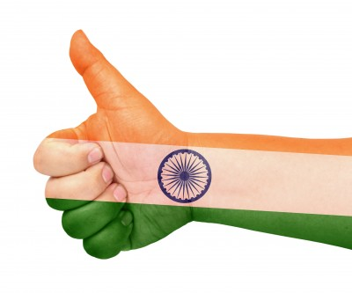
Our own indian start-ups!
Flipkart
Swiggy
Snapdeal
Redbus
Paytm
Oyo Rooms
Zomato
MakeMyTrip
BharathMatrimony

Slide 4
How to start a start-up??

Slide 5
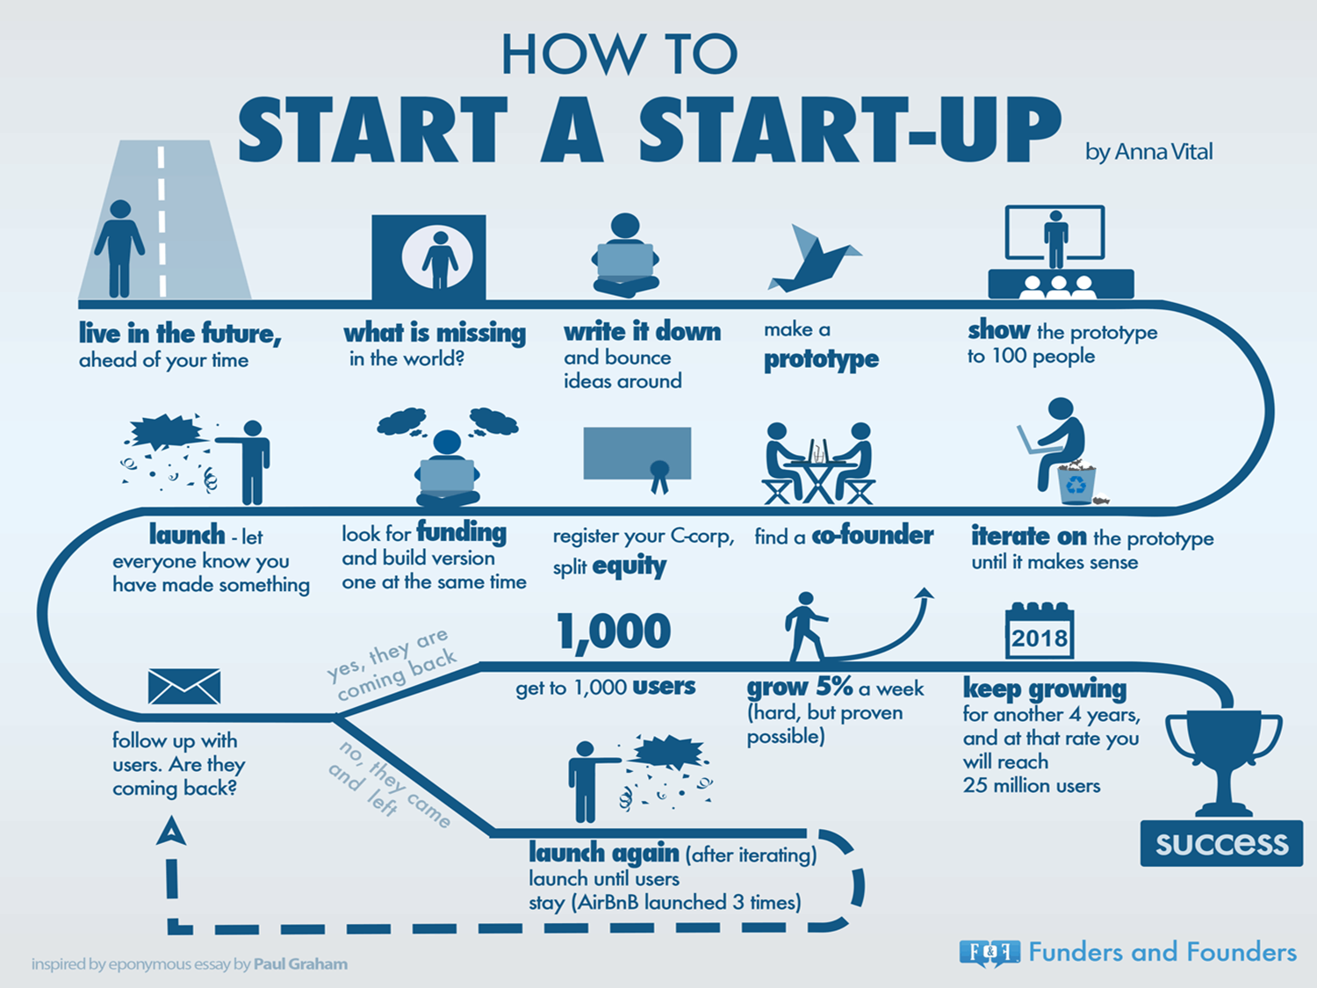

Slide 6

Funding in startups!!

