Slide 1


Create Azure ChatBot
Nishanth D Kini

Slide 2
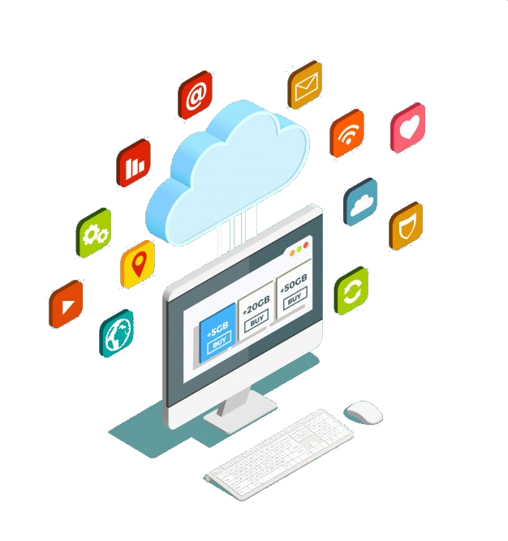
Offerings
01
Evolution Of Communication
02
What are Chatbots?
03
What Is Microsoft Azure
04
Azure Bot Service

Slide 3
Evolution of Chatbots

Slide 4
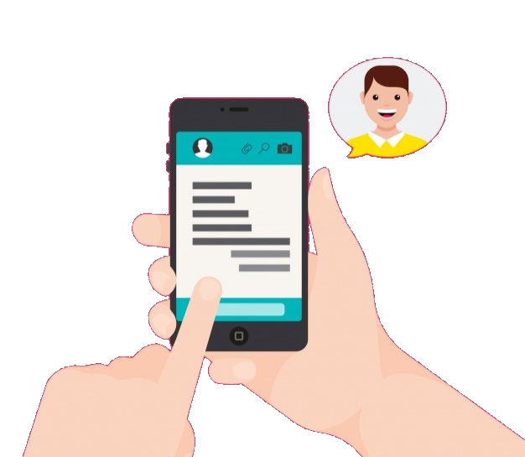
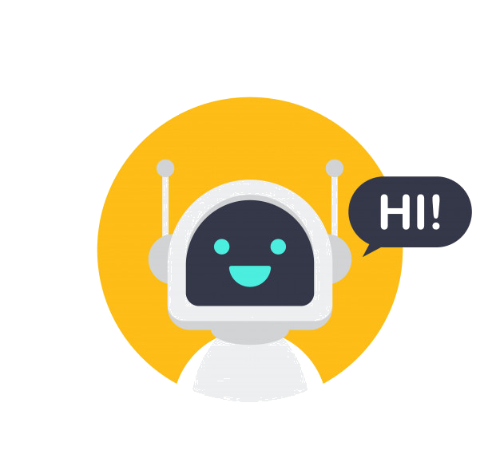
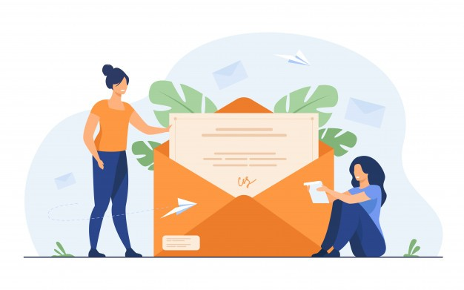
Evolution of Communication

Slide 5
What are Chatbots?

Slide 6

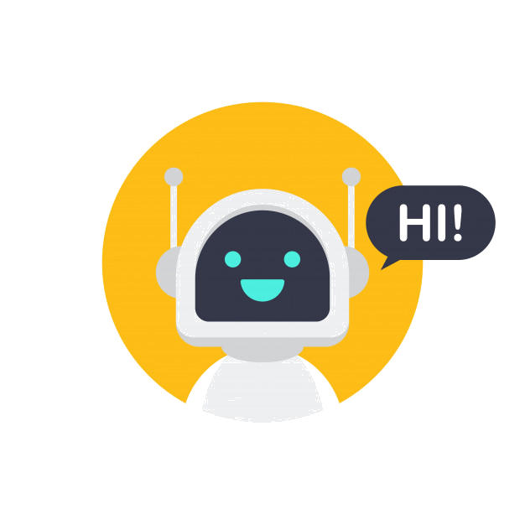
What are Chatbots?
A chatbot is an artificial intelligence (AI) software that can simulate a conversation (or a chat) with a user in natural language through messaging applications, websites, mobile apps or through the telephone.
Standard Chatbots
Self Learning Chatbots

Slide 7
What Is Microsoft Azure?

Slide 8












What Is Microsoft Azure?
Microsoft Azure is a Cloud Service Provider that enables on-demand services like compute, storage, networking, etc which can be accessed through the internet and the user is not required to manage these resources
Features
Cost Effective
Security
Availability and Disaster Recovery
Pay As You Go
Scalable
Flexible

Slide 9
Microsoft Azure Bot Service

Slide 10

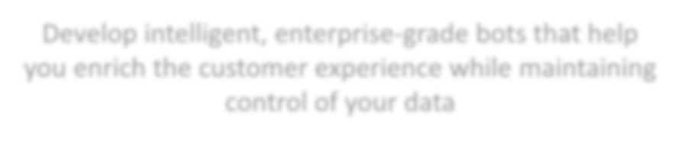

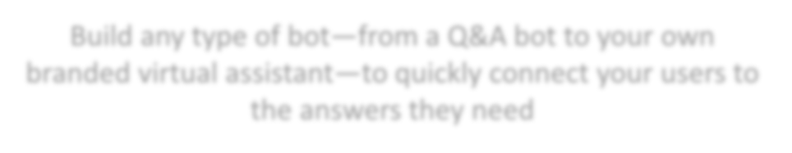
Azure Bot Service
Develop intelligent, enterprise-grade bots that help you enrich the customer experience while maintaining control of your data
Build any type of bot—from a Q&A bot to your own branded virtual assistant—to quickly connect your users to the answers they need

Slide 11
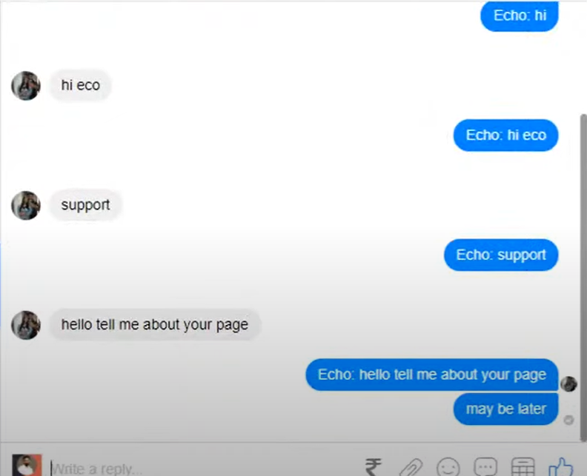
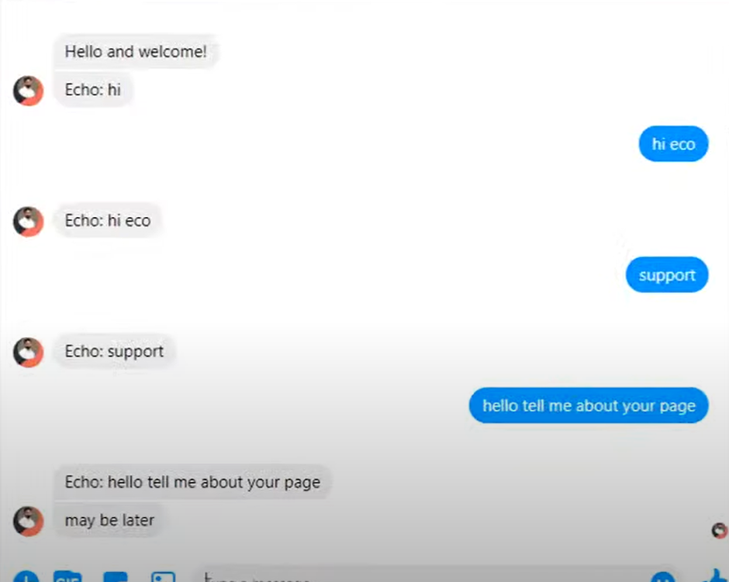
➔➔

Slide 12


Thank You

