Slide 1




E-Waste Tracking and Management
TG08003219
Author 1
Photo
Author 2
Photo
Author 3
Photo
Author 4
Photo
Deepika T R
Deepthi K
Nishanth K J
Skanda P M
Maharaja Institute of Technology Mysore
Mysore
Dr. Victor Ikechukwu Agughasi

Slide 2
Challenge Statement
E-waste management is a critical global issue, with only 20% of e-waste properly recycled, causing severe environmental and health risks. This challenge proposes a comprehensive system integrating IoT, GPS, and blockchain for real-time tracking, AI for efficient segregation, and collaboration with certified vendors for responsible recycling. The system also ensures reverse supply chain tracking to promote a circular economy while prioritizing data privacy and security. By leveraging advanced technologies, this solution aims to revolutionize e-waste management for a sustainable future.

Slide 3
Concept / Solution
Concept:
The concept revolves around addressing the growing issue of e-waste management by leveraging advanced technologies such as IoT, blockchain, and AI. The system aims to provide a transparent and efficient way to monitor, segregate, and recycle e-waste, ensuring traceability and promoting sustainability.
Solution:
The solution involves creating a comprehensive e-waste management system that:
Tracks e-waste from generation to recycling using IoT and blockchain.
Automates waste segregation through AI-driven classification.
Provides real-time updates on recycling metrics, including material purity and quantity.
Ensures data privacy and security throughout the process.
Promotes a circular economy by tracing recycled materials back to production or consumers.

Slide 4
Pros and Cons of the solution
Pros of the Solution:
Real-Time Monitoring: Accurate tracking of e-waste lifecycle using IoT and blockchain.
Efficient Segregation: AI ensures automated and precise classification of e-waste.
Sustainability: Supports a circular economy by tracing recycled materials back into production.
Transparency: Blockchain ensures accountability and prevents data tampering.
User Engagement: Intuitive platforms encourage participation in responsible e-waste disposal.
Cons of the Solution:
High Initial Cost: Implementation of IoT, blockchain, and AI requires significant investment.
Technical Complexity: Advanced technologies demand specialized expertise.
Data Privacy Concerns: Managing sensitive data securely can be challenging.
Dependency on Vendors: Collaboration with certified recycling vendors is critical for success.
Scalability Issues: Handling large-scale systems as e-waste volumes increase may pose challenges.

Slide 5
Technical Description
Component | Technology & Purpose
Frontend | React.js / Angular: Dynamic UI for web applications.
Mobile App | React Native: Cross-platform mobile app.
Backend | Node.js (Express) / Django: Scalable backend for requests and APIs.
Database | PostgreSQL / MongoDB: Data storage for structured and unstructured data.
Blockchain | Ethereum / Hyperledger: Transparency and traceability with smart contracts.
IoT | Raspberry Pi / Arduino: Collect real-time e-waste data.
Cloud | AWS / Google Cloud: Scalable cloud storage and computing.
Real-Time | Firebase / WebSocket: Real-time notifications.
AI & ML | TensorFlow / PyTorch: AI for classification and optimization.
IoT (Internet of Things):
Tracking and Monitoring: IoT devices (sensors, GPS) are used to monitor e-waste from generation to disposal, ensuring real-time tracking and location-based updates.
Data Collection: IoT enables data collection on various e-waste parameters such as type, weight, and condition of the e-waste, which is then transmitted to the central platform.
Blockchain:
Data Security: Blockchain ensures that data related to e-waste collection, recycling, and disposal is immutable and secure, preventing tampering.
Traceability: All actions performed on the e-waste are recorded on the blockchain ledger, providing transparency and traceability from generation to recycling.
Smart Contracts: Used to automate agreements between stakeholders (e.g., recycling vendors), ensuring compliance with regulations.
AI (Artificial Intelligence):
Automated Classification: AI algorithms automatically classify e-waste based on material type, hazard levels, and recycling potential.
Predictive Analytics: Machine learning models analyse trends in e-waste generation and recycling, offering insights for optimization and future improvements.
Mobile/Web Interface:
User Engagement: An intuitive mobile/web platform allows users to schedule pickups, report e-waste, and track recycling progress.
Community Interaction: The platform includes community forums for knowledge-sharing and collaboration on best practices for e-waste disposal.

Slide 6
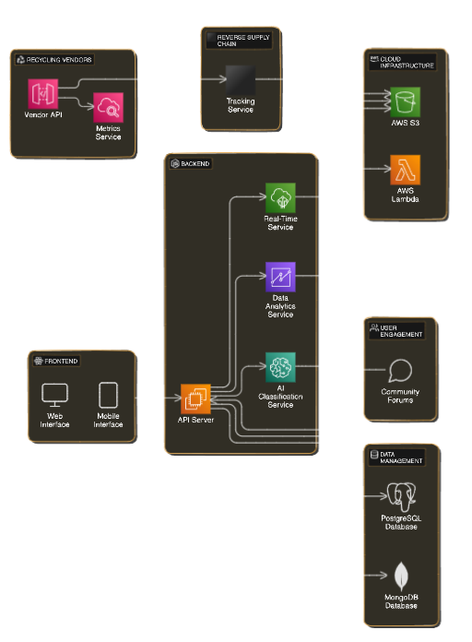
Technical Description
Recycling Vendors: Interacts via the Vendor API and shares data through the Metrics Service for tracking e-waste.
Reverse Supply Chain: Uses the Tracking Service to trace recycled materials back to production.
AWS Cloud: AWS S3 stores data, and AWS Lambda executes backend functions dynamically.
Backend: API Server connects frontend and backend, with services for real-time updates, data analytics, and AI classification of e-waste.
Frontend: Provides Web and Mobile Interfaces for user interaction.
User Engagement: Includes Community Forums to promote knowledge sharing.
Data Management: Uses PostgreSQL for structured data and MongoDB for unstructured data storage.

Slide 7
Implementation Plan
Planning:
Define Objectives: Set the goals for e-waste tracking (e.g., real-time monitoring, efficient recycling).
Identify Technologies: Decide on technologies (IoT, AI, Blockchain, Cloud).
Set Ethical Guidelines: Establish data privacy and security standards with stakeholders.
Data Collection:
Gather Data: Collect e-waste data from sensors, vendors, and public databases.
Categorize Data: Classify e-waste into categories (e.g., materials, hazardous levels) and annotate data for training.
Preprocessing:
Clean Data: Remove inconsistencies and irrelevant information.
Normalize and Split: Prepare data by normalizing values and splitting into training, validation, and testing datasets (e.g., 70% training, 20% validation, 10% testing).
Model Training:
Real-Time Monitoring: Train models for detecting e-waste condition using IoT data.
Classification Service: Fine-tune AI models for automated waste classification.
Blockchain Integration: Implement smart contracts to track e-waste lifecycle.
Train Models: Use GPUs/TPUs to train models and validate using performance metrics (accuracy, F1-score).
Deployment:
Deploy Models: Use TensorFlow or PyTorch to deploy models on cloud infrastructure (AWS, Google Cloud).
Scalability: Ensure the system can scale using services like AWS Lambda or Kubernetes.
Continuous Improvement:
Retrain Models: Continuously update models using feedback and new data.
Monitor Performance: Track system performance and optimize based on usage metrics.

Slide 8
Validation / Testing / Analysis
Unit Testing: Test individual components (IoT, AI, blockchain) for correct functionality.
Integration Testing: Ensure smooth interaction between frontend, backend, and cloud systems.
Model Evaluation: Measure AI model accuracy (precision, recall, F1-score) for waste classification.
End-to-End Testing: Simulate the full data flow from e-waste collection to recycling.
User Testing: Validate ease of use and performance with real users.
Performance Testing: Stress-test system for scalability and response time under load.
Security Testing: Assess data privacy, blockchain security, and overall system vulnerability.
Continuous Monitoring: Monitor system performance post-deployment and improve based on feedback.

Slide 9
Cost Estimate
Category | Estimated Cost
Development Costs | $50,000
Cloud Infrastructure | $20,000/year
IoT Devices | $5,000
Blockchain Implementation | $10,000
AI Model Training & Tuning | $15,000
Testing & Validation | $8,000
Maintenance & Support | $15,000/year
Security & Compliance | $5,000

Slide 10
Assumptions
Assumptions for the E-Waste Tracking and Management System:
Availability of Data: Assumes access to accurate, real-time data from IoT sensors and vendors for monitoring and tracking e-waste.
User Participation: Assumes active user participation in the system for waste reporting, scheduling pickups, and engaging in recycling efforts.
Recycling Vendor Cooperation: Assumes collaboration with certified recycling vendors who will provide real-time updates on recycling progress and material purity.
Technology Integration: Assumes that IoT devices, AI models, and blockchain can be effectively integrated and function seamlessly within the system.
Cloud Infrastructure Stability: Assumes the cloud infrastructure (AWS, Google Cloud) will handle the scalability and reliability needs of the system.
Regulatory Compliance: Assumes the system will meet all necessary environmental and data privacy regulations.
Data Security: Assumes that the implemented security measures (e.g., encryption, authentication) will be sufficient to protect user and system data.
Predicted Outcome:
Increased E-Waste Recycling: The system is expected to significantly increase the percentage of e-waste being properly recycled.
Efficiency in Collection and Segregation: With AI and real-time monitoring, the system will optimize waste collection routes and ensure better segregation at source.
Enhanced User Engagement: The mobile/web interface and community forums will lead to higher user engagement and awareness about responsible e-waste management.
Sustainable Circular Economy: Through reverse supply chain tracking, the system will promote a circular economy, enabling the reuse of recycled materials in production processes.

Slide 11
References

Slide 13
Guidelines
Do not use more than 15 slides.
Do not give any theoretical fundamentals.
Illustrate with suitable means such as drawings, examples, algorithms, flow chart etc.
Use a consistent format.
Check for spelling and grammar – ensure no errors (spell check).
Highlight the major advantages of the technique/method proposed when compared with other techniques or conventional techniques.
While uploading the PPT file, rename first 4 letters (i.e., 0000) with your PID nos.

