Slide 1




AI Powered Content Moderation
TG08001947
Author 1
Photo
Author 2
Photo
Author 3
Photo
Author 4
Photo
Deepika T R
Deepthi K
Nishanth K J
Skanda P M
Maharaja Institute of Technology Mysore
Mysore
Dr. Victor Ikechukwu Agughasi

Slide 2
Challenge Statement
Design and implement an AI-powered content moderation system capable of real-time detection, analysis, and management of inappropriate, harmful, or restricted content across text, image, and video formats on multimedia platforms. The system must harmonize the precision of automated AI models with the contextual understanding of human oversight, ensuring compliance with international copyright laws, cultural norms, and community standards.

Slide 3
Concept / Solution
The idea is to create a system that can automatically find and manage harmful or inappropriate content, like offensive language, violent images, or fake information, in posts, videos, and audio shared online. This system will also involve people for more complex decisions, ensuring fairness and understanding of cultural differences.
What It Does:
The system reviews text to spot harmful words or misinformation.
It looks at pictures and videos to find inappropriate visuals or actions.
It listens to audio to identify offensive or harmful speech.
How It Works:
The system handles most content automatically, quickly flagging anything inappropriate.
If the content is unclear, human reviewers will decide.
The system learns from human feedback to get better over time.
Why It’s Better:
It explains why something is flagged, helping users understand and build trust.
It suggests changes to flagged content so users can fix issues instead of just deleting it.
It can also identify fake or edited content like deepfakes to ensure authenticity.

Slide 4
Pros and Cons of the solution
Pros:
Real-Time Efficiency:
Quickly detects and responds to inappropriate content.
Multimodal Analysis:
Supports text, images, videos, and audio for comprehensive moderation.
Scalability:
Handles high volumes of content across global platforms.
Transparency:
Explainable AI provides clear reasons for flagged content, building trust.
Human-AI Collaboration:
Reduces workload while leveraging human expertise for nuanced cases.
Adaptability:
Customizable to cultural and regional standards.
Generative AI:
Suggests corrective edits and detects synthetic media like deepfakes.
Cons:
False Positives/Negatives:
Automated systems may misclassify content, requiring refinement.
High Costs:
Developing and maintaining AI infrastructure is expensive.
Complex Cultural Sensitivity:
Adapting to diverse norms and laws is challenging.
Computational Demands:
Requires significant resources for real-time analysis.
User Backlash:
Users may feel unfairly targeted by automated decisions.

Slide 5
Technical Description
Layer | Technologies
Frontend | React, Next.js, Tailwind CSS, Material-UI
Backend | Python (Django, Flask), Node.js (Express.js)
AI Models | NLP (BERT, GPT), Computer Vision (YOLO, Vision Transformers), OpenCV
LLMs | OpenAI GPT, LangChain
Databases | PostgreSQL, MongoDB
Cloud & DevOps | AWS, Google Cloud, Azure, Docker, Kubernetes
Explainable AI | SHAP, LIME
Generative AI | GPT, GANs
Analytics | Tableau, Power BI, Google Analytics
Multimodal AI Integration:
Text Analysis: Detect hate speech, misinformation, and threats using NLP.
Image Processing: Identify explicit imagery, violence, and copyright violations through Computer Vision (CV).
Video Analysis: Frame-by-frame evaluation to detect objectionable sequences and escalating patterns.
Audio Analysis: Speech-to-text conversion and tone analysis to identify offensive language.
Human-AI Collaboration:
AI automates bulk moderation.
Human moderators handle complex or ambiguous cases.
Feedback from moderators improves AI accuracy over time.
Explainable AI (XAI):
Transparent decision-making with detailed explanations for flagged content.
Builds user trust through clear, explainable moderation processes.
Generative AI:
Suggests edits for flagged content to help users meet guidelines.
Detects and mitigates synthetic media like deepfakes.

Slide 6
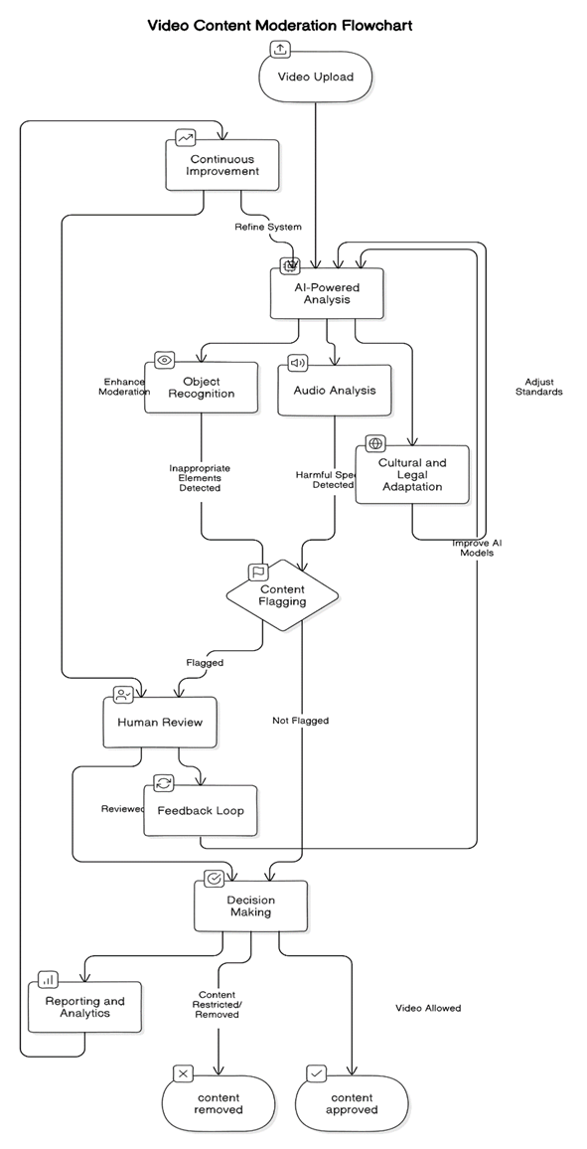
Technical Description
1. Video Upload
Users upload videos via a frontend interface (React/Next.js).
Files are handled by APIs (Django/Flask or Node.js) and stored in cloud storage (e.g., AWS S3).
2. AI-Powered Analysis
Object Recognition: Detects inappropriate visuals (e.g., violence, explicit imagery) using YOLO or Vision Transformers.
Audio Analysis: Converts speech to text and identifies harmful language using tools like Whisper.
Cultural and Legal Adaptation: Customizes AI thresholds for regional compliance.
3. Content Flagging
Automated flagging based on AI confidence levels.
Content flagged for potential violations proceeds to human review.
4. Human Review
Ambiguous cases are reviewed by moderators via a dashboard (React/Next.js).
Decisions are logged for feedback and model refinement.
5. Feedback Loop
Human inputs refine AI models to improve accuracy and reduce false flags.
6. Decision Making
Final decisions route content for approval or removal based on AI and human inputs.
7. Reporting and Analytics
Dashboards (Tableau/Power BI) track flagged content trends, system performance, and reviewer efficiency.

Slide 7
Implementation Plan
Planning:
Define objectives (e.g., detecting hate speech, violence).
Identify AI model needs and set ethical guidelines with stakeholders.
Data Collection:
Gather public datasets and anonymized user content.
Categorize (text, images, videos, audio) and annotate using tools like Label box.
Preprocessing:
Clean, normalize, and split data (70% training, 20% validation, 10% testing).
Model Training:
Text Analysis: Fine-tune GPT/BERT on labeled datasets for offensive language and misinformation detection.
Image Analysis: Fine-tune YOLO on custom image datasets for explicit content and violence detection.
Audio Analysis: Fine-tune Whisper with harmful speech and transcription datasets.
Video Analysis: Fine-tune 3D CNNs (I3D/C3D) using objectionable video sequences for frame-level detection.
Train all models on GPUs/TPUs and validate with F1-score, precision, and recall metrics.
Deployment:
Deploy models using TensorFlow or PyTorch and scale with AWS/Kubernetes.
Continuous Improvement:
Retrain models using feedback and monitor performance for updates.

Slide 8
Validation / Testing / Analysis
Validation:
Use metrics like Precision, Recall, F1-Score, and Accuracy.
Validate models on 20% unseen data to ensure accuracy and reliability.
Testing:
Unit Testing: Test individual components (e.g., text, image, audio, video models).
Integration Testing: Verify interaction between AI models and APIs.
System Testing: Check the full moderation workflow from upload to decision-making.
Stress Testing: Simulate high upload volumes to evaluate scalability.
Edge Case Testing: Test ambiguous or borderline content for robustness.
Analysis:
Review False Positives/Negatives and refine thresholds.
Incorporate flagged content for retraining models.
Monitor and analyze performance trends to enhance future iterations.

Slide 9
Cost Estimate
Category | Task | Optimized Cost
Development Costs | Data Collection & Annotation | $2,000 - $5,000 (use open datasets)
 | Annotation Tools/Services | $3,000 - $5,000 (crowdsourced platforms)
 | Training Infrastructure | $1,000 - $3,000/month (use Google Colab Pro or shared GPUs)
 | Fine-Tuning Models | $3,000 - $5,000 (per model, optimize data usage)
 | API and System Integration | $3,000 - $5,000
 | Validation and Testing | $2,000 - $3,000
Deployment Costs | Model Deployment (Cloud) | $1,000 - $2,000/month (use serverless architecture)
 | Data/Model Storage | $300 - $500/month
 | Edge AI Optimization | $3,000
Maintenance Costs | Retraining with Feedback | $1,000 - $2,000/cycle
 | Monitoring and Scalability | $300 - $500/month
Total Estimate | Initial Development | $15,000 - $30,000
 | Monthly Maintenance | $3,000 - $5,000

Slide 10
Assumptions
Improved Content Quality:
Reduction in harmful, offensive, or misleading content across the platform.
Enhanced User Experience:
Clean, positive, and inclusive media fosters a safe and engaging environment for users.
Higher Moderation Efficiency:
AI automates bulk moderation, reducing manual effort and speeding up content review.
Better Compliance:
Adherence to legal and ethical standards like GDPR ensures regulatory compliance.
Adaptability:
Continuous learning models keep the system effective against new threats like deepfakes or emerging harmful trends.
Increased Trust:
Transparent and explainable AI builds user trust in moderation decisions.
Cost Efficiency:
Automated moderation reduces long-term operational costs compared to manual-only systems.
Scalability:
The system efficiently handles growing content volumes, ensuring platform sustainability.

Slide 11
References

Slide 13
Guidelines
Do not use more than 15 slides.
Do not give any theoretical fundamentals.
Illustrate with suitable means such as drawings, examples, algorithms, flow chart etc.
Use a consistent format.
Check for spelling and grammar – ensure no errors (spell check).
Highlight the major advantages of the technique/method proposed when compared with other techniques or conventional techniques.
While uploading the PPT file, rename first 4 letters (i.e., 0000) with your PID nos.

