Slide 1
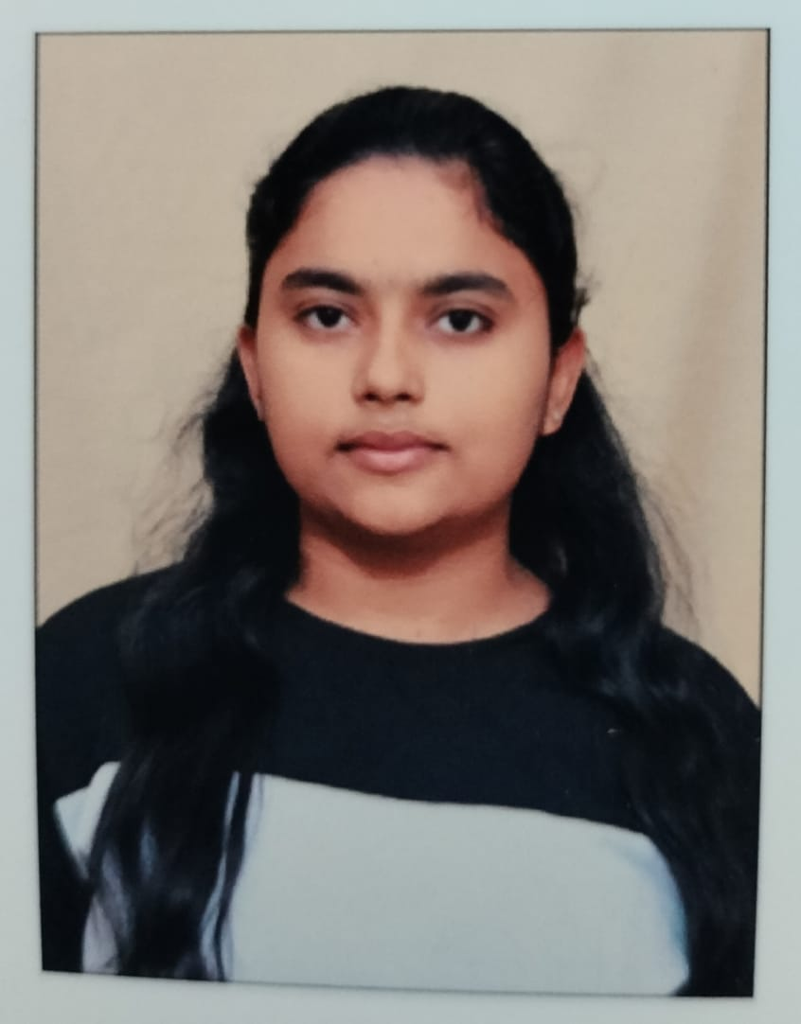
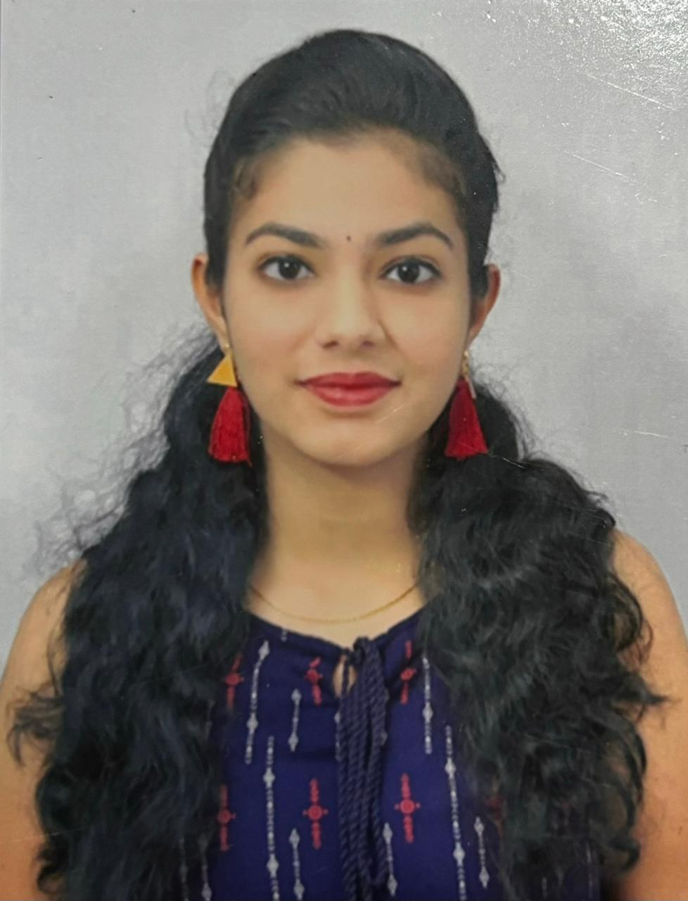

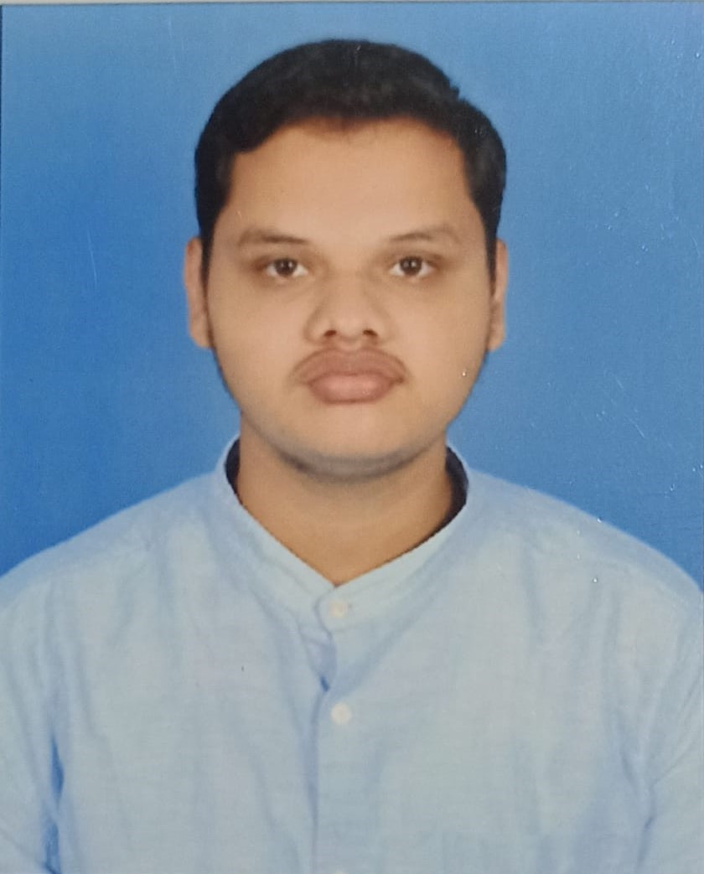
AI Powered Content Moderation
TG08001947
Author 1
Photo
Author 2
Photo
Author 3
Photo
Author 4
Photo
Deepika T R
Deepthi K
Nishanth K J
Skanda P M
Maharaja Institute of Technology Mysore
Mysore
Dr. Victor Ikechukwu Agughasi

Slide 2
Challenge Statement

Slide 3
Concept / Solution

Slide 4
Pros and Cons of the solution

Slide 5
Technical Description

Slide 6
Implementation Plan

Slide 7
Validation / Testing / Analysis

Slide 8
Cost Estimate

Slide 9
Assumptions

Slide 10
References

Slide 12
Guidelines
Do not use more than 15 slides.
Do not give any theoretical fundamentals.
Illustrate with suitable means such as drawings, examples, algorithms, flow chart etc.
Use a consistent format.
Check for spelling and grammar – ensure no errors (spell check).
Highlight the major advantages of the technique/method proposed when compared with other techniques or conventional techniques.
While uploading the PPT file, rename first 4 letters (i.e., 0000) with your PID nos.

