Slide 1
EECE5644: Final Project
Alex Montes McNeil (NUID: 001989922)
& Nishanth Marer Prabhu (NUID: 002624650)
04/18/2023

Slide 2
Dataset
NFL data since the year 2000 containing 30 features of each game played
Full list of the dataset features is listed in our report
Reference: https://github.com/ukritw/nflprediction

Slide 3
NFL Home-Team-Win Classification Problem
Take Aways from Dataset
Apply ML Dataset
Number of Games: 4783
Home Straight Up Win Percentage: 57.57%
Away Straight Up Win Percentage: 42.43%
Under Percentage: 49.70%
Over Percentage: 48.55%
Equal Percentage: 1.76%
Favored Win Percentage: 65.96%
Cover The Spread Percentage: 46.96%
Against The Spread Percentage: 49.32%
Can we train a Multilayer Perceptron (MLP) to predict if the home team or away team will win a game based on this dataset?
Does increasing the number of hidden layers improve the model size?
Use Expected Risk Minimization to determine the theoretical minimum probability of error.

Slide 4
Reduce the Size of the Dataset
Calculated the correlation coefficients of all numerical features with result
Chose to keep features with coefficient above +/- 0.05
Further reduction required to remove features the give away the result of the game
Feautures used for classification:
elo_prob1/2
team_current_win_pct
team_lastseason_win_pct
home/away_favorite
spread_favorite

Slide 5
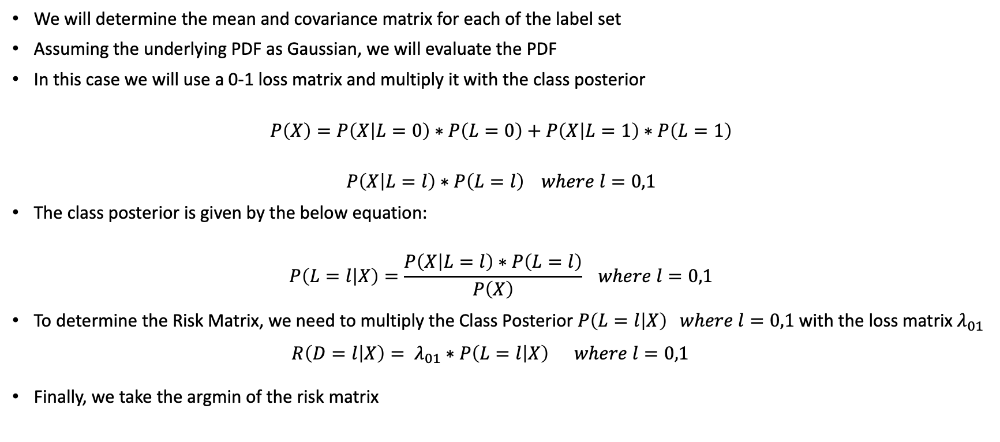
Expected Risk Minimization (ERM)
We will determine the mean and covariance matrix for each of the label set
Assuming the underlying PDF as Gaussian, we will evaluate the PDF
In this case we will use a 0-1 loss matrix and multiply it with the class posterior
$$P\left(X\right)=P\left(X | L=0\right)∗P\left(L=0\right)+P\left(X | L=1\right)∗P\left(L=1\right)$$
$$P\left(X | L=l\right)∗P\left(L=l\right) where l=0,1$$
The class posterior is given by the below equation:
$$P\left(L=l | X\right)=\frac{P\left(X | L=l\right)∗P\left(L=l\right)}{P\left(X\right)} where l=0,1$$
To determine the Risk Matrix, we need to multiply the Class Posterior $P\left(L=l | X\right) where l=0,1$with the loss matrix $λ_{01}$
$$R\left(D=l | X\right)= λ_{01}∗P\left(L=l | X\right) where l=0,1$$
Finally, we take the argmin of the risk matrix
ERM Confusion Matrix
0.50 | 0.23
0.50 | 0.77

Slide 6
Multilayer Perceptron Model (MLP)
MLPClassifier from scikit-learn python package
Number of hidden layers: 1
Find optimal number of neurons during cross validation
Activation function: relu
10k Iterations (convergence was reached before the end of the iterations)
N-fold cross-validation with GridSearchCV used to estimate number of neurons per layer
Varied number of folds to see the impact on the error of the model
[2, 5, 10, 15, 20]

Slide 7
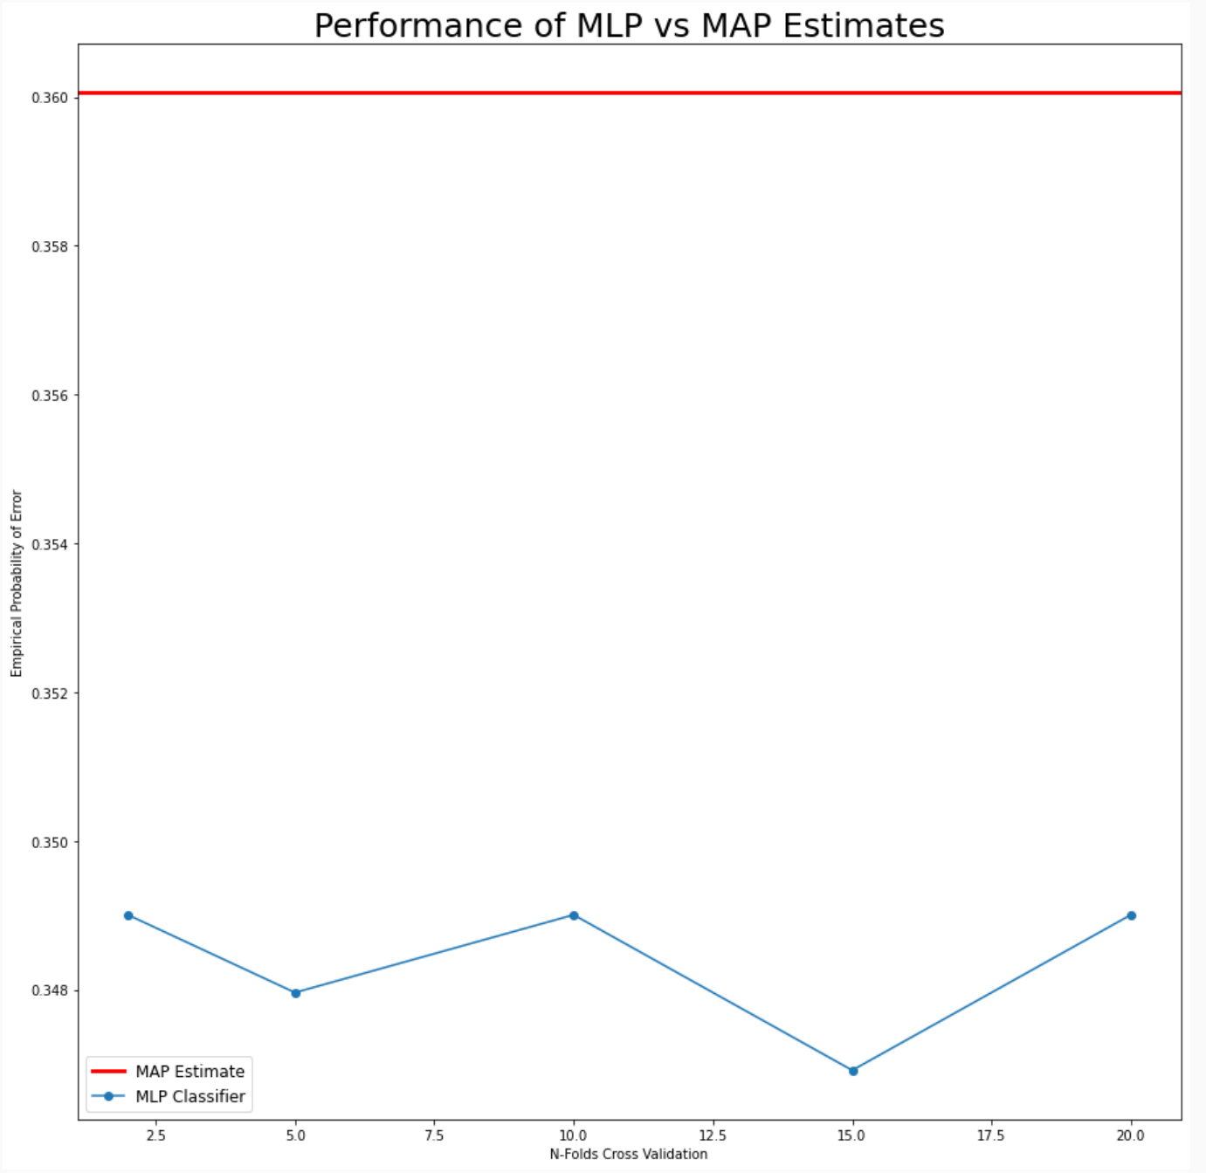
Results and Analysis
MLP outperforms MAP estimate
This could be due to the shape of the data
Our dataset is < 5000 samples
Future Work
Better understanding of the data set
This dataset only contains games from after the year 2000
In the future we could include a large set NFL games

Slide 8
Github Repository
All code and data used in this project can be found here:
https://github.com/nishanthmarer/ITMLPRFinalProjectAlex_Nishanth

