Slide 1
Assignment2
File created on: 29-07-2020 23:50:25

Slide 2
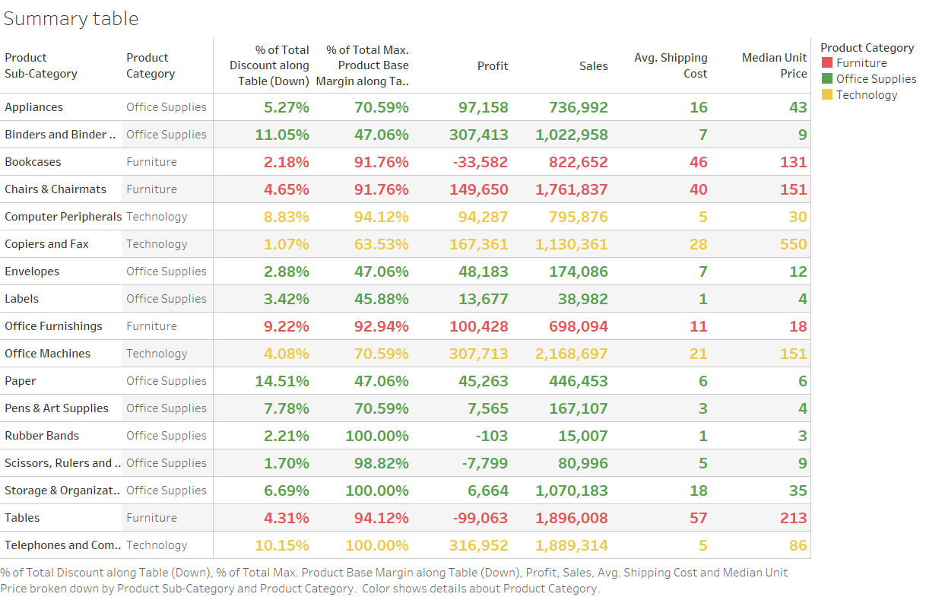

Slide 3
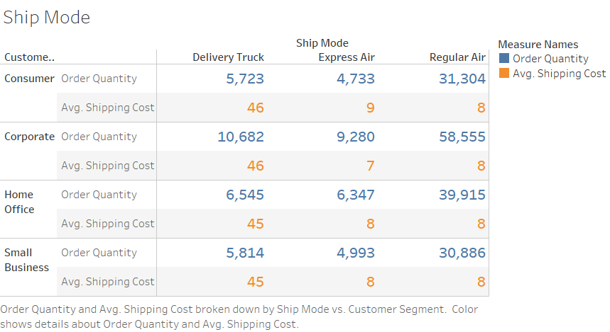

Slide 4


Slide 5


Slide 6
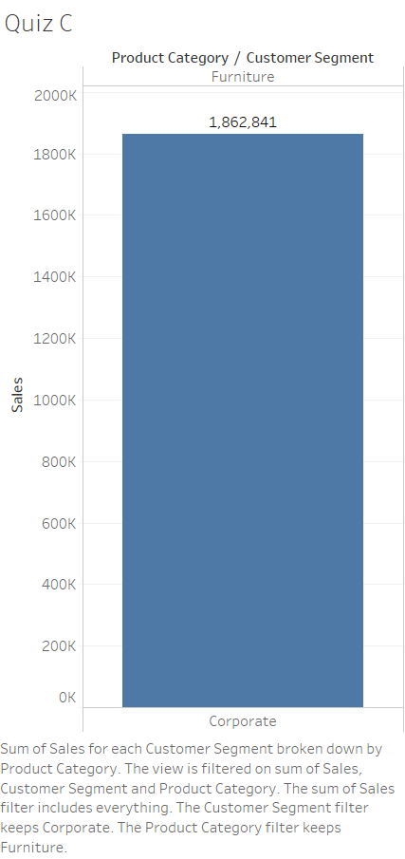

Slide 8
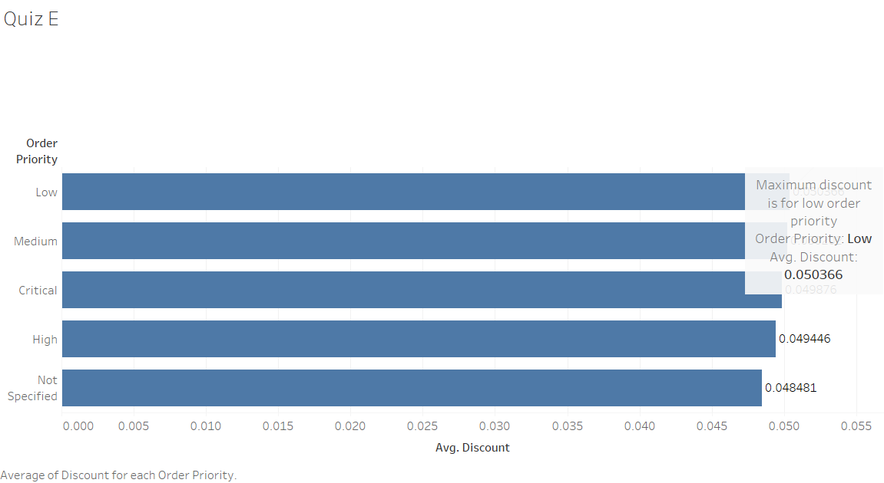

Slide 9
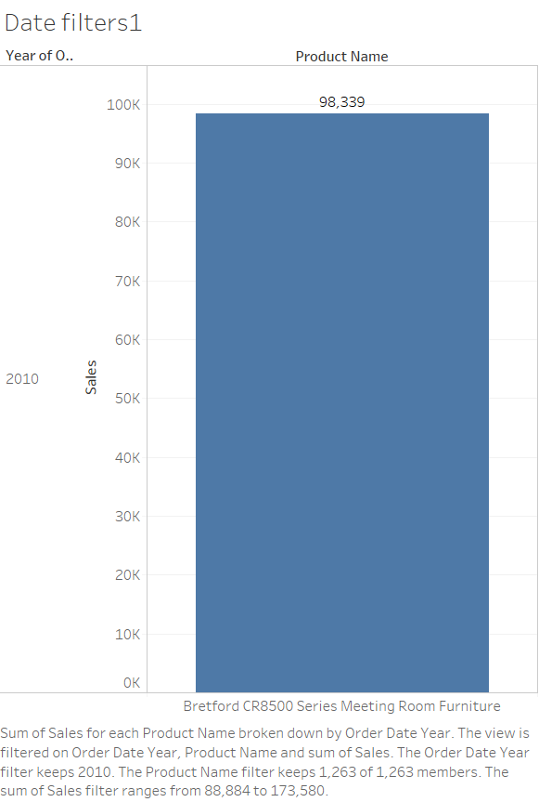

Slide 10
