Slide 1


SMART CROP PREDICTION AND IRRIGATION MANAGEMENT SYSTEM
Under the guidance of : Mrs. R Divya, M.E., Assistant Professor/EEE
Batch Members : 1. Agilan V S 715517105002 2. Deepak Nethaji M P 715517105008 3. Sri Nishanth G 715517105045 4. Vishnu Prasath M 715517105055

Slide 2
Introduction
The scarcity of clean water resources around the globe has generated a need for their optimum utilization.
Smart Farming grow exponentially as data have become the key element in modern agriculture to help producers with critical decision making.
This kind of data-based managed farms rely on data that can increase efficiency by avoiding the misuse of resources and the pollution of the environment.
This system is used to predict suitable crop for a field using parameter like soil moisture, temperature, and environmental conditions to get more yield

Slide 3
The intelligence of the proposed system is based on a smart algorithm, which considers sensed data along with the weather forecast parameters like precipitation, pH of the soil and UV for the near future.
For irrigation management system soil moisture data from farmer, weather data is fed into machine learning model which tells whether to irrigate the field or not.
The information that crops offer is turned into profitable decisions only when efficiently managed.

Slide 4
ABSTRACT
For past few decades agricultural land is decreasing day by day, choosing a particular crop for an area and optimal use of water is highly demanded in the agricultural sector, to get more yield and to minimize fertilizer cost.
The goal of this project is to predict the suitable crop and irrigation requirements of a field by using parameters like soil moisture,temperature, and environmental conditions .
The Automatic learning systems propose an alternative to traditional ways by means of the automatic elaboration of predictions based on the learning of an agronomist.
The aim of this project is to study several learning algorithms in order to determine the effectiveness and error-free to expert decision.
LightGBM, XGBoost and CatBoost as engines of the prediction.

Slide 5
LITERATURE SURVEY
S. No. | Technical Paper | Summary | Drawbacks
1. | An IoT based smart irrigation management system using Machine learning and open source technologies. Elsevier B V. 2018 | This paper presents an open source technology based smart system to predict the irrigation requirements of a field using the sensing of ground parameter like soil moisture temperature and environmental conditions. | This irrigation system do not consider weather forecasting information while making the irrigation decision which leads to wastage of fresh water and crop growth.
2. | IoT and machine learning approaches for automation of farm irrigation system. Elsevier B V. 2020 | This paper represents a monitoring system whose purpose is to solve over irrigation problems with Machine learning. | Extreme weather conditions pose a serious threat to the solution proposed in this research.

Slide 6
S. No. | Technical Paper | Summary | Drawbacks
3. | A Study on Smart Irrigation Using Machine Learning. Janani M and Jebakumar R.2019 | It involves a data analytic technique which has different types of algorithms and models to learn information directly from data optimizing the water usage and provides essential amount of water and fertility to field improves yield production, reduces manual intervention, and diminish crop diseases | Un-availability of structured data of crop water needs. Machine learning algorithm needs to be trained on large as well as region specific data.
4. | Machine Learning in Smart Irrigation System using Self-Organizing Maps & Hidden Markov Model. IJSTE - International Journal of Science Technology & Engineering. 2018 | This irrigation system is optimized for watering the crops and at the same time it will be updated by the data which was sensed by the cellular sensors and webcam which is coupled with the Raspberry-pi through a Wi-Fi or bound technology. | The machine will automatically learn itself rendering to the climatological condition that will lead to weather prediction.

Slide 7
S. No. | Technical Paper | Summary | Drawbacks
5. | Crop yield prediction using machine learning: A systematic literature review. | It involves a SLR to synthesize the algorithms and features that have been used in crop yield prediction studies and investigated those and analyzed the methods and features used, and provided suggestions for further research to identify deep learning-based studies. | This prediction system failed to develop a DL-based crop yield prediction model.
6. | A systematic literature review on machine learning for sustainable agriculture supply chain performance. | This identifies the role of ML algorithms in providing real-time analytic insights for pro-active data-driven decision-making in the ASCs with guidelines on the successful management of ASCs for improved agricultural productivity and sustainability. | This system failed to explore the extent of the ML application to ASCs in different regions across the world to provide a comparative assessment.

Slide 8
S. No. | Technical Paper | Summary | Drawbacks
7. | IoT based smart irrigation architecture alongside a hybrid machine learning based approach to predict the soil moisture. | The forecasted data for prediction of soil moisture of upcoming days. the proposed work uses sensors data of recent past and therefore the weather anticipated value of the soil of their accuracy and error rate moisture is best in terms | Water saving analysis to support the proposed algorithm with all the required multiple nodes alongside minimizing the system cost is to be enhanced.
8. | An IoT Fast and Low Cost Based Smart Irrigation Intelligent System Using Approach a Fuzzy Energy-Aware Routing | This paper presents an intelligent crop monitoring and irrigation system based on Fuzzy logic and neural network. Taking into account the needs of plants and soil, the proposed intelligent irrigation system achieves efficient utilization of water. | A number of wireless sensors are used to collect data which increases the overall cost of the system and involves complex algorithms.

Slide 9
S. No. | Technical Paper | Summary | Drawbacks
9. | IoT and neural network-based water pumping control system for intelligent irrigation. | This paper aims to save water wasted in the IoT irrigation process based on a set of sensors and a multilayer 3 perceptron neural network (MLP). Machine learning algorithm such as MLP neural network plays an important role effectively in supporting the decision of automatic control of IoT-based irrigation system, managing water consumption. | Study of different crops and their characteristics is not done and also automatic measuring the level of the water in the tank to alert the farmers could have performed with a Short Message Service (SMS).
10. | Seed classification using Machine Learning Techniques | In this paper shows the capability and potential of machine vision with the well- trained multilayer neural network classifiers for shapes, sizes, and varietal type identification of irregular rice grain samples grown in the assorted agro environmental zones in the country | Some more machine learning classifiers need to implemented other than the Weka classifiers. Need to use un-supervised machine learning techniques, such as clustering to classify the seeds.

Slide 10
Objectives
To study and compare the accuracy of various algorithms to find the algorithms which is most suitable.
To predict suitable crop for a particular area by consider parameters such as temperature, pH, humidity and amount of rainfall
To find whether to irrigate field or not by considering parameters such as air humidity, temperature, soil moisture and amount of light

Slide 11
Problem Statement
Agricultural land area is decreasing day by day and population is also increasing to get more yield in a same area.
Water resources are also decreasing . To use the available water as per the requirement of crops.

Slide 12
Tools and Packages used
The tools used are
Python(3.8.2)
Spyder
The packages used are
Scikit Learn
LightGBM
CatBoost
Tkinter
Pandas

Slide 13
Software Description
Python
Python is a high-level programming language designed to be easy to read
and simple to implement.
Python is open source, which means it is free to use, even for commercial applications. Python can run on Mac, Windows, and Unix systems and has also been ported to Java and .NET virtual machines.

Slide 14
Spyder
Spyder (Scientific Python Development Environment, previously known as
(Pydee) is a simple and lightweight, yet powerful interactive development
environment for scientific programming in the Python language. This software is open source and cross-platform.

Slide 15
Pandas
Pandas is a software library written for the Python programming language for data manipulation and analysis. In particular, it offers data structures and operations for manipulating numerical tables and time series.
Scikit Learn
Scikit-learn is a free software machine learning library for the Python programming language . It features various classification, regression and clustering algorithms including support vector machines, random forests, gradient boosting and is designed to interoperate with the Python numerical and scientific libraries NumPy and SciPy.

Slide 16
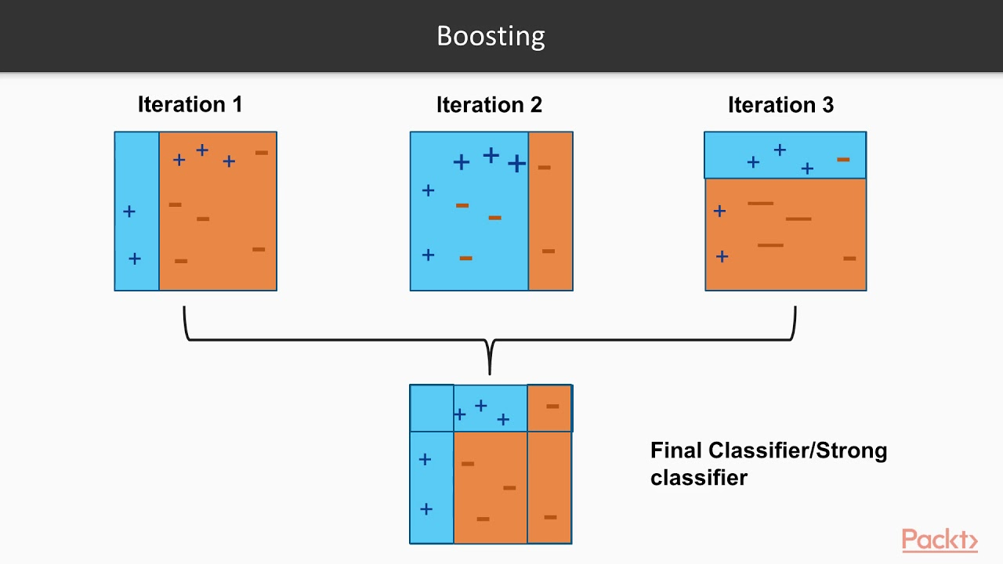
Software description(Algorithms)
Boosting Algorithms
The term 'Boosting' refers to a family of algorithms which converts weak learner to strong learners. Boosting is an ensemble method for improving the model predictions of any given learning algorithm. The thought of boosting is to teach weak learners sequentially, each trying to correct its predecessor.

Slide 17
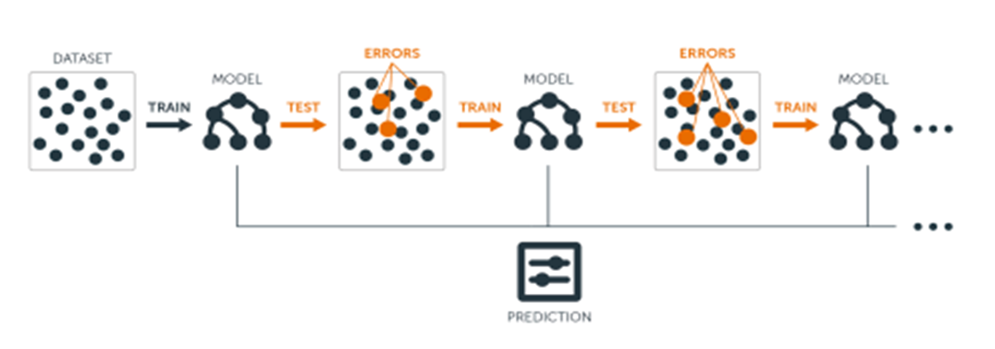
Gradient Boosting
Gradient boosting is a machine learning technique for regression and classification problems, which produces a prediction model within the type of an ensemble of weak prediction models, typically decision trees.
When a choice tree is that the weak learner, the resulting algorithm is known as gradient boosted trees, which usually outperforms random forest.
It builds the model during a stage-wise fashion like other boosting methods do, and it generalizes them by allowing optimization of an arbitrary differentiable loss function.

Slide 18
LightGBM
LightGBM is extremely fast, distributed, high-performance gradient boosting framework supported decision tree algorithm, used for ranking, classification and much of other machine learning tasks.
It splits the tree leaf wise with the only fit whereas other boosting algorithms split the tree depth wise or level wise rather than leaf-wise.

Slide 19
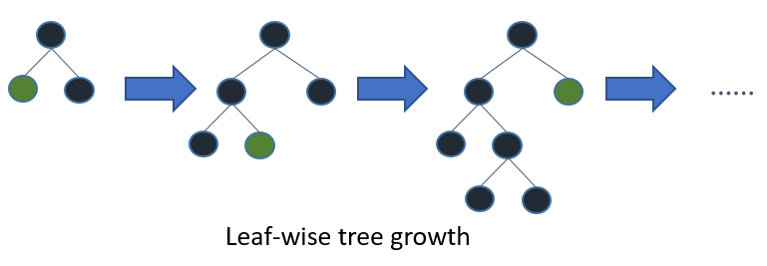
when growing on the same leaf in LightGBM, the leaf-wise algorithm can reduce more loss than the level-wise algorithm and hence results in much better accuracy which may rarely be achieved by any of the prevailing boosting algorithms
Leaf wise tree growth in LightGBM

Slide 20
CatBoost
CatBoost algorithm is another member of the gradient boosting technique on decision trees.
It yields state-of-the-art results without extensive data training typically required by other machine learning methods
During training, a set of decision trees is built consecutively. Each successive tree is built with reduced loss compared to the previous trees. The number of trees is controlled by the starting parameters.

Slide 21
Tkinter
Tkinter is the most commonly used library for developing GUI (Graphical User Interface) in Python.
It is a typical Python interface to the Tk GUI toolkit shipped with Python. As Tk and Tkinter are available on most of the Unix platforms also as on the Windows system, developing GUI applications with Tkinter becomes the fastest and easiest.

Slide 22
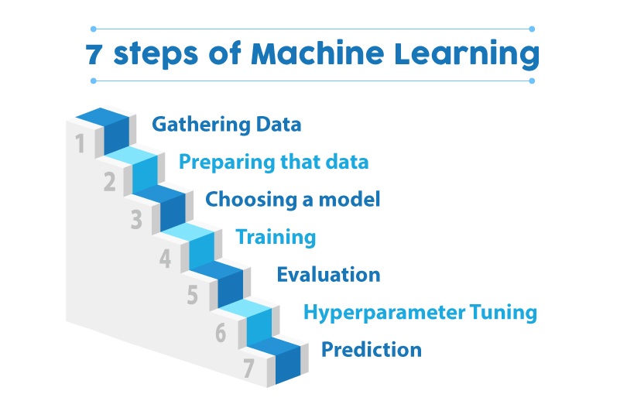
Common Block Diagram for crop prediction and irrigation management

Slide 23
Implementation Details
The implementation of crop prediction system starts with collection of datasets.
The dataset cannot be directly given to the machine learning model, the data has to be pre-processed.
Pre-processing consists of inserting the missing values, the appropriate data range, and extracting the functionality.
The data used for crop prediction system is obtained from GitHub
repository. It consists around 3500 data for 30 types of crops

Slide 24
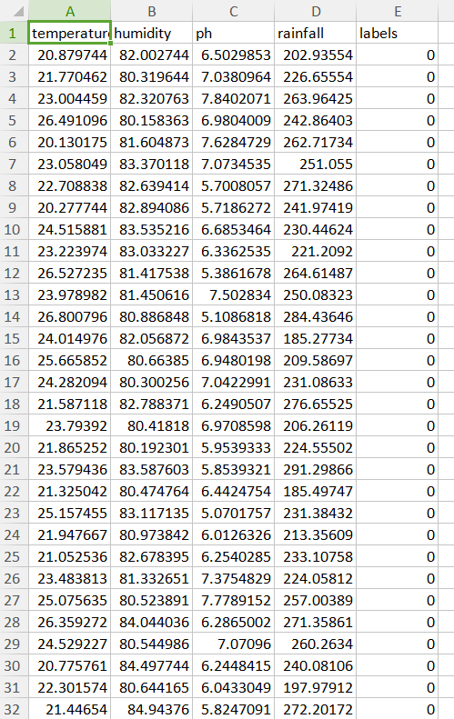
Dataset for Crop Prediction System

Slide 25
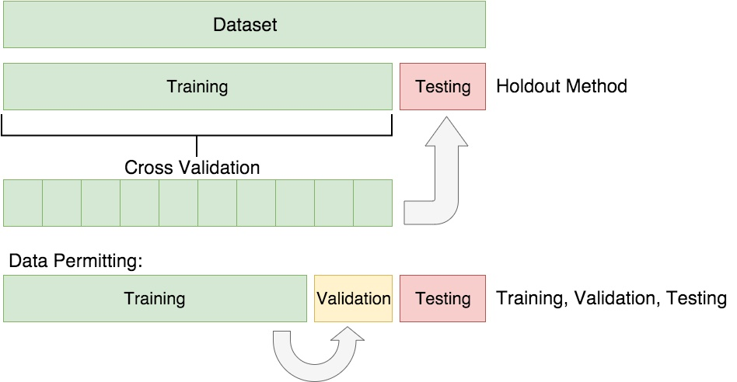
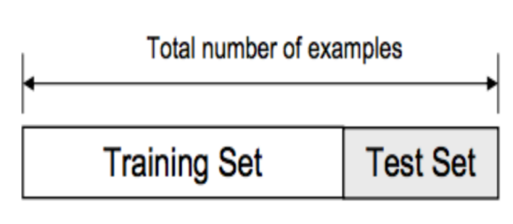
The loaded data is divided into two sets, such as training data and test data, with a division ratio of 80% or 20%, such as 0.8 or 0.2.

Slide 26
The dataset is then given to the machine learning model for training and then remaining data is used to evaluate the model.
The model's accuracy and various parameters are obtained using sklearn metrics package.
The parameters of the area are given to the model are given to LightGBM which predicts the crop for the field.

Slide 27
Finally all the results are displayed in application made by using tkinter
For the irrigation system the training and testing are done with catboost model . The input from the user are used to tell whether to irrigate field or not.

Slide 28
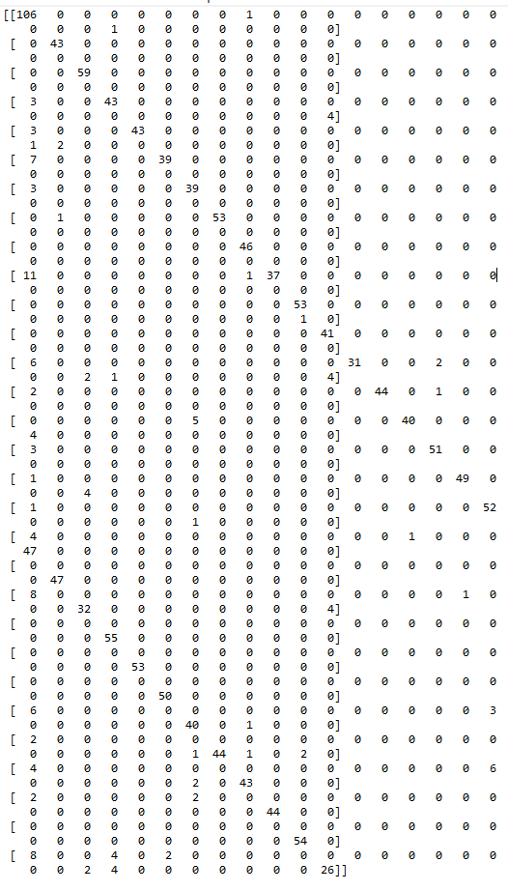
Result
Confusion Matrix for Crop Prediction

Slide 29
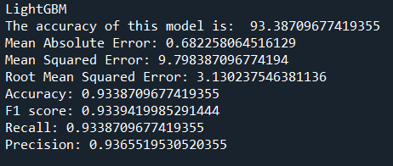
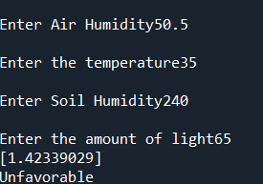

Slide 30
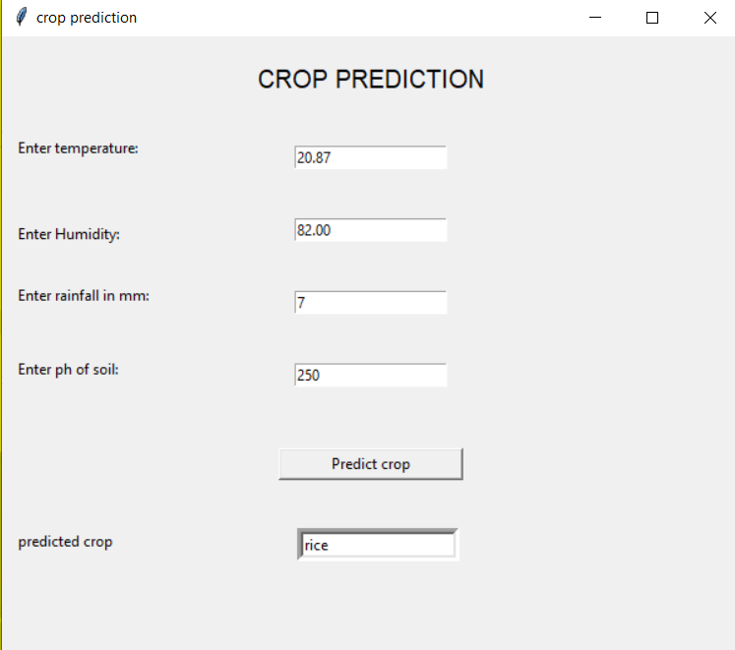

Slide 31
Conclusion
The Project work involves successful implementation for crop prediction system using lightGBM and Irrigation management system using CatBoost . Since these are boosting algorithms accuracy is better compared to other algorithms. Both in sample and out sample testing are done and accuracy is obtained for verification . The results obtained are displayed in a GUI application made by using tkinter.

Slide 32
Future Work
Instead of manually entering the data for crop prediction system a weather prediction system can be made which feed the data to the crop prediction system and pH of the soil can be sent the machine learning model with the help of node MCU so that the process can be fully automated. For the irrigation management system sensors such as humidity sensor, soil pH sensor and real time weather data can be used for accurate prediction. Finally all the results can be made to display in a webpage.

Slide 33
REFERNCES 1. Afrin, S., Ahsan, R., Mishal, Khan, A. T. Mahia, M. Rahman, R. M., Ahmed, W.(2018). Analysis of Soil Properties and Climatic Data to Predict Crop Yields. 2018 IEEE/ACIS 17th International Conference on Computer and Information Science (ICIS). 2. Ponce-Guevara, K. L., Palacios Echeverria, I A., Maya-Olalla, E Dominguez Limaico , H M Suarez Zambrano, L. E, Rosero Montalvo P D, Alvarado-Perez, J. C. (2017).Green Farm-DM: A tool for analyzing vegetable crops data from greenhouse using data mining techniques (First trial). 2017 IEEE Second Ecuador Technical Chapters Meeting (ETCM). 3. Dharesh Vadalia , Minal Vaity, Krutika Tawate, Dynaneshwar Kapse, “Real Time soil fertility analyzer and crop prediction”, IRJET, Volume 4, Issue 3, March 17. 4. Mrs. N. Hemageetha , Dr. G.M. Nasira,“Analysis of soil condition Based on pH value using Classification Technique”, IOSR-JCE, Volume 18, Issue 6, Nov 16.

Slide 34
Karar, M. E., Al-Rasheed, M. F., Al-Rasheed, A. F., & Reyad, O. (2020). IoT and Neural Network Based Water Pumping Control System For Smart Irrigation.
Alomar, B., & Alazzam, A. (2018, November). A Smart Irrigation System Using IoT and Fuzzy Logic Controller. In 2018 Fifth HCT Information Technology Trends (ITT) (pp. 175-179). IEEE.
Goap, A., Sharma, D., Shukla, A. K., & Krishna, C. R. (2018). An IoT based smart irrigation management system using Machine learning and open source technologies. Computers and electronics in agriculture.
Raja Haroon Ajaz, Lal Hussain . Seed Classification using Machine Learning Techniques, Journal of Multidisciplinary Engineeinrg Science and Technology (JMEST) ISSN: 3159-0040 Vol. 2 Issue 5, May – 2015.
Rajkumar, M. N., Abinaya, S., & Kumar, V. V. (2017, March). Intelligent irrigation system—An IOT based approach. In 2017 International Conference on Innovations in Green Energy and Healthcare Technologies (IGEHT) (pp. 1-5). IEEE.

Slide 35
Operations and SCM, National Institute of Industrial Engineering (NITIE), Mumbai-400087, India
10. Zhao, W., Lin, S., Han, J., Xu, R., & Hou, L. (2017, December). Design and implementation of smart irrigation system based on LoRa. In 2017 IEEE Globecom Workshops (GC Wkshps) (pp. 1-6). IEEE.
11. Rohit Sharma, Sachin S. Kamble, Angappa Gunasekaran, Vikas Kumar, Anil Kumar. A systematic literature review on machine learning applications for sustainable agriculture supply chain performance July 2020 IEEE. National Institute of Industrial Engineering (NITIE),Mumbai.
12.Srivastava, P., Bajaj, M., & Rana, A. S. (2018, February). Overview of ESP8266 Wi-Fi module based smart irrigation system using IOT. In 2018 Fourth International Conference on Advances in Electrical, Electronics, Information, Communication and Bio-Informatics (AEEICB) (pp. 1-5). IEEE.

