Slide 1
Locks

Slide 2


Locks: Basic idea
Consider update of shared variable
We can use a special lock variable to protect it
All threads accessing a critical section share a lock
One threads succeeds in locking – owner of lock
Other threads that try to lock cannot proceed further until lock is released by the owner
Pthreads library in Linux provides such locks

Slide 3
Building a lock
Goals of a lock implementation
  Mutual exclusion (obviously!)
  Fairness: all threads should eventually get the lock, and no thread should starve
  Low overhead: acquiring, releasing, and waiting for lock should not consume too many resources
Implementation of locks are needed for both userspace programs (e.g., pthreads library) and kernel code
Implementing locks needs support from hardware and OS

Slide 4
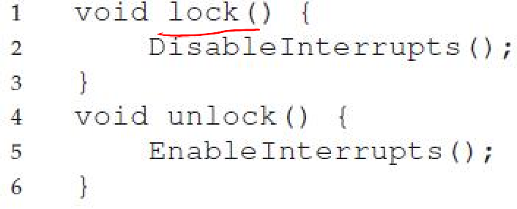
Is disabling interrupts enough?
Is this enough?
No, not always!
Many issues here:
  Disabling interrupts is a privileged instruction and program can misuse it (e.g., run forever)
  Will not work on multiprocessor systems, since another thread on another core can enter critical section
This technique is used to implement locks on single processor systems inside the OS
  Need better solution for other situations

Slide 5
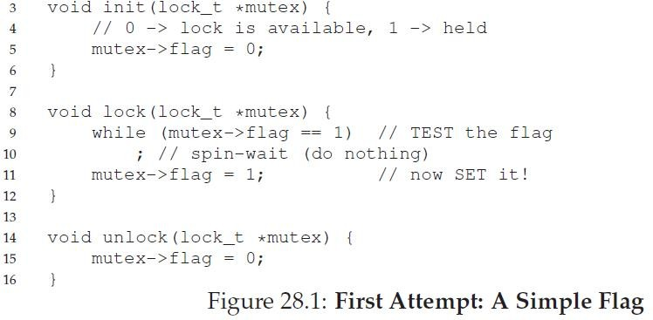
A failed lock implementation (1)
Lock: spin on a flag variable until it is unset, then set it to acquire lock
Unlock: unset flag variable

Slide 6
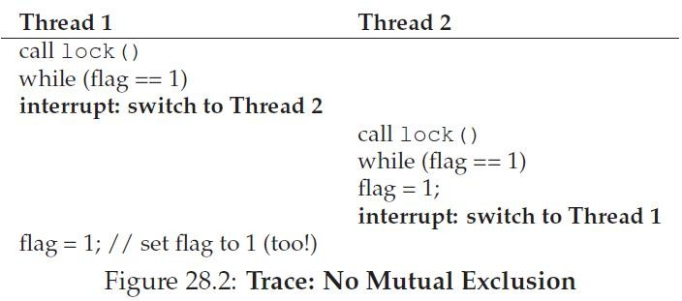
A failed lock implementation (2)
Thread 1 spins, lock is released, ends spin
Thread 1 interrupted just before setting flag
Race condition has moved to the lock acquisition code!

Slide 7
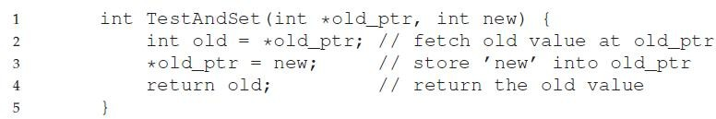
Solution: Hardware atomic instructions
Very hard to ensure atomicity only in software
Modern architectures provide hardware atomic instructions
Example of an atomic instruction: test-and-set
– Update a variable and return old value, all in one hardware instruction

Slide 8
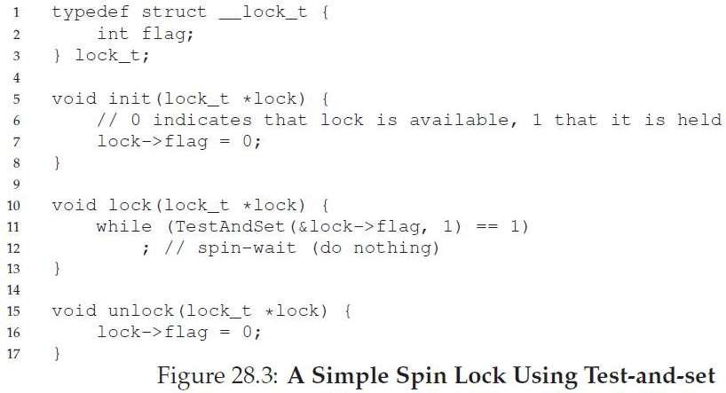
Simple lock using test-and-set
If TestAndSet(flag,1) returns 1, it means the lock is held by someone else, so wait busily
This lock is called a spinlock – spins until lock is acquired

Slide 9
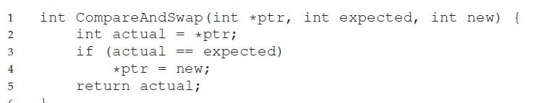

Spinlock using compare-and-swap
Another atomic instruction: compare-and-swap

Slide 10
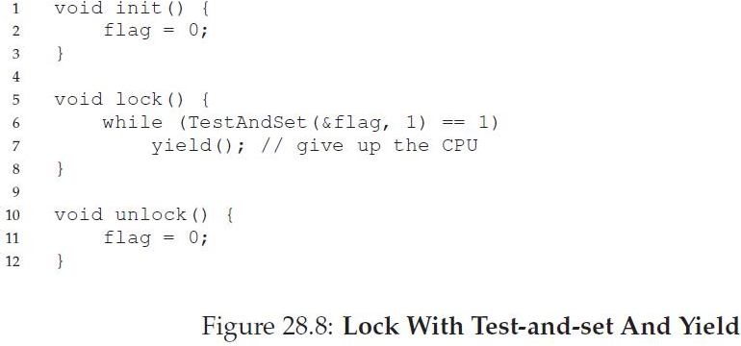
Alternative to spinning
Alternative to spinlock: a (sleeping) mutex
Instead of spinning for a lock, a contending thread could simply give up the CPU and check back later
– yield() moves thread from running to ready state
10

Slide 11
Spinlock vs. sleeping mutex
Most userspace lock implementations are of the sleeping mutex kind
  CPU wasted by spinning contending threads
  More so if a thread holds spinlock and blocks for long
Locks inside the OS are always spinlocks
  Why? Who will the OS yield to?
When OS acquires a spinlock:
  It must disable interrupts (on that processor core) while the lock is held. Why? An interrupt handler could request the same lock, and spin for it forever.
  It must not perform any blocking operation – never go to sleep with a locked spinlock!
In general, use spinlocks with care, and release as soon as possible
11

